Slide 1
A Note for those Stumbling on these Slides (Hi!)
These lecture slides are not intended as written reference materials.
Just reading them probably won’t be very educational.
Best used in combination with webcasts and source code references.
See (Video) and (Code) links under each lecture: http://datastructur.es

Slide 2

CS61B: 2021
Lecture 1:
Introduction
Course Logistics
Hello World

Slide 3
61B Overview
What is 61B about?
Writing code that runs efficiently.
Good algorithms.
Good data structures.
Writing code efficiently.
Designing, building, testing, and debugging large programs.
Use of programming tools.
git, IntelliJ, JUnit, and various command line tools.
Java (not the focus of the course!)
Assumes solid foundation in programming fundamentals, including:
Object oriented programming, recursion, lists, and trees.

Slide 4
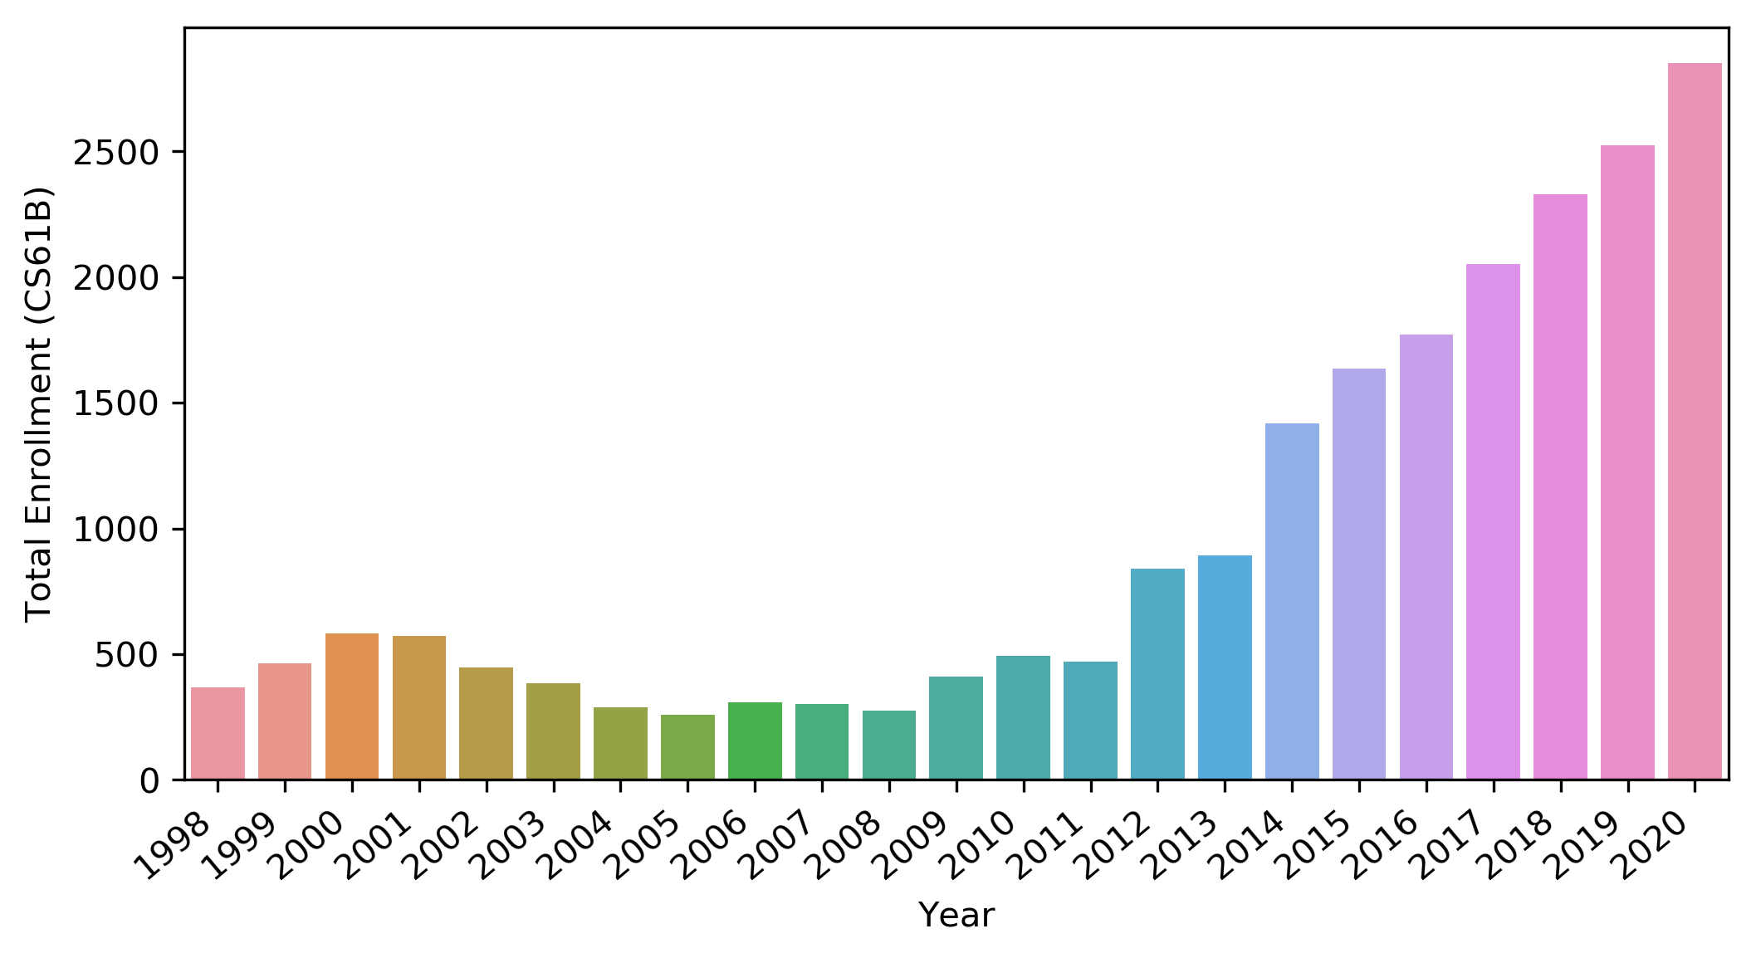
Why Study Algorithms or Data Structures?
Sp21

Slide 5
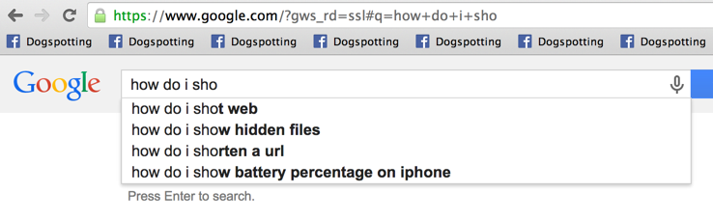
Why Study Algorithms or Data Structures?
Daily life is supported by them.

Slide 6
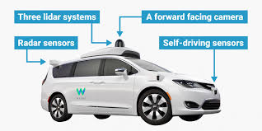
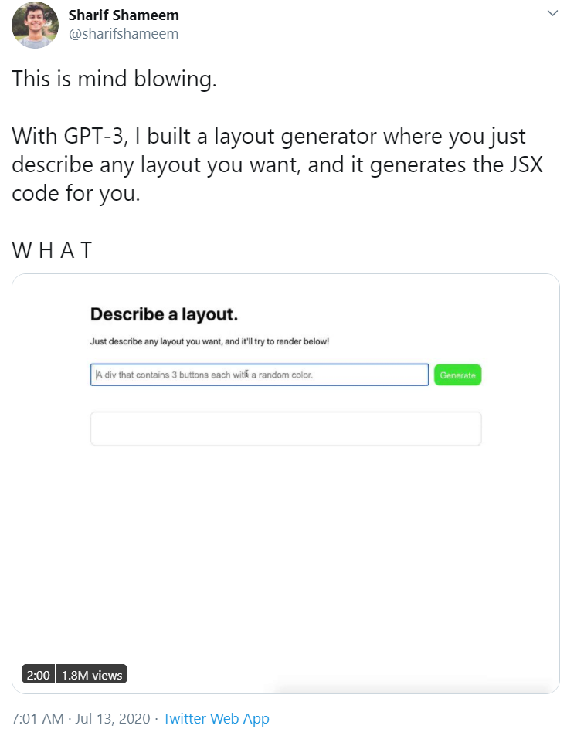

Why Study Algorithms or Data Structures?
Major driver of current progress (?) of our civilization.
Link
Notes:
http://www.businessinsider.com/how-does-googles-waymo-self-driving-car-work-graphic-2017-1
https://twitter.com/sharifshameem/status/1282676454690451457?lang=en

Slide 7
Why Study Algorithms or Data Structures?
To become a better programmer.
Being an efficient programmer means using the right data structures and algorithms for the job.
“The difference between a bad programmer and a good one is whether [the programmer] considers code or data structures more important. Bad programmers worry about the code. Good programmers worry about data structures and their relationships.” - Linus Torvalds (Creator of Linux)

Slide 8

Why Study Algorithms or Data Structures?
To understand the universe. Science is increasingly about simulation and complex data analysis rather than simple observations and clean equations:

Slide 9



Why Study Algorithms or Data Structures?
to
create
beautiful
things

Slide 10
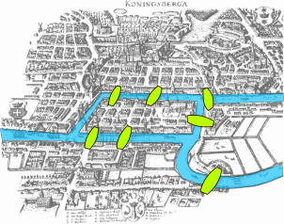

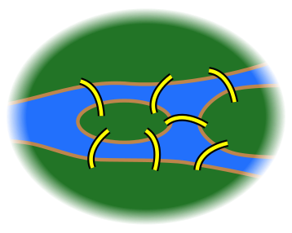
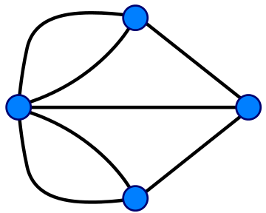
Why Study Algorithms or Data Structures?
As an end unto itself.
Possible to draw without picking up pencil or going back over any lines.
Impossible.
Notes:
http://members.ozemail.com.au/~macinnis/scifun/house.gif
Euler path: Must have exactly zero or two nodes of odd degree.

Slide 11
Question for You
What do you hope / expect to learn from this class? Why are you taking it?

Slide 12
Who Are You?
Assuming the Zoom webinar polls are set up correctly, let’s do a quick poll.
Year?
Prior Java experience?
Which pre-req did you take?
Notes:
Freshman? Sophomore? Junior? Senior? Grad student? None of the above?
CS Major? Intending to be a CS Major? Something else?
61A? Java experience?

Slide 13
Who Are We?
Instructor: Josh Hug (me) hug@cs.berkeley.edu 779 Soda (goodbye office)
GSIs:
Tutors
Abhishek Kumar, Ahmed Baqai, Angela Chen, Arushi Somani, Avyakth Challa, David Lee, Jesse Dai, Michael Sparre, Nandini Singh, Nikhil Mandava, Nishant Patwardhan, Saad Jamal, Saikumar Gantla, Sean Kim, Shreyans Sethi, Shriya Nandwani, Smruthi Balajee, Srinidhi Sankar, Todd Yu
Part time
Ajay Singh, Anton Zabreyko, Aram Kazorian, Cindy Zhang, Crystal Wang, Ethan Mehta, Fatema Yasini, Grace Altree, Hannah Yan, Isha Srinivasan, Jack Wang, Joshua Blanchard, Joshua Yang, Luke Liu, Naama Bareket, Richa Kotni, Robin Qiu, Romain Priour, Sara Reynolds, Sarah Liu, Sarina Sabouri, Sherry Fan, Shreyas Kompalli, SreeVidya Ganga, Tony Kam
Full time
Ada Hu, Alex Schedel, Allyson Park, Anjali Kantharuban, Arjun Sahai, Boren Tsai, Claire Ko, Connor Lafferty, Eric Tang, Eric Zhu, Henry Maier, Itai Smith, Linda Deng, Neil Kulkarni, Omar Khan, Sohum Hulyalkar, Sumer Kohli

Slide 14
Who Are We? (continued)
Academic interns:
Tanya Jain
Justin Thein
Kyle Yu
Michael Huang
Xinling Yu
Rahul Mohankumar
Deepak Ragu
Tymon Thi
Aryan Agrawal
Devin Sze
YiTing Yan
David Chung
Viansa Schmulbach
Ritik Batra
Yash Gupta
Arda Demirci
Eric Pineda
Anik Gupta
Nitya Goyal
Sonja Johanson
Stephanie Jue
Dexter To
Sean Hayes
Olivia Huang
Genevieve Brooks
Kush Garg
Reza Sajadiany
Michelle Cheung
Maryam Azmandian
Arth Vidyarthi
Amanda Yao
Arvind Rajaraman
Andrew Lee
Anrui Gu
Haroun Khaleel
Ansh Nanda
Catherine Hwu
Stephen Yang
Jerry Sun
Aady Pillai
Emmett Dreyer
Kaci Gu
Richard Lee
Suhrid Saha
Sunay Dagli
Anne Nguyen
Fakhri Widodo
Shefali Goel
Alina Trinh
Amritansh Saraf
Siddhant Sharma
Phoebe Troup-Galligan
Steven Chen

Slide 15
Who Are We? (continued (continued))
Abrar Rahman
Xinqi Yu
Sum Ying Celeste Wu
Brenda Huang
Zoe Parcells
Nathan Tran
Aditi Bamba
Jasper Emhoff
Amudha Sairam
Ananya Gupta
Samuel Stulman
Carolina Rios-Martinez
Elise Ong
Ola Alsaedi
Shivani Ahuja
Tiffany Luu
Isha Arora
Aditya Prasad
Daniel Detchev
Grace Chen
Austin Ho
Nicholas Cheng
Shannon Bonet
Jane Lee
Kaaviya Sasikumar
Ankita Janakiraman
Leo Kao
Kevin Jin
Kuhu Sharma
Vivian Liu
Xinyu Fu
Christina (Siting) Shao
Sofia Roz
Annie Wang

Slide 16
Learning Philosophy

Slide 17
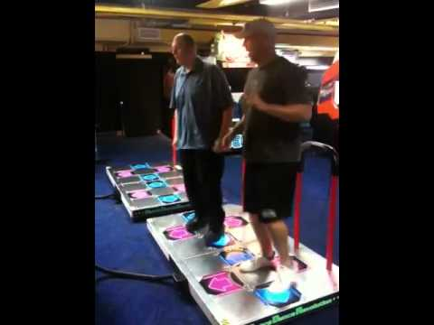

The Manner in Which Learning Occurs (TMWLO)
Notes:
12 minutes to reach this point (16 with new stuff)

Slide 18
TMWLO
Small minority of your learning:
Introduction to new material: Lectures / reading.
The vast majority of your learning:
Theory: Discussion sections, study guides, theory homework.
Programming, Tool Usage, Problem Decomposition: Labs, coding HW, projects.
Design: Projects 2 and 3.

Slide 19
Course Logistics

Slide 20
Places to Get Information
Official Course Resources
Course website: http://datastructur.es
Lectures. Discussion. Lab. Office Hours.
Ed Discussions: https://edstem.org/us/courses/3735/discussion/
Mini-Textbook: Obscurantism in Java https://joshhug.gitbooks.io/hug61b
Unofficial: Google, Stack Overflow, other programming courses on the web, various online documentation, etc.

Slide 21
Logistical Details
For waitlisted folks: If you do project 0, I’ll do what I can to get you in by week 4, but no guarantees.
We should be able to accommodate everyone, but I can’t 100% promise.
To sign up for a discussion section or lab, see https://edstem.org/us/courses/3735/discussion/213629
Please post administrative issues to Ed or send an email to cs61b@berkeley.edu
Please don’t email me with such issues directly (sorry!).
1600 students * 1 minute/student = 26 hours.

Slide 22
61B 4.0 - Course Structure
Phase 1: Programming Intensive Introduction to Java.
Weeks 1-4.
One browser-based programming HW (this HW0 is optional).
Four labs to introduce you to various tools (starting this week).
Two projects (proj0 and proj1).
Midterm 2/10 at time TBD.

Slide 23
61B 4.0 - Course Structure
Phase 2: Data Structures.
Weeks 5-10.
Incredibly important and foundational material: Expect an CS job interview to lean heavily on this part of the course.
One programming HWs (HW1) and one exam-prep theory HW (HW2).
Applications and deeper insight into data structures.
One very large solo project (Proj 2), due 4/2. Checkpoint due 3/12.
Labs:
Lab 5: Peer review on project 1.
Two labs that implement data structures (hash table and BST).
Remaining labs are focused on project 2.
Midterm 3/17 at time TBD.

Slide 24
61B 4.0 - Course Structure
Phase 3: Algorithms and Software Engineering.
Weeks 10-14
Project:
Proj 3: Build Your Own World: An open ended project where you and a partner build a 2D world with physics according to your own design. Due during lab in the last week of the class.
Labs devoted to project.
One theory homework due 5/3.
See calendar at http://datastructur.es for more.

Slide 25
Labs and Discussion
Attendance for lab/discussion is not required.
Cameras must be on to attend.
If you don’t cameras on, offline versions will be provided.
Labs:
Lab always due by Friday at 11:59 PM.
Full credit for ‘reasonable effort’.
Only have to pass some of the autograder tests for full credit.

Slide 26
Collaboration Policy
Collaboration:
You will submit your own solution to all HWs and projects 0, 1, and 2.
For labs, you may optionally have a partner.
For project 3, you must have a partner.
All code on solo projects, HWs, labs must be your own work.
Ok to discuss with others and help debug.
There are more details on the course website. You are responsible for knowing these policies!

Slide 27

Weekly Surveys and Study Guides
Weekly survey due every Sunday.
Check in on your progress and report attendance.
Free points, but no late submissions allowed!
Lowest four dropped.
Study guides for each lecture.
Provides a brief summary of the lecture.
Provides (usually) C level, B level, and A level problems for exam studying.
A level problems are usually hard enough that I anticipate TAs will have a hard time with them, so be nice!
Study guide includes a check-in exercise. No credit, but useful!

Slide 28
Exams
Closed note except you can bring cheat sheets.
Will be pretty hard (60-65% medians).
Showing improvement on final can boost overall exam score.
If your final is statistically better, it can replace both of your midterms. See “clobbering” under course website for details.
Exam dates:
Midterm 1: February 10th, time TBD. Will accommodate timezones.
Midterm 2: Match 17th, time TBD. Will accommodate timezones.
Final Exam Times: May 11th, 8 AM Pacific time. Will accommodate timezones.
There will be no alternate exams (see exam replacement policy).
One exception: Direct conflict with a final in another class.

Slide 29
Course Grade
Breakdown: 12,800 points total. Letter grade will be determined by your total.
Midterms: 3200 points total.
Final: 3200 points.
Projects: 4480 regular points.
HW: 960 points (320 points each)
Lab: 640 points (64 points each)
Weekly Surveys: 320 points (32 points each)
Grades are not curved, i.e. they are not based on your relative performance. In past semesters, my grade bin cutoffs have not moved much at all.
See http://sp21.datastructur.es/about.html for full details including grading bin cutoffs (values not chosen yet, but will be by week 3).
Plus extra credit for filling out pre-, mid-, and post- semester course surveys.
Plus extra credit for project checkpoints.
Plus extra credit for project stretch goals.
Notes:
26 minutes

Slide 30
Lateness and Mentor GSIs
No late work will be accepted in the course. No hws/labs/projects are dropped.
You should treat the deadlines seriously!
If needed, use automated extension system to request extensions.
Up to 6 total slip days.
Maximum of 3 per assignment.
Don’t expect similar extensions in other classes. 61B is not as strongly cumulative as classes like EE16A or CS70.
During week 2, you will pick a mentor GSI.
If you do not pick one, one will be assigned for you.
Mentor GSI will keep track of your progress and reach out (or have someone else reach out) if they feel like there are potential issues.
Reach out to mentor GSI if you are falling behind.

Slide 31
Course Pacing
We will start off very fast.
Optional HW0 is out.
Intro to Java syntax.
Will take 1-4 hours.
Work with friends!
Recommended that you complete before your lab.
Strongly recommended that you complete by lecture Friday.
Lab1 and Lab1 Setup are both available.
Lab1 Setup: How to set up your home computer (do before lab1).
Lab1: How to use various tools.
Project 0 released Friday. Due Friday Jan 29th (9 days from start of semester).
Start by Saturday if possible, especially if you’re new to Java.
Exercises basic Java features.
Full credit requires solving a very challenging algorithmic problem.

Slide 32
Hello World
(See guide for link to the code I write today)
(Might be a little boring if you know Java already)

Slide 33
Java and Object Orientation
Java is an object oriented language with strict requirements:
Every Java file must contain a class declaration*.
All code lives inside a class*, even helper functions, global constants, etc.
To run a Java program, you typically define a main method using public static void main(String[] args)
*: This is not completely true, e.g. we can also declare “interfaces” in .java files that may contain code. We’ll cover these later.

Slide 34
Java and Static Typing
Java is statically typed!
All variables, parameters, and methods must have a declared type.
That type can never change.
Expressions also have a type, e.g. “larger(5, 10) + 3” has type int.
The compiler checks that all the types in your program are compatible before the program ever runs!
e.g. String x = larger(5, 10) + 3 will fail to compile.
This is unlike a language like Python, where type checks are performed DURING execution.

Slide 35
Reflections on Static Typing
The Good:
Catches certain types of errors, making it easier on the programmer to debug their code.
Type errors can (almost) never occur on end user’s computer.
Makes it easier to read and reason about code.
Code can run more efficiently, e.g. no need to do expensive runtime type checks.
The Bad:
Code is more verbose.
Code is less general, e.g. had to have two different larger functions earlier.

Slide 36
What’s Next
This week:
HW0: Out now. Will give you a chance to explore Java basics on your own.
Lab1: How to compile and run code. How to check out homework starter files and submit them. If possible, do HW0 before lab!
Lab1 Setup (optional): How to compile and run code on your own machine.
Project 0 (released Friday). Must be done solo.
Next lecture: What all that public static blah blah stuff actually means.

