Slide 1

DEV for KINECT with WINDOWS 7 AND .NET
Mike Hodnick http://www.kindohm.com @kindohm https://github.com/kindohm/kinect-nite-dev

Slide 2
About the presenter

Slide 3
About the audience

Slide 4
Where we are headed…

Slide 5

== Hacky

Slide 6
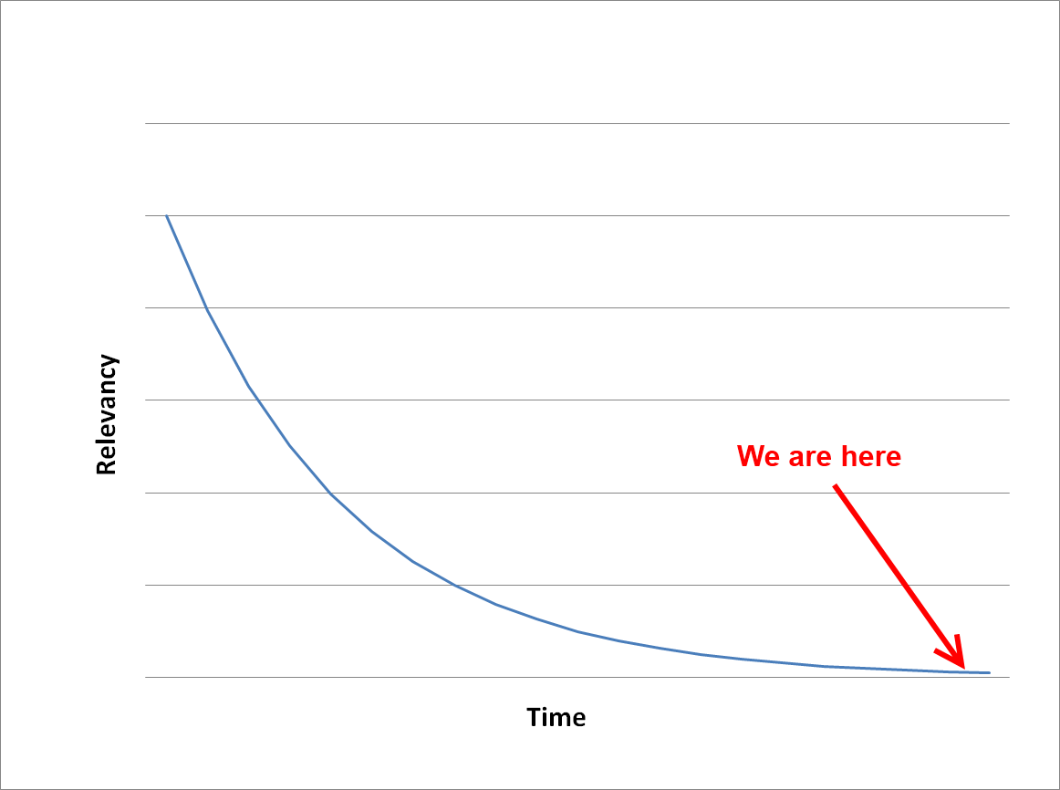

Slide 7
Drivers and Libraries

Slide 8
OpenKinect vs. OpenNI/NITE vs. CodeLaboratories NUI SDK (NKinect)

Slide 9
Support
groups.google.com/group/openni-dev

Slide 10
Installing OpenNI and NITE on Windows 7 PrimeSense Driver: https://github.com/PrimeSense OpenNI, NITE Middleware: openni.org

Slide 11
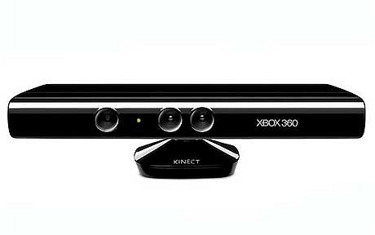
PrimeSense Kinect Device Driver
OpenNI
NITE
Managed NITE
Your Codez!

Slide 12
Managed NITE DLL’s: OpenNI.net.dll XnVNITE.net.dll versus
ManagedNite.dll

Slide 13
Your first ManagedNite.dll Kinect app

Slide 14
Anatomy of a .NET Kinect Project

Slide 15
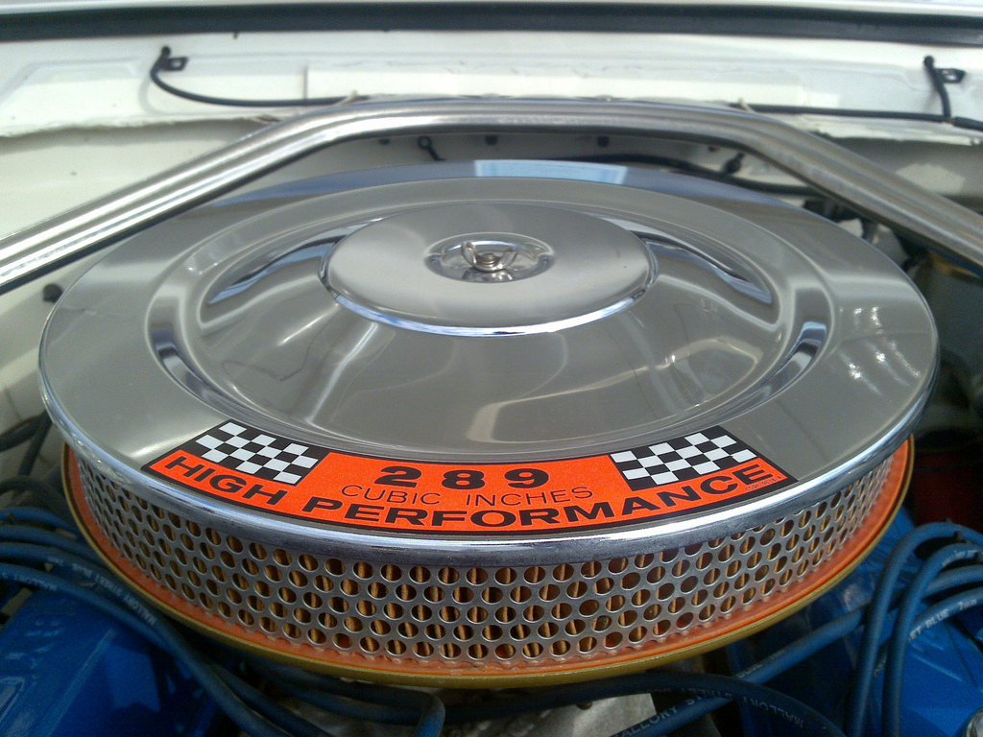
ManagedNite Filters

Slide 16
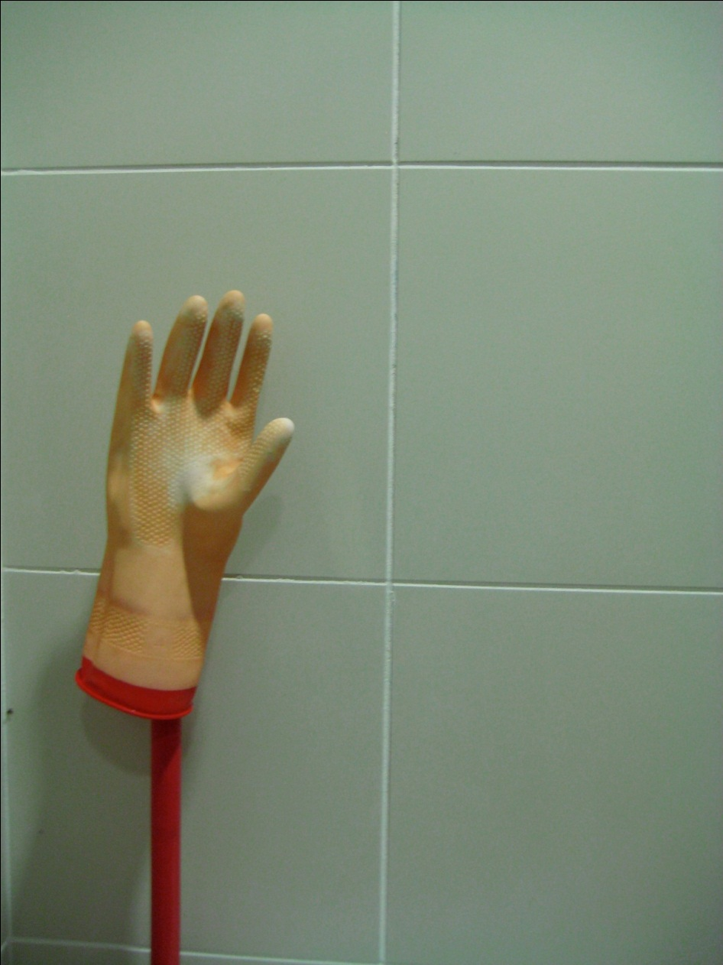
Hand tracking

Slide 17
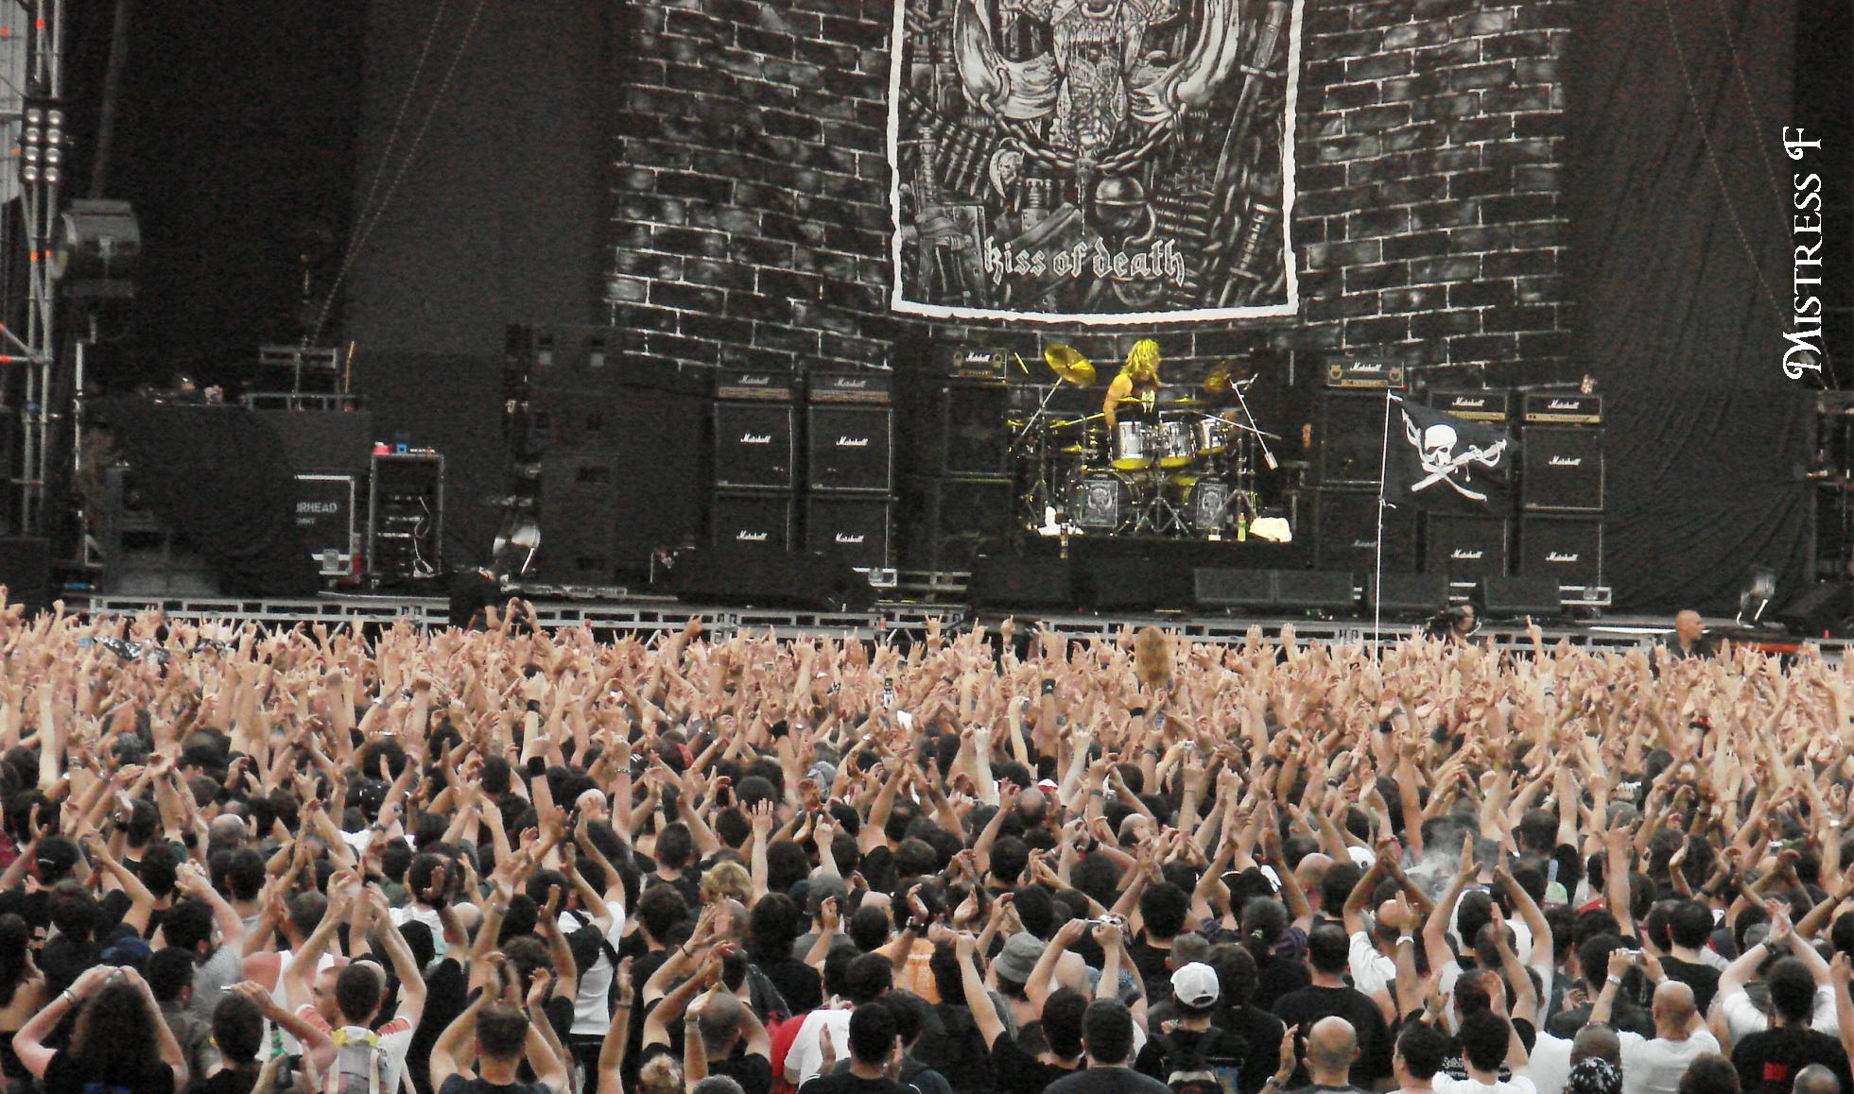

Multiple hands

Slide 18
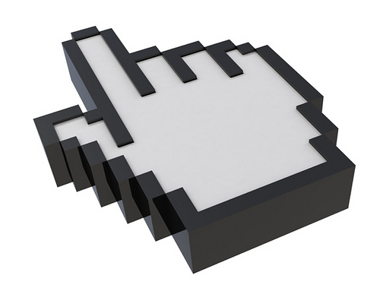
Cursor control

Slide 19
Two options for “clicking”: Push and a WPF Behavior

Slide 20

Cursor Smoothing

Slide 21

Swiping

Slide 22
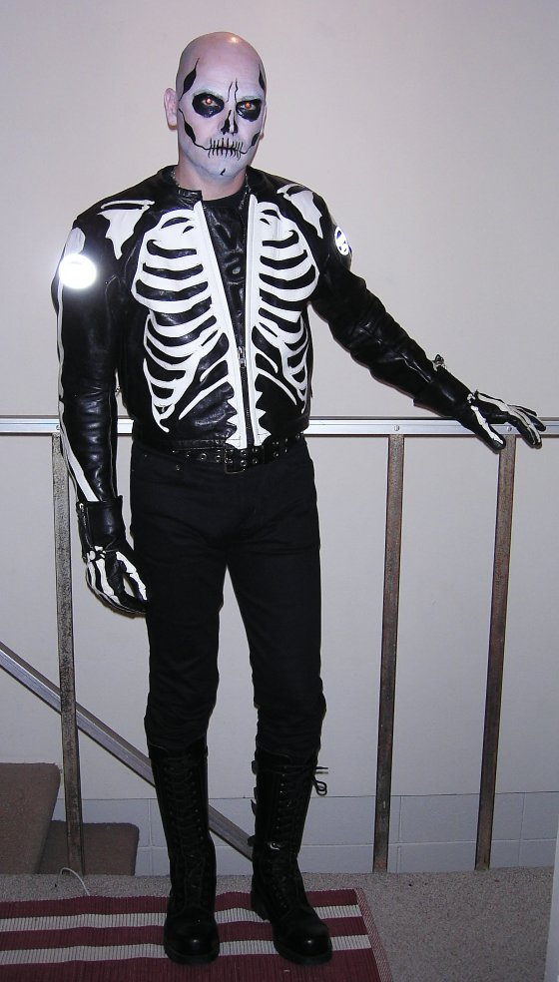
OpenNI.NET Depth, Users, Skeletons

Slide 23

Pro Tip: Keyboard Control

Slide 24
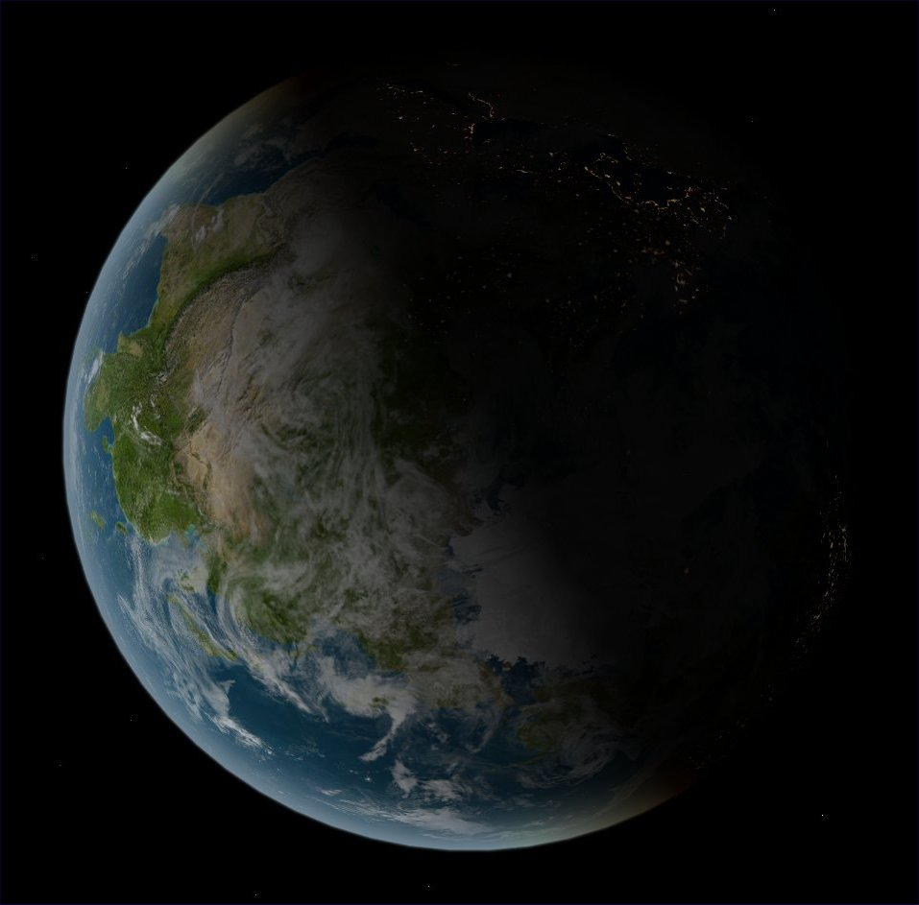
The Real World

Slide 25

What’s next?

Slide 26
Image Credits
http://www.kindohm.com https://github.com/kindohm/kinect-nite-dev
http://www.flickr.com/photos/artisandhu/2951619905/ http://www.flickr.com/photos/crashmaster/3183161494/ http://www.flickr.com/photos/shawe/3486394808/ http://www.flickr.com/photos/mistressf/581070318/ http://www.flickr.com/photos/flyingsinger/86898564/
http://www.flickr.com/photos/publicworksgroup/2269566166/
http://www.flickr.com/photos/fsse-info/3559697586/ http://www.flickr.com/photos/wapster/3919855338/
http://www.flickr.com/photos/lovelihood/5399818533/
http://www.flickr.com/photos/peterkaminski/1510724/ http://www.flickr.com/photos/ste3ve/87689464/

