Slide 1

DEV for KINECT with WINDOWS 7 AND .NET
Mike Hodnick http://www.kindohm.com @kindohm

Slide 2
About the presenter

Slide 3
About the audience

Slide 4
Where we are headed…

Slide 5
We’re covering the basics

Slide 6
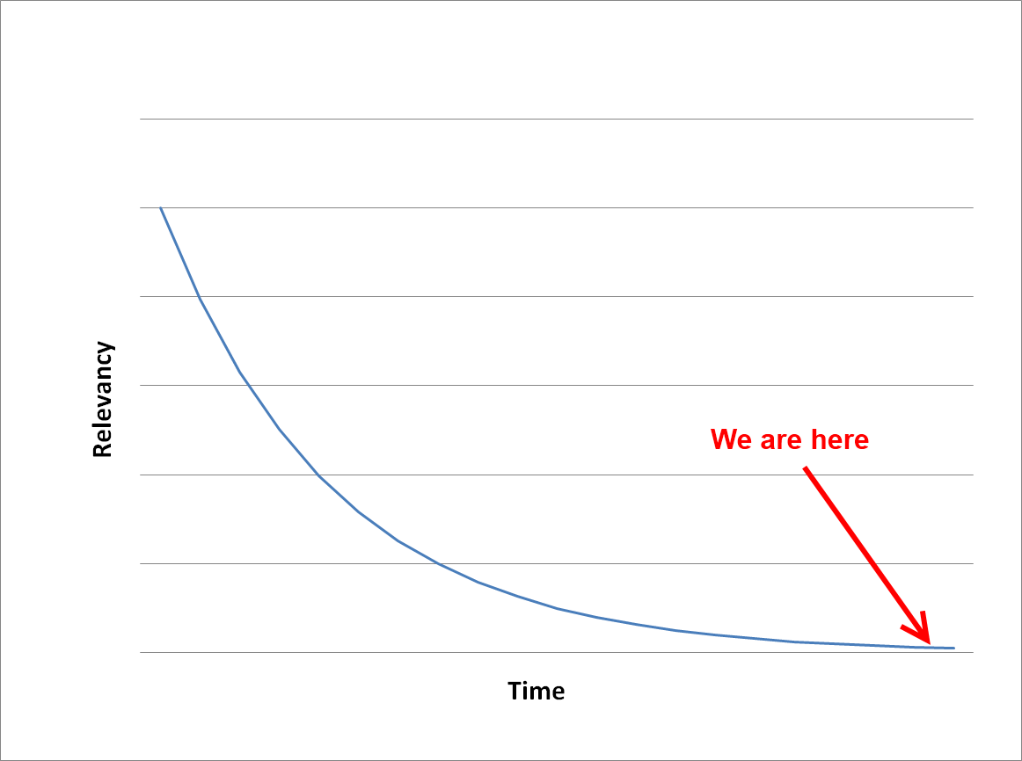

Slide 7

Drivers and Libraries

Slide 8
OpenKinect versus OpenNI

Slide 9
Support
groups.google.com/group/openni-dev
groups.google.com/group/openkinect

Slide 10
Installing OpenNI and NITE on Windows 7

Slide 11
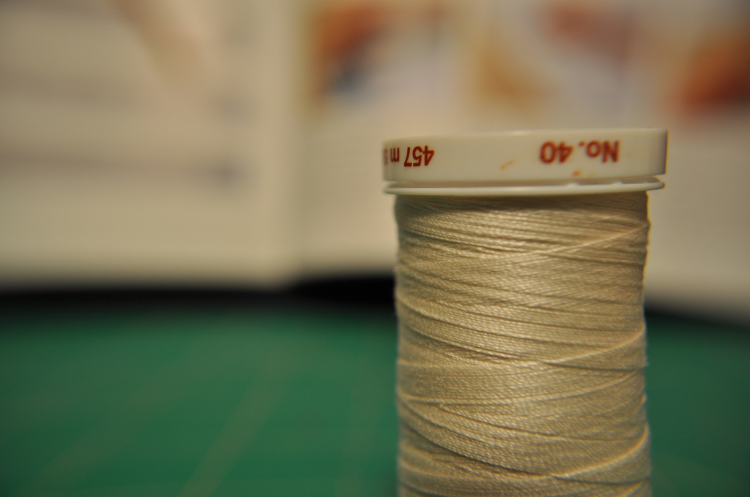
Your first multi-threaded Kinect session

Slide 12
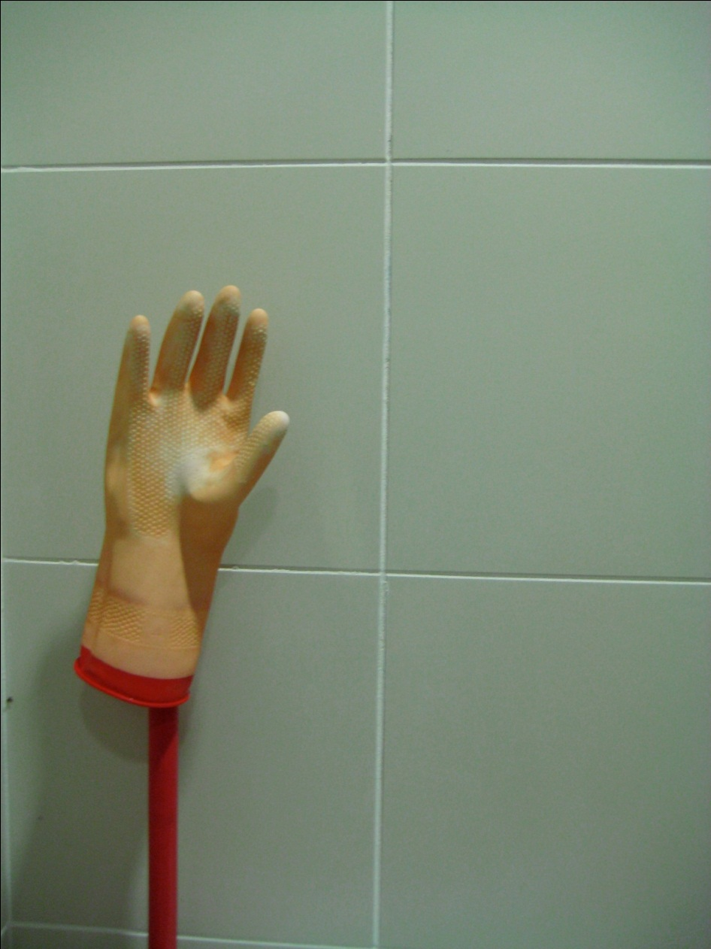
Hand tracking

Slide 13
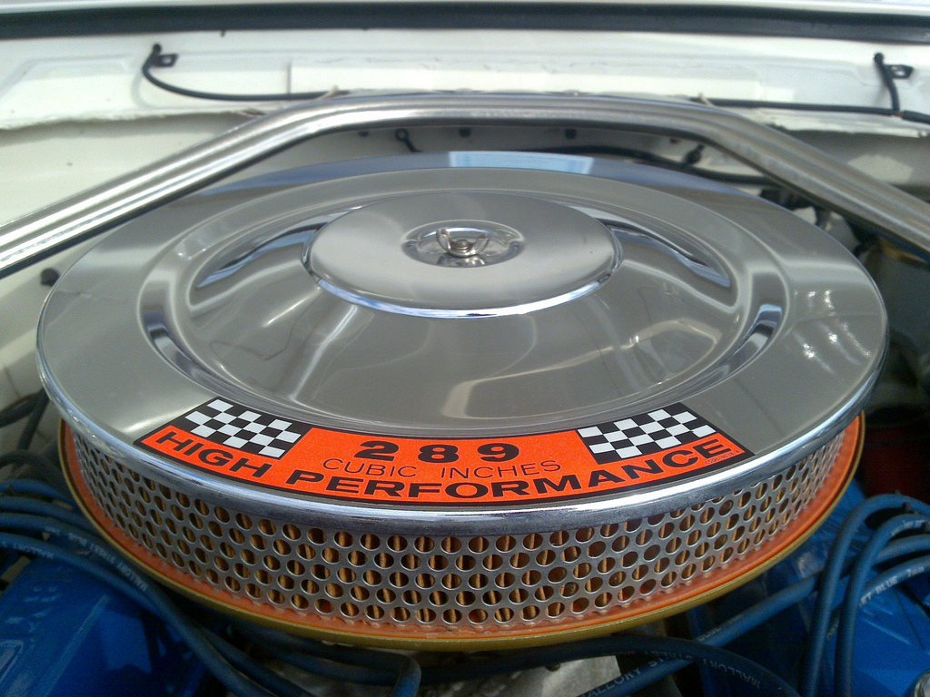
NITE Filters

Slide 14
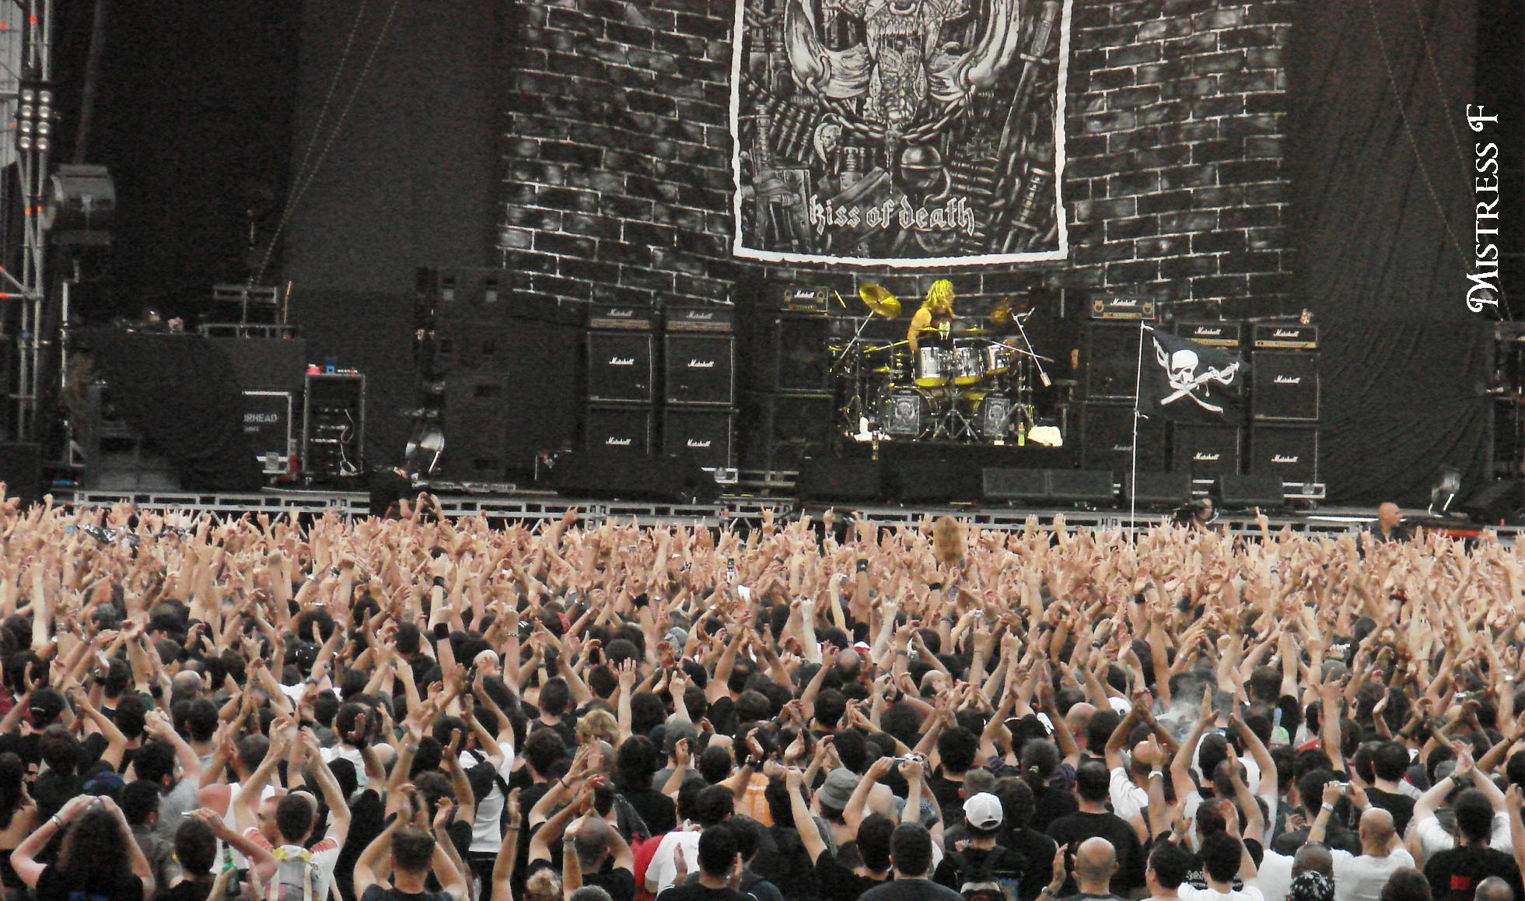
Multiple hands

Slide 15
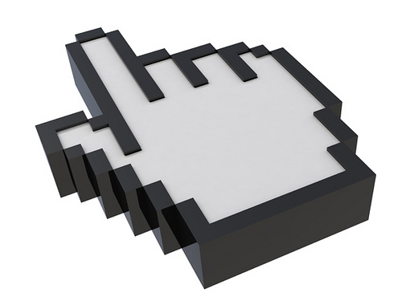
Cursor control

Slide 16

Smoothing (and scaling)

Slide 17

Swiping

Slide 18
Two options for “clicking”: Push and a WPF Behavior

Slide 19

Pro Tip: Keyboard Control

Slide 20

The Real World

Slide 21

ManagedNite.dll Limitations

Slide 22
Image Credits
http://www.kindohm.com
http://www.flickr.com/photos/artisandhu/2951619905/ http://www.flickr.com/photos/crashmaster/3183161494/ http://www.flickr.com/photos/shawe/3486394808/ http://www.flickr.com/photos/mistressf/581070318/ http://www.flickr.com/photos/flyingsinger/86898564/
http://www.flickr.com/photos/publicworksgroup/2269566166/
http://www.flickr.com/photos/fsse-info/3559697586/ http://www.flickr.com/photos/wapster/3919855338/
http://www.flickr.com/photos/lovelihood/5399818533/
http://www.flickr.com/photos/peterkaminski/1510724/

