Slide 1

DEV for KINECT with WINDOWS 7 AND .NET
Mike Hodnick http://www.kindohm.com @kindohm

Slide 2
About the presenter

Slide 3
About the audience

Slide 4
Where we are headed…

Slide 5
We’re covering the basics

Slide 6

== Hacky

Slide 7
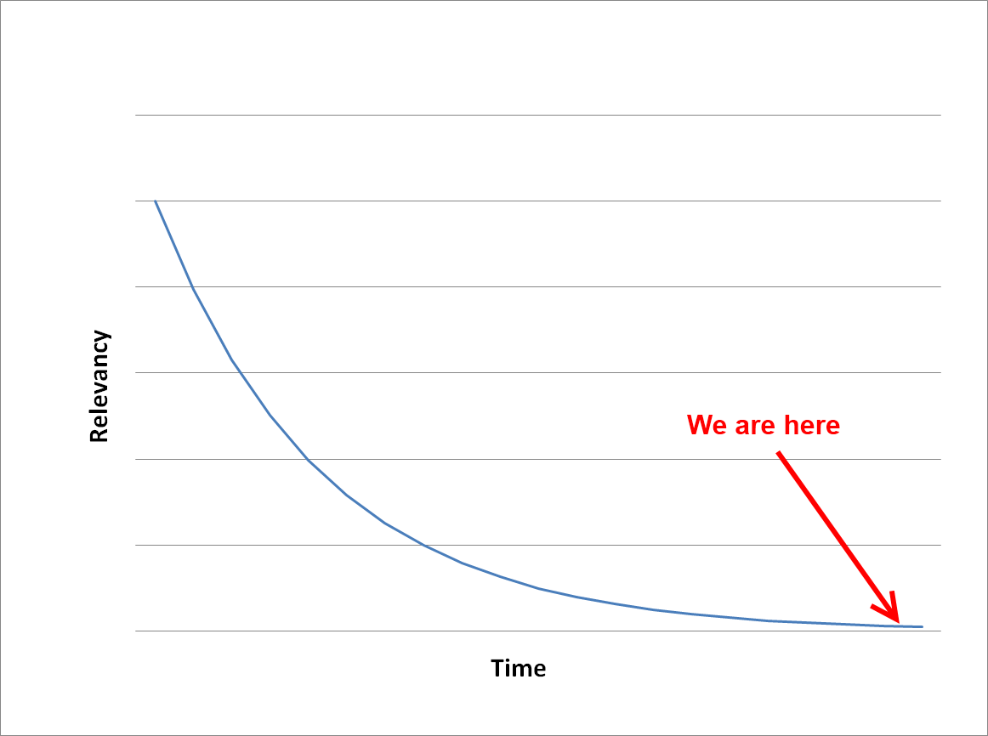

Slide 8
Drivers and Libraries

Slide 9
OpenKinect versus OpenNI

Slide 10
Support
groups.google.com/group/openni-dev
groups.google.com/group/openkinect

Slide 11
Installing OpenNI and NITE on Windows 7

Slide 12
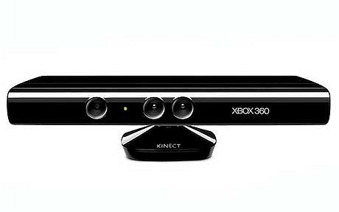
PrimeSense Kinect Device Driver
OpenNI
NITE
Managed NITE
Your Code

Slide 13
Managed NITE DLL’s: OpenNI.net.dll XnVNITE.net.dll versus
ManagedNite.dll

Slide 14
Your first Kinect session

Slide 15
Anatomy of a .NET Kinect Project

Slide 16
Gaining Focus for Tracking and Gestures

Slide 17
Depth, Image, and Hand Generators

Slide 18
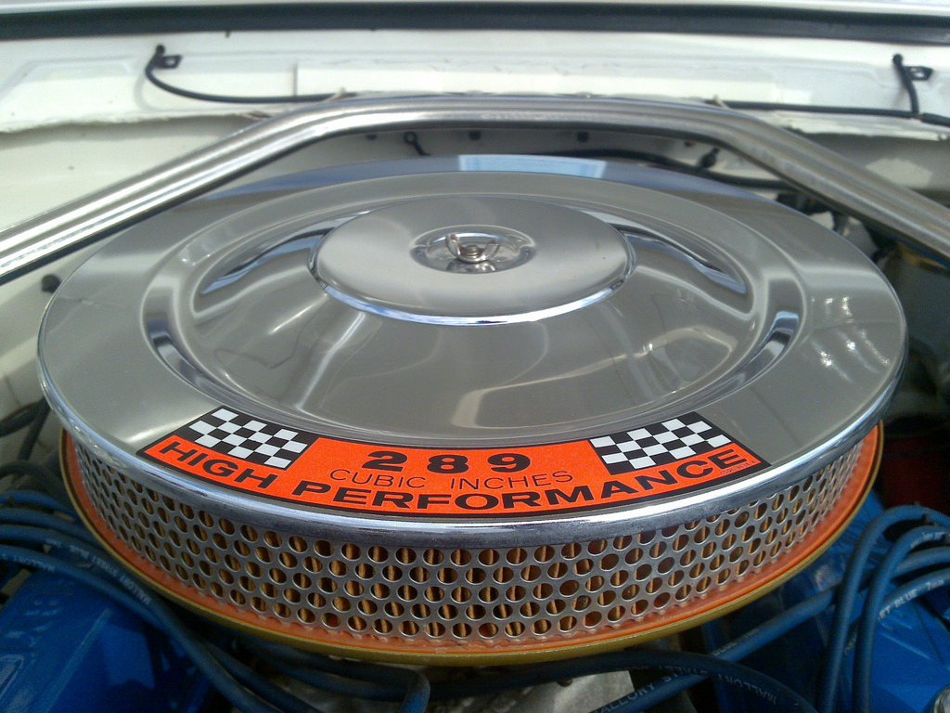
NITE Filters

Slide 19
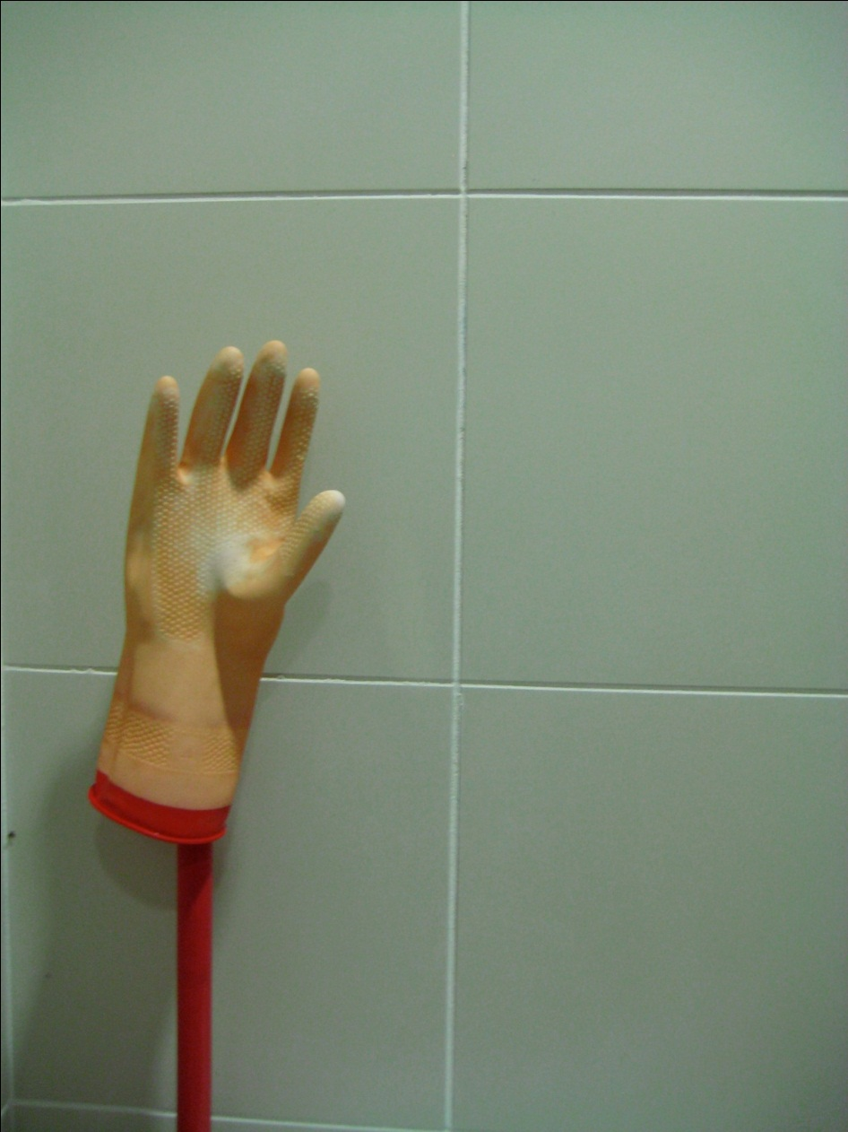
Hand tracking

Slide 20
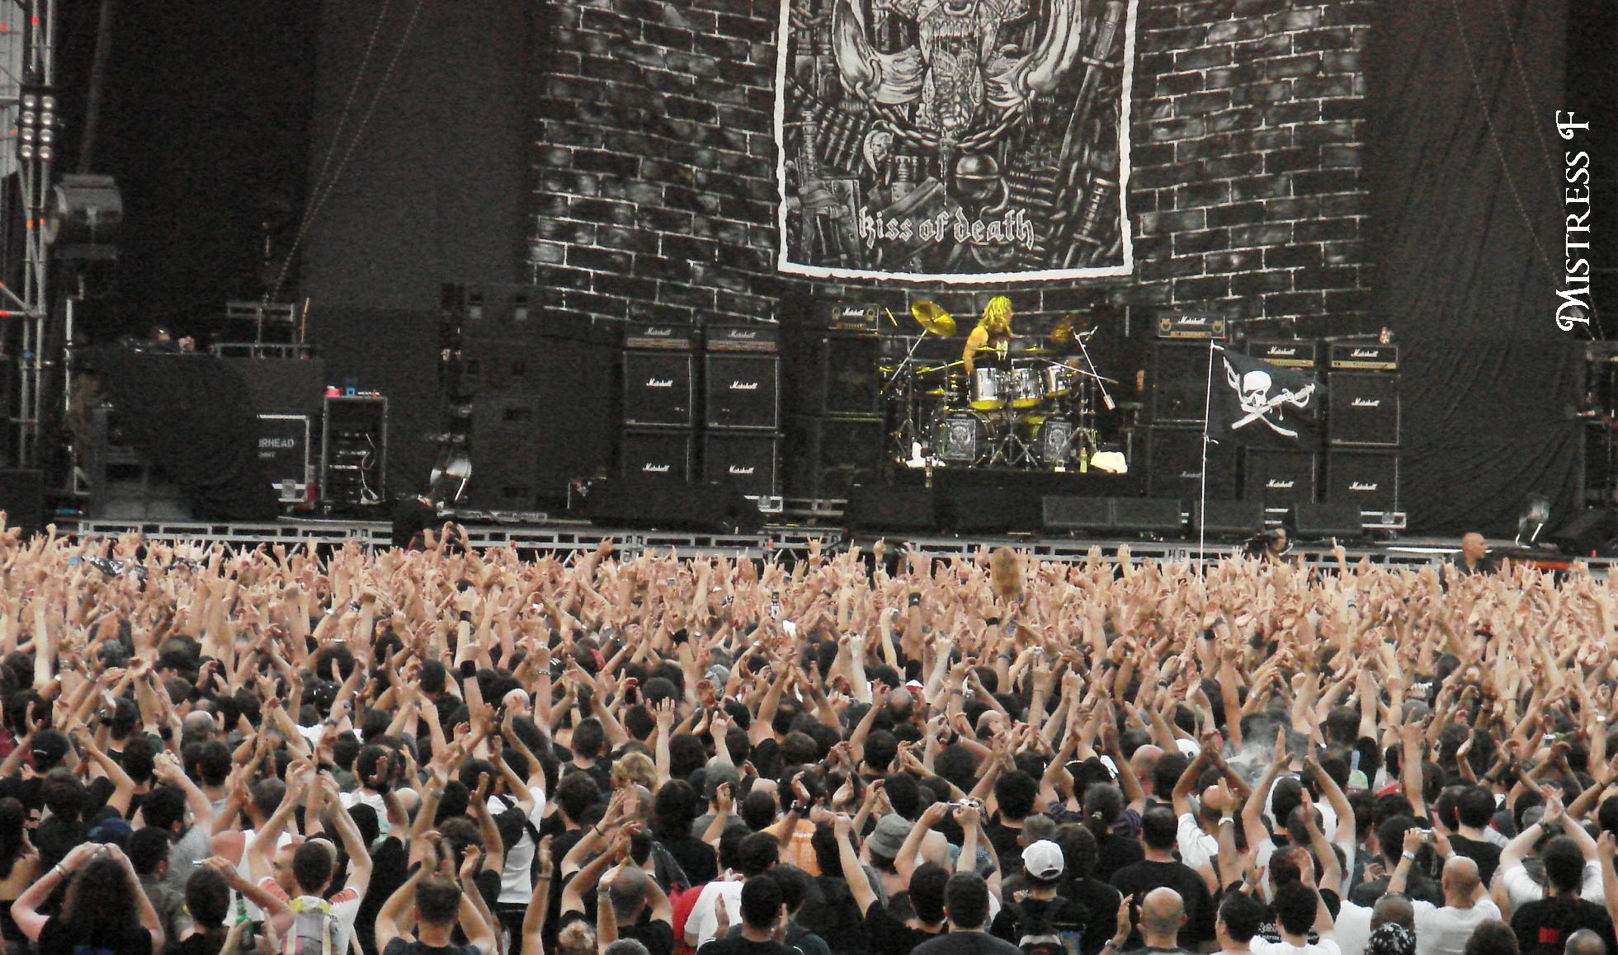
Multiple hands

Slide 21
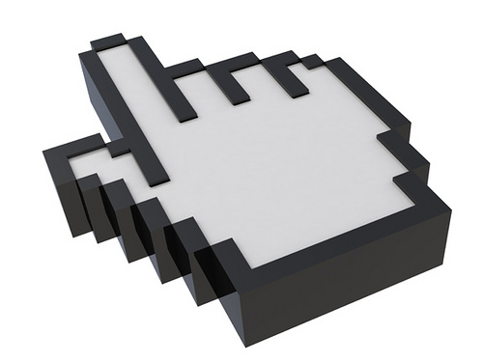
Cursor control

Slide 22
Two options for “clicking”: Push and a WPF Behavior

Slide 23

Cursor Smoothing

Slide 24

Swiping

Slide 25
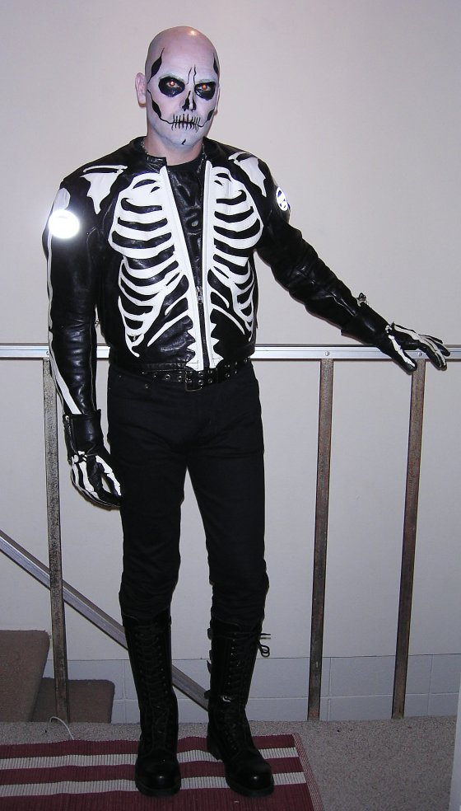
User Skeletons

Slide 27

Pro Tip: Keyboard Control

Slide 28

The Real World

Slide 29

ManagedNite.dll Limitations

Slide 30
Image Credits
http://www.kindohm.com
http://www.flickr.com/photos/artisandhu/2951619905/ http://www.flickr.com/photos/crashmaster/3183161494/ http://www.flickr.com/photos/shawe/3486394808/ http://www.flickr.com/photos/mistressf/581070318/ http://www.flickr.com/photos/flyingsinger/86898564/
http://www.flickr.com/photos/publicworksgroup/2269566166/
http://www.flickr.com/photos/fsse-info/3559697586/ http://www.flickr.com/photos/wapster/3919855338/
http://www.flickr.com/photos/lovelihood/5399818533/
http://www.flickr.com/photos/peterkaminski/1510724/ http://www.flickr.com/photos/ste3ve/87689464/

