Slide 1

DEV for KINECT with WINDOWS 7 AND .NET
Mike Hodnick http://www.kindohm.com @kindohm

Slide 2
About the presenter

Slide 3
About the audience

Slide 4
Where we are headed…

Slide 5
We’re covering the basics

Slide 6
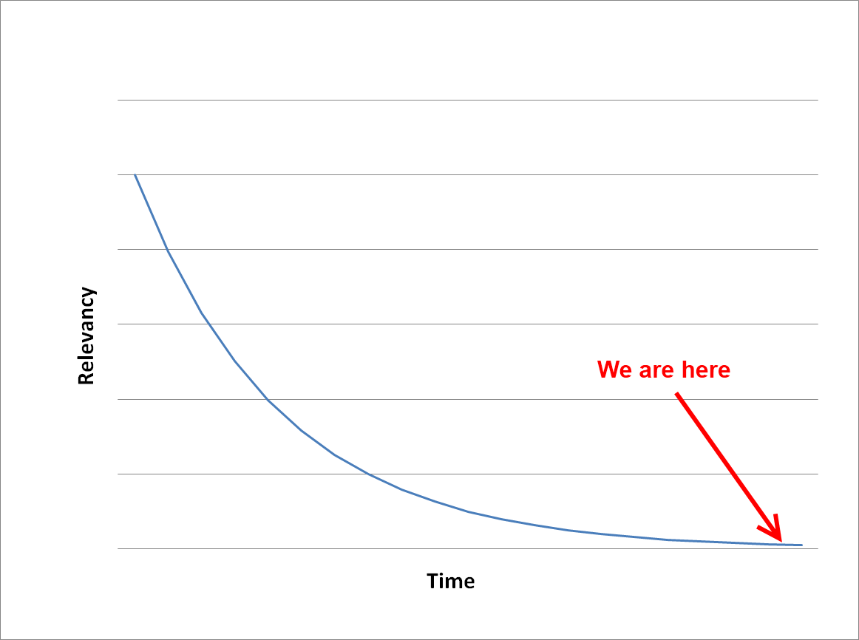

Slide 7

Drivers and Libraries

Slide 8
OpenKinect versus OpenNI

Slide 9
Support
groups.google.com/group/openni-dev
groups.google.com/group/openkinect

Slide 10
Installing OpenNI and NITE on Windows 7

Slide 11
Difference between PrimeSense driver, OpenNI, and NITE

Slide 12
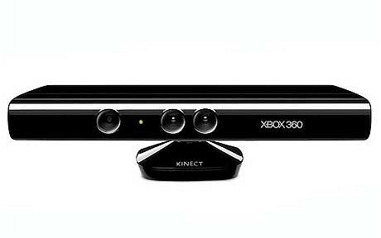
PrimeSense Kinect Device Driver
OpenNI
NITE
Managed NITE
Your Code

Slide 13
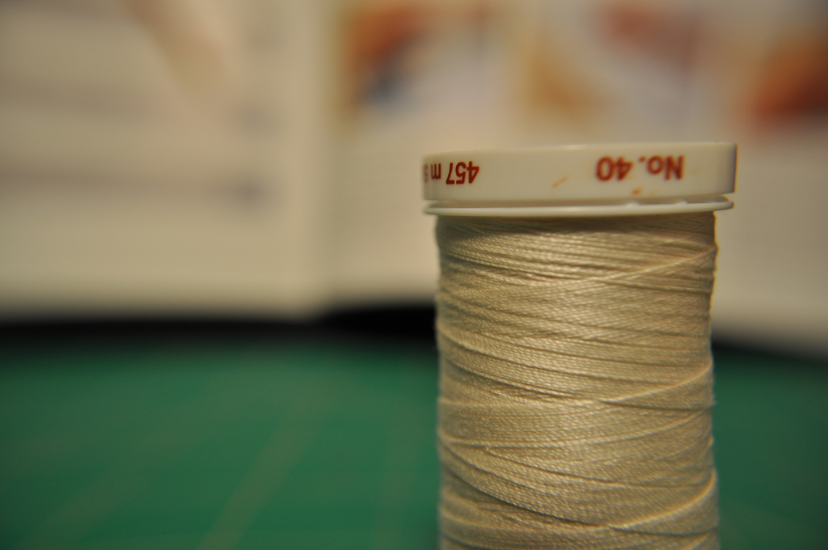
Your first multi-threaded Kinect session

Slide 14
Anatomy of a .NET Kinect Project

Slide 15
Depth, Image, and Hand Generators

Slide 16
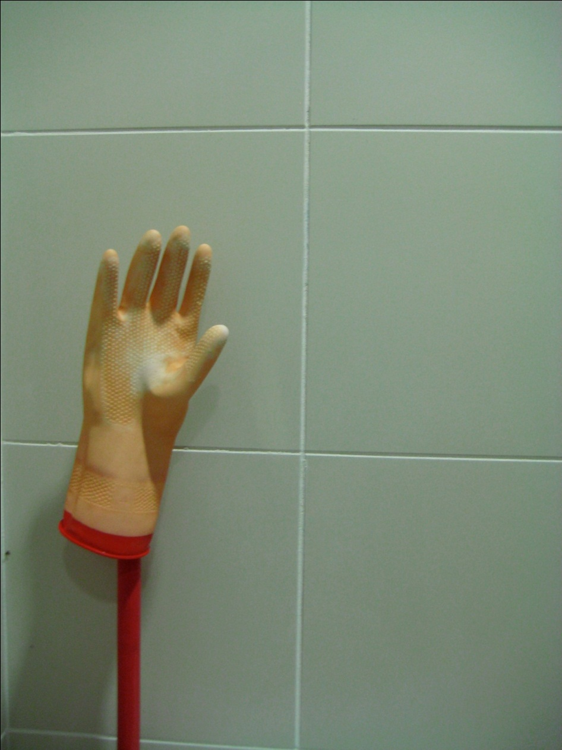
Hand tracking (NITE)

Slide 17
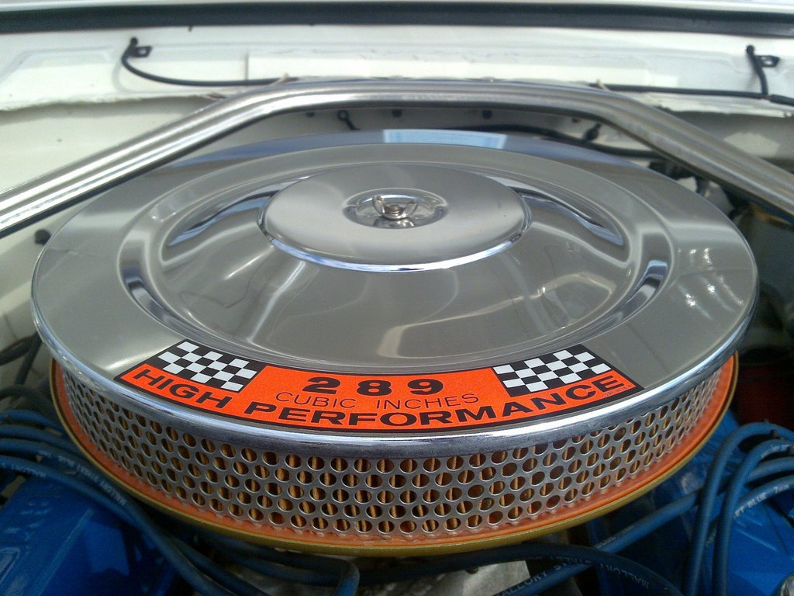
NITE Filters

Slide 18
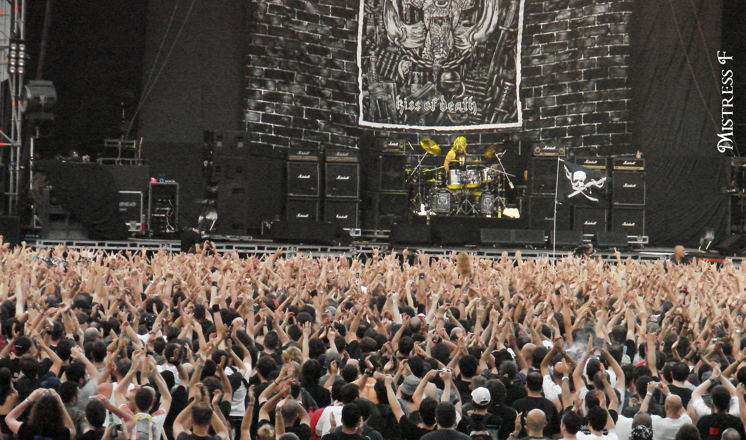
Multiple hands (NITE)

Slide 19
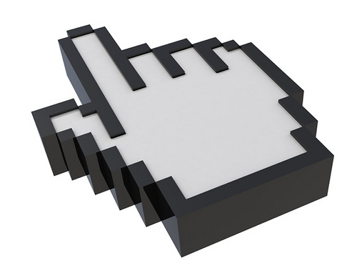
Cursor control with NITE

Slide 20

Cursor Smoothing (and scaling)

Slide 21

Swiping (NITE)

Slide 22
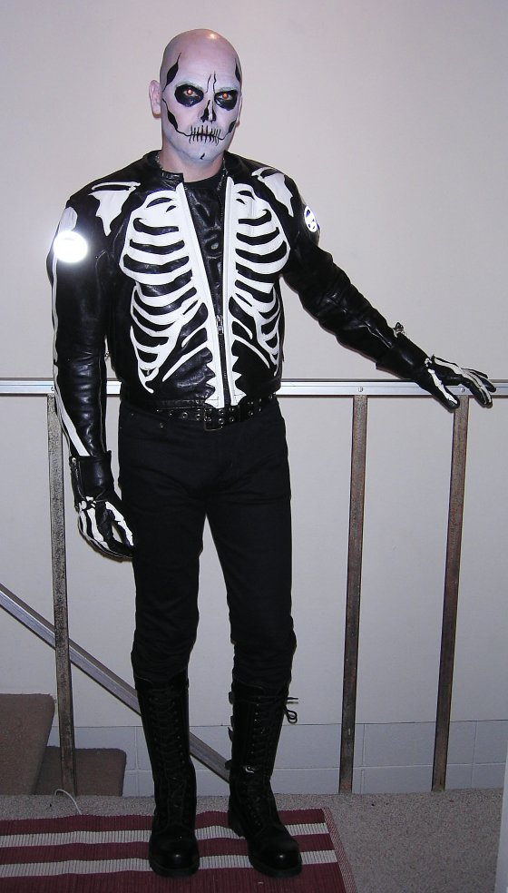
User Skeletons (OpenNI)

Slide 24
Two options for “clicking”: Push and a WPF Behavior

Slide 25

Pro Tip: Keyboard Control

Slide 26
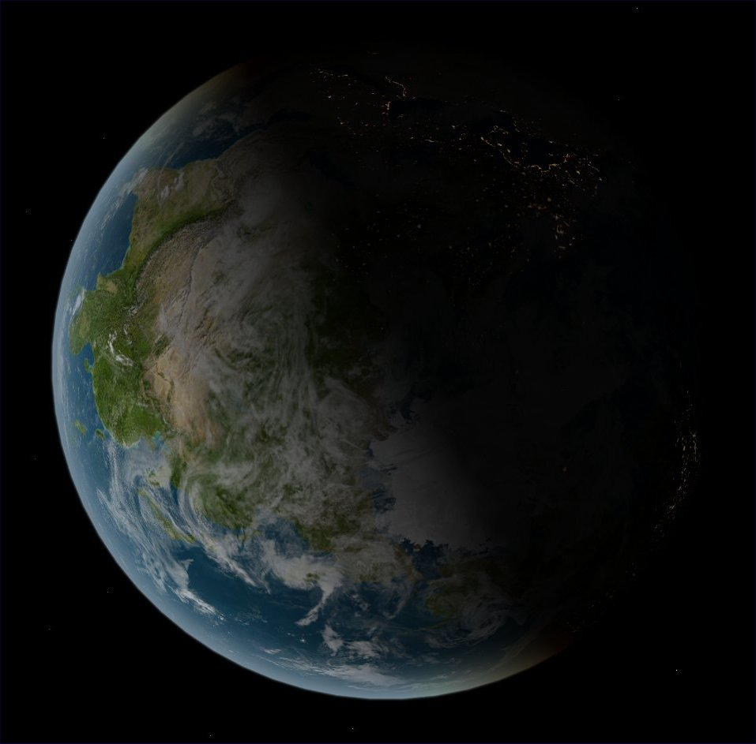
The Real World

Slide 27

ManagedNite.dll Limitations

Slide 28
Image Credits
http://www.kindohm.com
http://www.flickr.com/photos/artisandhu/2951619905/ http://www.flickr.com/photos/crashmaster/3183161494/ http://www.flickr.com/photos/shawe/3486394808/ http://www.flickr.com/photos/mistressf/581070318/ http://www.flickr.com/photos/flyingsinger/86898564/
http://www.flickr.com/photos/publicworksgroup/2269566166/
http://www.flickr.com/photos/fsse-info/3559697586/ http://www.flickr.com/photos/wapster/3919855338/
http://www.flickr.com/photos/lovelihood/5399818533/
http://www.flickr.com/photos/peterkaminski/1510724/ http://www.flickr.com/photos/ste3ve/87689464/

