Slide 1

DEV for KINECT with WINDOWS 7 AND .NET
Mike Hodnick http://www.kindohm.com @kindohm

Slide 2
About the presenter

Slide 3
About the audience

Slide 4
Where we are headed…

Slide 5
We’re covering the basics

Slide 6
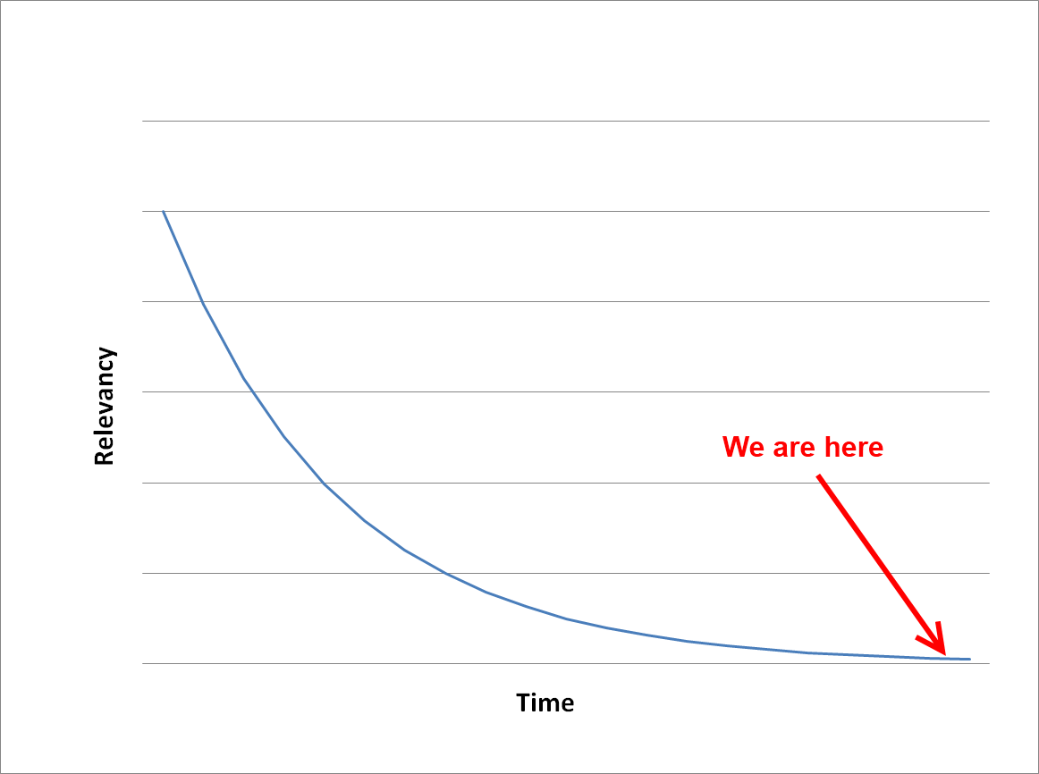

Slide 7

Drivers and Libraries

Slide 8
OpenKinect versus OpenNI

Slide 9
Support
groups.google.com/group/openni-dev
groups.google.com/group/openkinect

Slide 10
Installing OpenNI and NITE on Windows 7

Slide 11
Difference between PrimeSense driver, OpenNI, and NITE

Slide 12
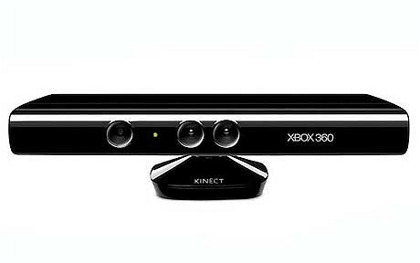
PrimeSense Kinect Device Driver
OpenNI
NITE
Managed NITE
Your Code

Slide 13
Your first Kinect session

Slide 14
Anatomy of a .NET Kinect Project

Slide 15
Gaining Focus for Tracking and Gestures

Slide 16
Depth, Image, and Hand Generators

Slide 17
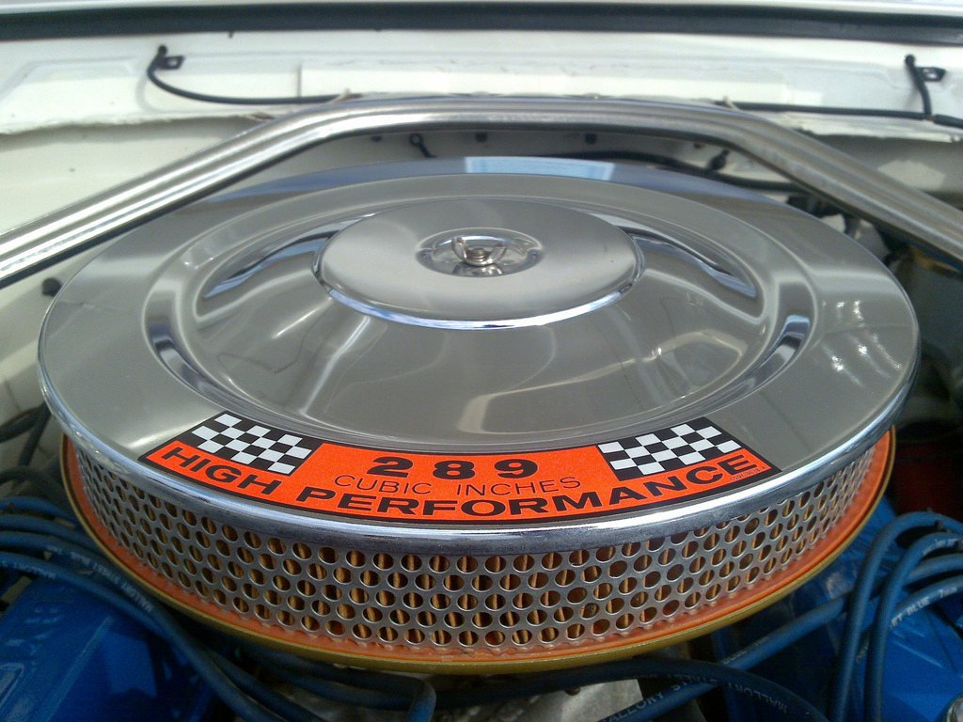
NITE Filters

Slide 18
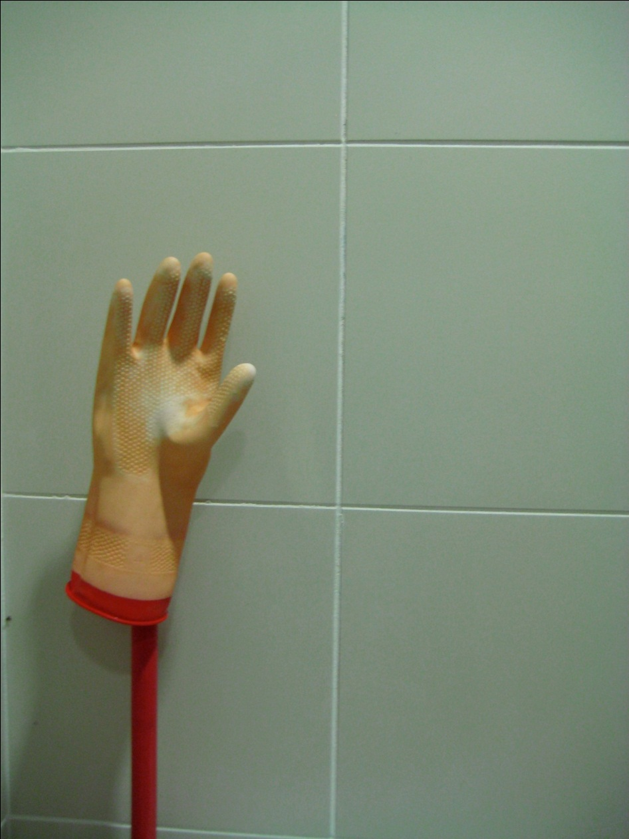
Hand tracking

Slide 19
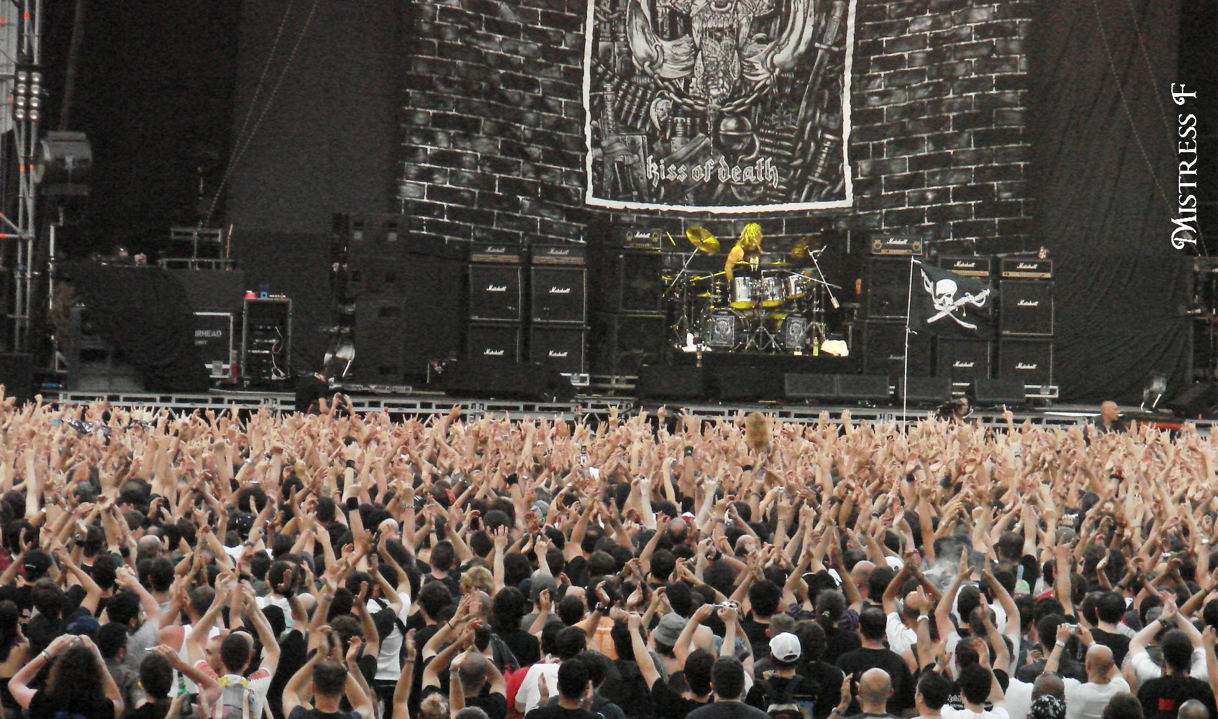
Multiple hands

Slide 20
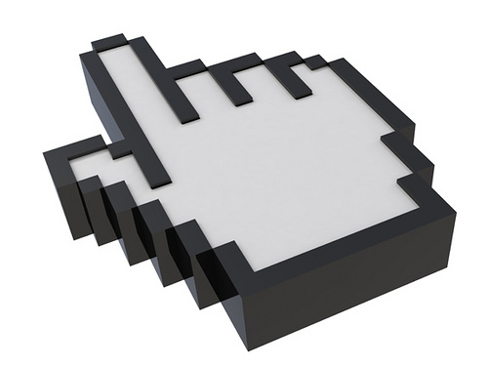
Cursor control

Slide 21
Two options for “clicking”: Push and a WPF Behavior

Slide 22

Cursor Smoothing

Slide 23

Swiping

Slide 24
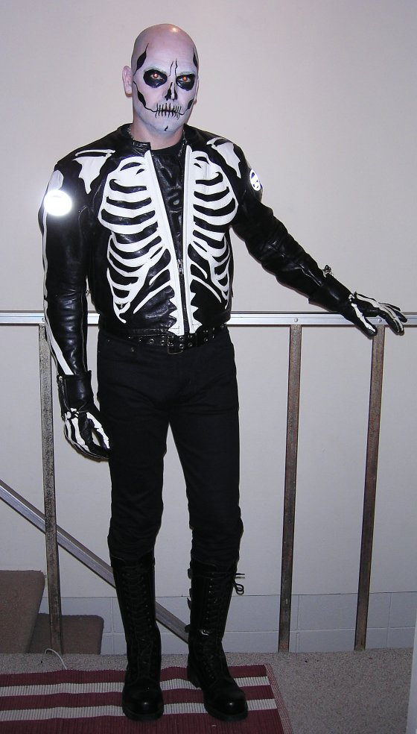
User Skeletons

Slide 26

Pro Tip: Keyboard Control

Slide 27

The Real World

Slide 28

ManagedNite.dll Limitations

Slide 29
Image Credits
http://www.kindohm.com
http://www.flickr.com/photos/artisandhu/2951619905/ http://www.flickr.com/photos/crashmaster/3183161494/ http://www.flickr.com/photos/shawe/3486394808/ http://www.flickr.com/photos/mistressf/581070318/ http://www.flickr.com/photos/flyingsinger/86898564/
http://www.flickr.com/photos/publicworksgroup/2269566166/
http://www.flickr.com/photos/fsse-info/3559697586/ http://www.flickr.com/photos/wapster/3919855338/
http://www.flickr.com/photos/lovelihood/5399818533/
http://www.flickr.com/photos/peterkaminski/1510724/ http://www.flickr.com/photos/ste3ve/87689464/

