Slide 1
Hyundai Price Regression
Team Members:
Devraj Jadeja
Govind Agrawal
Prerna Pachauri
Shivam Sharma
Swapnil Pharate

Slide 2
Overview
Introduction
Objective
About Data
Phases
Some Visualization
Insights
Challenges
Learnings
Future Scope
Conclusion

Slide 3
Introduction And Objective
This dataset contains used cars sale prices in the UK
We've enforced the model exploitation supervised Learning techniques of Machine Learning, which is outlined by its use of labeled information sets to coach algorithms to classify data or predict outcomes accurately.
Problem Definition - It is easy for any company to price their new cars based on the manufacturing and marketing cost it involves. But when it comes to a used car it is quite difficult to define a price because it involves it is influenced by various parameters like car brand, manufactured year and etc. The goal of our project is to predict the best price for a pre-owned car in the UK market based on the previous data related to sold cars using machine learning.
Objective Of the Project - The goal of this project is to create an efficient and effective model that will be able to predict the price of a used car by using the Regression and Classification Models For the better accuracy.

Slide 4
About Data
This dataset contains used cars sale prices in the UK
Variables
model - Hyundai Car Brands
year - Production Year
price - Price of car in £
transmission - Automatic,Manual, Semi-Auto
mileage - Number of miles traveled
fuel_type - Petrol,Diesel,Hybrid,Electric,Other
tax - Annual Tax
mpg - Miles per Gallon
engineSize - Car's Engine Size

Slide 5
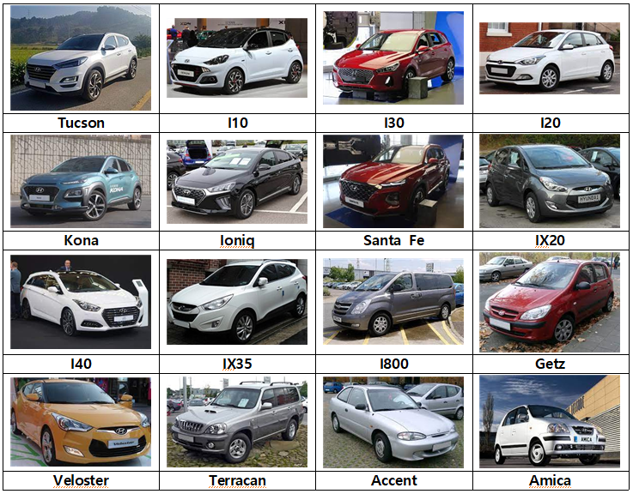

Slide 6
Phases
Project is divided into four phases:
Exploratory Data Analysis
Feature Engineering
Feature selection
Model Deployment
Project is divided into four phases

Slide 7
Observations
Fuel Type
Petrol cars have the highest market shares with 60% on an average with 10,900 £
transmission
Manual cars have the highest market share with 74% on average With 11,000 £
Combo of petrol with manual are very popular with market share of 52% at avg price of 10,500 £.
Market share of
fuel type and transmission

Slide 8
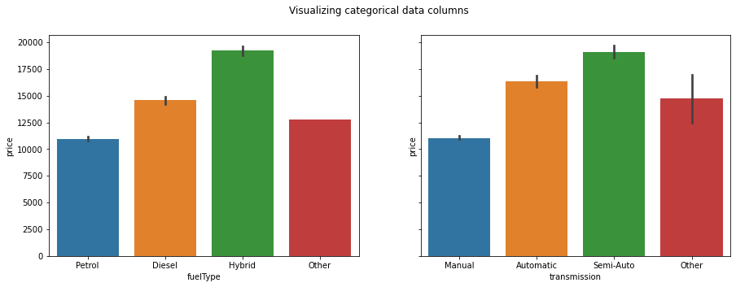
Insight
2. Insight
Hybrid Fuel Type car are more Expensive compare To other fuel type
Semi-Auto Transmission car are more Expensive compare To other transmission
Automatic transmission car 48% more expensive than manual
Hybrid Fuel Type 75% more expensive than Petrol
Combos of automatic and hybrid vehicles have just 6% market share

Slide 9
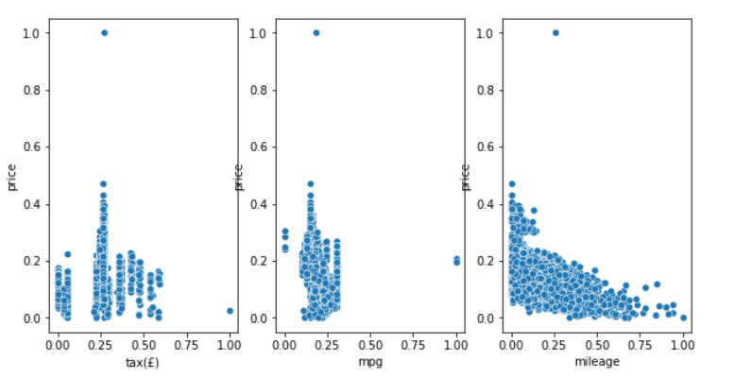
3. Insight
4. Insight
Correlation And Trends
Model Based On Fuel Efficiency
Tax doesn't show any trend.
Mileage and mpg seem to have a negative correlation with price.
Ioniq model car is most fuel efficient with 78 mpg
I800 model car is worst fuel efficient with 32 mpg
Ioniq is 8 % more expensive than I800

Slide 10
Some Visualizations Based On Univariate and Bivariate Analysis

Slide 11
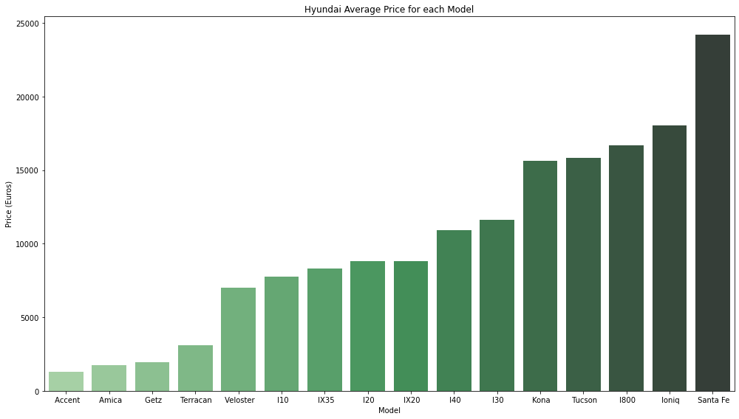
Average price for each model

Slide 12
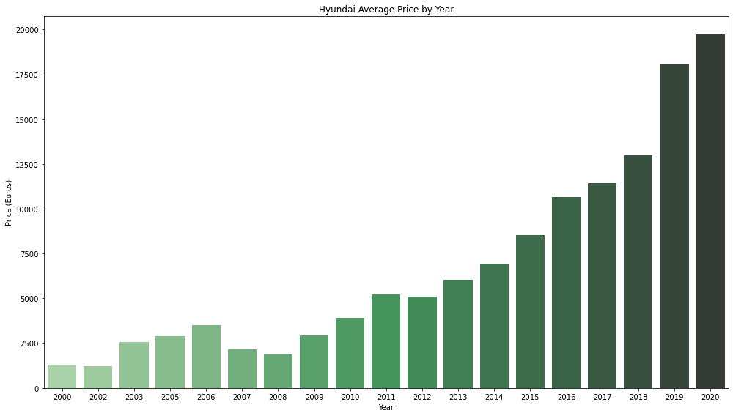
Average price by Year

Slide 13
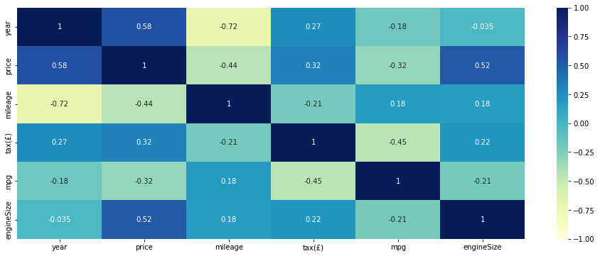
Correlation
Price and Year have high positive correlation.
Engine Size has a medium positive correlation with price.
Mpg,mileage have a medium negative correlation with price.
Other features do not seem to have an impact on Price.

Slide 14
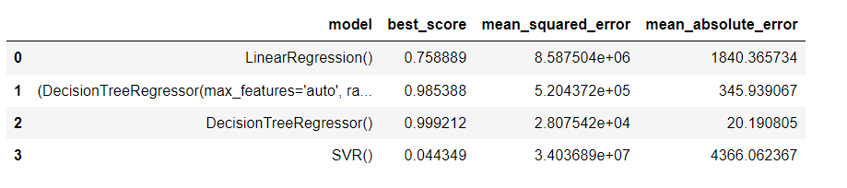
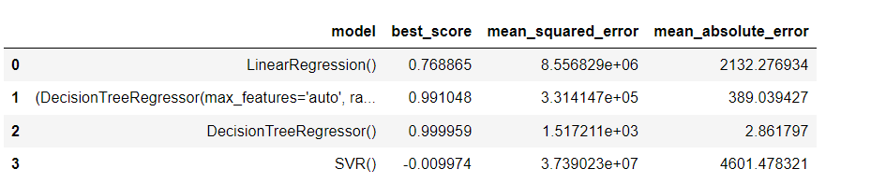
Insights
Accuracy On Training Data
Accuracy On Testing Data
Notes:
2ND MODEL IS RANDOM FOREST.

Slide 15
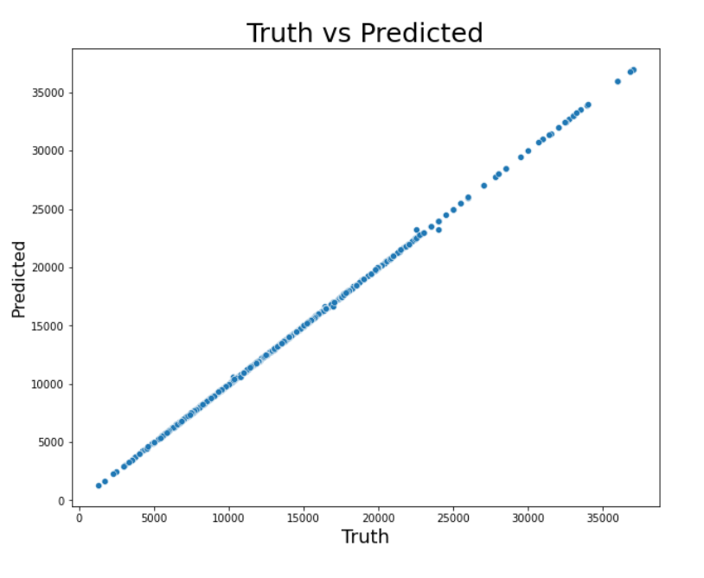
Accuracy Visualization
From Analysing Multi Models Regressions Decision Tree Gives Best Results Among the All and here is the Visualization Of Predicted and Actual Data

Slide 16
Future scope
Since it involves a specialist's expertise and discernible effort, predicting the price of cars has been a topic of research that attracts a lot of interest. For dependable and accurate forecasts, a large number of unique attributes are considered. The gathering and pre-processing of the data is a crucial phase in the prediction process.
An advanced machine learning model and deep learning techniques can be used to create this system, which has shown astounding performance in the automobile price prediction challenge. This will increase the system's effectiveness and accuracy. Additionally, we can see that as automotive innovation has grown, electric vehicles have drawn attention from the public and are chosen by the majority over conventional cars.

Slide 17
Problems
car prediction can be a challenging task due to the high number of attributes that should be considered for accurate prediction.
The main limitation of this study is the low number of records that have been used.
In future work, we intend to collect more data related to electric vehicles and combustion vehicles and to use more advanced techniques.
Conclusion
The model which has performed better is Decision Tree Regressor with accuracy 99%.
The model has performed well in training and testing data

Slide 18
ML Codes

Slide 19
References
Information regarding machine learning techniques and algorithmshttps: //en.wikipedia.org/wiki/Machine_learning
https://scikit-learn.org/stable/modules/tree.html#minimal-cost-complexity-pruning
https://scikit-learn.org/stable/modules/generated/sklearn.ensemble.RandomForestClassifier.html
https://www.kaggle.com/code/yogidsba/predict-used-car-prices-linearregression
https://www.kaggle.com/code/adhurimquku/car-price-prediction-99-accuracy

