Slide 1

Class 3
Michael T Minella

Slide 2

Notes:
Questions from last week?

Slide 3
REVIEW

Slide 4
HBM FILES
Root element is the <hibernate-mapping> tag
Can have one or more <class> elements inside
Convention is to have one <class> element per hbm file
You can use an *.hbm.xml file to set global values or declare constants

Slide 5
ENTITIES
Has it’s own database identity (key of some kind)
Has a lifecycle of it’s own (independence)
Can be referred to from other entities (foreign key references)

Slide 6
VALUES
Has no database identity
Belongs to an entity
Lifespan tied to the entity instance it belongs to
Cannot be referenced from other entities
Custom value types can be created and are typically called components

Slide 7
COLLECTION TYPES
Properties can be primitives, components and collections
Collection can hold primitives, components or entities
Component vs Entity
  If the child can live without the parent - Entity
  If the child cannot live without the parent - Consider Component

Slide 8
COLLECTION NOTES
POJO must initialize collection
Use accessors like regular properties
Generics are allowed
Consider helper methods

Slide 9
ANNOTATIONS
JPA annotations provide a vendor agnostic way to map objects to database.
Not a complete replacement.
A good compromise between XML and “hard coding”

Slide 10
Notes:
Questions from last week?

Slide 11

Homework

Slide 12
DEPAUL ATM COMPANY
DePaul is starting an ATM company
You have been awarded the contract to develop the software
You are to develop a DAO that addresses the requirements
You will also create a service object that will expose methods for my unit test to call.

Slide 13
DELIVERABLES
A zip file with the completed Maven project.
All classes should be well thought out and use self documenting code.
Unit tests are encouraged but not required.

Slide 14

Mapping cont.

Slide 15
INHERITENCE

Slide 16
INHERITENCE
A fundamental aspect of object oriented programming
Not so common in databases
ORM must provide a solution

Slide 17
EMPLOYEE
Employee
  ContractEmployee
  CompanyEmployee
    PartTimeEmployee
    FullTimeEmployee

Slide 18
OPTIONS
One table per concrete class with implicit polymorphism
One table per concrete class with unions
Table per subclass (joins)
Table per class hierarchy

Slide 19
TABLE PER CLASS/UNIONS
Parent class does not have a table (assuming it’s abstract)
Uses the <union-subclass> tag
Hibernate adds a discriminator field to the tables
Queries use unions

Slide 20
TABLE PER SUBCLASS/JOINS
Creates a table for every class including abstract classes
Primary key of each table is also a foreign key back to parent table
<joined-subclass> is used to represent the hierarchy
Queries use outer joins

Slide 21
TABLE PER CLASS HIERARCHY
Everything is mapped to a single class
Type discriminator field is used to determine which type the row maps to
Most simple method, best performance.
Not normalized. Lots of duplicate data and nulls.

Slide 23
PERSISTENT CONTEXT

Slide 24
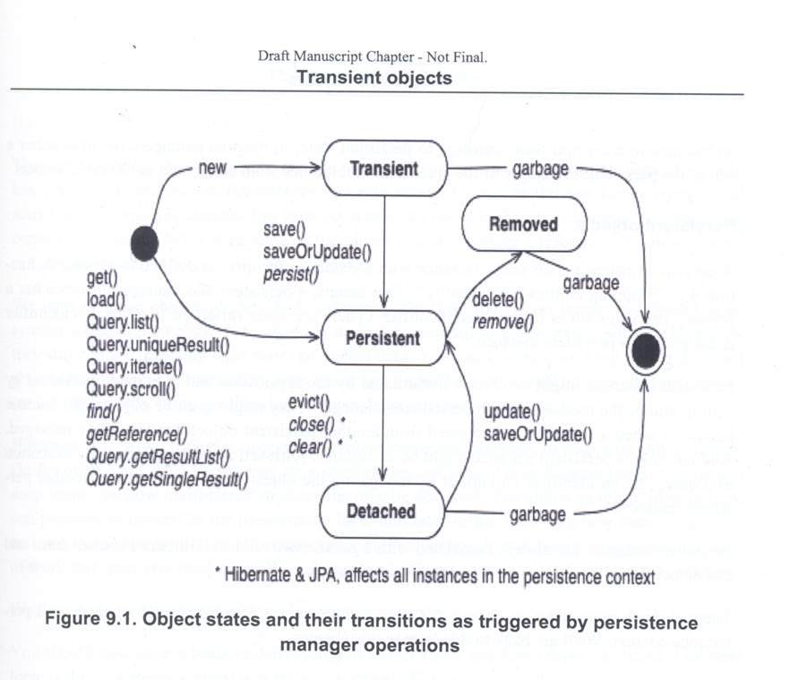

Slide 25
STATES IN HIBERNATE
Transient
Persistent
Removed
Detached

Slide 26
TRANSIENT
When an object is created but not stored yet
Not associated with a row in the database
Changes are not monitored
State is lost when object dies

Slide 27
PERSISTENT
Object is managed by a Session instance
Cached for duration of work unit
Monitored for changes

Slide 28
PERSISTENT II
Four ways to get a persistent object
  User action (Session.save(), Session.saveOrUpdate())
  Direct lookup (Session.get(), Session.load())
  Querying (Query.list(), Query.singleResult(), etc)
  Reattach/merge (Session.update(), Session.merge())

Slide 29
REMOVED
Scheduled for deletion at end of unit of work
Still managed by the Session
Do not reuse references
Session.delete()

Slide 30
DETACHED
Entity was attached but removed from persistent Session
Changes are no longer tracked
Done two ways:
  Session.evict()
  Close the session (Session.close())
Can be reentered into persistence later

Slide 31
PERSISTING OBJECTS
Hibernate will optimize as much as it can
That may or not be what you want
Example:
  Save an object, then continue to make changes on it.
  Hibernate may just issue a single insert with the updated values

Slide 32
GETTING PERSISTED OBJECTS
Two ways to get persistent objects directly
  .get()
  .load()
Each take two args
  class object or string name of the class
  id

Slide 33
.get() VS .load()
.get()
  Returns null if nothing is found
  Returns a true entity if it is
.load()
  Throws an ObjectNotFoundException if nothing is found
  May return a proxy if it is found

Slide 34
.get() VS .load() II
load() can return a proxy without hitting the database
Proxy is a wrapper around the id only
Any fields required later, hibernate will lazy load
Very useful for association manipulation
Detaching a proxy is trouble

Slide 35
DELETING
Object must be associated with a Session to delete
Session.delete()

Slide 36
REATTACHING
Session.update(entity)
Forces an update to be executed
"Update the persistent instance with the identifier of the given detached instance. If there is a persistent instance with the same identifier, an exception is thrown. This operation cascades to associated instances if the association is mapped with cascade="save-update"."

Slide 37
REATTACHING II
Session.delete(entity)
  All you need is the id to delete
Session.saveOrUpdate(entity)
  If the id has not been saved yet, save() is called
  else update() is called

Slide 38
REATTACHING III
Session.merge()
  If persistent object already associated with the Session copy fields over
  else get instance from db and copy fields over
  else save
The detached instance is still detached after a merge!

Slide 39
SESSION MANAGEMENT
Session flushes
  When a transaction commits
  Before a query is executed
  When Session.flush() is called

Slide 40
PROPOGATION
  Session per method...NOT GOOD!
  Option 1. Create session and pass it everywhere
  Option 2. ThreadLocal Session Pattern

Slide 42
CASCADE

Slide 43
CASCADE XML OPTIONS
none (Default)
save-update
delete
all
delete-orphan
all-delete-orphan

Slide 44
CASCADETYPE
ALL
DETACH
MERGE
PERSIST
REFRESH
REMOVE

Slide 46
QUERY OPTIONS
HQL
Criteria
Native SQL

Slide 47
HQL
Hibernate’s object oriented version of SQL
Based upon objects, not tables
Case insensitive
Select clause is optional

Slide 48
HQL
Hibernate’s object oriented version of SQL
Based upon objects, not tables
Case insensitive
VERY similar to SQL
Doesn’t use select

Slide 49
THE BASICS
from <object name>
from Employee
from Employee as emp

Slide 50
JOINS & ASSOCIATIONS
Same types supported as ANSI SQL
  inner join
  left outer join
  right outer join
  full outer join
Extra conditions can be added using the with keyword

Slide 51
EXPLICIT VS IMPLICIT JOINS
Explicit
  from Employee emp inner join emp.dependant dep where dep.name = ‘Michael’
Implicit
  from Employee emp where emp.dependent.name = ‘Michael’

Slide 52
FETCHING
Overrides the lazy loading configured in HBM files
Allows Hibernate to optimizing query with joins instead of individual queries
Cannot fetch from more than one bag at a time!
from Employee emp inner join fetch emp.dependant
from Employee emp fetch all properties where emp.name like ‘%Michael%’

Slide 53
SELECT
Optional in HQL
Still object based
Can return individual properties, Object [], List/Map, typesafe object
select dependent from Employee as emp inner join emp.dependent as dependent
Notes:
select new Family(mother, mate, offspring)

Slide 54
AGGREGATE FUNCTIONS
avg, sum, min, max, count(*), count(...), count(distinct ...), count(all...) all supported as usual
Arithmatic operators can be used in conjunction to them
select cat.weight + sum(kitten.weight) from Cat cat inner join cat.kittens kitten group by cat.id, cat.weight
distinct and all have the same effects as in ANSI SQL
Notes:
all = select *

Slide 55
POLYMORPHIC QUERIES
from Employee returns all employee types

Slide 56
WHERE CLAUSE
Used to filter results
from Employee where name = ‘Michael’
Joins are implicitly applied
  from Customer as cust where cust.order.product.attribute.name = ‘oversized’

Slide 57
ORDER/GROUP BY
Work as expected from ANSI SQL
Order by
  from Employee as emp order by emp.name asc
Group by
  select emp.name, max(emp.yearsofservice) group by emp.name

Slide 58
SUBQUERIES
HQL supports subqueries, same as ANSI SQL
from Employee as emp were emp.name not in (select dep.name from Dependent as dep)

