Slide 1


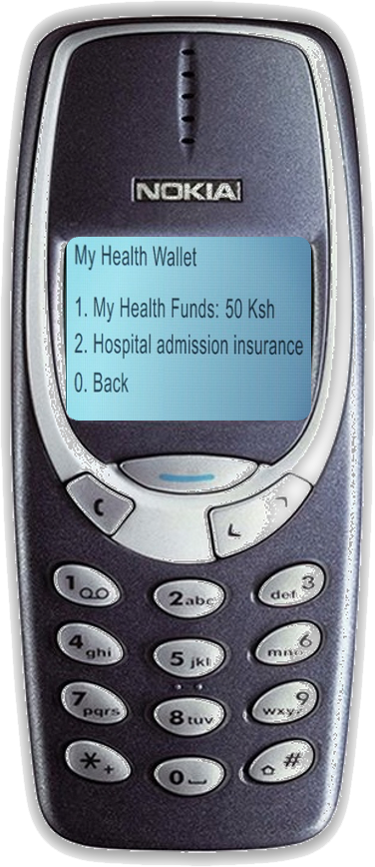
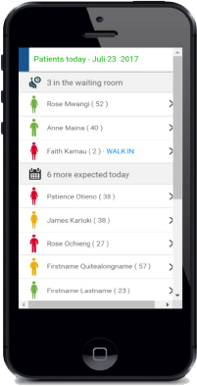
MomCare – A Value Based Care program to improve MNCH in Kenya and Tanzania
The gridlines can be used to keep things neatly lined up.
IMNHC428
by: Julie Fleischer, Emma Waiyaiya, Rowena Njeri, Liberatha Shija, Johnson Yokoyana, Jonia Bwakea, Mark van der Graaf, Nicole Spieker
affiliation: PharmAccess
Background
In Sub-Saharan Africa, 200,000 women die annually from pregnancy-related complications, representing 68% of maternal deaths worldwide. Value-based healthcare (VBHC) could help improve maternal and neonatal health outcomes, by promoting a data-driven and patient-centered approach to increase adherence to and the quality of pregnancy care. Therefore, PharmAccess launched ‘MomCare’ in Kenya in 2017 followed by Tanzania in 2019.
Methods
Mobile wallet
Financial cover for ANC, delivery (normal & C-section), PNC, immunization and comorbidities
Value-based payments:
Bundled payments for full visits and comorbidities
Bonus payments related to quality of care
Timely payments
Results
MomCare has been implemented in over 70 clinics in Kenya and Tanzania, supporting over 56.000 mothers to date.
Throughout the program we measured
Improved adherence to maternal care (figures 1 & 2), and
Improved risk mitigation for mothers
At limited increase or decrease in wallet costs (MomCare does not necessarily aim to minimize journey costs, but enables clinics and patients to utilize available resources in a way to reach the best possible clinical outcomes)
$118 to $132 in Kenya
$31 to $28 in Tanzania
Conclusion
MomCare proves that value-based healthcare can be successfully implemented in LMICs to improve financing and delivery of maternal care
Providing insights, incentives and financial agency at clinic level can lead to improved delivery of maternal care
Recommendations for the field
Use or adapt the MomCare transparency model for your setting to:
attract payers and align (public) healthcare funding / payments with outcomes that matter to mothers
empower mothers by
providing financial entitlement to care, and
ensuring their voice is heard by all stakeholders, even on sensitive subjects
provide key insights and agency for decisionmakers at all levels, stimulating innovation and care delivery aligns with the (local) needs of women
MomCare demonstrates how mobile technology, a patient-centered approach and value-based payments lead to improved adherence and better risk mitigation in maternal care. The model is ready for adoption and ensures that all (financial and clinical) systems and stakeholders align around improving outcomes that matter to women.
Journey tracking
Actionable insights for providers
Automated risk stratification, plus test & treatment flags
Overview of mothers due for delivery
Dashboards
Visit reminders
SMS based surveys and calls after delivery covering (mental) wellbeing and quality of care
Research and analytics on >56.000 pregnancy journeys
Figure 1 Improved pregnancy journeys in Kenya after 33 months
Figure 2 Improved pregnancy journeys in Tanzania after 18 months
Preliminary results on our last 3 cohorts show >99 % facility-based delivery
Quality support
SafeCare assessments & standards
Mental health pilot
Trainings & workshops
Network management & referrals
Based on data from cohorts 1-16 in Kenya and 24.519 completed pregnancy journeys
Based on data from 7 public facilities in Tanzania except ultrasounds, which are based on 3 public facilities that had ultrasound in the vicinity
The MomCare program is sponsored by donors: MSD for Mothers, Children’s Investment Fund Foundation (CIFF), ELMA, De Nederlandse Postcodeloterij and The Dutch Ministry of Foreign Affairs
Notes:
The above charts are examples, and you may input your data points or use these as a visual reference. To input data, double click the chart. In the top menu under Chart Tools, click Design, and click Edit.
Images
If you are adding images of charts, pictures, or other graphics, you will need high-resolution versions of those images. We recommend re-creating tables and charts inside of PowerPoint or Excel and then placing them into PowerPoint, so they are high resolution, rather than using screenshots / jpegs. If you use images, graphics, etc. that are low resolution, they will be pixelated and blurry.

