Slide 1


Follow-up Health Data Commons project

Slide 2
AGENDA
RECAP PREVIOUS SESSION
HOW: “Health Data Commons” framework for standards-based implementation of demonstrators
WHAT: Results MomCare Tanzania
DISCUSSION FOR TODAY
Update on latest results
Discuss projects on horizon

Slide 3
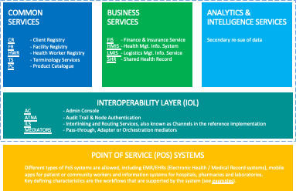
HOW: Health Data Commons framework and its ecosystem
Aim to achieve interoperability with existing programmes such as DHIS2, openIMIS
Partners such as Infospective can help demonstrate new care models
Opportunities for collaboration with insurance companies
Universities, for example, Strathmore, as custodians for governing secondary data re-use
Possible role for VODAN Africa to implement findability and data catalog services
Pharma industry, e.g. IQVIA, seeking real-world evidence
Possible funders for kick-starting data commons?
Local authorities are key stakeholders
Our aim is to help and accelerate the implementation of the interoperability layer and common services
Suppliers of PoS systems at the COMMUNITY level e.g., Medtronic Spice, remote diagnostics
Suppliers of PoS systems at FACILITY level e.g., AfyaRecod, Elephant, bahmni
Suppliers of PoS systems for PHARMACIES
Suppliers of PoS systems for LABORATORIES

Slide 4






WHAT: results demonstrators with MomCare Tanzania
PoS: Chain of Trust app functions as electronic medical record for MomCare programme
Interoperability: Demonstrator for FHIR translation to create ‘data station’ of shared health record for re-use
Business Services:
Automation of DHIS2 reporting based on shared health records
Implementation of Value Points Dashboard based on shared health records
Capability for plug-&-play publishing of dashboards into existing mobile web that is resilient to intermittent Internet connections
Analytics Services:
Configured analytics workbench (in-the-clear)
Pilot multi-party computation (MPC, in-the-blind)
COMMON
SERVICES
CR - Client Registry
FR - Facility Registry
HWR - Health Worker Registry
TS - Terminology Services
PC - Product Catalogue
BUSINESS
SERVICES
FIS - Finance & Insurance Service
HMIS - Health Mgt. Info. System
LMIS - Logistics Mgt. Info. Service
SHR - Shared Health Record
DS - Data Services (?!)
ANALYTICS & INTELLIGENCE SERVICES
Secondary re-sue of data
DHIS2 report
Shared Health Record
Value Points Dashboard
Analytics workbench
INTEROPERABILITY LAYER (IOL)
AC - Admin Console
ATNA - Audit Trail & Node Authentication
ILS - Interlinking and Routing Services, also known as Channels in the reference implementation
MEDIATORS - Pass-through, Adapter or Orchestration mediators
FHIR legacy mediator
POINT OF SERVICE (POS) SYSTEMS
Different types of PoS systems are allowed, including EMR/EHRs (Electronic Health / Medical Record systems), mobile apps for patient or community workers and information systems for hospitals, pharmacies and laboratories.
Key defining characteristics are the workflows that are supported by the system (see examples).
Chain of Trust app

Slide 5
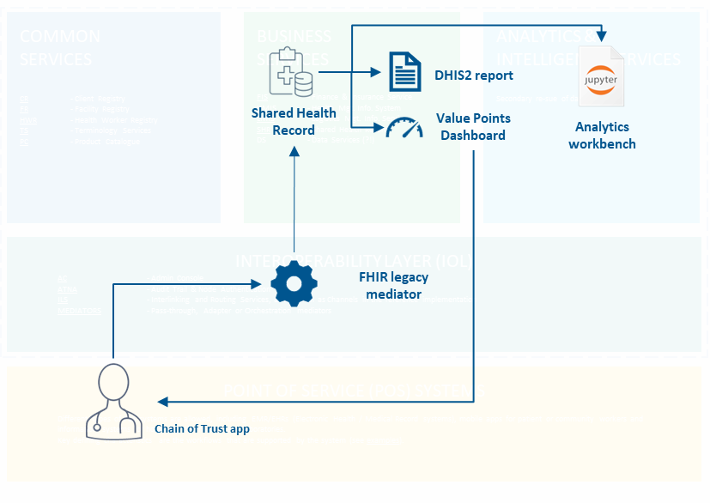
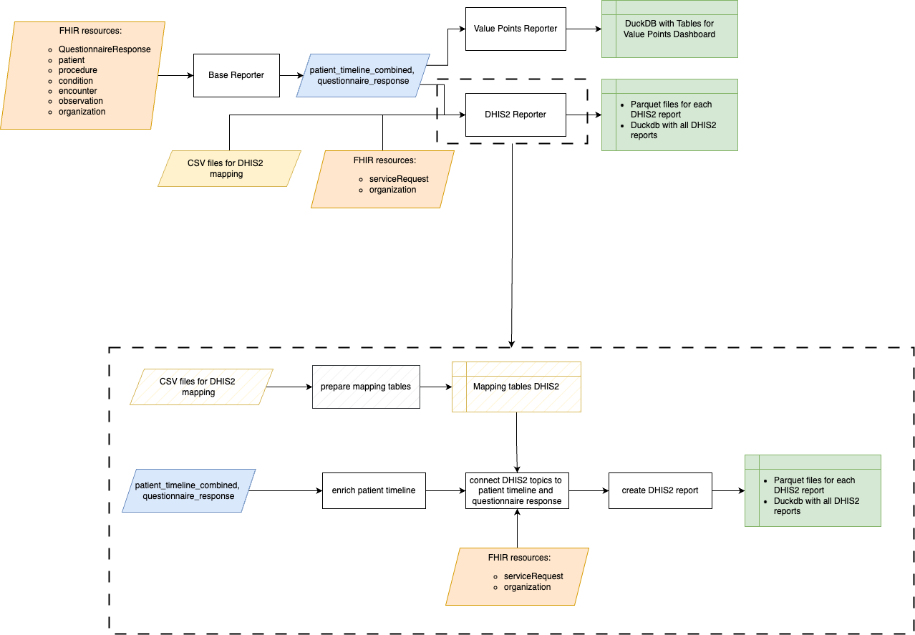
WHAT: results demonstrators with MomCare Tanzania
Insights DHIS2 report
Better overview and structure how DHIS2 metrics are calculated per clinic using mapping tables
Functionality being built allow district officer to view data across all clinics

Slide 6
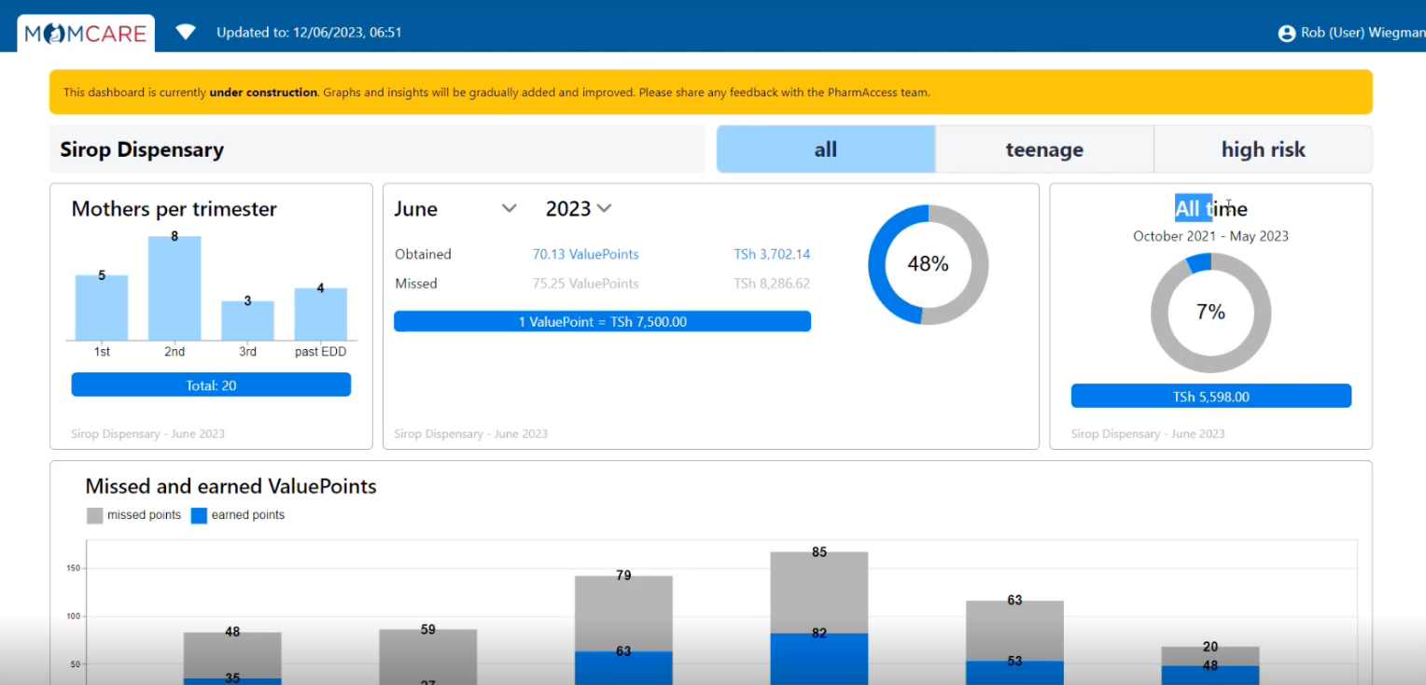
WHAT: results demonstrators with MomCare Tanzania
screenshot from test server with dummy data
data is refreshed daily, so clinics have up-to-date info to act upon

Slide 7
Outlook Explore work in Innovative Care Models & Health Data Commons
EXPLORE (done)
Implement ICM demonstrators at sufficient scale for selected patient groups
MomCare Value-Points Dashboard and DHIS2 reports in production in Tanzania
Analytics workbench ready for service
Design and specify standards-based Health Data Commons framework
Technical documentation ready for internal publication (intranet PAF)
EXPLORE (to-do)
Implement ICM demonstrators at a sufficient scale for selected patient groups
District officer reports in production coming month
Wrap-up MomCare Tanzania, incl. feedback from clinics
Start development activities JMF Kenia
Design and specify standards-based Health Data Commons framework
Presentation at the upcoming strategy session
On-boarding IntelliSOFT as a local implementation partner
More knowledge sharing sessions for using the framework and its components (e.g., analytics workbench)

Slide 8





Proposed solution design JMF Kenya (1 of 2)
High-level design
Solution by turn.io using WhatsApp Business as PoS for collecting questionnaire data at enrollment
Questionnaire data is pushed to EMR using the interoperability layer
Questionnaire data is included in Shared Health Record for reporting purposes in HMIS
Integration of other data in a later phase of the project
M-TIBA: claims data
SMS and Infospective: PROMs & PREMs
COMMON
SERVICES
CR - Client Registry
FR - Facility Registry
HWR - Health Worker Registry
TS - Terminology Services
PC - Product Catalogue
BUSINESS
SERVICES
FIS - Finance & Insurance Service
HMIS - Health Mgt. Info. System
LMIS - Logistics Mgt. Info. Service
SHR - Shared Health Record
DS - Data Services (?!)
ANALYTICS & INTELLIGENCE SERVICES
Secondary re-sue of data
3
HMIS
Shared health record
INTEROPERABILITY LAYER (IOL)
AC - Admin Console
ATNA - Audit Trail & Node Authentication
ILS - Interlinking and Routing Services, also known as Channels in the reference implementation
MEDIATORS - Pass-through, Adapter or Orchestration mediators
1
2
4
POINT OF SERVICE (POS) SYSTEMS
Different types of PoS systems are allowed, including EMR/EHRs (Electronic Health / Medical Record systems), mobile apps for patient or community workers and information systems for hospitals, pharmacies and laboratories.
Key defining characteristics are the workflows that are supported by the system (see examples).
EMR

Slide 9
Proposed solution design JMF Kenya (2 of 2)
COMMON
SERVICES
CR - Client Registry
FR - Facility Registry
HWR - Health Worker Registry
TS - Terminology Services
PC - Product Catalogue
BUSINESS
SERVICES
FIS - Finance & Insurance Service
HMIS - Health Mgt. Info. System
LMIS - Logistics Mgt. Info. Service
SHR - Shared Health Record
DS - Data Services (?!)
ANALYTICS & INTELLIGENCE SERVICES
Secondary re-sue of data
Use case 1: combine data from different sources for journey tracking and value-based payments
Use case 2: more advanced operational data exchange to facilitate
Availability of EMR (IPS) at multiple click & brick providers
Automated nudging and PROMs/PREMs collection
HMIS
Shared health record
INTEROPERABILITY LAYER (IOL)
AC - Admin Console
ATNA - Audit Trail & Node Authentication
ILS - Interlinking and Routing Services, also known as Channels in the reference implementation
MEDIATORS - Pass-through, Adapter or Orchestration mediators
POINT OF SERVICE (POS) SYSTEMS
Different types of PoS systems are allowed, including EMR/EHRs (Electronic Health / Medical Record systems), mobile apps for patient or community workers and information systems for hospitals, pharmacies and laboratories.
Key defining characteristics are the workflows that are supported by the system (see examples).
EMR

Slide 10
Aligning our work for the coming academic year
EXPLORE
Implement ICM demonstrators at a sufficient scale for selected patient groups
Design and specify standards-based Health Data Commons framework
INSPIRE
Research, communication, advocacy …
SUSTAIN
Scale-up, operations, …

Slide 11
High-level budget estimates for Health Data Commons project
Work package | Content | Duration | Budget estimate | Notes
Consultancy | Second opinion on architecture and design Engage local partners Embed project in local context, e.g. government initiatives | 6 months | USD 40k –70k | Intended long-term partnership with Steven Wanyee / IntelliSOFT
Implementation: base infrastructure | Configure and deploy OpenHIM als interoperability layer Configure and deploy Shared Health Record server Technical documentation | 6 months | Initial setup: USD 50k – 150k Running cost: USD 1k - 2k per month | Same base infrastructure can be re-used for all countries
Implemementation: per ICM use-case | Development of Point-of-Service systems Development of mappings/translations Development of reports Technical documentation and implementation guide | tbd | Initial setup: USD 150k – 350k Running cost: USD 2k – 4k per month | Running cost mainly technical support and change management

