Slide 1


Implementing standards-based health data commons

Slide 2
Discussion document for GPITG
This document provides background information for GPITG pertaining to the NCD project with PharmAccess. It describes the principles of a standards-based health data commons.
In addition, it lists a number of question specific to the project at hand.

Slide 3
Framework for a standards-based health data commons based on OpenHIE
COMMON
SERVICES
CR - Client Registry
FR - Facility Registry
HWR - Health Worker Registry
TS - Terminology Services
PC - Product Catalogue
BUSINESS
SERVICES
FIS - Finance & Insurance Service
HMIS - Health Mgt. Info. System
LMIS - Logistics Mgt. Info. Service
SHR - Shared Health Record
ANALYTICS & INTELLIGENCE SERVICES
Secondary use of data
Why OpenHIE?
One of the most widely used architectural frameworks for implementing health data exchange
Standards-based, modular and with increasing number of implementations More info: OpenHIE documentation
Many African countries have adopted it or use similar frameworks (Nigeria, Kenya, Tanzania, review HIE in Africa)
How do we want to use this?
Digital technologies have matured in the past decade, creating opportunities for more effective and efficient implementation of openHIE components using modern open source component
We specifically add Analytics & Intelligence services as an important domain for improving healthcare
INTEROPERABILITY LAYER (IOL)
AC - Admin Console
ATNA - Audit Trail & Node Authentication
ILS - Interlinking and Routing Services, also known as Channels in the reference implementation
MEDIATORS - Pass-through, Adapter or Orchestration mediators
POINT OF SERVICE (POS) SYSTEMS
Different types of PoS systems are allowed, including EMR/EHRs (Electronic Health / Medical Record systems), mobile apps for patient or community workers and information systems for hospitals, pharmacies and laboratories.
Key defining characteristics are the workflows that are supported by the system (see examples).

Slide 4
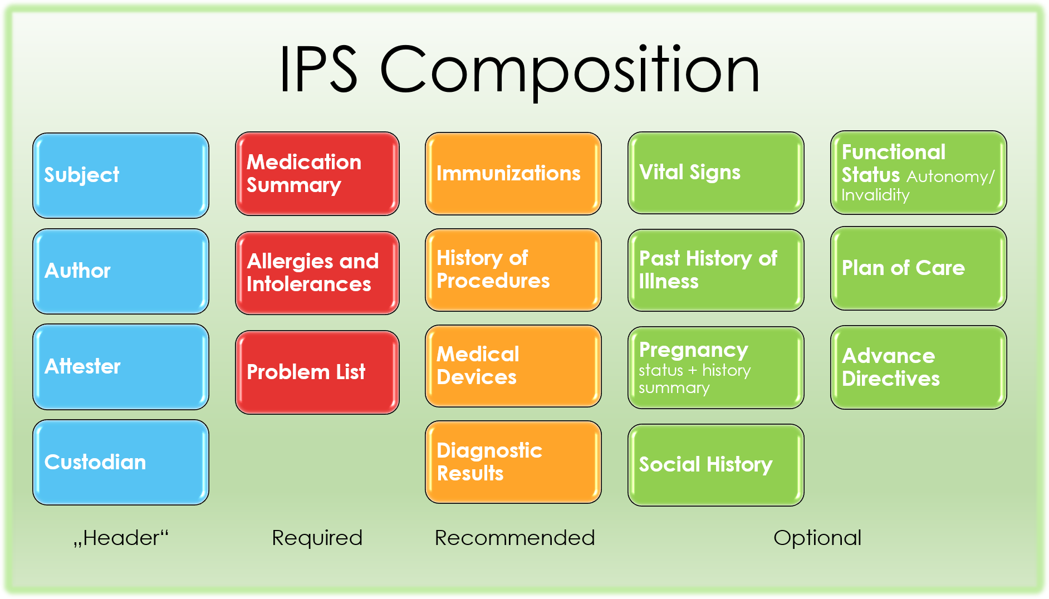
We use Fast Healthcare Interoperability Resources (FHIR) International Patient Summary (IPS) as the semantic standard for data exchange
Details: FHIR IPS
Additions:
Questionnaire
QuestionnaireResponse
ServiceRequest (for referral)

Slide 5




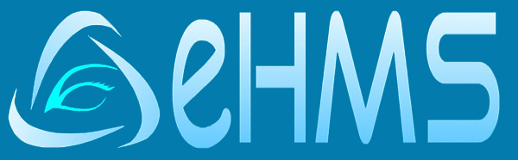
High-level overview of solution design for NCD Kilimanjaro project
COMMON
SERVICES
CR - Client Registry
FR - Facility Registry
HWR - Health Worker Registry
TS - Terminology Services
PC - Product Catalogue
BUSINESS
SERVICES
FIS - Finance & Insurance Service
HMIS - Health Mgt. Info. System
LMIS - Logistics Mgt. Info. Service
SHR - Shared Health Record
DS - Data Services (?!)
ANALYTICS & INTELLIGENCE SERVICES
Secondary re-sue of data
All instances of eHMS exchange data via the interoperability layer (IOL)
IOL provides mediation services, including translation of data from eHMS to and from the FHIR standard
A persistent copy of all data is store in the Shared Health Record (SHR)
Reporting, for example at district level, is done using the SHR
Secondary use, for example for research, is support through the analytics workbench
reporting
Shared Health Record
Research using analytics workbench
INTEROPERABILITY LAYER (IOL)
AC - Admin Console
ATNA - Audit Trail & Node Authentication
ILS - Interlinking and Routing Services, also known as Channels in the reference implementation
MEDIATORS - Pass-through, Adapter or Orchestration mediators
FHIR legacy mediator
POINT OF SERVICE (POS) SYSTEMS
Different types of PoS systems are allowed, including EMR/EHRs (Electronic Health / Medical Record systems), mobile apps for patient or community workers and information systems for hospitals, pharmacies and laboratories.
Key defining characteristics are the workflows that are supported by the system (see examples).
District facility 1
District facility 2
District facility 3 …
Zonal facility 1

Slide 6
3. Define data that will be pushed to shared health record to start building International Patient Summary (IPS) record
Details: FHIR IPS
Suggestion: push Medication Summary and Problem List to shared health record

Slide 7
Questions for GPITG
Please provide 50 example records of patients (anonimyzed) such that we can perform a first scan how the data can be transformed into the FHIR IPS standard
Please provide technical details how the IOL can interact with the eHMS system
What type of APIs are supported, for reading and writing?
Please refer to the OpenHIE architecture specification for more details for the various options to achieve interoperability
Please provide screen-shots of the relevant parts of eHMS that are used by the doctors during an encounter with a NCD patient

