Slide 1
Deep Learning and Critically Assessing ML/AI Studies in Healthcare
Olivia Bryant
Thursday 9th November

Slide 2
Think AI/ML won’t impact you?
More available data means that methods need to become more computationally complex.
Greater number of AI-backed tools for researchers to use to assist with everything from coding to paper writing to summarising papers. We need to think critically!
AI use in the data itself. Huge rise in AI-enabled medical devices and this data could in future be more integrated into our studies.

Slide 3
Artificial Intelligence:
Computational approaches attempting to mimic human behaviour and cognition.
Supervised learning = learning by example
e.g. image classification, prediction of stroke
Unsupervised learning = discovering patterns
e.g. generative models for speech synthesis, clustering of patients
Reinforcement learning = feedback on right or wrong results
e.g. learning to play a game, identifying tumours from images
Machine Learning:
Algorithms with the ability to learn (e.g. do not need to hard code all potential outcomes).
Deep Learning:
Uses highly-flexible and complex algorithms with a ‘brain-like’ structure.

Slide 4
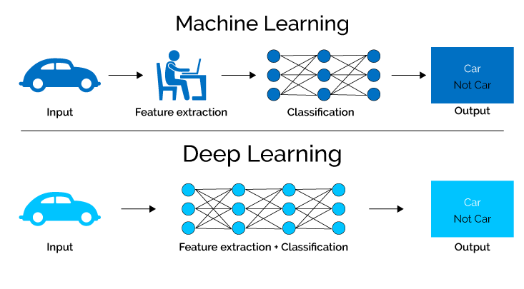
What is deep learning?
Artificial neural networks with many layers.
Includes feature engineering, which is the process of extracting and transforming variables from the raw data that can be used in models.

Slide 5
What is deep learning?
Deep learning is very computationally intensive compared to other machine learning methods.
Therefore, it is best to use when:
There are a large number of examples (ideally, in the millions). Deep learning takes a ‘start from scratch’ approach to learning.
There is either complex model input or output (e.g. images/video, audio, sensor data, free text).

Slide 6
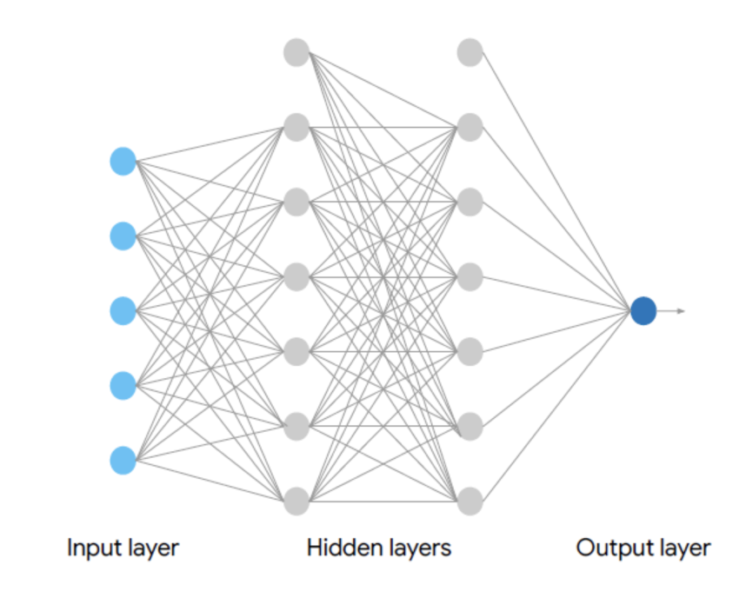
Feed Forward Neural Networks
Every node is fully connected.
Every edge has an associated weight assigned to it.
Single output node = binary prediction.
Input layer is a numerical representation (e.g. each node could represent a picture).
No fixed rule on deciding on the number of hidden layers but >2 = deep.
Edges
Nodes

Slide 7
Input layer
Hidden layers
Input layer value x the weights

Slide 8
Input layer
Hidden layers
Produce a single weighted sum of the products

Slide 9
Input layer
Hidden layers
Activation function allows us to work with non-linear outputs. This output is then passed onto all the nodes in the next hidden layer.

Slide 10
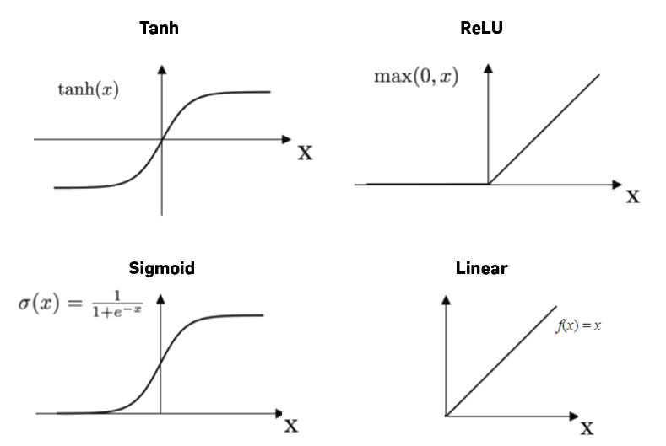

Slide 11
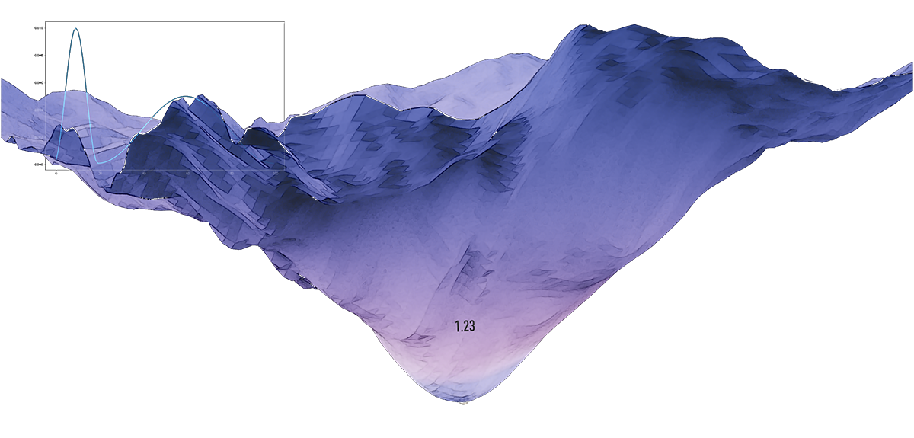
How are weights learned?
Learn from making mistakes and quantifying how wrong the network is by using a loss function.
Same loss function as used in logistic regression if there’s a binary outcome.
If the loss landscape is convex (like with logistic regression), we can use a simple equation to find the minimum points but with neural networks, combinations of activation functions mean that the loss landscape is not convex.

Slide 12
Gradient Descent
Choose a point, calculate the gradient. Take a step in the opposite direction and re-calculate the gradient. Continue until at a local minima.
The size of steps taken is called the learning rate.
A learning rate that is too small will take an extremely long time to reach convergence.
A learning rate that is too large will result in a ‘jumping’ back and forth of the loss.
Loss
Parameter value

Slide 13
Hyperparameters
Learning rate
Optimizer
Batch size
Number of hidden layers
Number of nodes per hidden layer
Activation function
L1 penalty
L2 penalty
etc
All of these hyperparameters have to be decided by the developer. For some of these, there are methods to assist with decision making but not all.

Slide 14
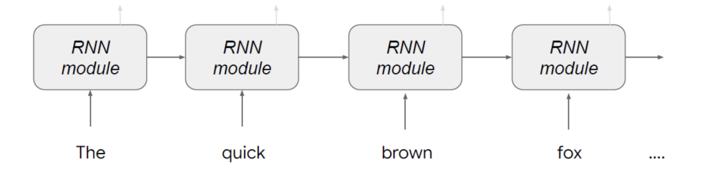
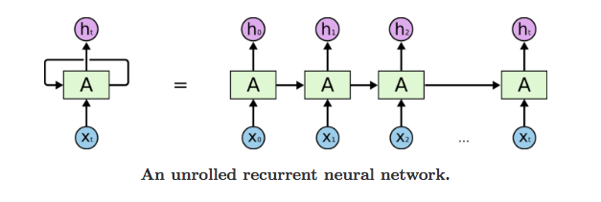
Sequence Models
Recurrent Neural Networks (RNN)
Reads the sequence of tokens (numeric representation of the word) one word at a time, like humans.
Produced output one word at a time.
You don’t need to directly translate word for word which enables more complex grammar and word order structures.

Slide 15

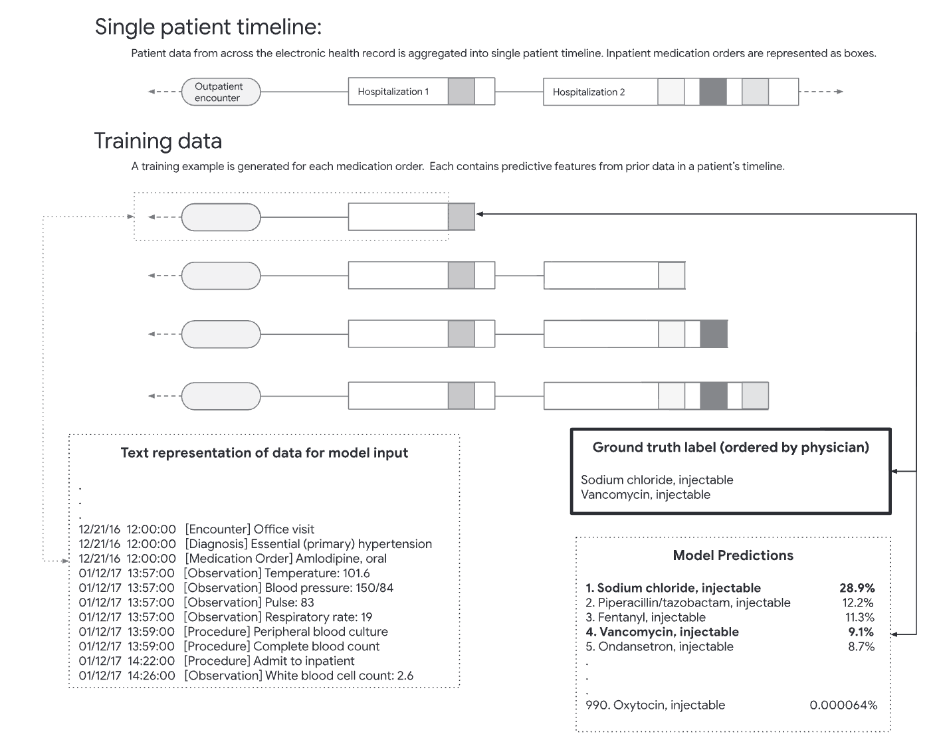
Conditional to everything that had been ordered so far, what was the physician likely to prescribe next?
Out of the vocabulary of 990 medications, top-10 recall of 55% and top-25 recall of 75%.
Are the other guesses garbage? If taking the top 10 guesses, 90% contained a drug that was ordered in the next 24 hours.

Slide 16
Hallucinations
When a model connects unrelated ideas or concepts, or completely fabricates information and presents it as true. E.g. asking ChatGPT to answer what is the world record for walking across the English Channel on foot, mayonnaise is white supremacist.
ChatGPT’s estimated hallucination rate is 15-20%.
In context of analysing textual patient records, an LLM was asked to summarise records for a female patient who with a specified height and said she had been diagnosed with anorexia. The output of the model made up a weight and BMI and fabricated claims about the patient raising concerns about poor body image.

Slide 17
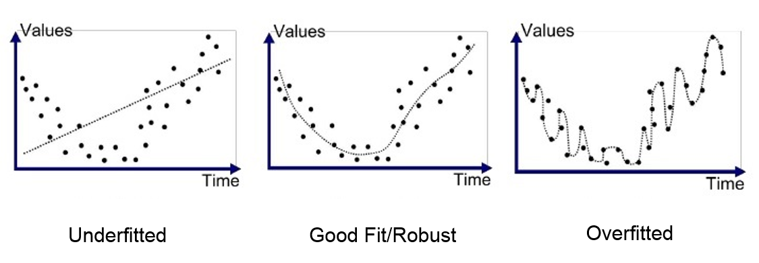
Being Critical About ML/AI Use in Studies
Did the study need to use ML? Would another method have been more appropriate?
Overfitting is when the model is so closely fit to the training dataset, it cannot reasonably be applied to other data. Does the study report a training dataset of 100%?

Slide 18
Does the study use cross validation? Used to reduce the risk of overfitting. Trains several models on subsets of the data and then combines results.
How large is the training dataset? Does the study use a validation dataset to assess the performance on an unbiased subset of the training dataset?
Is the training dataset representative? If not, the model can only be applied to similarly biased data.
Is the model actually interpretable? Does it produce results that are meaningful?
Intellectual property concerns?
Are poorly-performing models reported? Especially important as ML/DL model development is more iterative than other methods.

Slide 19
References
Faes L, Liu X, Wagner SK, Fu DJ, Balaskas K, Sim DA, Bachmann LM, Keane PA, Denniston AK. A Clinician's Guide to Artificial Intelligence: How to Critically Appraise Machine Learning Studies. Transl Vis Sci Technol. 2020 Feb 12;9(2):7. doi: 10.1167/tvst.9.2.7. Erratum in: Transl Vis Sci Technol. 2020 Aug 21;9(9):33. PMID: 32704413; PMCID: PMC7346877.
The Tensor Flow Neural Network Playground https://playground.tensorflow.org/
Rough, K., Dai, A.M., Zhang, K., Xue, Y., Vardoulakis, L.M., Cui, C., Butte, A.J., Howell, M.D. and Rajkomar, A. (2020), Predicting Inpatient Medication Orders From Electronic Health Record Data. Clin. Pharmacol. Ther., 108: 145-154. https://doi.org/10.1002/cpt.1826
Mittermaier, M., Raza, M.M. & Kvedar, J.C. Bias in AI-based models for medical applications: challenges and mitigation strategies. npj Digit. Med. 6, 113 (2023). https://doi.org/10.1038/s41746-023-00858-z

