Slide 1

Stroke Prediction Model
Ryan Croasdale

Slide 2
Project Description
What is a Stroke?
An ischemic stroke occurs when the blood supply to part of the brain is interrupted or reduced, preventing brain tissue from getting oxygen and nutrients. Brain cells begin to die in minutes.
A stroke is a medical emergency, and prompt treatment is crucial. Early action can reduce brain damage and other complications.
The good news is that many fewer Americans die of stroke now than in the past. Effective treatments can also help prevent disability from stroke.
The data scientists at World Health Organization have collected 12 pieces of information from 583 individuals. The aim is to build a predictive model and find out trends among the individuals.

Slide 3
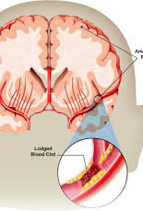
Context
According to the World Health Organization (WHO) stroke is the 2nd leading cause of death globally, responsible for approximately 11% of total deaths. This dataset is used to predict whether a patient is likely to get stroke based on the input parameters like gender, age, various diseases, and smoking status. Each row in the data provides relevant information about the patient.

Slide 4
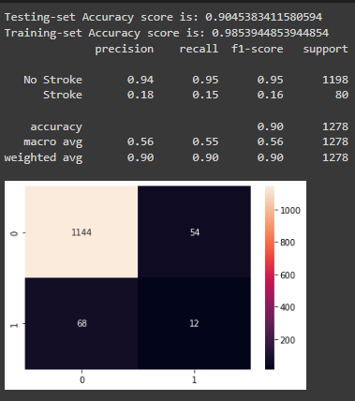
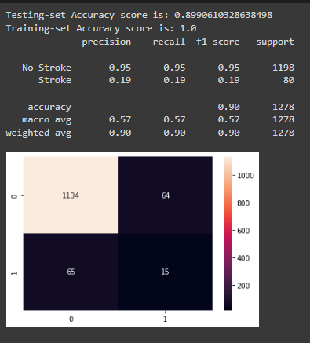
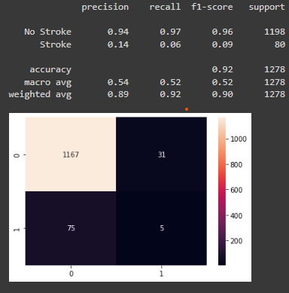
Methods
After cleaning the data and completing preprocessing, I used multiple models, such as: Logistic Regression, Random Forest Classifer w/ GridSearchCV, KNN w/ GridSearchCV, and XGBoost, to find a model that would best predict the data.
I evaluated all of these models with metrics valid to a classification problem such as this.

Slide 5
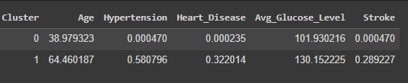
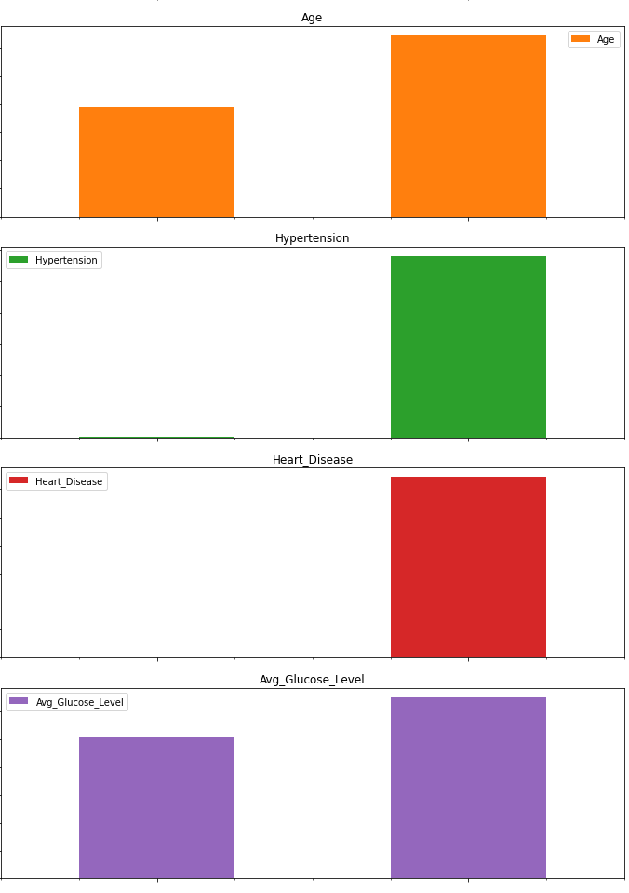
Clustering Data
I decided to break the group down into clusters to get a better understanding of the cohort of data, and try to see why we obtained the data we did.

Slide 6
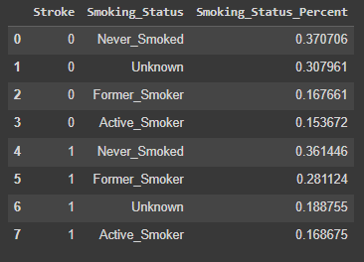
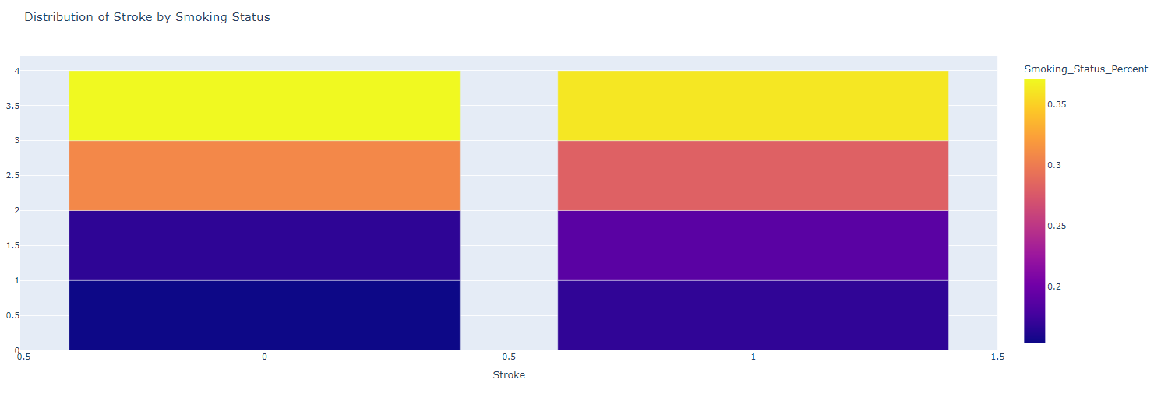
Let's Take a Look at Smoking

Slide 7
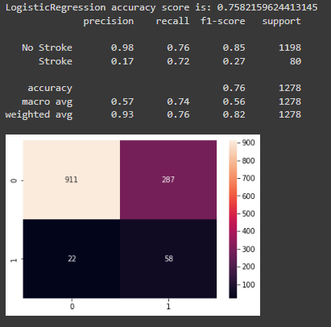
Results
The data shows that if you're a 65+ y/o Male, Smoker, with Hypertension and Heart Disease with elevated Avg Glucose Level, has been married and had kids, and worked in the Private Sector then you would be an individual with the absolute highest risk to have a stroke.
All models tested performed very similarly, with accuracy scores at or around 93.7%, before oversampling was applied.
After oversampling was applied all models preformed very differently, giving a better outcome of results.
The Logistic Regression Model had an Accuracy of only 76%, but this model was able to predict a stroke 72% of the time, which was the highest out of all models tried.

Slide 8
Conclusion
The Logistic Regression model would be the model I would put forward as the model a healthcare or insurance company could use to predict whether an individual is at risk for a stroke or not

