Slide 1
Domain Driven Design
Implementation Patterns and Considerations in .NET

Slide 2









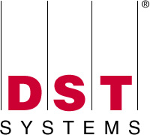



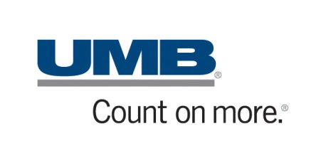

We want to thank the sponsors of KCDC. Without them, none of this would be possible.
Thanks to Our Sponsors
Gold Sponsors
Silver Sponsors
Product Sponsors

Slide 3
Do I suck?
Let me (and the world) know!
http://spkr8.com/t/7865

Slide 4
Who am I?
…and why should you care?
Steve Bohlen
I Read Books + Write Software
vs. “Read Software + Write Books” ☺
Blog, Screencast, Speak, Share, Learn

Slide 5

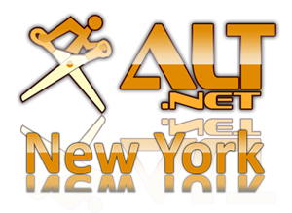

Steve Bohlen
Nearly 20 years developing software
LISP, Delphi, C/C++, VB, VB.NET, C#
Senior Engineer Springsource/VMware
Co-Founder, NYC Alt.Net User Group
http://nyalt.net
Co-Organizer, NYC DDD User Group
http://dddnyc.org
Contributor: various OSS projects
NHibernate http://www.nhforge.org
NDbUnit http://www.googlecode.com/ndbunit
Spring.NET http://www.springframework.net
blog: http://blog.unhandled-exceptions.com
e-mail: sbohlen@gmail.com
twitter: @sbohlen

Slide 6

Test Studio Express
Telerik OpenAccess ORM
RAD Controls for ASP.NET AJAX
RAD Controls for Windows Phone
RAD Controls for WPF
ASPX to Razor Converter
Telerik TeamPulse
Sitefinity CMS
C#/VB.NET Converter
Telerik JustDecopile
Telerik Reporting
Telerik JustMock
RAD Controls for Winforms
RAD Controls for Silverlight
Telerik JustCode
Telerik Extensions for ASP.NET MVC
Telerik Test Studio

Slide 7
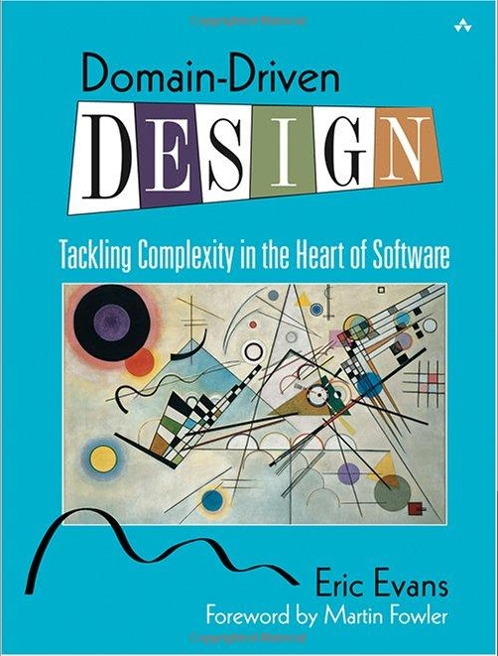

http://tinyurl.com/badnay

Slide 8
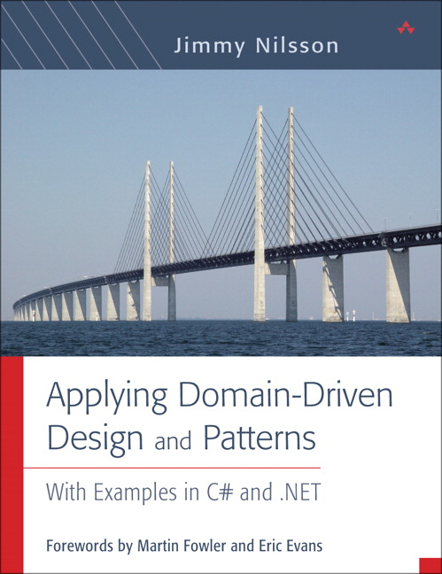
http://tinyurl.com/b55f6q

Slide 9
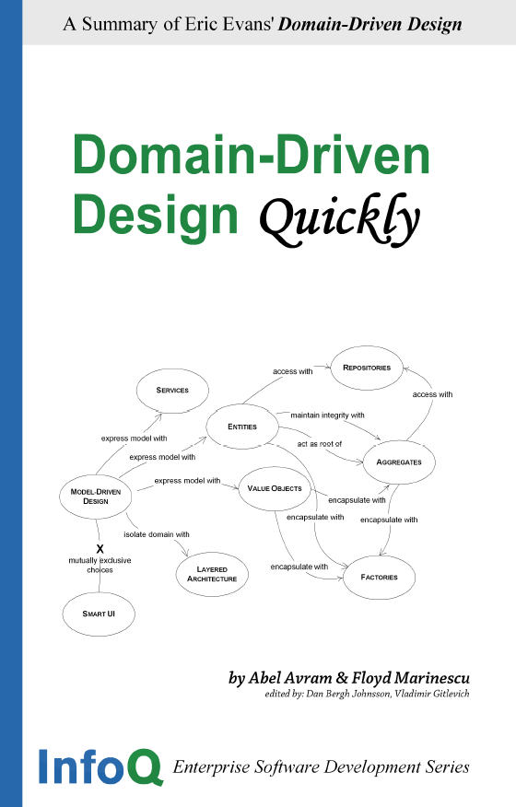
http://tinyurl.com/ykv4tf
http://tinyurl.com/58yf3k

Slide 10

Beta Presentation

Slide 11
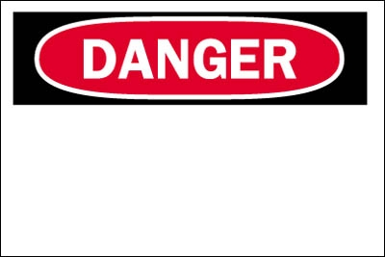
Opinions Ahead

Slide 12
Agenda
Concepts Behind DDD (as needed)
Implementation Patterns and Concerns for DDD Model Building Blocks in C#
General DDD Coding Anti-Patterns
Domain Entities
Domain Value Objects
Domain Repositories
Domain Services
Domain Validation
Discussion

Slide 13
Exploring DDD Concepts

Slide 14
The Role of Patterns in Software
Once: it’s a fluke, twice: its coincidence, three times: it’s a pattern
Discovered (observed), not Invented
Except for their name ☺
Elevate effectiveness of our communication
A ‘shorthand’ for more complex ideas
Only effective if we all agree on the semantic meaning of the elements of the Pattern Language!

Slide 15
Software Pattern Language Hierarchy
Evans DDD
Solution Design
Software Architecture
Software Construction
Fowler POEAA
GOF Design Patterns

Slide 16
DDD: The Premise
Writing software is actually straightforward
Determining what to write is hard!
The Key to success is understanding the Problem Domain intimately
The words we choose to express concepts matter and convey rich meaning

Slide 17
Ubiquitous Language
Developers and Business People move in different worlds
Different languages to express our ideas
F R I C T I O N ! ! !
What if we all spoke the same language?
Our common language would be…ubiquitous ☺

Slide 18
Ubiquitous Language
Used everywhere
classes, methods, variables, etc.
Even in Tests
Behavior-Driven Development!
Conversing using the language enables…
‘Solution smells’ detected by Domain Experts
Discovery of new domain concepts by developers
Shared learning by all involved

Slide 19
DDD: Organizing Strategies
Aggregate Roots
Bounded Contexts
Context Maps
Anti-Corruption Layers

Slide 20

DDD: Aggregate Root
‘Parent Entity’
Controls all access to children objects
Simplifies interaction with complex object graphs
‘Gateway’ to richer objects

Slide 21
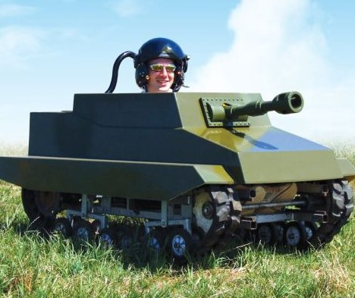
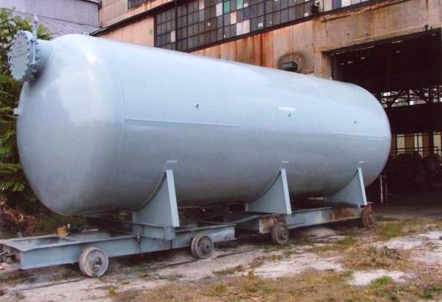
DDD: Bounded Contexts
Semantic Meaning is all about Context

Slide 22
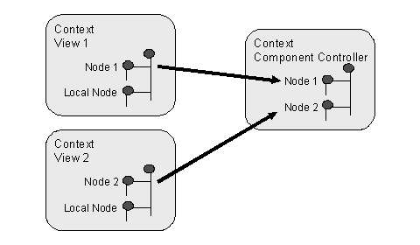
DDD: Context Maps
When we need to communicate across Bounded Contexts
Translation of ideas
Not always bi-directional

Slide 23

DDD: Anti-Corruption Layers
Protect your self from the Big Ball of Mud!
Isolate the parts of your system that change from the parts that are stable!

Slide 24
DDD: Model Building Blocks

Slide 25
DDD: Organizing Strategies

Slide 26
DDD: Model Building Blocks
Entities
Value Objects
Repositories
Services
Validation

Slide 27

Entities

Slide 28
Coding DDD Entities Distilled
Identity Equality
Objects are just reference-equal by default in .NET
Equals, GetHashCode, IEquatable<T>
Identity Comparison
Control of Access to Children Objects within the aggregate
Customer.AddOrder(theOrder);, Customer.RemoveOrder(theOrder);
Not Customer.Orders.Add(theOrder);
Infrastructure-Ignorant
Persistent-Ignorant, UI-Ignorant, etc.

Slide 29
Challenges with DDD Entities
Do we expose Identity value as a property?
Isn’t that a persistence-concern?
Providing a setter means the ‘identity’ of my entity can be changed by something external to it (bad!)
Are General Property Setters/Getters a smell?
Means your domain is trending towards DTO-hell
Entities as property-containers for data
Non-Meaningful names for things!

Slide 30
Exploring Entities in Code

Slide 31

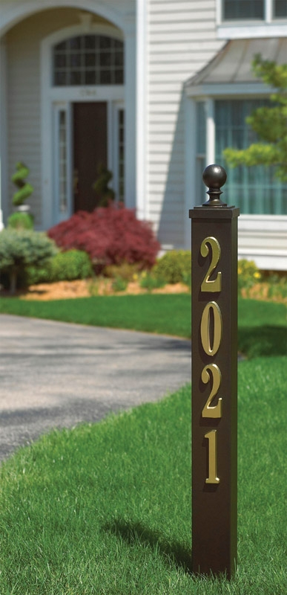
Value Objects

Slide 32
DDD: Entities and Value Objects
public class Name
{
public string Firstname {get; set;}
public string Lastname {get; set;}
}
public class Customer
{
public int Id { get; set;}
public Name FullName {get; set;}
public Address ShippingAddress {get; set;}
public Address BillingAddress {get; set;}
}
public class Customer
{
public int Id { get; set;}
public string Firstname {get; set;}
public string Lastname {get; set;}
public int BuildingNumber {get; set;}
public string Street {get; set;}
public string City {get; set;}
public string State {get; set;}
public string PostalCode {get; set;}
}
public class Address
{
public int BuildingNumber {get; set;}
public string Street {get; set;}
public string City {get; set;}
public string State {get; set;}
public string PostalCode {get; set;}
}

Slide 33
Coding DDD Value Objects Distilled
Immutable
After construction, no changes to the object
Read-Only Properties
Value-Equality
Equals, GetHashCode, IEquatable<T>
Property-by-Property comparison!

Slide 34
Challenges with DDD Value Objects
Tedious to write boilerplate IEquatable<T> implementation code by hand every time
If immutable, how do we modify one?
Not entirely a trick question ☺
If no identity, how do we persist them????
Deconstruction into basic data types?

Slide 35
Exploring Value Objects in Code

Slide 36
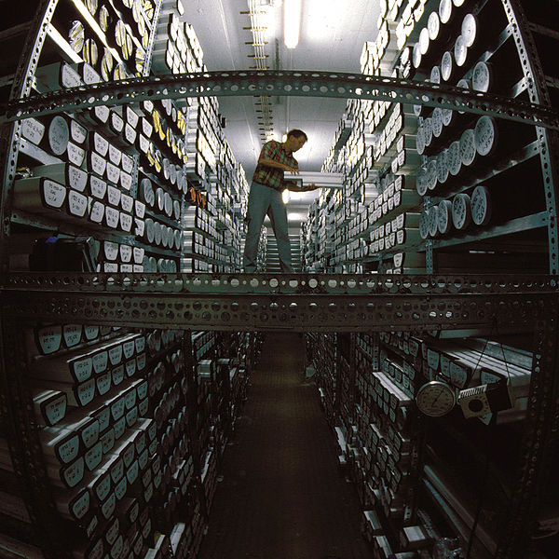
Repositories

Slide 37
Coding DDD Repositories Distilled
Domain Model not tied to specific Persistence
Abstract the act of query/retrieval
Do so in a Domain-Centric Way
(CustomerRepository.GetById(int id) is NOT domain-centric!)
This is a data-access-layer suffixed with ’Repository’!

Slide 38
Challenges with DDD Repositories
If no persistence in the Domain Model, how do we reference repositories in there?
Abstraction/indirection
Repository Boundary blurring
OK for query constructs to come from outside?
repos.GetBySpecification(Specification spec);
OK for Specification to be tied to implementation?
repos.GetByCriteria(DetachedCriteria crit);
OK for lazy-executed queries to be returned?
public IQueryable<Customer> GetCustomers()
Guarding against Repository API-bloat
The repository is dead, long live the repository!

Slide 39
Exploring Repositories in Code

Slide 40

Services

Slide 41
Coding DDD Services Distilled
Actions/Behaviors not belonging in Entities
Injected into Entities (?)
Operating Autonomously from Entities

Slide 42
Challenges with DDD Services
Is having Services just to inject into Entities an anti-pattern?
Order order = new Order(taxservice);
double cost = Order.TotalWithTax();
If Services coordinate Entity interaction, who news-up the service?
Having all behavior expressed in Services and none in Entities is an anti-pattern
Or is it? And why?

Slide 43
Exploring Services in Code

Slide 44

Validation

Slide 45
Coding DDD Validation Distilled
Validation is often a stand-in for ‘business rules’
bool CanShipOrder();
Distinguish between persistence validation and business action validation
Rarely the same thing!
Entity Validation
Entities can be valid for some things and invalid for others
Place an order (if valid customer w/ a valid account)
Ship an Order (if valid account and under credit limit)
Value Object Validation
Prevent VO from entering an invalid state in the first place!

Slide 46
Challenges with DDD Validation
Validation without ‘for what?’ is pointless
bool IsValid(); //???
Validation Frameworks tend to assume validation means persistence
Does NOT mean cannot be repurposed for Domain Validation!
Where does validation happen if it requires collaboration between multiple Entities?
bool order.CanShipTo(customer);
bool customer.CanShip(order);
bool shippingValidator.CanShip(customer, order)
Anemic Domain Model Anti-Pattern?

Slide 47
Exploring Validation in Code

Slide 48
Common DDD Coding Anti-Patterns
DDD Constructs with ‘type-suffixes’
‘Types’ are ‘roles’ in the Domain Model
Not…
CustomerEntity
AddressValueObject
CustomerRepository
ShippingService
OverdueOrderSpecification
Repository as glorified DAL
repository.Get(int id)
repository.Save(Customer c)
repository.Delete(Customer c)
repository.Update(Customer c)

Slide 49
Common DDD Anti-Patterns
Anemic Domain Model
The DTO pattern
Exposed DAOs
Repository ‘leakage’ into the domain
‘Fat’ Service Layer
Separation of Data and Behavior
Technical terms sneak into the Domain Model
Slightly-less-than-ubiquitous-language

Slide 50
Some Criticisms of DDD
Jeremy Miller: “Jargon Explosion”
Aggregates, Entities, Value Objects, Bounded Contexts, Anti-Corruption Layers, Oh My!
Singleton, Observer, State, Strategy, Adapter, Bridge, Facade
Rob Conery: “Bland, Generic Terms”
Singleton, Observer, State, Strategy, Adapter, Bridge, Facade

Slide 51
Discussion
Viewpoints
Experiences
Values
Domain Language
http://www.domainlanguage.com
More Discussion:
http://www.domaindesign.org
http://tech.groups.yahoo.com/group/
Domaindrivendesign/

