Slide 1
Introduction to pycalphad 0.7
Richard Otis and Brandon Bocklund
Sunday, May 27, 2018
CALPHAD XLVII

Slide 2

pycalphad = Python + CALculation of PHAse Diagrams
pycalphad is software for designing thermodynamic models, calculating phase diagrams and investigating phase equilibria.
Using CALPHAD-based models, pycalphad predicts properties of materials, including
Transition (e.g., melt) temperatures, phase fractions, solidification, degradation, corrosion, etc.
Anything that can be connected to a chemical or thermodynamic process
Free and open source at pycalphad.org

Slide 3
Notable Features in pycalphad 0.7
State-of-the-art global energy minimization
Binary and ternary phase diagram plotting
T, P, x_{i} conditions with multiple components
Step/map calculation
Support for associates and ionic liquids
IHJ and Xiong magnetic models
Order-disorder model, Two-state model, Einstein model
Windows, Mac, and Linux support
R. Otis, M. Emelianenko, Z. K. Liu, “An improved sampling strategy for global energy minimization of multi-component systems”, Comp. Mat. Sci. 130 (2017) 282–291.

Slide 4
Current Limitations in pycalphad 0.7
In progress: “Advanced” conditions (e.g., amount of a phase)
Target release: August 2018
First calculation of a session takes a minute to warm up the cache
Subsequent calculations are fast
Not yet implemented: Quasichemical model, ternary excess models other than Muggianu (the standard for alloys)
A few TDB features are unsupported (Option “B”, Option “F”, STATUS_BITS, etc…)
Contact us: we can usually help you work around the issue

Slide 5
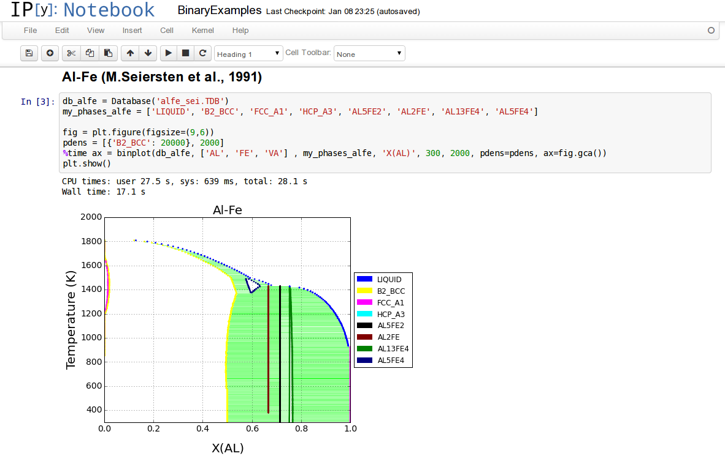
Why use pycalphad
Custom Gibbs energy models
Custom material property models
Digital notebooks (shareable, reproducible)
Semi-automated database development (via ESPEI)
R. Otis and Z-K. Liu, “pycalphad: CALPHAD-based computational thermodynamics in Python”, Journal of Open Research Software, 5: 1 (2017)

Slide 6
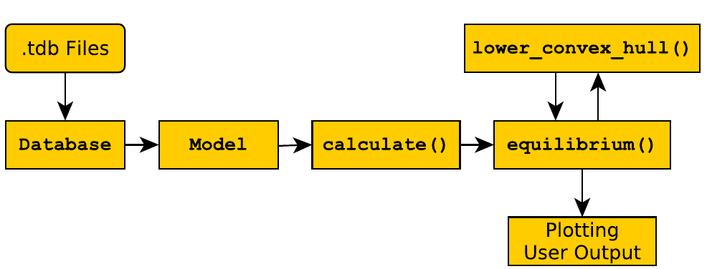
Object-Oriented Design

Slide 7
Object-Oriented Design
Manipulate Databases programmatically

Slide 8
Object-Oriented Design
Manipulate Databases programmatically
Modify and extend Models in your scripts

Slide 9
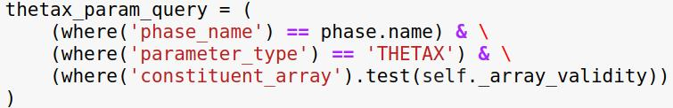
Custom Database parameter types

Slide 10
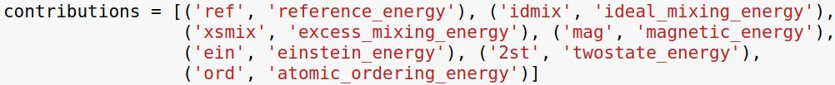

Defining custom Models
[function continues here]

Slide 11
Project Sustainability
pycalphad is developed as part of Richard’s job responsibilities
Brandon has a fellowship supporting his development work
We are looking to grow our team of collaborators!

Slide 12
Contact Us
richard.otis@outlook.com
pycalphad.org
Chat with us on Gitter: gitter.im/pycalphad/pycalphad

