Slide 1
Pycalphad and ESPEI Workshop and Tutorial
Brandon Bocklund and Richard Otis
Sunday, May 27, 2018
CALPHAD XLVII

Slide 2
Agenda
9:00 – 9:10: Introduction and Welcome
9:10 – 9:40: Software Installation
9:40 – 10:00: Python Crash Course
10:00 – 10:55: pycalphad Tutorial
10:55 – 11:10: Coffee Break
11:10 – 11:55: ESPEI Tutorial
11:55 – 12:00: Participant Feedback

Slide 3
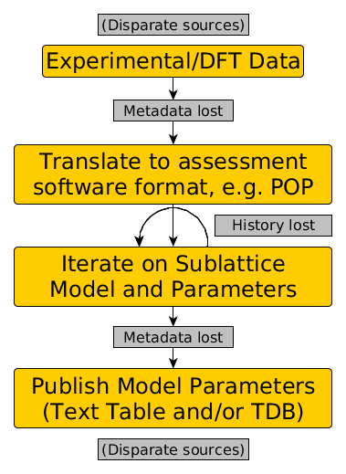
CALPHAD Data Challenges
Data fragmentation
Data standards
Workflow tools
Uncertainty quantification
Reproducibility

Slide 4
The ESPEI (Simplified) Software Stack
ESPEI
High-throughput modeling
Data management
pycalphad
CALPHAD modeling
Phase diagrams
NumPy
Numeric computation
Externally developed
SymPy
Symbolic computation

Slide 5
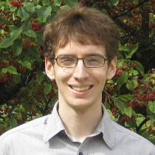
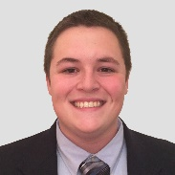
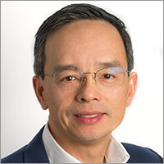
Team and Project History
Richard Otis created pycalphad in 2014, under a NASA Space Technology Research Fellowship. He graduated Penn State in 2016.
Brandon Bocklund (PSU) joined the team in 2016. He is the lead developer of ESPEI and a co-developer of pycalphad.
Prof. Zi-Kui Liu (PSU) advises on both projects and leads public outreach efforts.

Slide 6
Goals for Workshop
Interactively learn the basics of how to use the ESPEI stack
Not expert-level, but enough to ask good questions!
Learn how to make your CALPHAD workflow more shareable and reproducible
Understand how pycalphad and ESPEI fit into the materials modeling ecosystem

Slide 7
Software Installation
1. Download from https://app.box.com/folder/49757976049 or copy from USB
2. Double-click to run and follow installation instructions
Accept license agreement and use default options
3. Copy the workshop files to somewhere in your HOME directory
Linux users: You may need to:
Add $HOME\workshop-installer\bin to your PATH
Add $HOME\workshop-installer\site-packages to your PYTHONPATH
4. Open command prompt or terminal and
Windows: Run jupyter-notebook %USERPROFILE%
Linux/Mac: Run jupyter-notebook $HOME
If you need help, please ask!

