Slide 1
Automation of thermodynamic modeling
Alexander Richter, Shuang Lin
Oct 29th 2026

Slide 2
Codes on github
Github website:
https://github.com/PhasesResearchLab/MatSE580GuestLectures

Slide 3
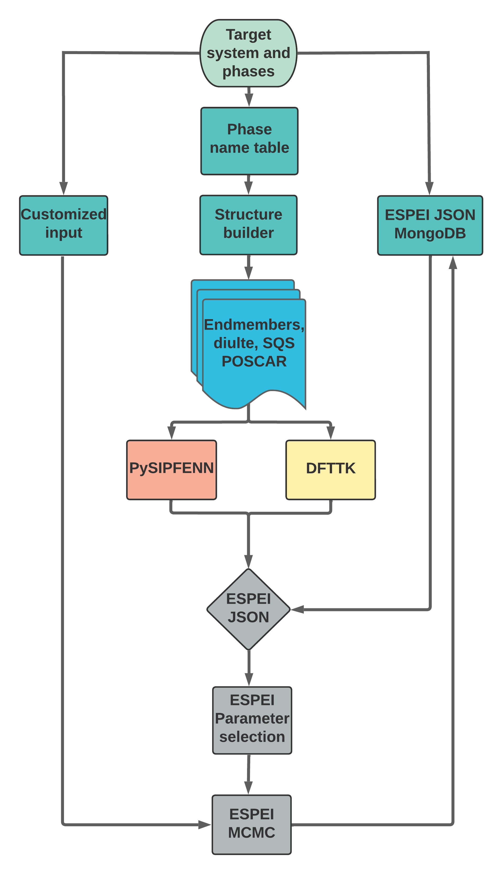
Automation workflow
Motivation and background
Certain areas of parameterization and refinement procedure remain manual
Improve efficiency and reliability of CALPHAD modeling process
Open-source computational tools and our uniqueness​
PySIPFENN: Python package allows efficient predictions of the formation energy of atomic configurations
DFTTK: High-throughput first-principles calculations Tool Kit​
PyCalphad: Python library for computational thermodynamics using the CALPHAD
ESPEI: High-throughput modeling tool for ​creating CALPHAD databases
Application and Demo
Applying in building 9 refractory elements thermodynamic database (Cr-Hf-Mo-Nb-Ta-Ti-V-W-Zr)
Demo with Hf-Mo system

Slide 4
ESPEI Overview
ESPEI, or Extensible Self-optimizing Phase Equilibria Infrastructure, is a tool for creating CALPHAD databases and evaluating the uncertainty of CALPHAD models.
What does ESPEI do?
  Parameter generation: generate model parameters for CALPHAD models of the Gibbs energy
  Optimization and uncertainty quantification: optimize and quantify the uncertainty of CALPHAD model parameters to thermochemical and phase boundary data
Reference: B. Bocklund et al., MRS Communications 9(2) (2019) 1–10. doi:10.1557/mrc.2019.59.
Websites: https://espei.org/en/latest/

Slide 5
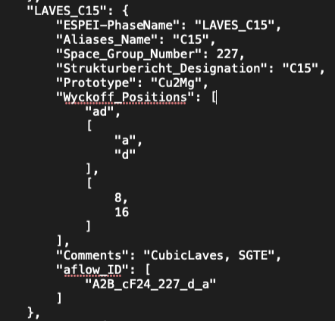
Phase name database
ESPEI-name.JSON
Provides the structure information:
Aliases_Name
Space_Group_Number
Strukturbericht_Designation
Prototype
Wyckoff_Positions
Comments
aflow_ID
Benefits:
Consistent phase names
Easy to add and update the phase information
Practice:
Try to find the phases information of your selected binary system

Slide 6
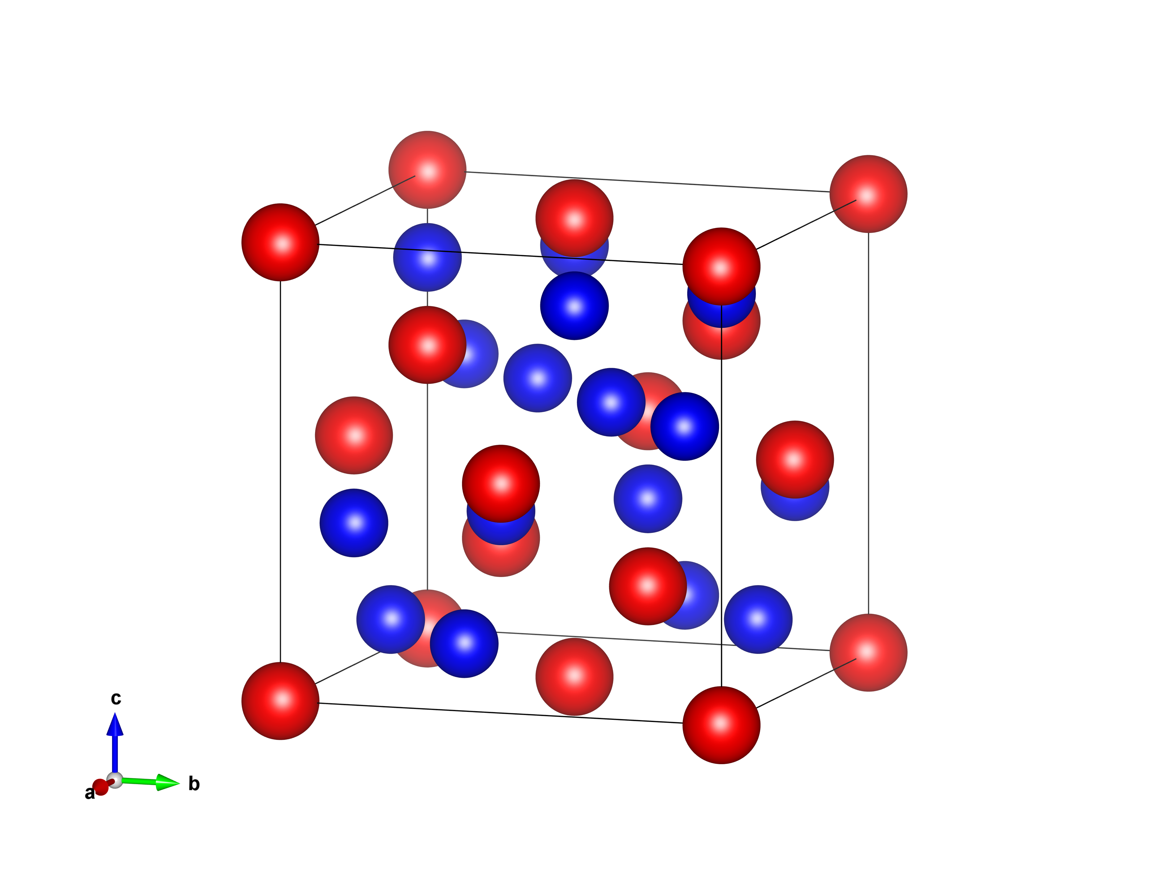
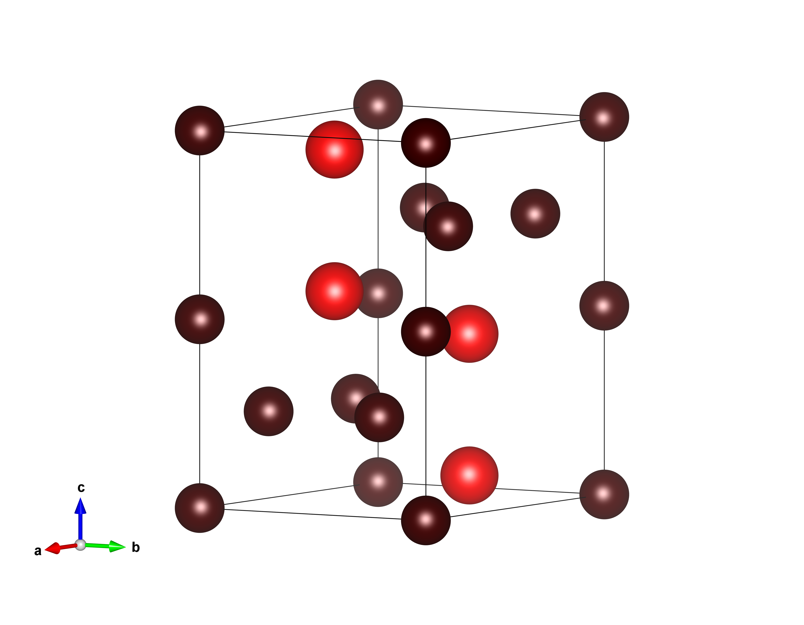
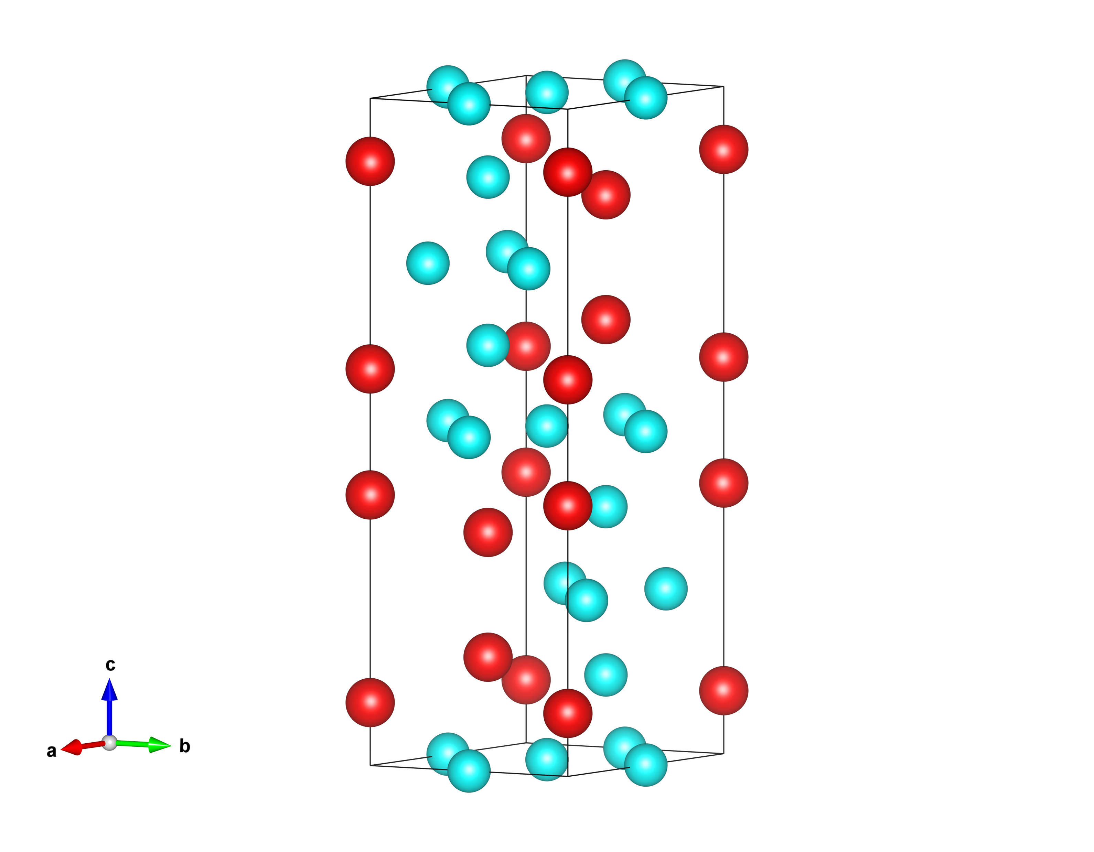
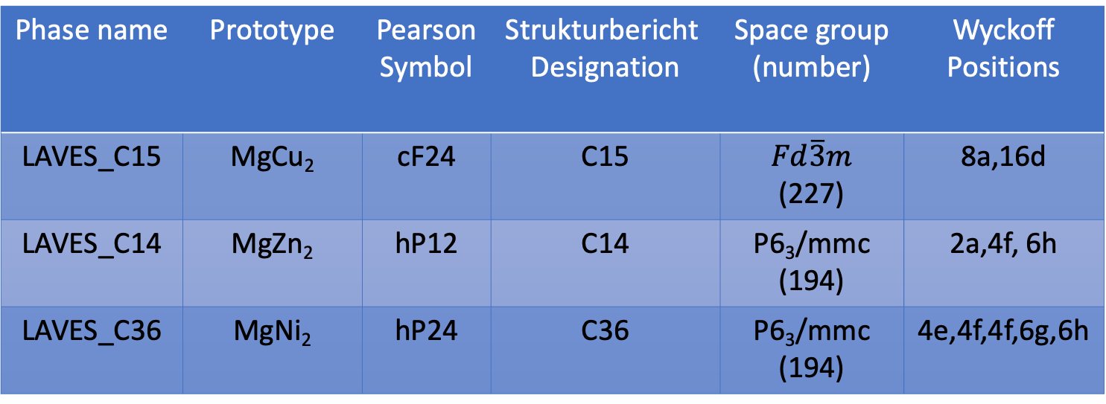
LAVES phases of Hf-Mo
Phase name | Prototype | Pearson Symbol | Strukturbericht Designation | Space group (number) | Wyckoff Positions
LAVES_C15 | MgCu₂ | cF24 | C15 | $Fd\overline{3}m$ (227) | 8a,16d
LAVES_C14 | MgZn₂ | hP12 | C14 | P6₃/mmc (194) | 2a,4f, 6h
LAVES_C36 | MgNi₂ | hP24 | C36 | P6₃/mmc (194) | 4e,4f,4f,6g,6h
C15
C14
C36
Mg atoms in red, Cu in blue, Zn in brown and Ni in light blue

Slide 7
Structures builder
Endmembers
  2^{n} of each phase, where n is Wyckoff position
Dilute
  n*2^{n} dilute POSCAR
  Near the most stable endmember
SQS
  BCC and HCP template
  SQS ATAT database
Phase name | Wyckoff Positions | Sublattice models
LAVES_C15 | 8a,16d | (Hf,Mo)₁(Hf,Mo)₂
LAVES_C14 | 2a,4f, 6h | (Hf,Mo)₁(Hf,Mo)₂(Hf,Mo)₃
LAVES_C36 | 4e,4f,4f,6g,6h | (Hf,Mo)₂(Hf,Mo)₂(Hf,Mo)₂(Hf,Mo)₃(Hf,Mo)₃
BCC_A2 | 2a | (Hf,Mo)₁(VA)₃
HCP_A3 | 2c | (Hf,Mo)₁(VA)_{0.3}
https://phaseslab.com/#/resources/

Slide 8
Automation workflow
Motivation and background
Certain areas of parameterization and refinement procedure remain manual
Improve efficiency and reliability of CALPHAD modeling process
Open-source computational tools and our uniqueness​
PySIPFENN: Python package allows efficient predictions of the formation energy of atomic configurations
DFTTK: High-throughput first-principles calculations Tool Kit​
PyCalphad: Python library for computational thermodynamics using the CALPHAD
ESPEI: High-throughput modeling tool for ​creating CALPHAD databases
Application and Demo
Applying in building 9 refractory elements thermodynamic database (Cr-Hf-Mo-Nb-Ta-Ti-V-W-Zr)
Demo with Hf-Mo system

Slide 9
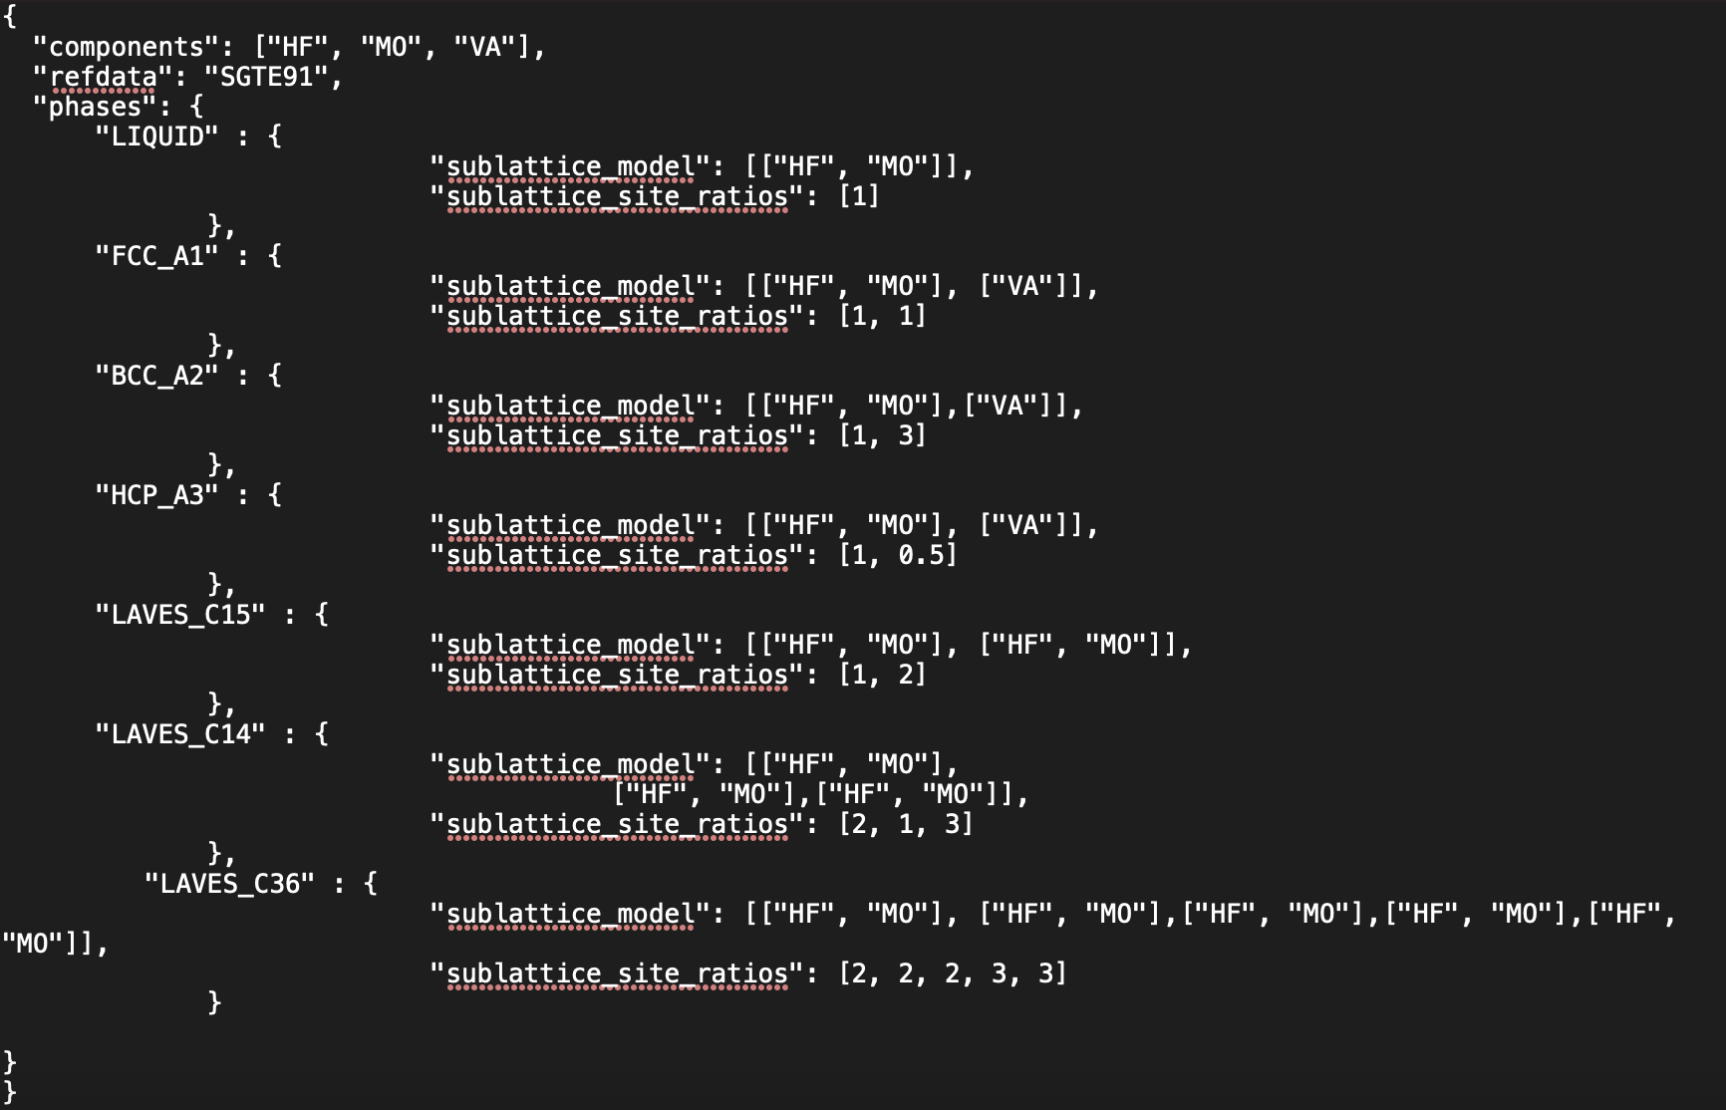
ESPEI Input data
Phases and CALPHAD models

Slide 10
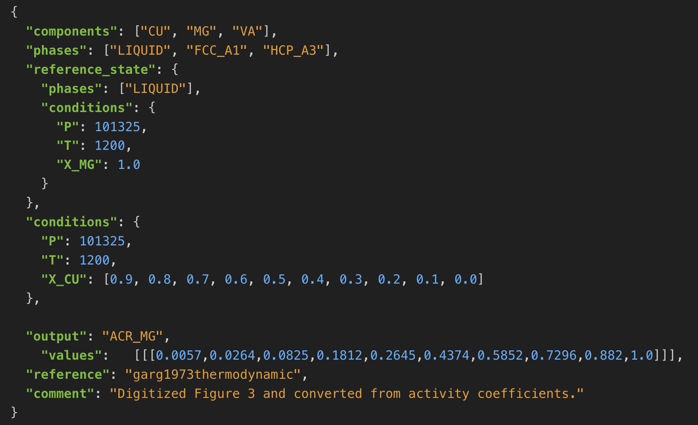
ESPEI Input data
Non-equilibrium Thermochemical Data
  This can in principle be any thermodynamic quantity, but currently only CPM*, SM*, and HM* (where * is either nothing, _MIX or _FORM) are supported.
Equilibrium Thermochemical Data
  Activity data
  Enthalpy of formation data in region with two or more phases in equilibrium
  Enthalpy of formation for a phase with multiple sublattice, e.g. the σ phase

Slide 11
ESPEI Input data
Phase Diagram data
ESPEI can consider multi-component phase diagram data with an arbitrary number of phases in equilibrium. Phase diagram data JSON datasets are distinguished by using "output": "ZPF”.
Each entry in the JSON values corresponds to a phase region where one or more phases are participating in equilibrium under the given temperature and pressure conditions.

Slide 12
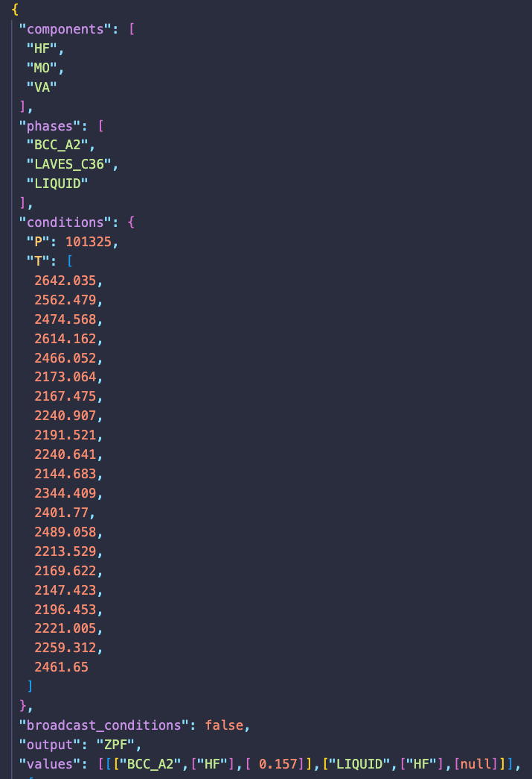
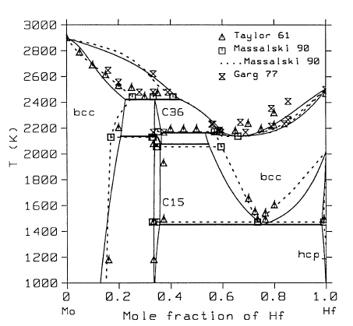
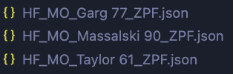
Hf-Mo phase boundary data
Webplotdigitizer get the experimental data in template
ZPF_to_JSON.py convert ZPF data to ESPEI readable JSON

Slide 13
Units
Energies are in J/mol-atom (and the derivatives follow)
All compositions are mole fractions
Temperatures are in Kelvin
Pressures in Pascal

Slide 14
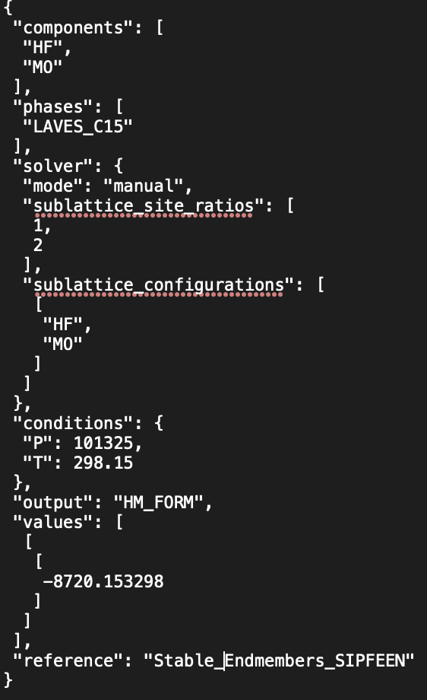
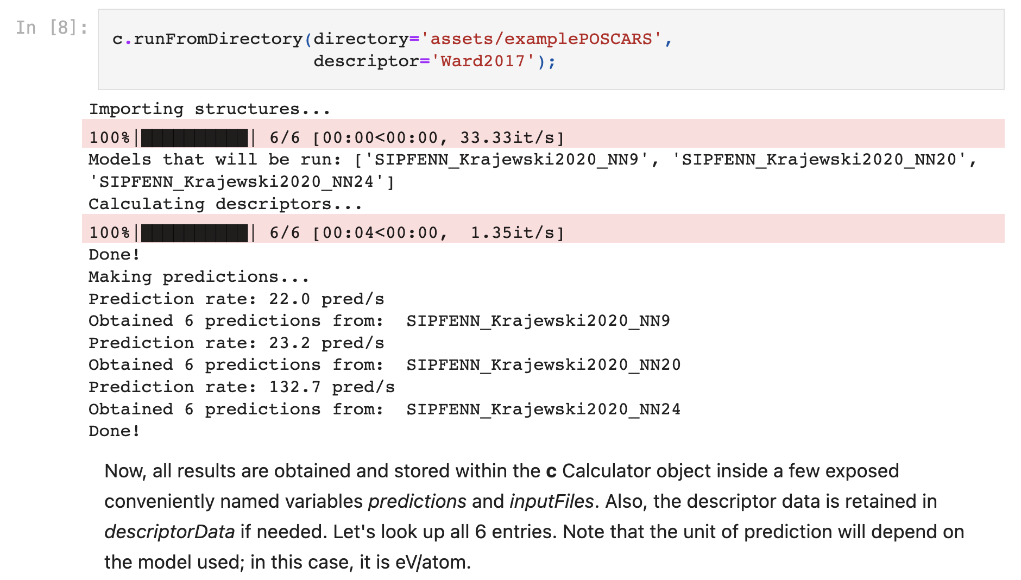
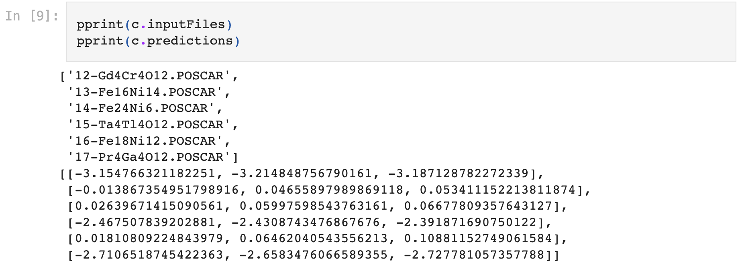
Pysipfenn result to ESPEI JSON

Slide 15
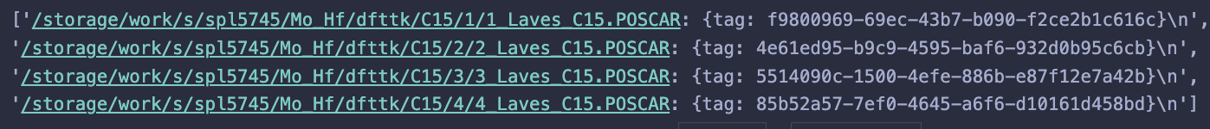
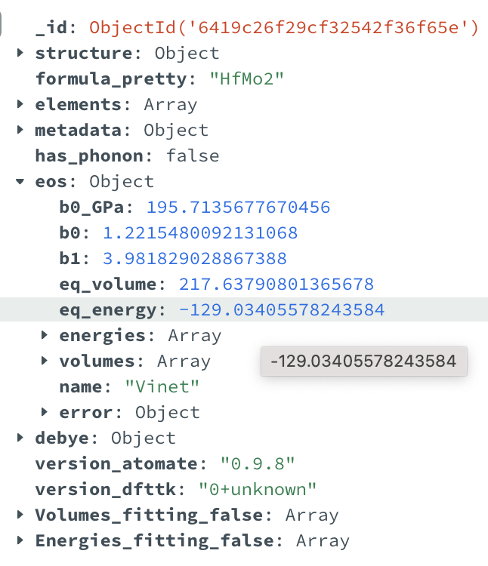
DFTTK Mongodb to espei JSON
Get the tags information from METADATAS after submitting DFTTK job
DFTTK_to_ESPEI_JSON.py
  Connect with dfttk MongoDB
  Target the systems with tags information
  Convert EOS fitting energy to formation enthalpy in ESPEI JSON format
Notes:
Brando liquid the
Pop file for liquid

Slide 16
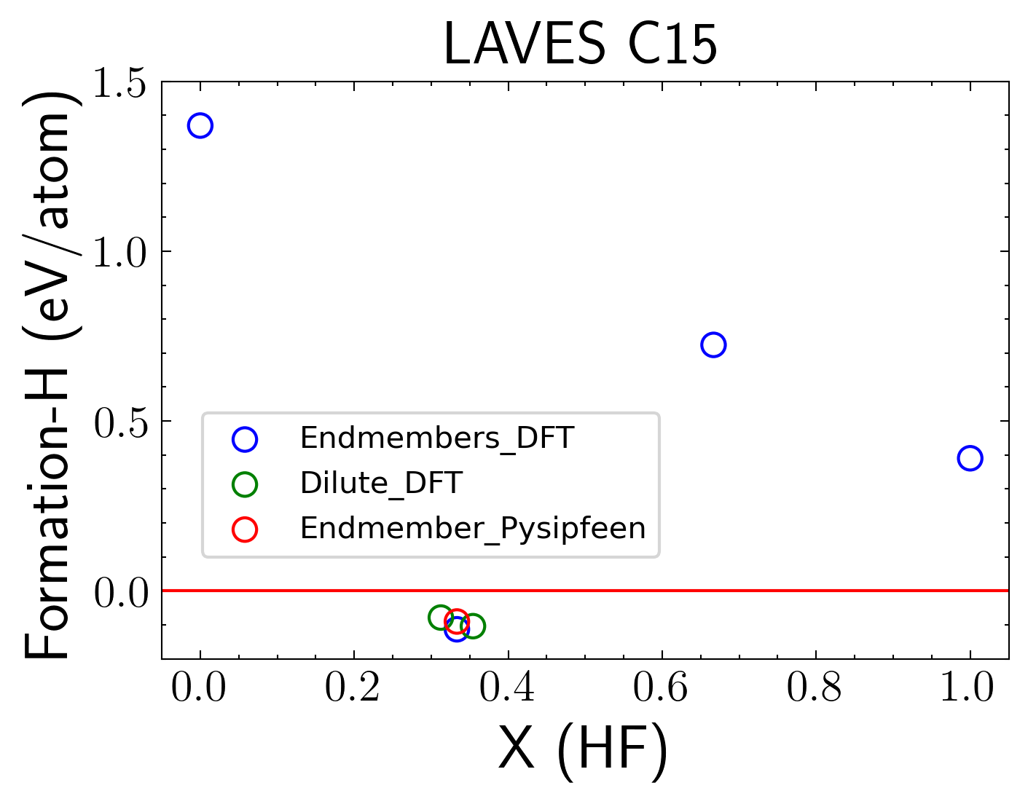
Hf-Mo LAVES_C15
Sublattice model (Hf,Mo)₁(Hf,Mo)₂
2 dilute structures of the most stable endmembers
Lattice occupation
16 | 32
Hf 16 | Hf, Mo 1, 31
Hf, Mo 15, 1 | Mo 32

Slide 17
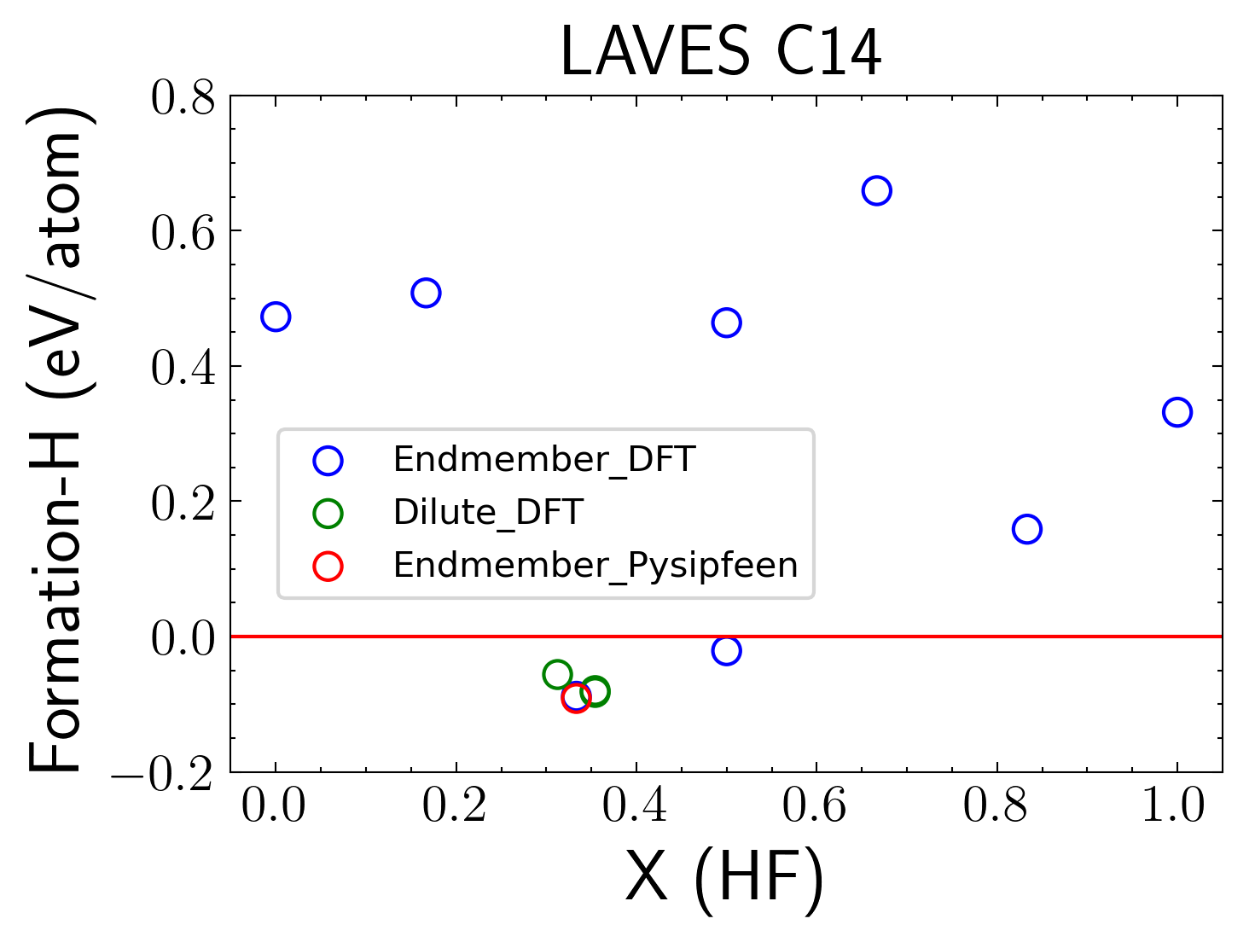
Hf-Mo LAVES_C14
Sublattice model (Hf,Mo)₂(Hf,Mo)₁(Hf,Mo)₃
3 dilute structures of the most stable endmembers
Lattice occupation
1 | 2 | 3
Hf 16 | Mo,Hf 7,1 | Mo 24
Hf 16 | Mo 8 | Mo,Hf 23,1
Hf,Mo 15,1 | Mo 8 | Mo 24

Slide 18
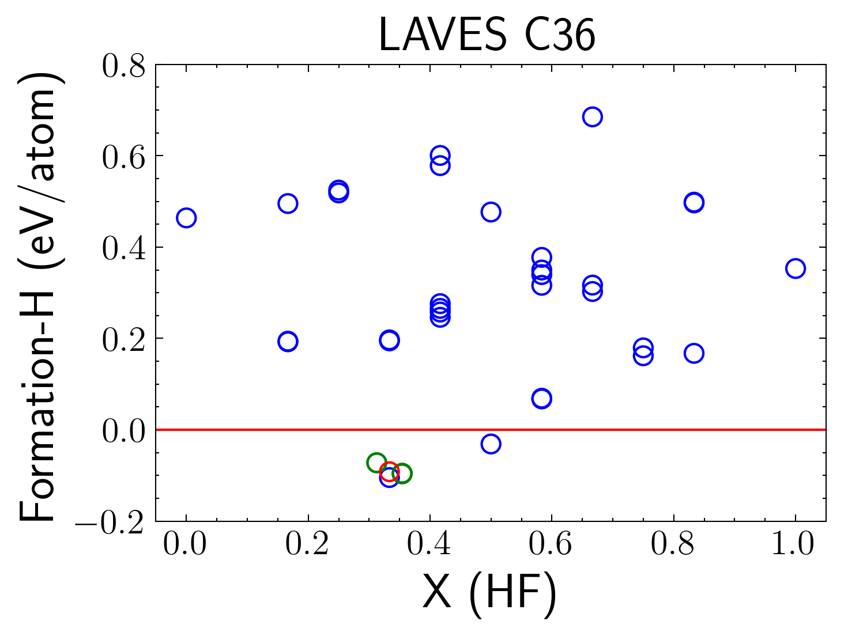
Hf-Mo LAVES_C36
Sublattice model (Hf,Mo)₂(Hf,Mo)₂(Hf,Mo)₂(Hf,Mo)₃(Hf,Mo)₃
5 dilute structures of the most stable endmembers
Lattice occupation
1 | 2 | 3 | 4 | 5
Hf 8 | Hf 8 | Mo,Hf 7,1 | Mo 12 | Mo 12
Hf 8 | Hf 8 | Mo 8 | Mo,Hf 11, 1 | Mo 12
Hf 8 | Hf 8 | Mo 8 | Mo 12 | Mo,Hf 11, 1
Hf,Mo 7,1 | Hf 8 | Mo 8 | Mo 12 | Mo 12
Hf 8 | Hf,Mo 7,1 | Mo 8 | Mo 12 | Mo 12

Slide 19
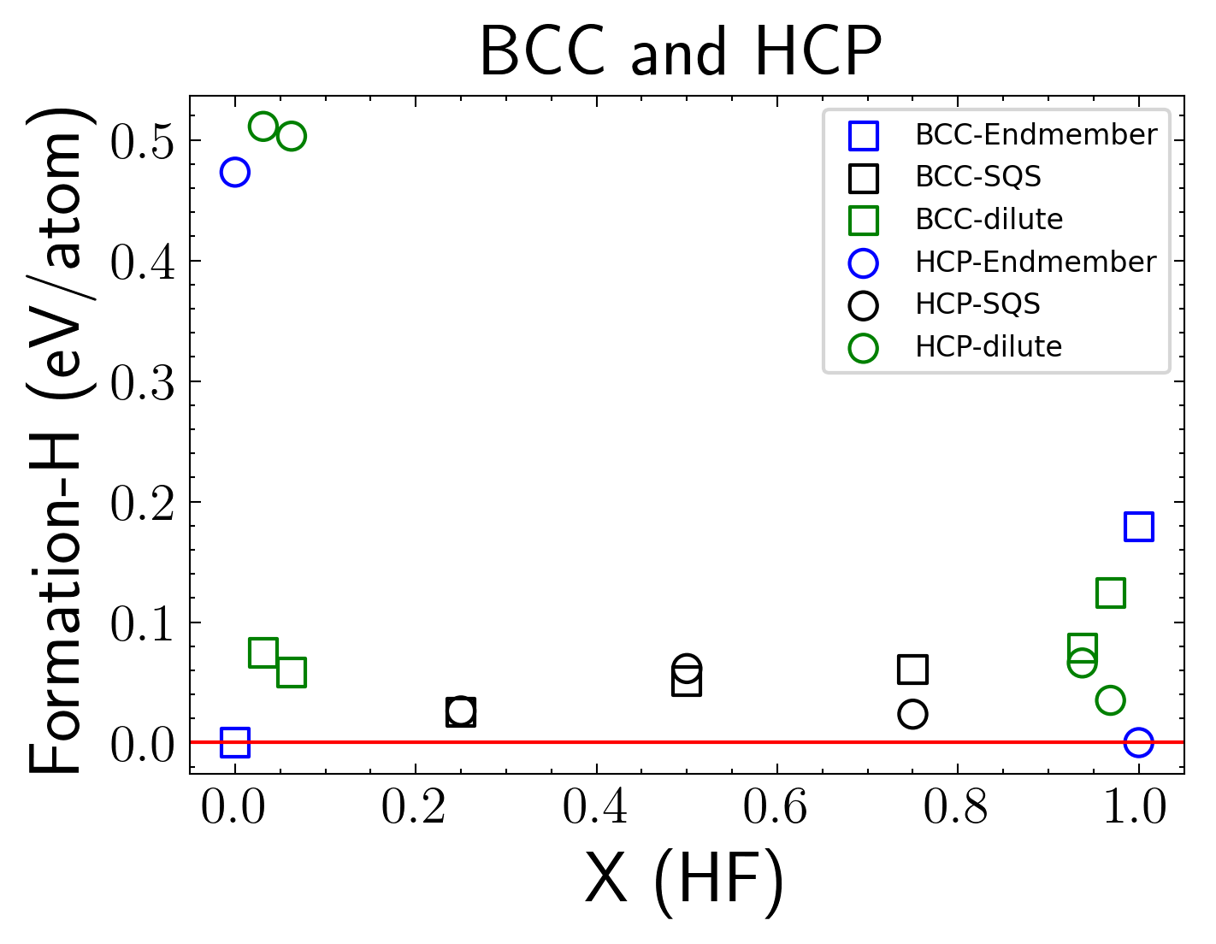
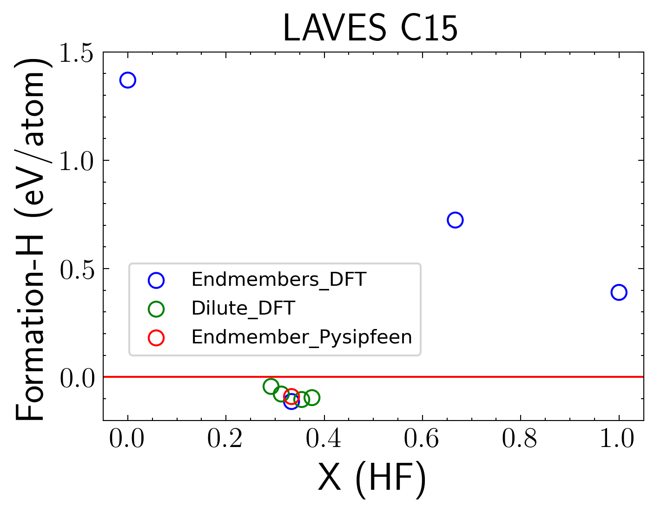
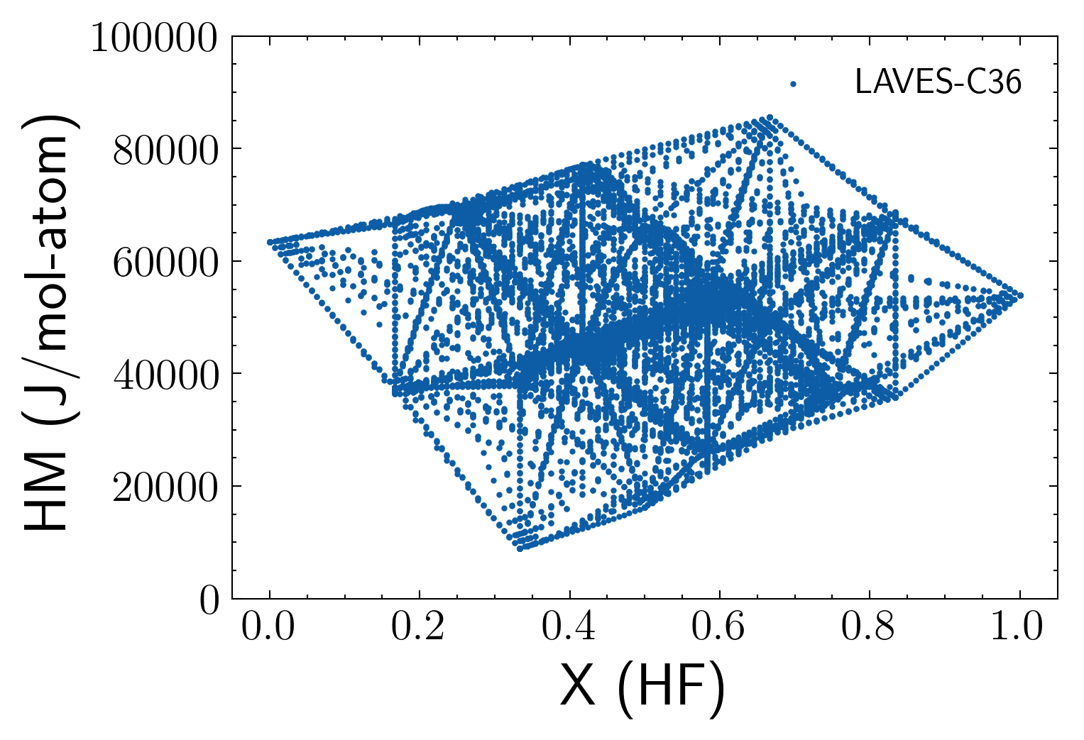
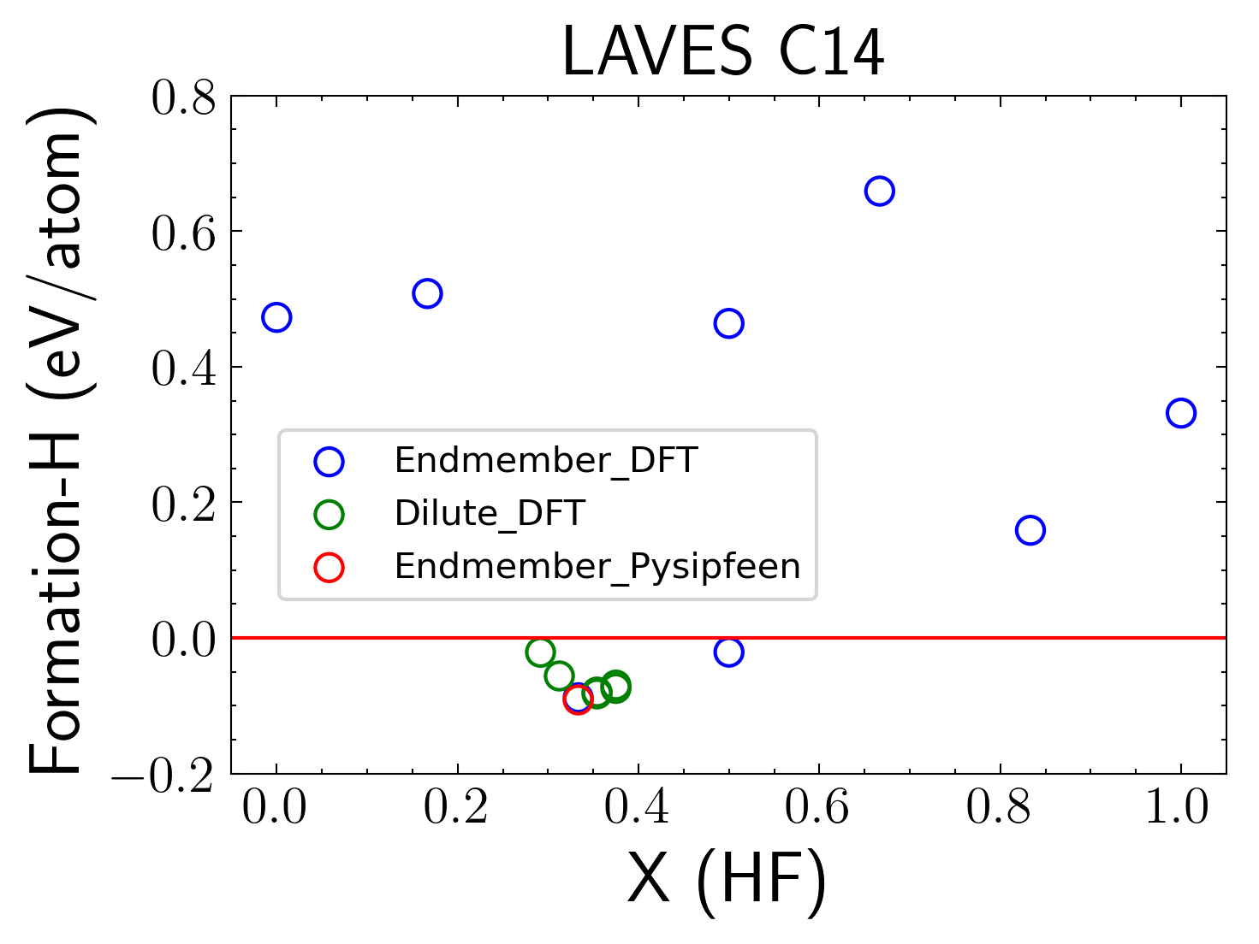
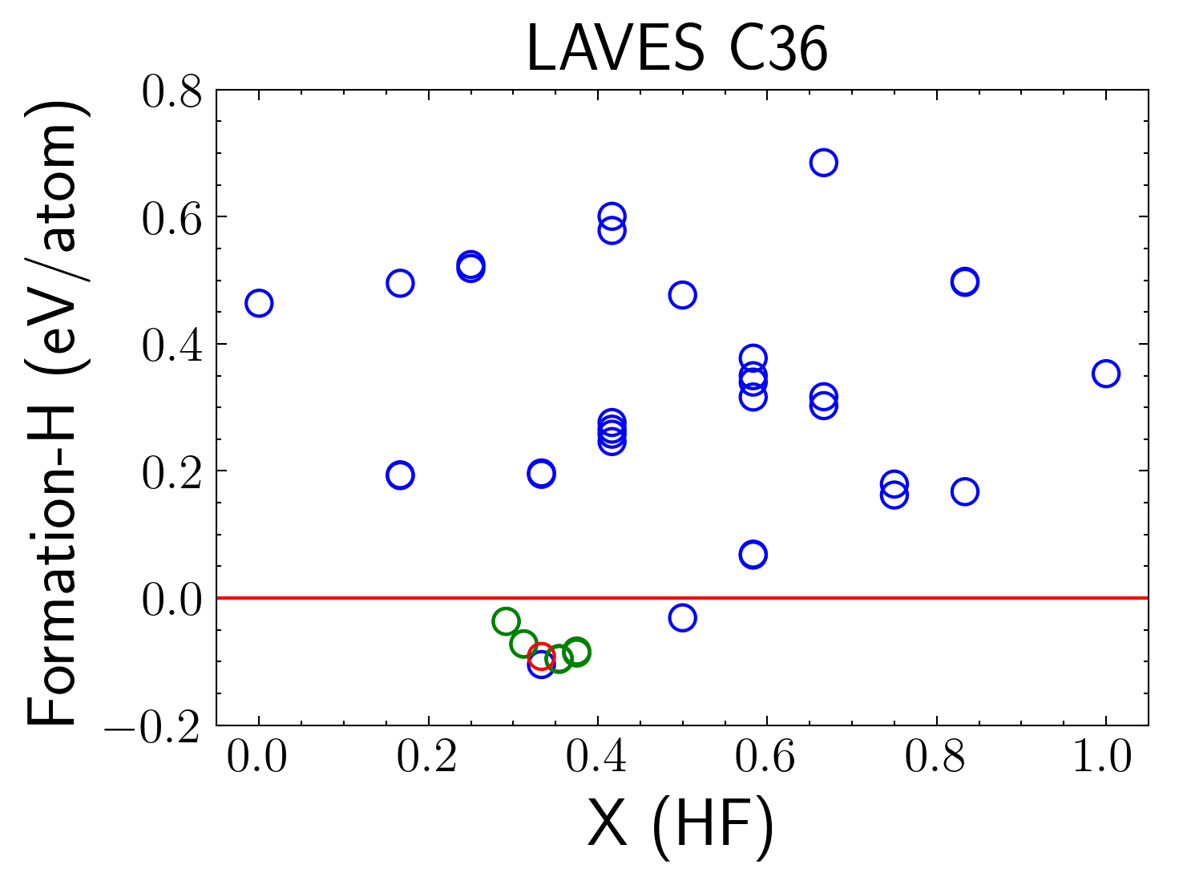
Input data for ESPEI parameter selection
Visualize the HM surface of LAVES_36 phase in 2-D

Slide 20
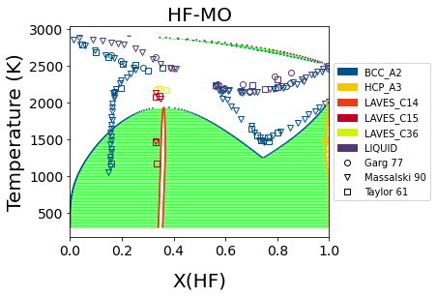
Phase diagram generation by ESEPI Parameter selection
First-principles + machine learning
Input data of Formation_H
BCC and HCP: 2 endmembers+ 3 SQS + 4 dilute
C15: 4 endmembers+ 4 dilute
C14: 6 endmembers + 6 dilute
C36: 32 endmembers+ 10 dilute
Liquid: No interaction parameter
66 parameters in the generated TDB

Slide 21

ESPEI MCMC optimization
Optimizing model parameters by Bayes theorem
Posterior probability : p(θ|D), of the model parameters, θ, conditioned on the data, D
The prior: p(θ), contains the domain knowledge of the modeler in the probability distribution of each parameter.
The likelihood: p(D|θ), is the probability that the data are described by a set of parameters
The evidence : p(D), is the probability of the data marginalized over the possible parameters

Slide 22
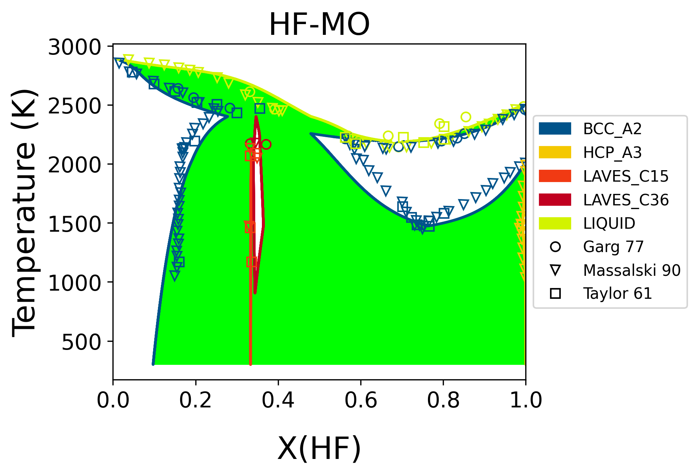
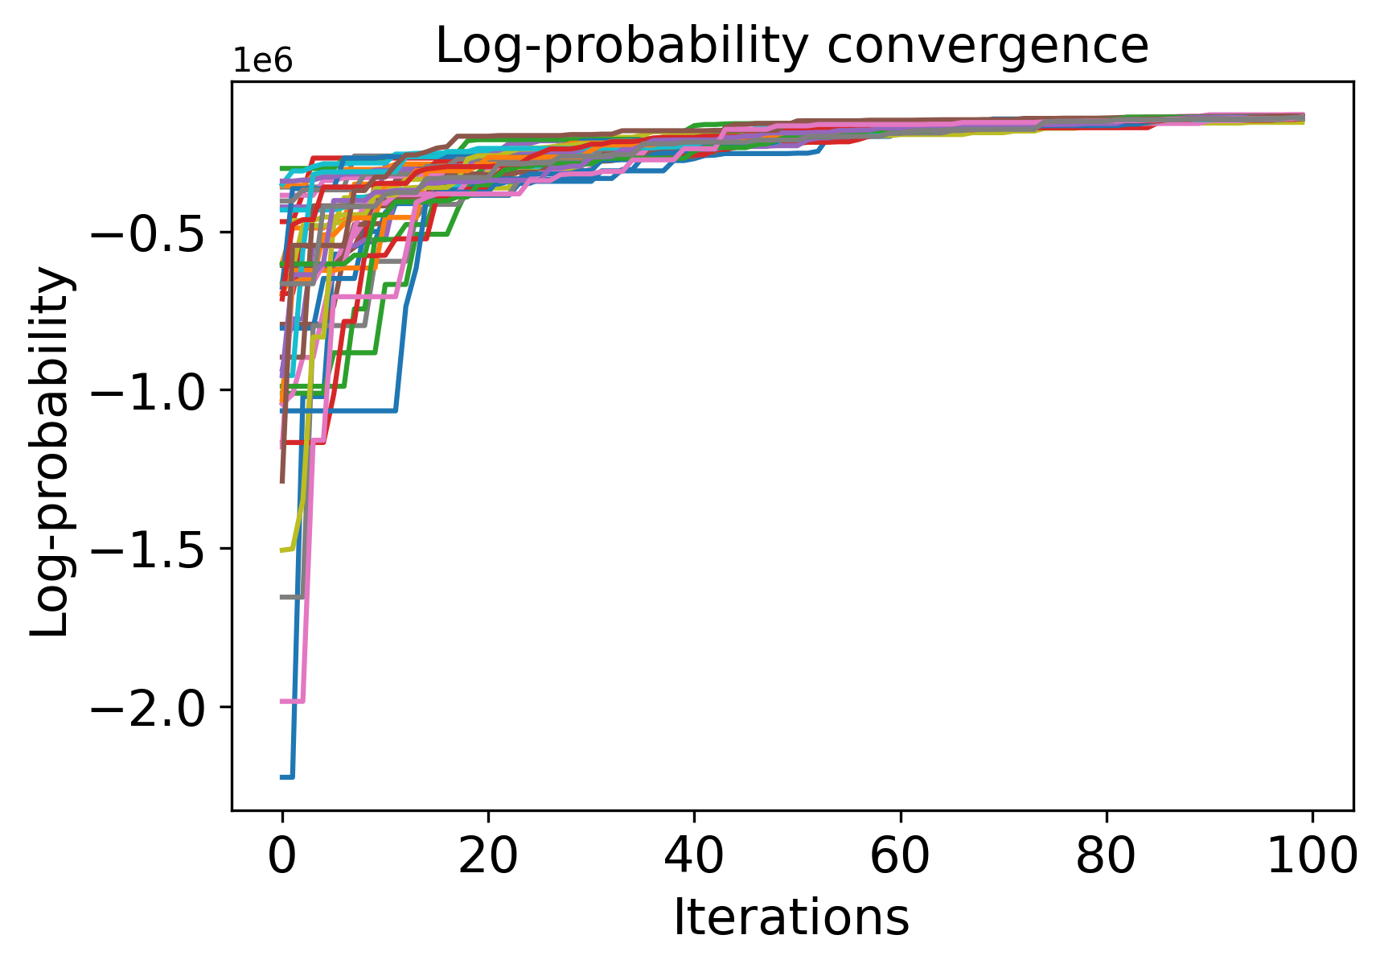
Phase diagram optimization by ESEPI MCMC
Convergence of the posterior log probabilities from the MCMC simulation.
Converge after 100 iterations.

Slide 23
Run ESPEI MCMC on Roar collab
Activate environment in Roar collab
conda activate your ESPEI environment
Prepare the input data:
  Input files (json)
  MCMC setting.yaml
Sbatch job file:

Slide 25
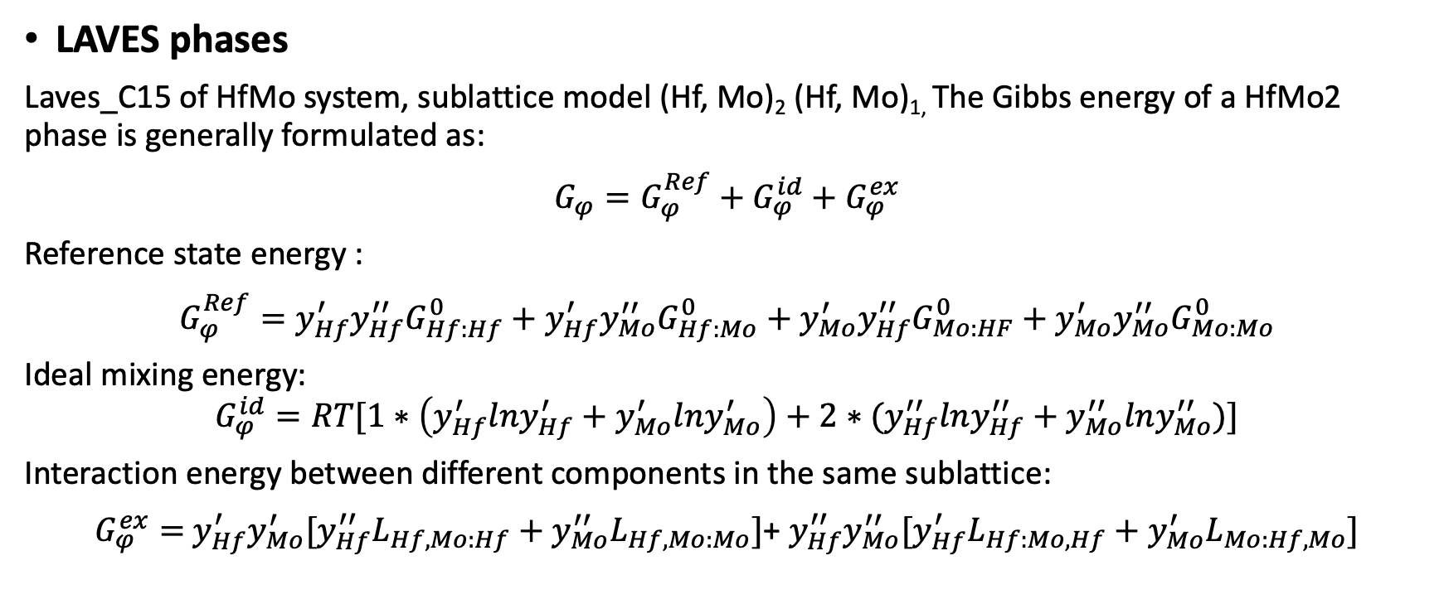
Thermodynamic modeling methodology
LAVES phases
Laves_C15 of HfMo system, sublattice model (Hf, Mo)₂ (Hf, Mo)_{1,} The Gibbs energy of a HfMo2 phase is generally formulated as:
$G_{φ}=G_{φ}^{Ref}+G_{φ}^{id}+$ $G_{φ}^{ex}$
Reference state energy :
$G_{φ}^{Ref}=y_{Hf}^{′}y_{Hf}^{′′}G_{Hf:Hf}^{0}+y_{Hf}^{′}y_{Mo}^{′′}G_{Hf:Mo}^{0}+$ $y_{Mo}^{′}y_{Hf}^{′′}G_{Mo:HF}^{0}+y_{Mo}^{′}y_{Mo}^{′′}G_{Mo:Mo}^{0}$
Ideal mixing energy:
$$G_{φ}^{id}=RT[1∗\left(y_{Hf}^{′}lny_{Hf}^{′}+y_{Mo}^{′}lny_{Mo}^{′}\right)+2∗(y_{Hf}^{′′}lny_{Hf}^{′′}+y_{Mo}^{′′}lny_{Mo}^{′′})]$$
Interaction energy between different components in the same sublattice:
$G_{φ}^{ex}=$ $y_{Hf}^{′}y_{Mo}^{′}[y_{Hf}^{′′}L_{Hf,Mo:Hf}+y_{Mo}^{′′}L_{Hf,Mo:Mo}]$+ $y_{Hf}^{′′}y_{Mo}^{′′}[y_{Hf}^{′}L_{Hf:Mo,Hf}+y_{Mo}^{′}L_{Mo:Hf, Mo}]$

