Slide 1
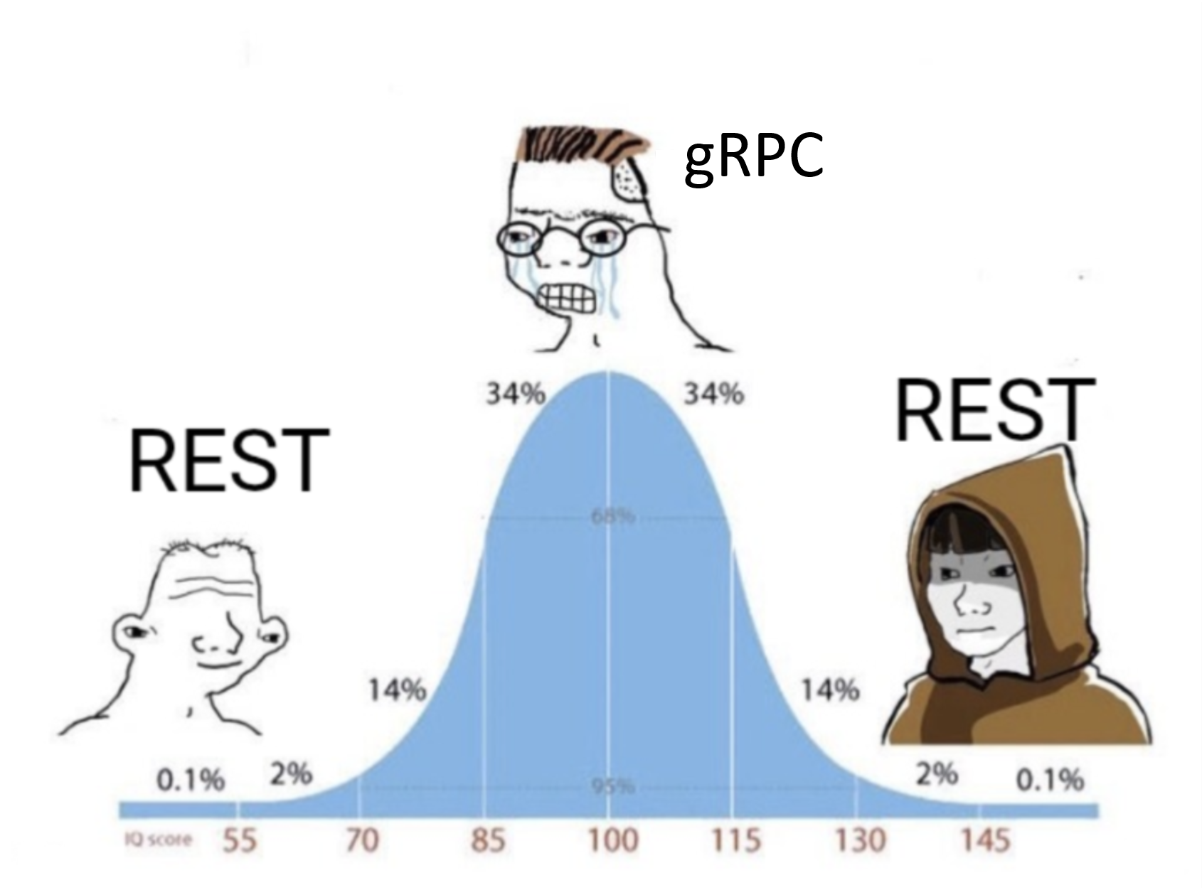

GRPC

Slide 2
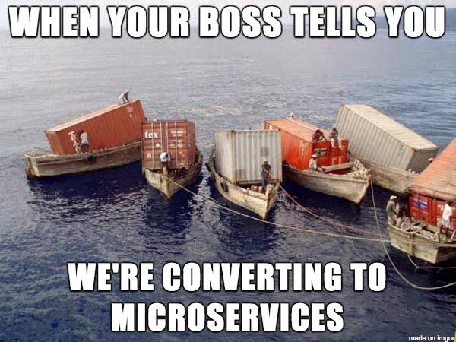
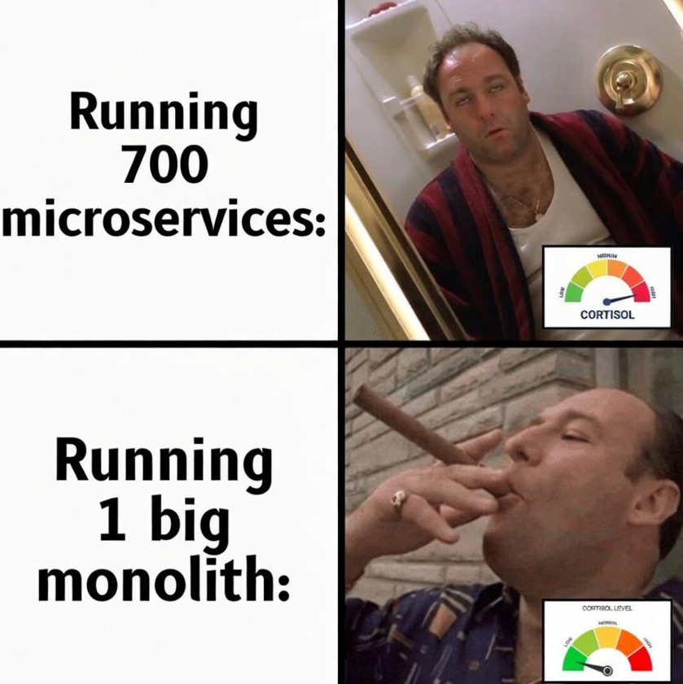

Slide 3
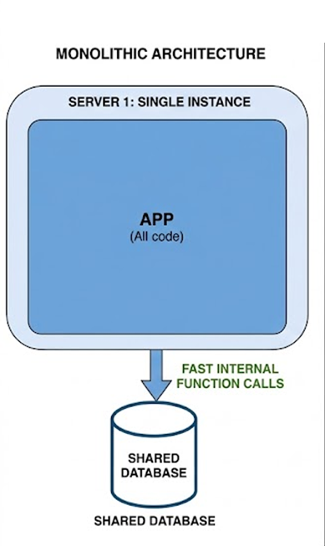
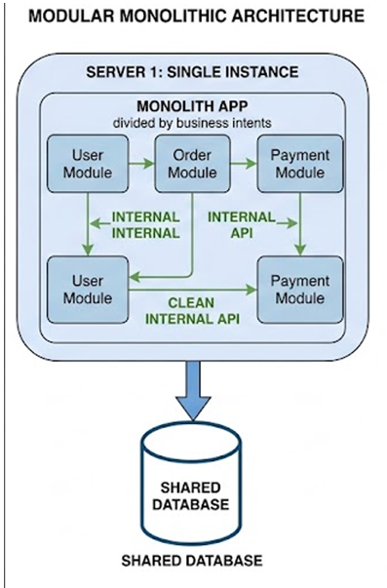
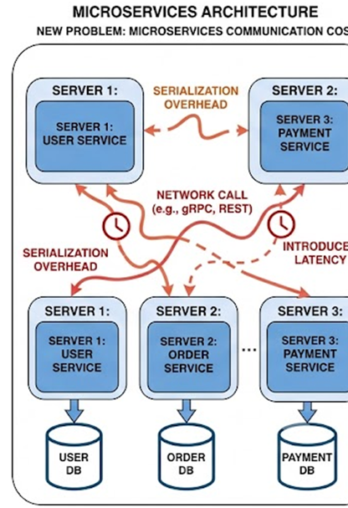

Slide 4
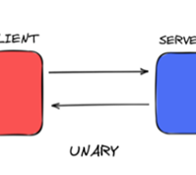
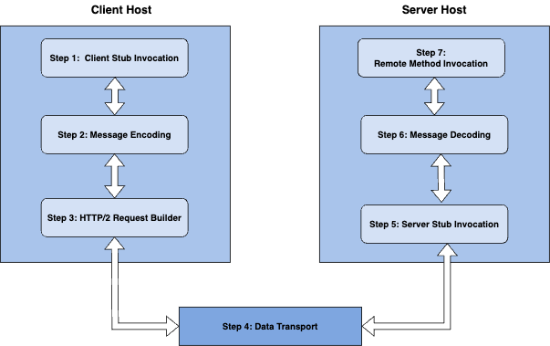
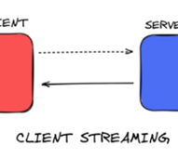
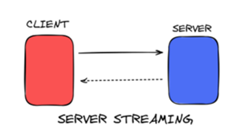
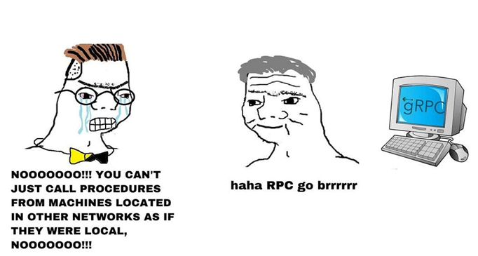
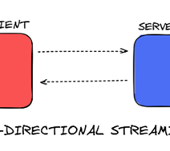
gRPC -
(Google) Remote Procedure Call
Procedure -> Function – method
=> Call a method from a server from far away as if it’s on a same server, same process.

Slide 5


gRPC Pattern | How It Works | When to Use | Real-World Example
1. Unary | Traditional request-response paradigm. Client sends a single request protobuf message, server processes it, and returns a single response protobuf message. | • Standard point-to-point microservice queries. • Short-lived CRUD operations. • Synchronous domain actions where payload size is small and predictable. | • GetUserProfile(UserId) -> UserProfile • ExecutePayment(PaymentPayload) -> TransactionResult
2. Client Streaming | Client writes a continuous sequence of messages to the server over an HTTP/2 stream. Once finished, client sends an end-of-stream signal (EOF) and waits for a single summary response from the server. | • Uploading large files/blobs without loading entire payload into memory. • Ingesting continuous batch telemetry or metrics from edge devices. • Aggregating multiple events into a single database commit. | • Chunked video or log file uploads (stream Chunk -> UploadStatus) [1] • Pushing IoT sensor metrics for server
3. Server Streaming | Client sends a single request message; server responds with a stream of messages. Client reads from the stream until the server finishes or closes the connection. | • Returning large query result sets that exceed single-message buffer limits. • Real-time server-to-client notifications or data feeds. • Tailing live application logs or audit trails. | • Exporting audit logs (DateRange -> stream AuditRecord). • Real-time stock ticker or sports score updates (Subscribe(Symbol) -> stream PriceTick).
4. Bidirectional Streaming | Both sides send sequence of messages using independent read/write HTTP/2 sub-streams. Communication is completely asynchronous—either side can read, write, or wait in any order. | • Low-latency, full-duplex interactive channels. • Complex pipeline processing where transformed outputs stream back as inputs arrive. • Real-time collaborative applications or turn-based sync. | • Multi-user chat applications or live voice/video token streaming. • Real-time AI processing (streaming audio input in, receiving transcribed text chunks out).
Refs:
[1] https://dev.to/dimk00z/grpc-file-transfer-with-go-1nb2
[2] https://oneuptime.com/blog/post/2026-02-17-how-to-implement-real-time-streaming-speech-recognition-with-cloud-speech-to-text/view
[3]

Slide 6
Feature / Dimension | gRPC | RESTful API
Primary Protocol | HTTP/2 (Multiplexed, single long-lived TCP connection) | HTTP/1.1 or HTTP/2
Data Payload Format | Binary (Protocol Buffers / Protobuf) | Text-based (JSON, XML, HTML)
API Contract | Strict & Enforced (Defined via .proto schemas) | Flexible / Optional (OpenAPI, Swagger, JSON Schema)
Performance & Latency | High (Compact binary serialization, low CPU & network overhead) | Moderate (Text parsing and larger header payloads)
Code Generation | Native (protoc generates strongly-typed client/server stubs) | Third-party (OpenAPI Generator, Swagger Codegen)
Browser Support | Limited (Requires grpc-web proxy or API Gateway transcoding) | Native (Supported directly by all web browsers)
Load Balancing | Complex (Requires L7 HTTP/2 frame-aware balancing e.g., Envoy, xDS) | Simple (Standard L4/L7 proxies handle per-request balancing)
Error Handling | gRPC Status Codes + Error Metadata Trailers | Standard HTTP Status Codes (2xx, 4xx, 5xx) + Response Body
Best Suited For | Internal microservices, low-latency control planes, real-time pipelines | Public APIs, web frontends, third-party vendor integrations

Slide 7
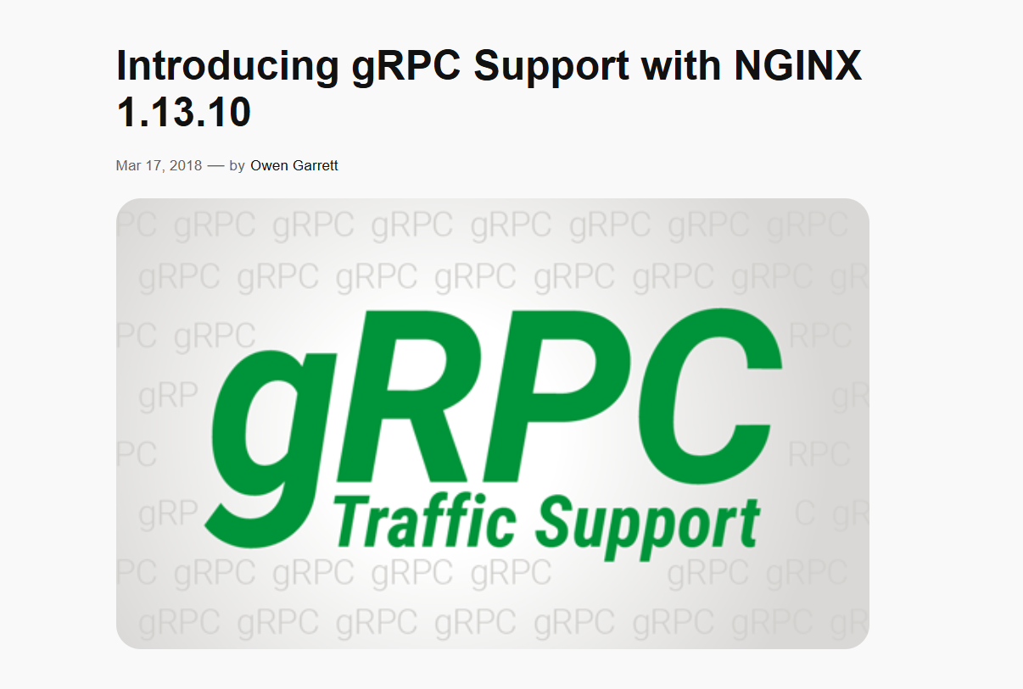
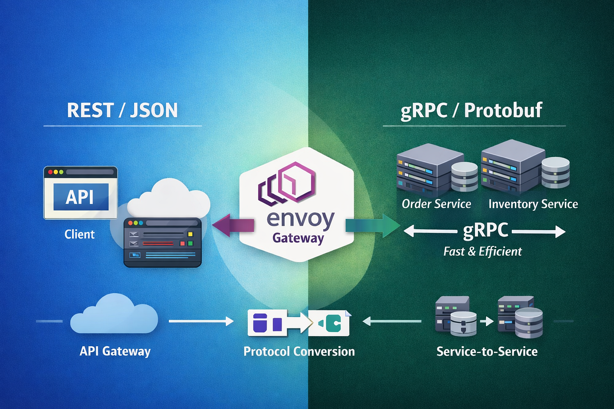

Slide 8
gRPC Status Code | HTTP Status Code | Context
0 OK | 200 OK | Request succeeded
3 INVALID_ARGUMENT | 400 Bad Request | Malformed request body / validation failure
5 NOT_FOUND | 404 Not Found | Requested resource missing
7 PERMISSION_DENIED | 403 Forbidden | Authentication/Authorization failed
4 DEADLINE_EXCEEDED | 504 Gateway Timeout | Backend call timed out
14 UNAVAILABLE | 503 Service Unavailable | Backend service unreachable
8 RESOURCE_EXHAUSTED | 429 Too Many Requests | Exceed backend rate limit
2 UNKNOWN |  | ?

Slide 9
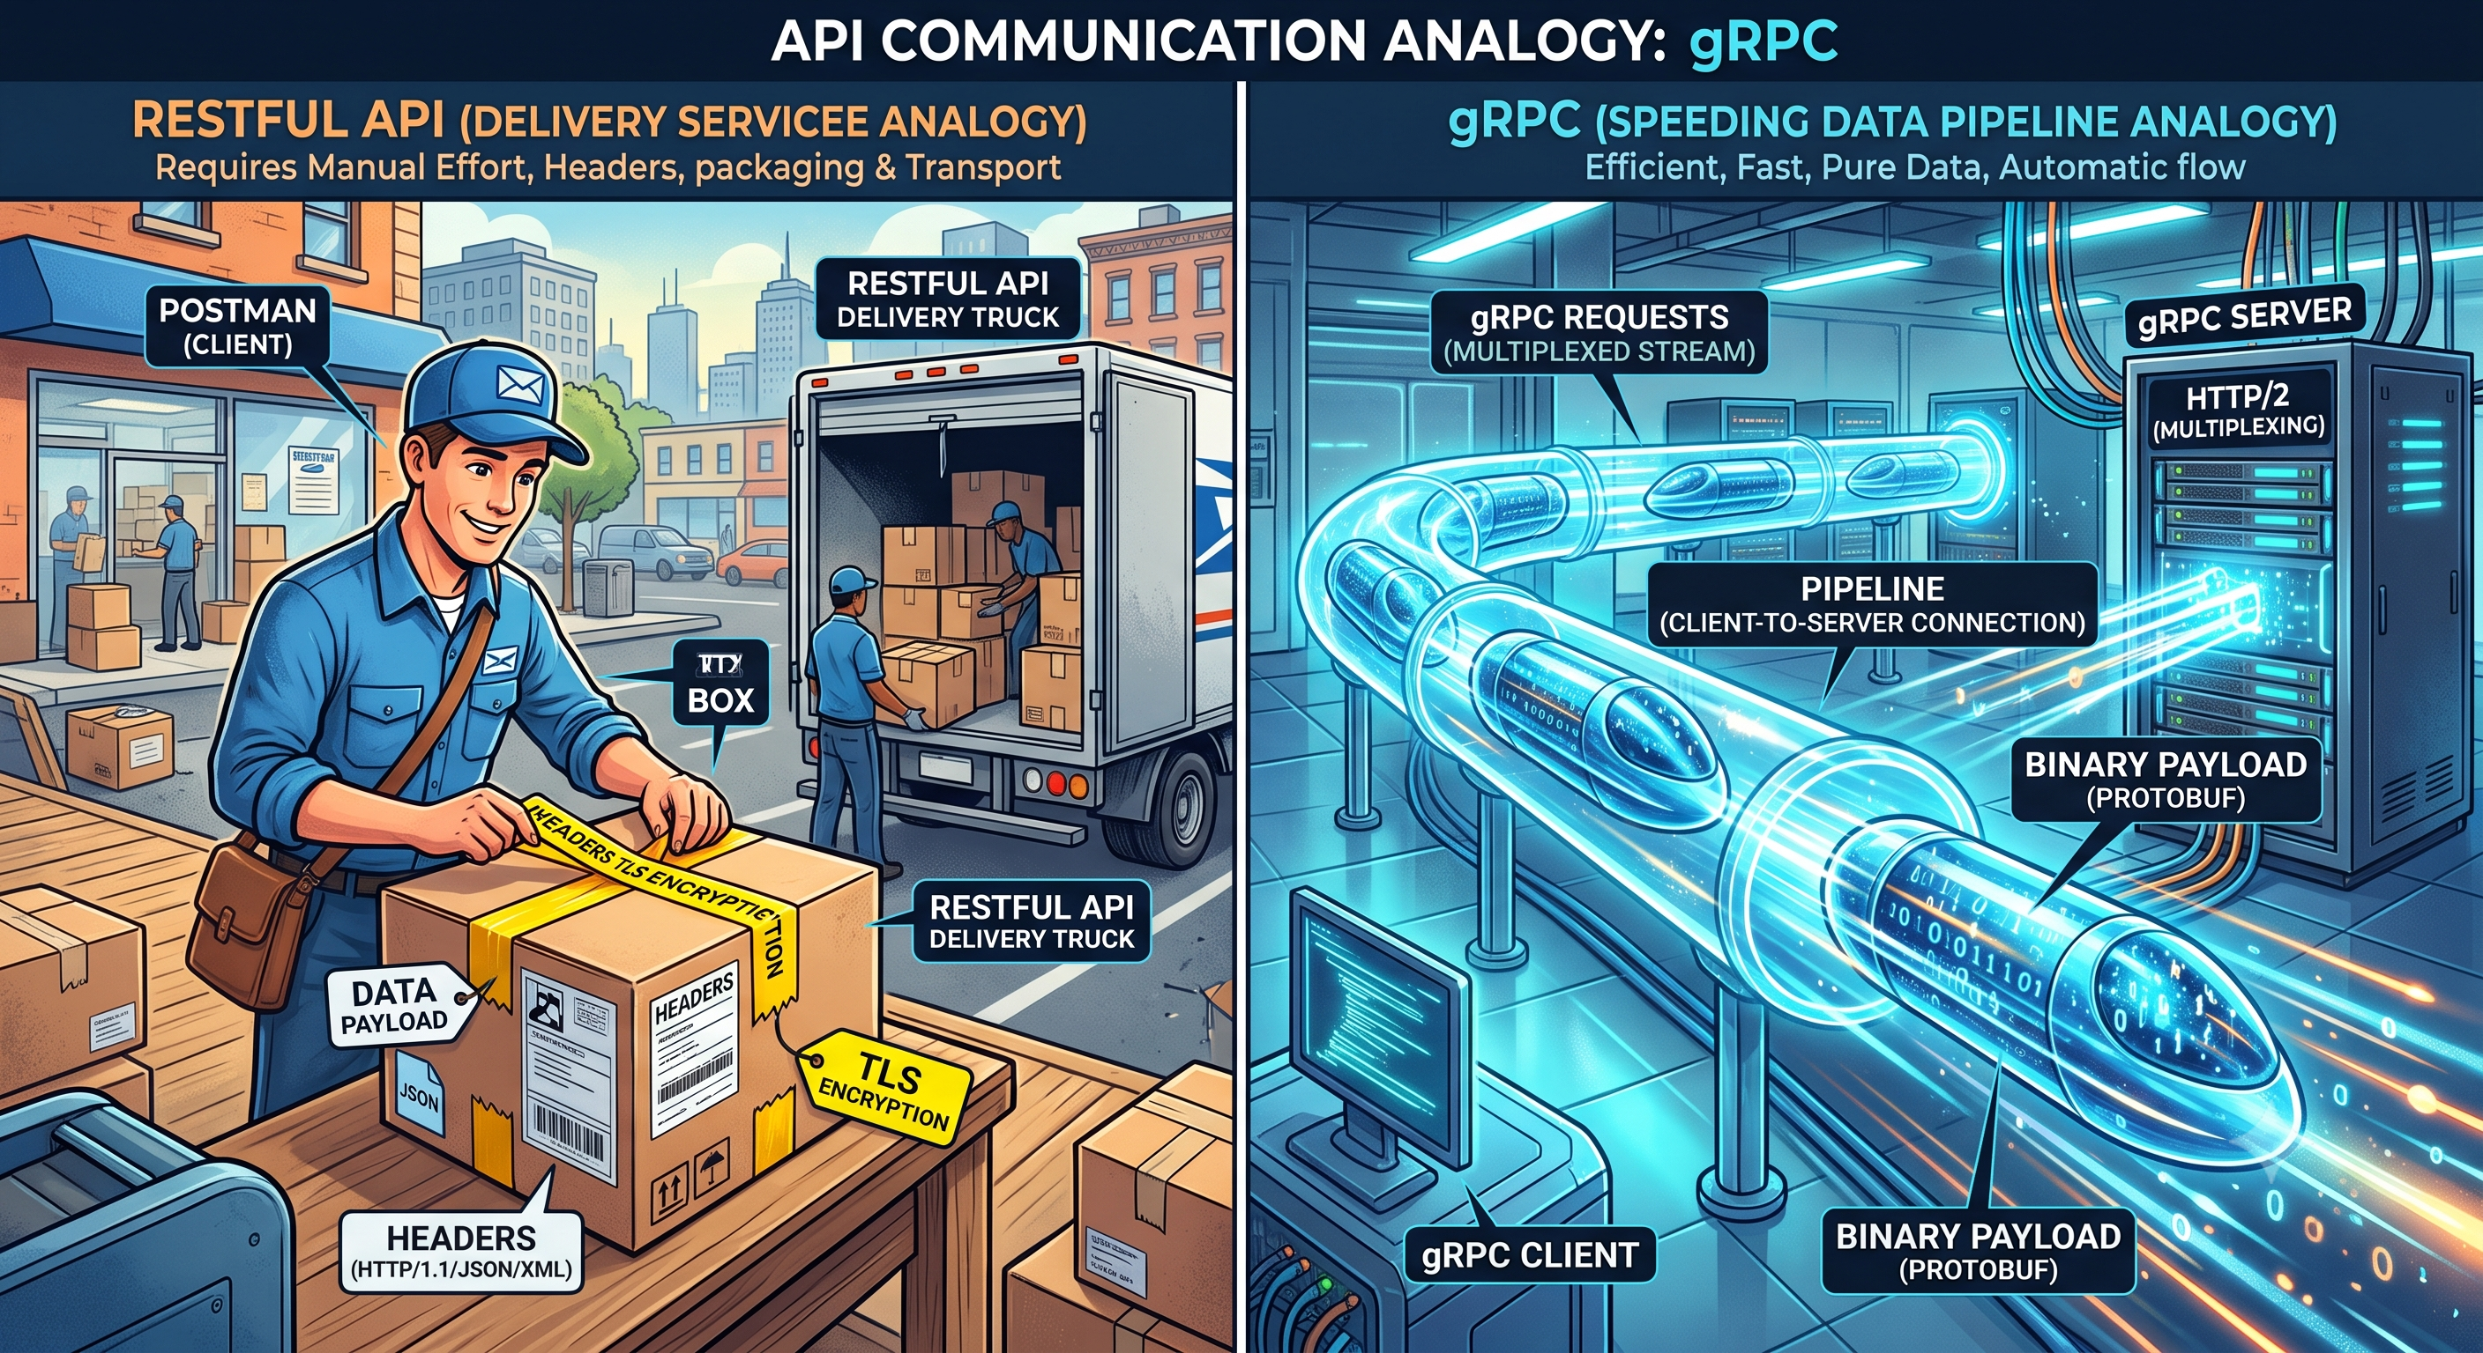

Slide 10
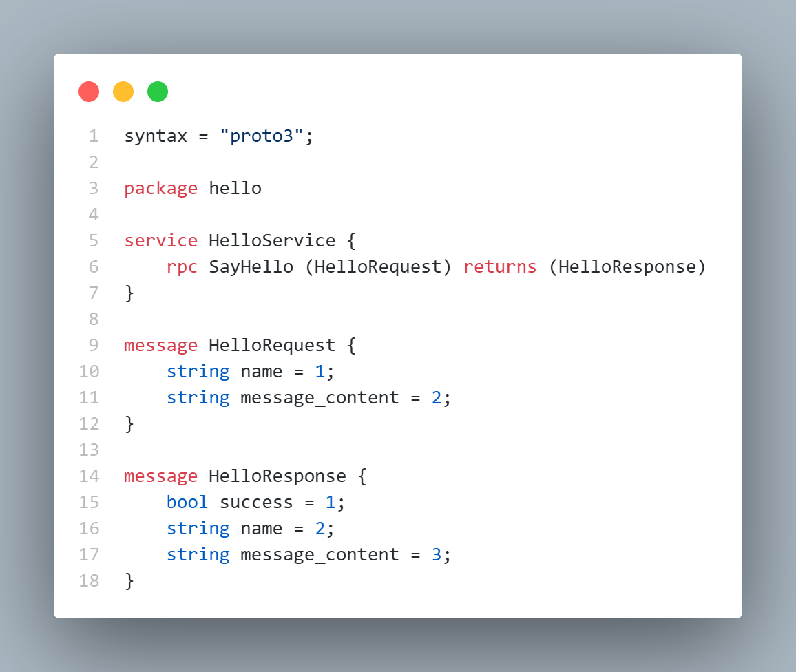
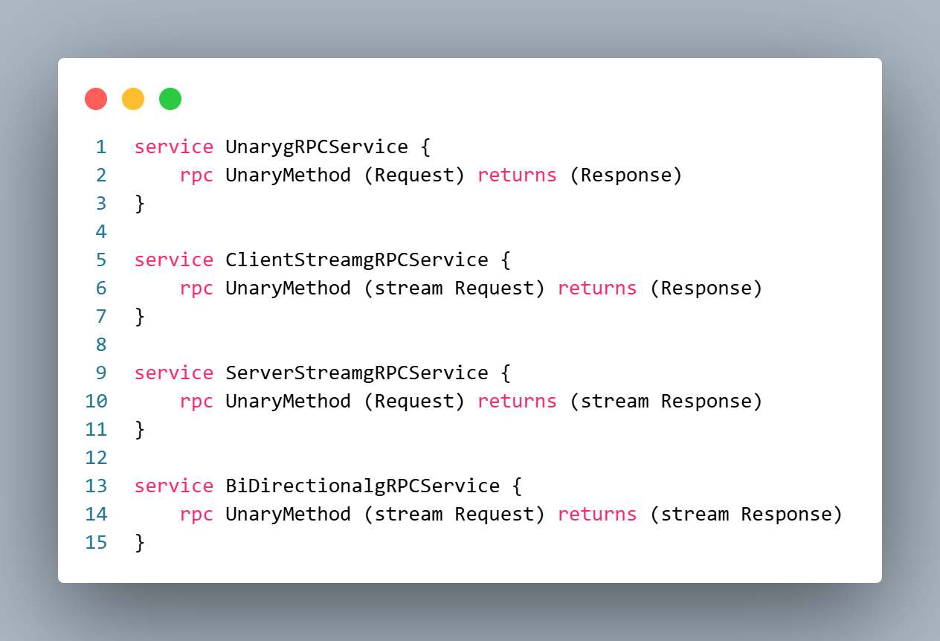
Protobuf

Slide 11
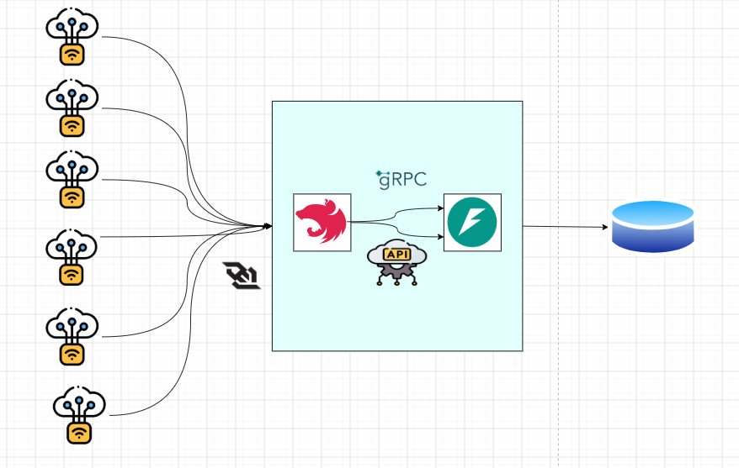
Hand-on project demo
Repo source: https://github.com/Phat-pham99/gRPC-demo

Slide 12
Q&A
1) What difficulties prevent teams from implement gRPC ?
2) Can migrate some Restful into gRPC later on ?
3) Do some quiz
gRPC - Unary
gRPC – Client Stream
gRPC – Server Stream
RestFull API
Websocket
Usecase | API type
Realtime translation | gRPC – Server Stream
Stock dashboard (frontend) | Websocket
Stock dashboard (backend) | gRPC – Server Stream
Token validation via Auth-microservice | gRPC - Unary
Send order request from mobile app | RestFull API

