Slide 1

Mobile application design and implementation
Proximity chat for iOS devices
Fumagalli – Mariani – Mastellone
Year 2015 - 2016

Slide 2
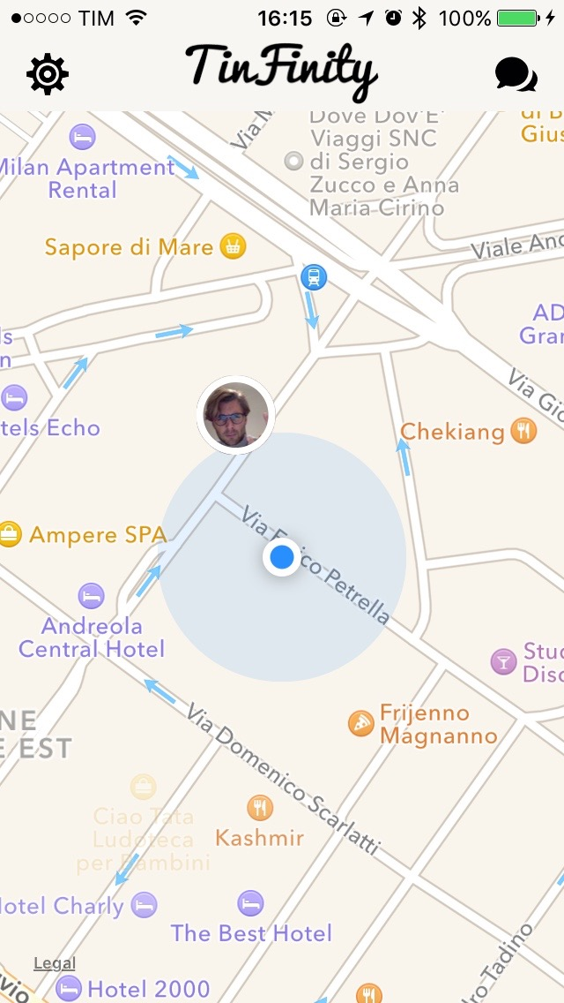
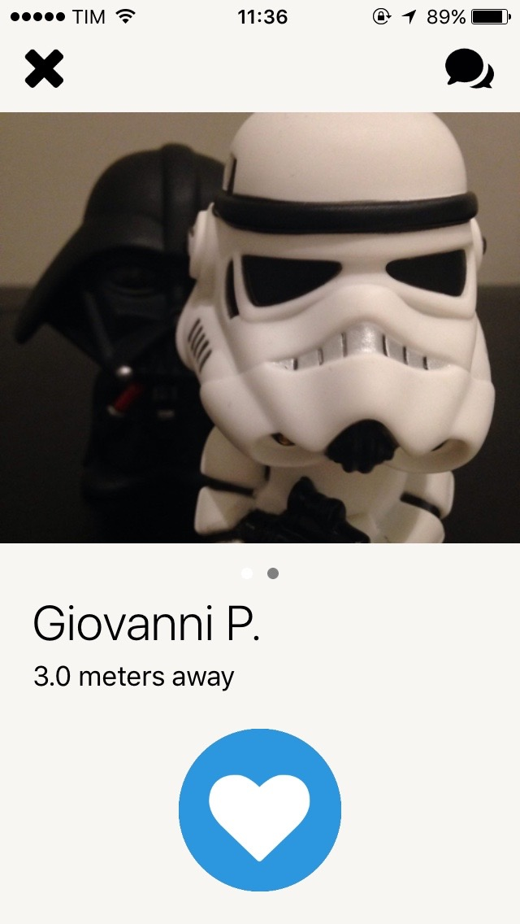
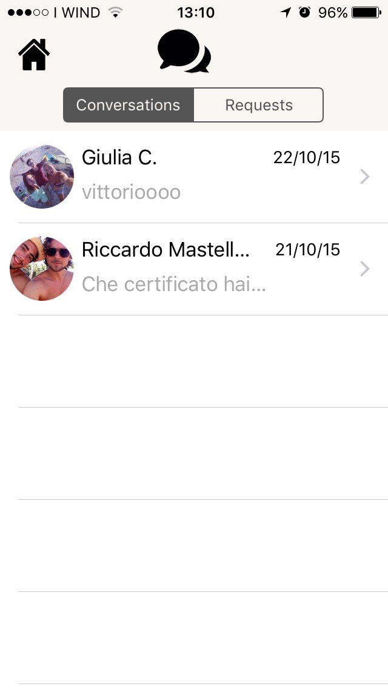
High level description - 1
Tinfnity is a mobile application that implements a proximity chat system aiming to connect people in the same area

Slide 3
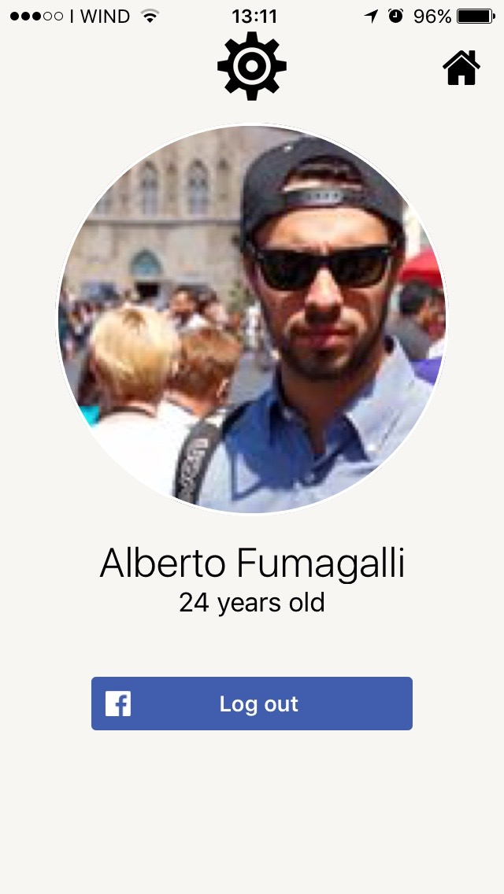
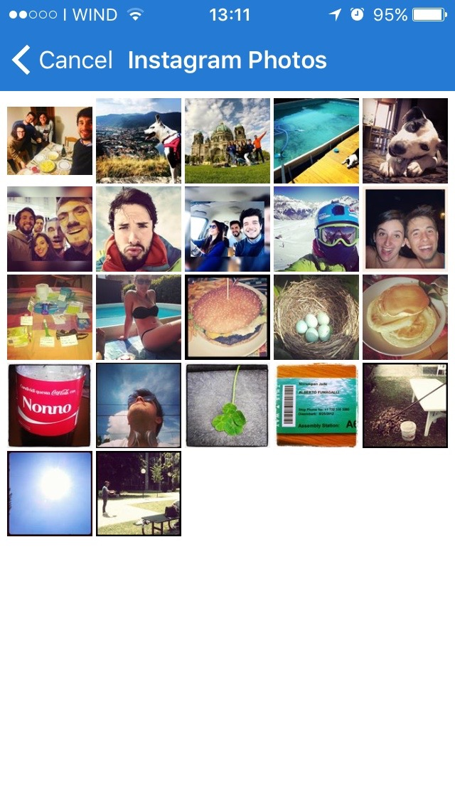
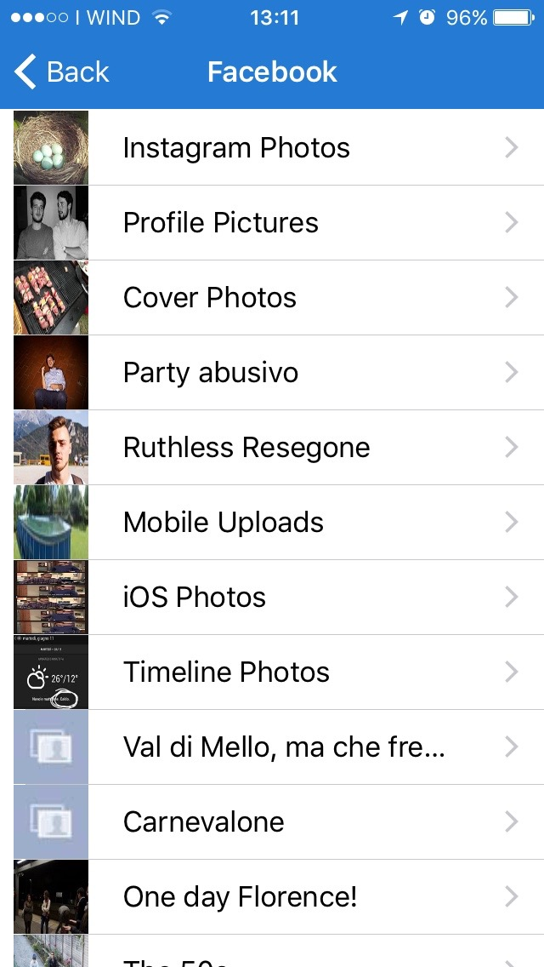
High level description - 2
The application is fully integrated with the user Facebook profile

Slide 4
Functional and non -functional requirements
Functional Requirements:
  Display to the user a map containing the position of other user within 800 m from his position
  Provide a chat system and allow the user to interact with it
  Enable the user to personalise the photos that have to be shared
  Enable the user to send a friendship request and accept / decline the received one
  Create a web application in order to manage the chat system and location system
  Create a push notification system in order to inform the user when a message is received
  Develop an iOS mobile version of the application
Non-functional requirements:
  The application should run on devices with an iOS version > 8.4

Slide 5
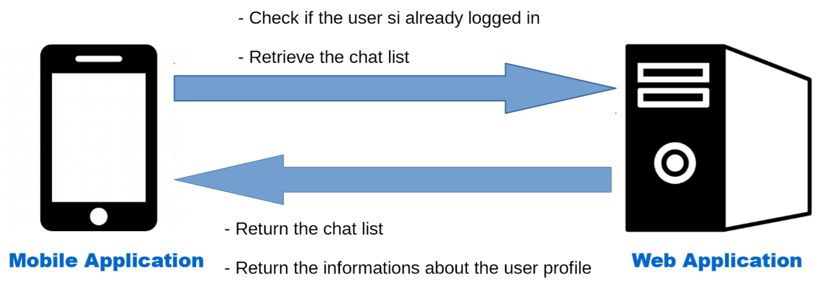
Architecture overview
The architectures of the application is composed by two main parts:
A client iOS application
A server web application

Slide 6
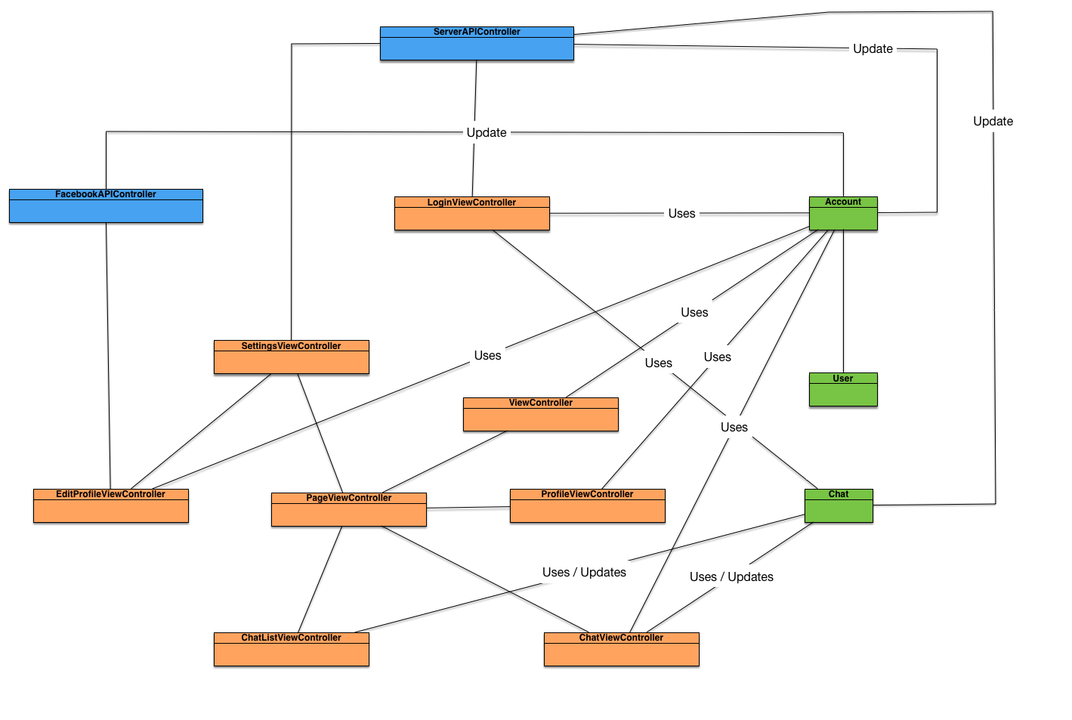
Main class diagram

Slide 7
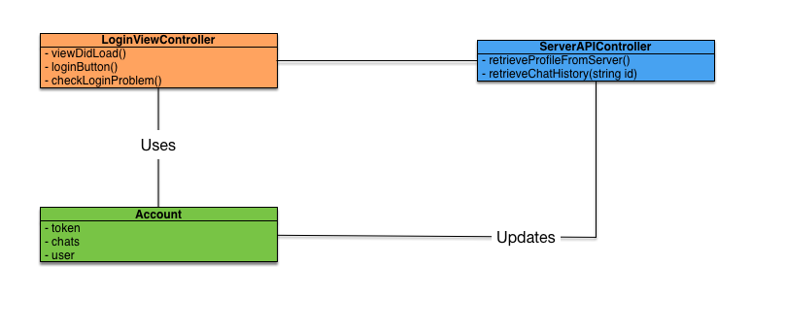
LoginViewController
The LoginViewController manages the view that implement the login functionalities with Facebook and set up the initial settings relative to the account.

Slide 8
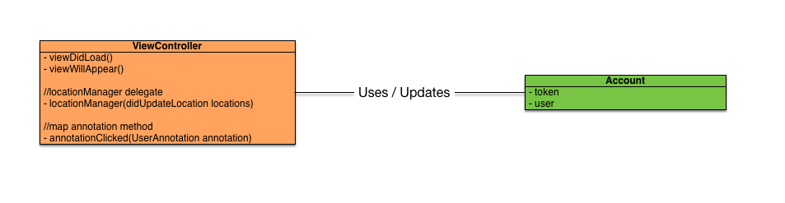
ViewController
The ViewController manages the main view of the application and it show the map with the user location and the location of the other users around him. It is the delegate for the location manager and the mapView callback functions.

Slide 9
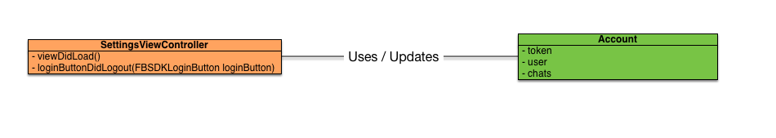
SettingsViewController
The SettingsViewController shows a view with the recap of the user informations and implement the logout functionality.

Slide 10
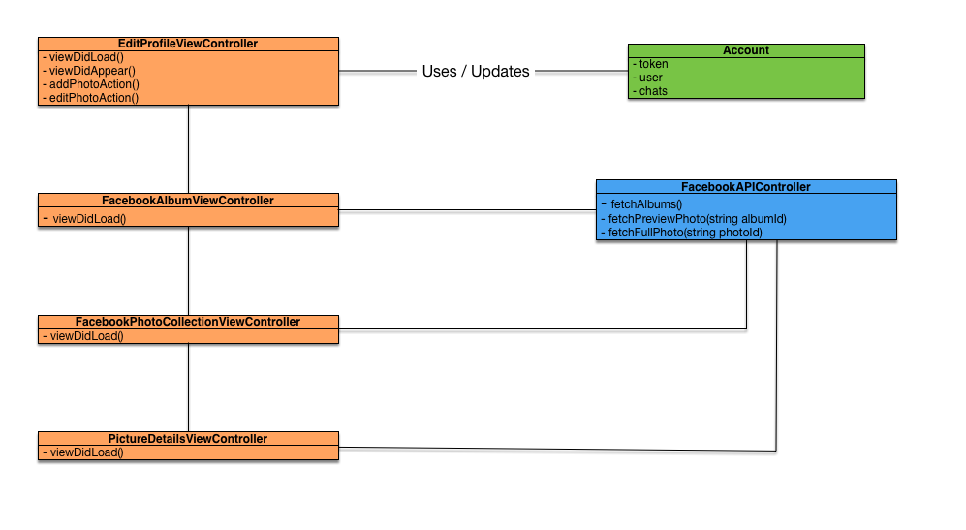
EditProfileViewController

Slide 11
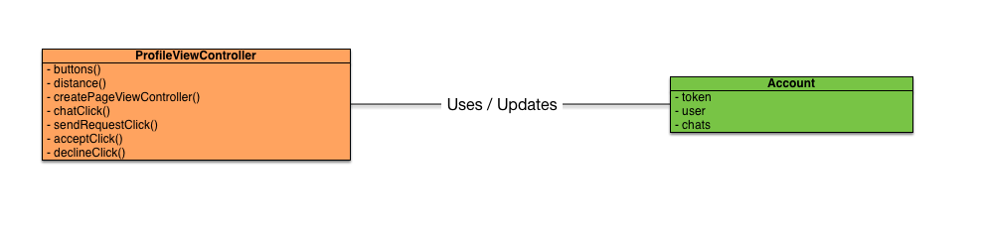
ProfileViewController
The ProleViewController manages the view displayed when the user click on a marker on the map or when he receive a friendship reques

Slide 12
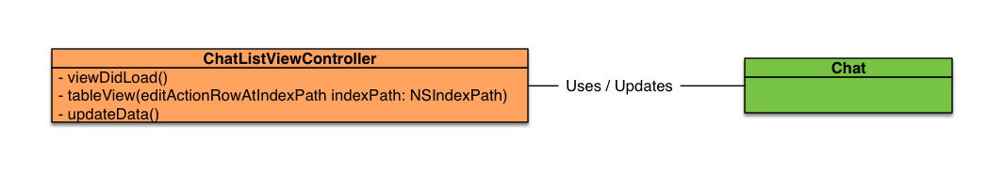
ChatListViewController
Display all the chats that a user has begun
Display all the friendship request received
Implement the functionalities provided if two users are friend (unfriend, delete chat)
Implement the functionalities provided if two users aren't friend (accept, decline, delete chat)

Slide 13
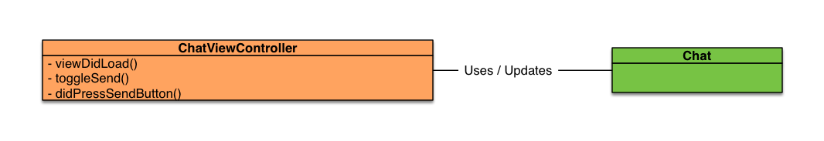
ChatViewController
The ChatViewController manages and display correcly the chat history between two users. It provides also the functionalities in order to send messages and updates the history when a new one is received

Slide 14
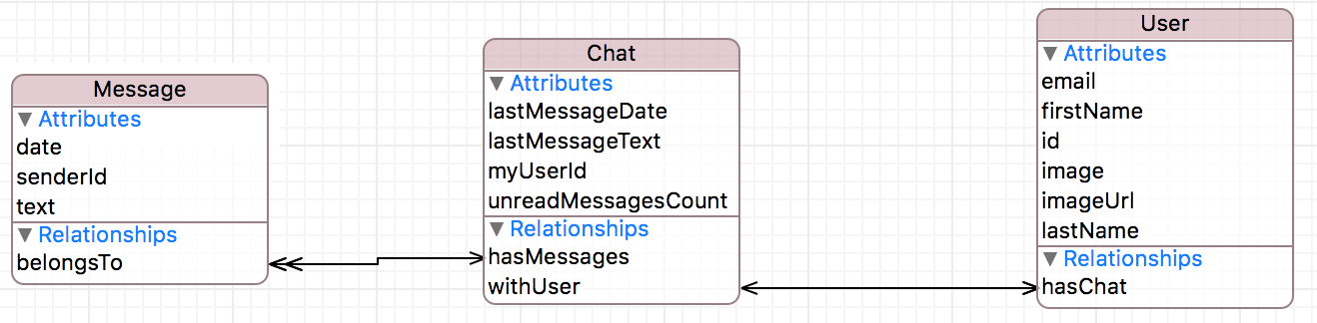
Persistent data design
Message : contains the informations of a single message
Chat : contains the information about the entire chat
User : contains all the information of a user

Slide 15
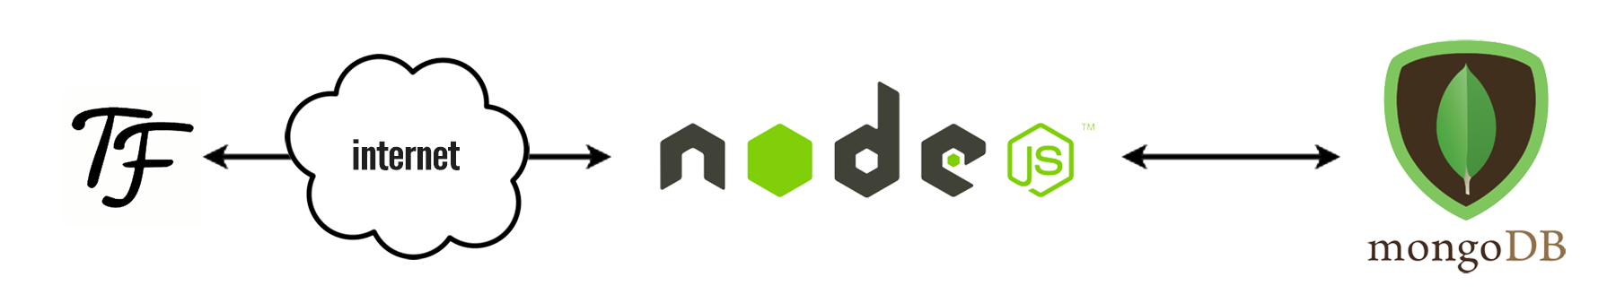
Web app
Handles the users profiles, chat system, and the location system
Not Tightly coupled with the client
Exploit Geospatial data type of mongoDB

