Slide 1
Concurrency
Vu Tuyet Trinh
trinhvt@soict.hut.edu.vn
Department of Information Systems, Faculty of Information Technology
Hanoi University of Technology

Slide 2
Example
500USD
Account A
Account B
read(A)
If A > 500 then
B:=B+500
Crash
What happen ???
A:=A-500

Slide 3
Transaction
A sequence of read and write operations on data items that logically functions as one unit of work
  Assuring data integrity and correction
ACID Properties
  Atomicity
  Consistency
  Isolation
  Durability
Concurrency
Control
Recovery

Slide 4
Automicity
guarantee that either all of the tasks of a transaction are performed or none of them are
Example
T: Read(A,t1);
If t1 > 500 {
Read(B,t2);
t2:=t2+500;
Write(B,t2);
t1:=t1-500;
Write(A,t1);
}
crash

Slide 5
Consistency
ensures that the DB remains in a consistent state before the start of the transaction and after the transaction is over
Example
A+B = C
T: Read(A,t1);
If t1 > 500 {
Read(B,t2);
t2:=t2+500;
Write(B,t2);
t1:=t1-500;
Write(A,t1);
}
A+B = C

Slide 6
Isolation
ability of the application to make operations in a transaction appear isolated from all other operations.
Example A= 5000, B= 3000
T: Read(A,t1);
If t1 > 500 {
Read(B,t2);
t2:=t2+500;
Write(B,t2);
t1:=t1-500;
Write(A,t1);
}
T’: A+B
(= 5000+3500)
(A+B = 4500+3500)

Slide 7
Durability
guarantee that once the user has been notified of success, the transaction will persist, and not be undone
Ví dụ: A= 5000, B= 3000
T: Read(A,t1);
If t1 > 500 {
Read(B,t2);
t2:=t2+500;
Write(B,t2);
t1:=t1-500;
Write(A,t1);
}
crash
A= 4500, B=3500

Slide 8
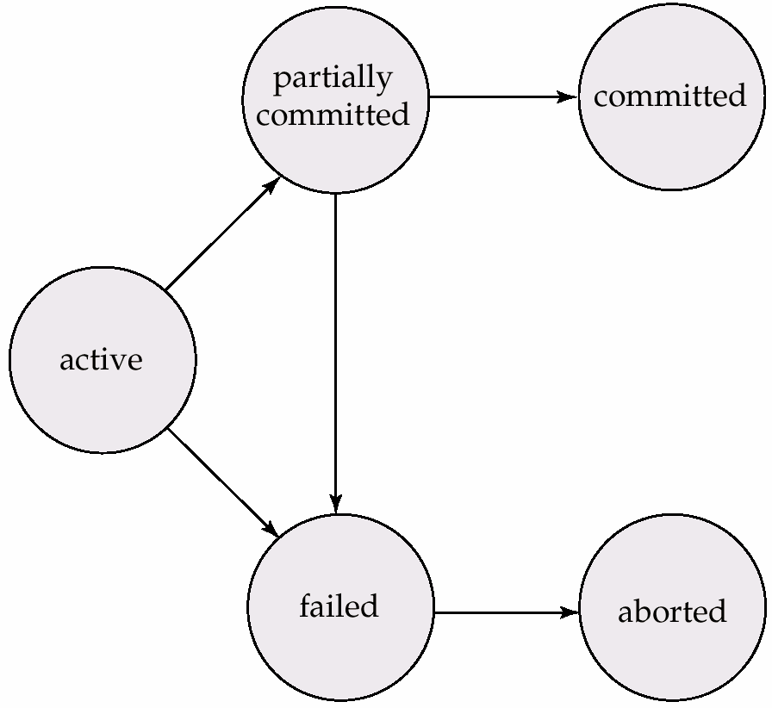
Transaction States

Slide 9
Transaction Management Interfaces
  Begin Trans
  Commit ()
  Abort()
  Savepoint Save()
  Rollback (savepoint)
  (savepoint = 0 ==> Abort)

Slide 10
Concurrency Control
Objective:
  ensures that database transactions are performed concurrently without the concurrency violating the data integrity
  guarantees that no effect of committed transactions is lost, and no effect of aborted (rolled back) transactions remains in the related database.
Example
  T0: read(A); T1: read(A);
  A := A -50; temp := A *0.1;
  write(A); A := A -temp;
  read(B); write(A);
  B := B + 50; read(B);
  write(B); B := B + temp;
  write(B);

Slide 11
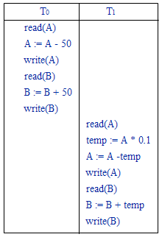
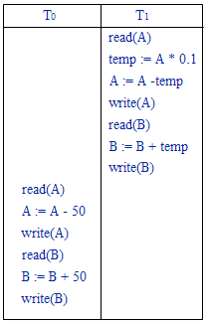
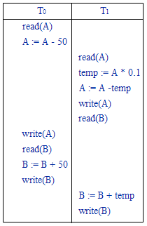
Scheduling
(1)
(2)
(3)

Slide 12
Serializability
A schedule of a set of transactions is a linear ordering of their actions
  e.g. for the simultaneous deposits example:
R1(X) R2(X) W1(X) W2(X)
A serial schedule is one in which all the steps of each transaction occur consecutively
A serializable schedule is one which is equivalent to some serial schedule

Slide 13
Lock
Definition
  a synchronization mechanism for enforcing limits on access to DB in concurrent way.
  one way of enforcing concurrency control policies
Lock types
  Shared lock (LS) readable but can not write
  Exclusive lock (LX): read and write
  UN(D): unlock
Compatibility
 | LS | LX
LS | true | false
LX | false | false

Slide 14
Example
  T0: LX(A); T1: LX(A);
  read(A); read(A);
  A := A -50; temp := A *0.1;
  write(A); A := A -temp;
  LX(B); write(A)
  read(B); LX(B);
  B := B + 50; read(B);
  write(B); B:=B+temp;
  UN(A); write(B);
  UN(B); UN(A);
  UN(B);

Slide 15
Well-Formed, two-phased transaction
A transaction is well-formed if it acquires at least a shared lock on Q before reading Q or an exclusive lock on Q before writing Q and doesn’t release the lock until the action is performed
  Locks are also released by the end of the transaction
A transaction is two-phased if it never acquires a lock after unlocking one
  i.e., there are two phases: a growing phase in which the transaction acquires locks, and a shrinking phase in which locks are released

Slide 16
2Phase Locking (2PL)
Phase 1
  locks are acquired and no locks are released
Phase 2
  locks are released and no locks are acquired
BOT
EOT
t
Phase lock
Phase unlock

Slide 17
Example
T₁
T₃
Lock(A)
T₂
Lock(B)
T₄
Read(A)
Lock(B)
Read(B)
Lock(A)
Lock(B)
Read(B)
B=B-50
Read(A)
Read(B)
Lock(A)
Write(B)
Unlock(A)
B:=B+A
Read(A)
Unlock(B)
Lock(B)
Write(B)
Unlock(B)
Lock(A)
Read(B)
Unlock(A)
A:=A+B
Read(A)
Unlock(B)
Unlock(B)
Write(A)
A=A+50
Pritn(A+B)
Unlock(A)
Write(A)
Unlock(A)
2PL
Not 2PL

Slide 18
Deadlock
  T0: LX(B); (1) T1: LX(A); (4)
  read(B); (2) read(A); (5)
  B := B +50; (3) temp := A *0.1; (6)
  write(B); (8) A := A -temp; (7)
  LX(A); (10) write(A) (9)
  read(A); LX(B);
  A := A - 50; read(B);
  write(A); B:=B+temp;
  UN(A); write(B);
  UN(B); UN(A);
  UN(B);

Slide 19
Resolving Deadlock
Detecting
  Recovery when deadlock happen
    rollback
  Used waiting-graph
Avoiding
    Resource ordering
    Timeout
    Wait-die
    Wound-wait

Slide 20
Waiting Graph
Graph
  Node handling lock or waiting for lock
  Edge T→U
    U handle L(A)
    T wait to lock A
    T must wait until U unlock A
If there exists a cycle in the waiting graph → deadlok

Slide 21
Timeout
Set a limit time for each transaction
If time-out → do rollback

Slide 22
Exercises

