Slide 1


Azure Functions
A serverless computer service
Phat.Tran & Loc.Nguyen October 2022

Slide 2


TABLE OF CONTENTS
01.
04.
06.
What is Azure?
Demo
Pricing
02.
05.
07.
What is Azure Functions?
Best practices & Common Scenarios
Q & A
03.
Benefits of using Azure Functions

Slide 3


What is Azure?
Notes:
Vì Azure Function là một phần của hệ sinht hái Azure Cloud => overview nhanh qua Azure Cloud

Slide 4
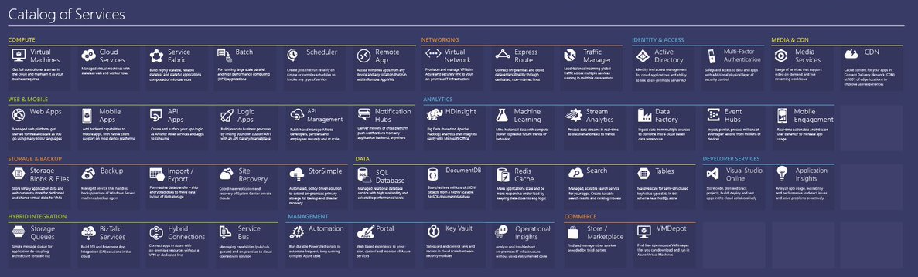
What is Azure?
Microsoft Azure is a cloud computing service operated by Microsoft. It provides a range of cloud services, including compute, analytics, storage and networking
Notes:
- It is a serverless compute service of Microsoft Azure *Giới thiệu nhanh qua Azure: Là một computing cloud của Microsoft

Slide 5
What is Azure Functions?

Slide 6
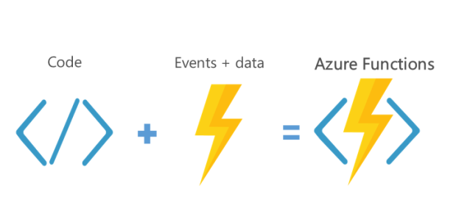
What is Azure Functions?

Slide 7
What is Azure Functions?
Function as a Service (FaaS) offering that allows developers to focus on writing code and not worry about maintaining the underlying computing infrastructure.
Azure Functions are "nanoservices" that can scale based on demand (only paying for the resources you use)
Notes:
Azure Function là 1 service của Azure cloud được cung cấp theo kiến trúc FaaS => Dev ko cần handle physical hardware, OS, software,…. Chỉ cần tập trung vào code sao cho tinh gọn, hiệu quả và hiệu suất nhất có thể

Slide 8
Supported languages and tools
Azure Functions can be created in C#, Node/JavaScript, Python, F#, PHP and scripting languages like PowerShell, Batch and Bash.
Tools: Azure portal, Azurite, Microsoft Azure Storage Explorer

Slide 9
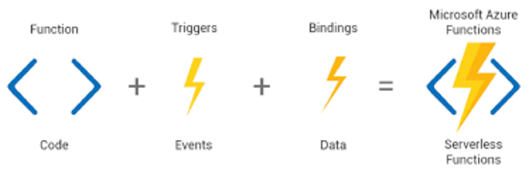
Main concept
Triggers and bindings lets you avoid hardcoding access to other services and abstracting away boilerplate code keeping your functions lean.
Notes:
Concept chính của azure fuction là trigger và bindings. Nó giúp bạn ko phải hard code các access vào các data hoặc services. Từ đó giúp code của bạn lean hơn

Slide 10
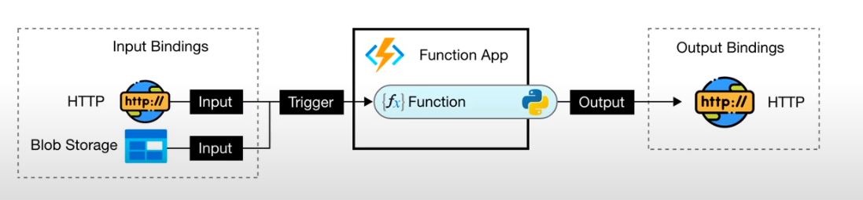
Main concept
Trigger is a specific type of event which causes the function to run. It defines how a function is invoked and a function must only have one trigger. Triggers can have associated data which is often provided as the payload of the function.
Bindings define if your function is connected to another service. The data from bindings is provided to the function as parameters. Bindings are optional, and a function can have multiple input and output bindings
Notes:
Triggers: Là cách mà các function sẽ được excuted => Ví dụ như khi 1 http được call, 1 message được gửi vào queue…
Bindings: Là kết nối đến data trong các functions. Nó là một option trong định dạng của input và output của function. (Ví dụ: Data input là dữ liệu đến từ nội dung message trong queue, output là record trong cosmos) *Unlike a trigger, a function can have multiple input and output bindings.
=> Vì bindings chỉ là optional vì thế chúng ta sẽ tiếp tục đi tìm hiểu sâu hơn về Trigger

Slide 11
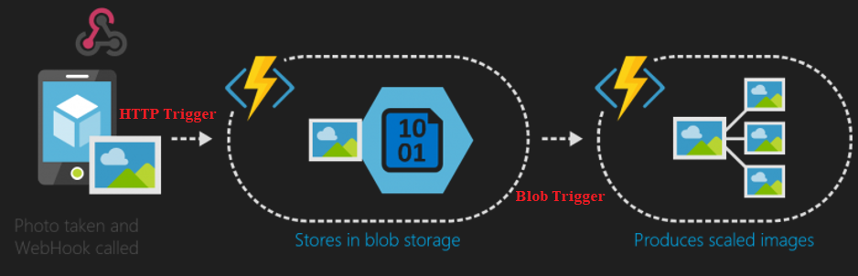
Triggers
HTTPTrigger: Trigger the execution of your code by using an HTTP request.
BlobTrigger: Process Azure Storage blobs when they are added to containers. You might use this function for image resizing.

Slide 12
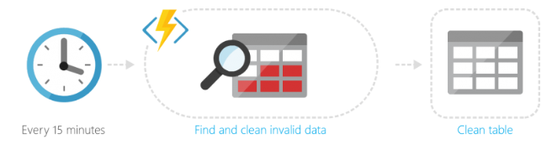
Triggers
TimerTrigger: Execute clean up or other batch tasks on a predefined schedule.
CosmosDBTrigger: Process Azure Cosmos DB documents when they are added or updated in collections in a NoSQL database.
QueueTrigger: Respond to messages as they arrive in an Azure Storage queue.

Slide 13
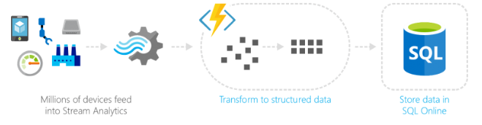
Triggers
EventHubTrigger: Respond to events delivered to an Azure Event Hub. Particularly useful in application instrumentation, user experience or workflow processing, and internet-of-things (IoT) scenarios.
Notes:
EventHubTrigger ứng dụng trong bài toán IoT, ví dụ như xử lý dữ liệu phi cấu trúc nhận được từ các thiết bị IoT thành dữ liệu có cấu trúc và lưu vào cơ sở dữ liệu SQL

Slide 14
Triggers
EventGridTrigger: Respond to events delivered to a subscription in Azure Event Grid. Supports a subscription-based model for receiving events, which includes filtering. A good solution for building event-based architectures.
ServiceBusQueueTrigger: Connect your code to other Azure services or on-premises services by listening to message queues.
ServiceBusTopicTrigger: Connect your code to other Azure services or on-premises services by subscribing to topics.

Slide 15
Benefits of Using Azure Functions

Slide 16
Benefits of using Azure Functions
Lightweight and can be serverless
Easier to write and deploy
Support a lot of programming languages
Do not need any infrastructure and have zero maintenance
Integration with other Azure Services
Support using third party libraries
Flexibility in development
Cost-Efficient + Scalable

Slide 17
Demo

Slide 18
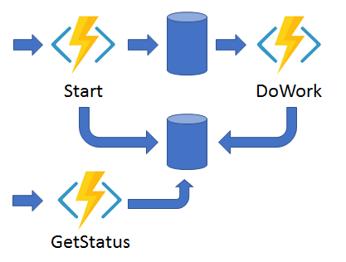
Demo – Durable Function
Durable Functions provide built-in APIs that simplify the code we write for interacting with long-running function executions.
The Async HTTP API pattern addresses the problem of coordinating the state of long-running operations with external clients.
Notes:
A common way to implement this pattern is to have an HTTP call trigger the long-
running action, then redirect the client to a status endpoint that they can poll to learn
when the operation is complete.

Slide 19
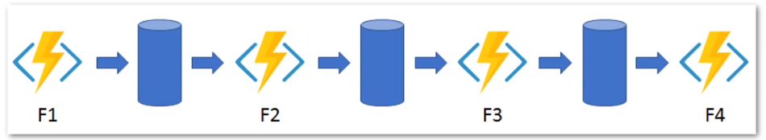
Demo – Durable Function
Function chaining: the pattern of executing a sequence of functions in a specific order.
Notes:
Often the output of one function needs to be applied to the input of another function.
Durable Functions allows us to implement this pattern concisely in code.

Slide 20
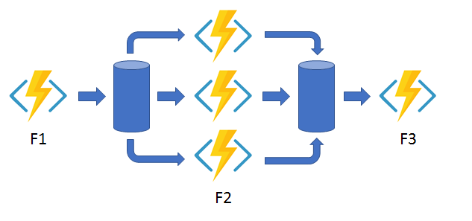
Demo – Durable Function
Fan-out/fan-in: the pattern of executing multiple functions in parallel and then waiting for them all to finish.
Notes:
- Fanning out can be completed with normal functions by having the function send
multiple messages to a queue.
- Fanning in is much more difficult because we have to write code to track when
the queue-triggered functions end and store function outputs.
=> But durable Functions extension handles this pattern with relatively simple code

Slide 21
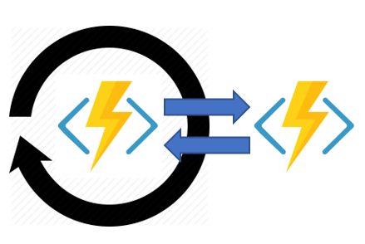
Demo – Durable Function
The Monitor pattern refers to a flexible recurring process in a workflow such as polling until certain conditions are met.
Notes:
A simple scenario, such as a periodic cleanup job, can be addressed with a regular
timer-trigger, but its interval is fixed, making managing instance lifetimes difficult.
Durable Functions enables flexible recurrence intervals, task lifetime management,
and the ability to create multiple monitor processes from a single orchestration.

Slide 22
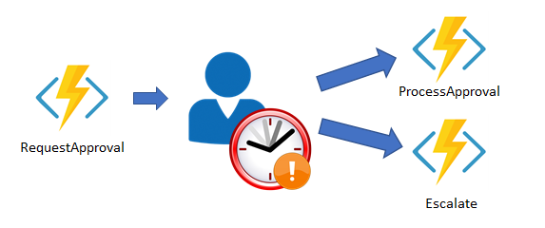
Demo – Durable Function
Human Interaction
Notes:
Many automated processes involve some form of human interaction
Humans are not always as available and responsive as cloud services,
which makes involving humans in an automated process tricky.
Automated processes must allow for this, and they often do so by
using timeouts and compensation logic.

Slide 23
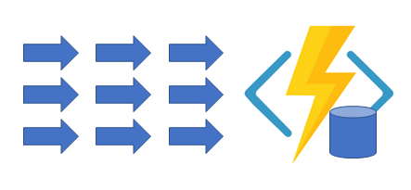
Demo – Durable Function
The Aggregator (stateful entities)
Notes:
The Aggregator (stateful entities) pattern is about aggregating
event data over a period of time into a single, addressable entity.
The data being aggregated may come from multiple sources, be
delivered in batches, or may be scattered over long-periods of time
The aggregator may need to act on event data as it arrives external
clients may need to query the aggregated data.

Slide 24
Best practices & Common Scenarios

Slide 25
Common Scenarios
Azure functions are best suited for smaller apps have events that can work independently of other websites.
Business Use-Cases Scheduled Tasks Reminders and Notifications Lightweight Web API Sending background emails Running background backup tasks Doing backend calculations | Technical Use-Cases Sending emails Starting backup Order processing Task scheduling + Database cleanup + Sending notifications + Messages + IoT data processing

Slide 26
Best practices
Functions should "do one thing“.
Functions should be idempotent.
Functions should finish as quickly as possible.
If you want to use Azure function for your old project, Implement it as a new layer on top of old layers & replace one by one API or background processing item.
Should choose Windows host when create Function. Because generally Microsoft Azure better supports compute running Windows.

Slide 27
Pricing

Slide 28
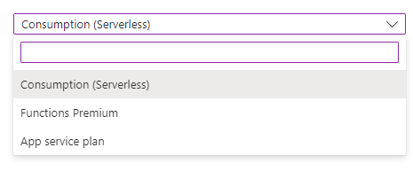
Pricing
Only pay for the time our code is running. You'll be charge based on the number of resources your Azure Functions needs, and only for as long as it takes your code to execute.
Azure Functions has 3 available of plans

Slide 29
Pricing
Consumption Plan (Serverless) Cold-Starts
You only pay for the time your code or application is running.
Billing is based on the number of executions, the duration of each execution, and the amount of memory used.
Just pay while you have functions running and scale-out automatically, even through long loading times.
Notes:
Consumption plan - When your function runs, Azure
provides all of the necessary computational resources. You
don't have to worry about resource management, and you
only pay for the time that your code runs.
- Consumption Plan pricing includes a monthly free grant of 1 million
requests and 400,000 GB-s of resource consumption per month:

Slide 30
Pricing
Premium Plan (Functions Premium) Pre-Warmed
The user has designated a set of pre-warmed cases, which are already online and ready to react instantly.
Azure provides any additional computing services that are required when your function is running.
You pay for the constantly pre-warmed instances including any additional instances needed to scale the Azure app in/out.
Azure Functions host instances are added and removed based on the number of incoming events.

Slide 31
Pricing
Dedicated Plan (App service plan) VM sharing
When you use App Service for other apps, your functions will run on the same plan (VMs) at no extra cost.
You may scale it out manually by adding more VM instances for an App Service plan.
You may also have autoscale enabled.
Optimal when you have existing, underutilized VMs, which also operate other instances of the App Service.
Notes:
App Service plan - Run your functions just like your web,
mobile, and API apps. When you're already using App
Service for your other applications, you can also run your
functions on the same plan at no additional cost.
- Your functions run on dedicated VMS
Dedicated VM's are allocated to your App Service apps and
function apps are always available whether code is actively
running or not
Good option if you have under utilized VMS
A VM decouples the cost from both runtime and memory
size — you can limit the cost for long- running functions to
the cost of the VMS they run on

Slide 32
Q & A

Slide 33

THANK YOU!

