Slide 1
Rails Framework

Slide 2
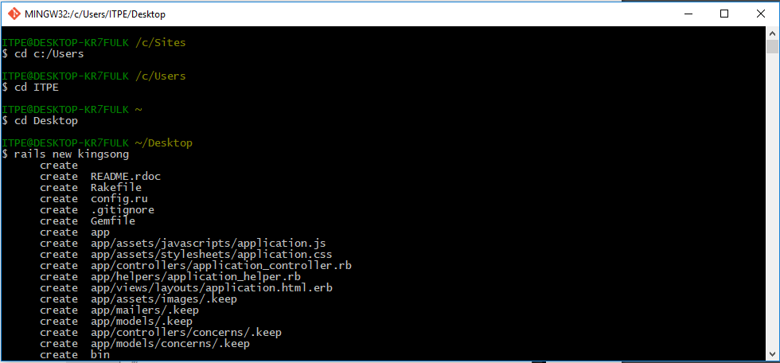
1. Go to desktop 2. rails new kingsong

Slide 3
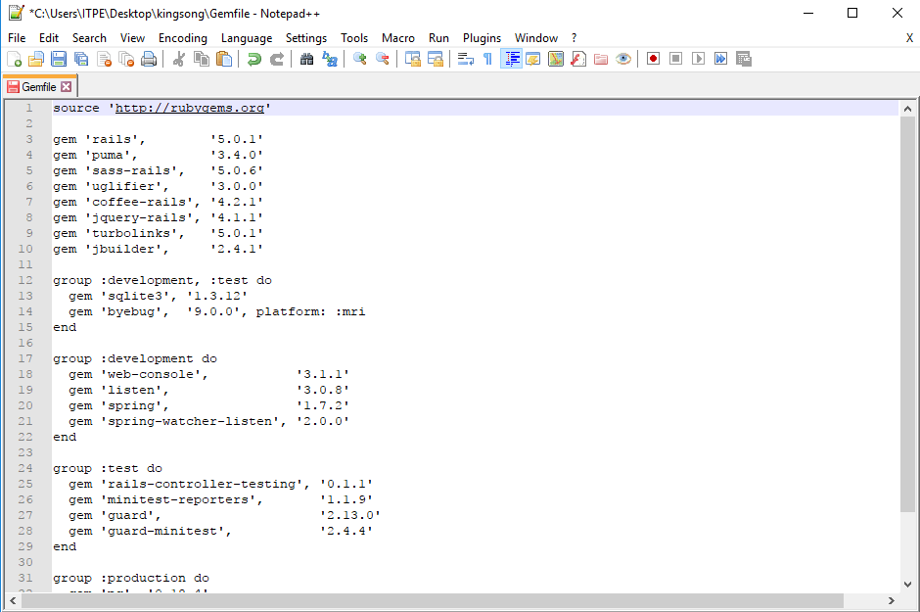
3. change Gemfile

Slide 4
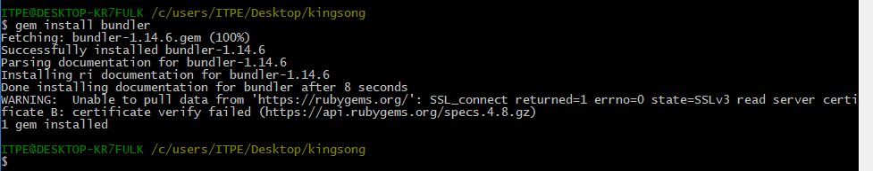
4. cd kingsong 5. gem sources –a http://rubygems.org 6. answer y 7. gem install bundler

Slide 5
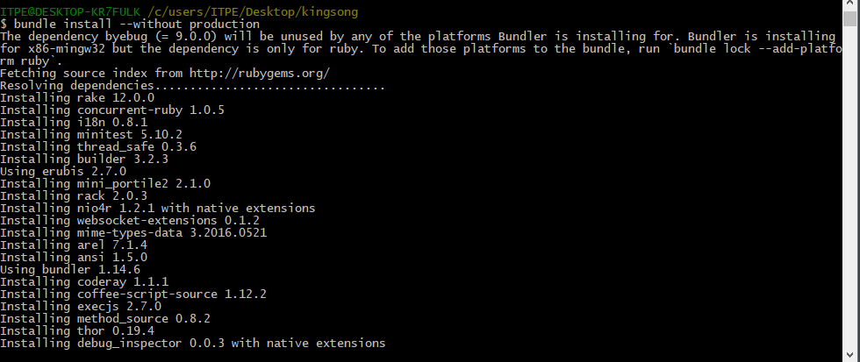
8. bundle install --without production

Slide 6
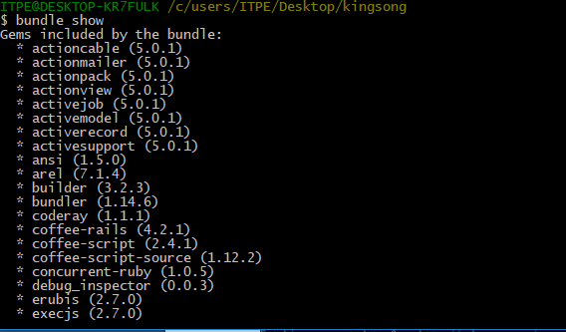
9. bundle show

Slide 7
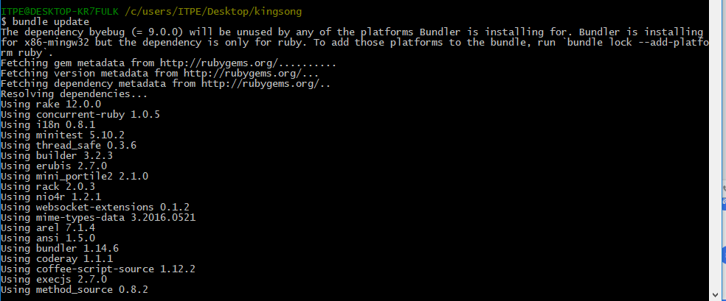
10. bundle update

Slide 8
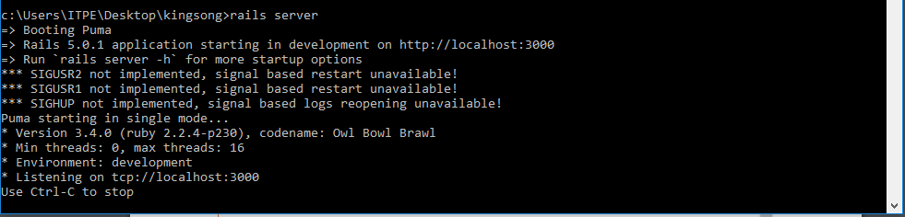
11.open cmd run rails server

Slide 9
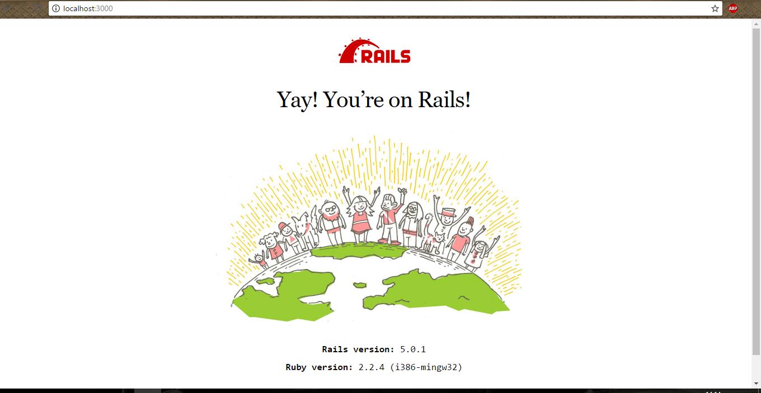
12.open localhost:3000 will see welcome rails

Slide 10
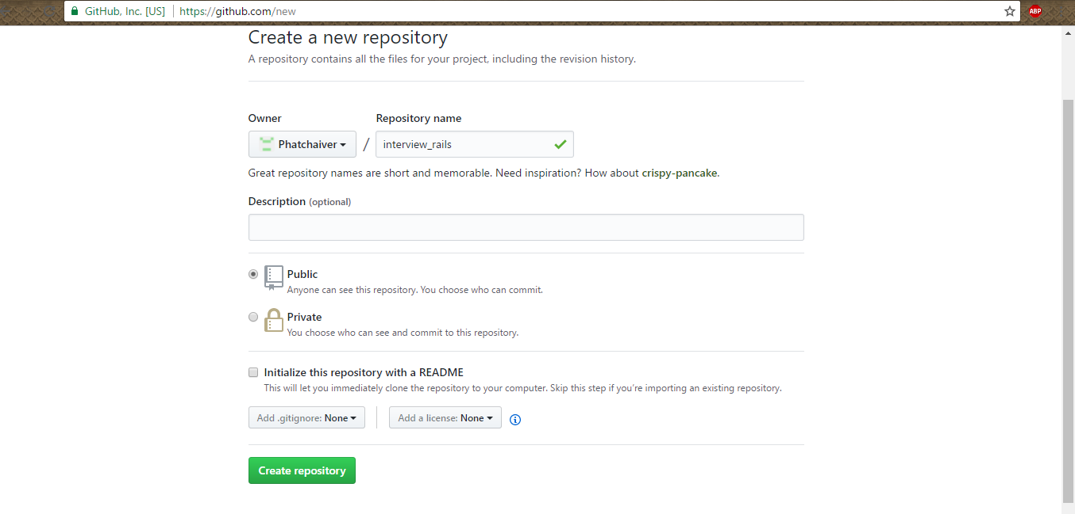
13.create repo at github

Slide 11
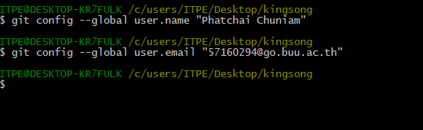
14.git config --global user.name "your username" 15.git config --global user.email "your email"

Slide 12
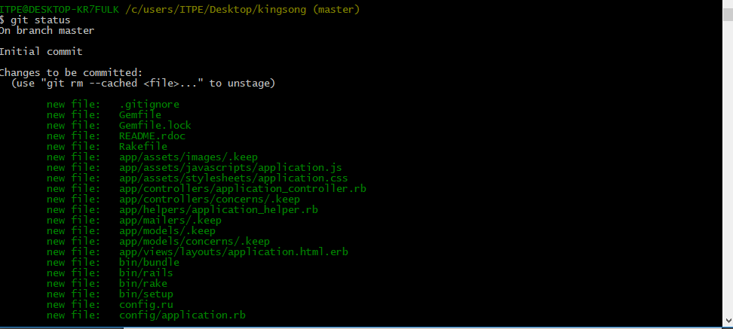
16.git init 17.git add –A (**A only**) 18.git status

Slide 13
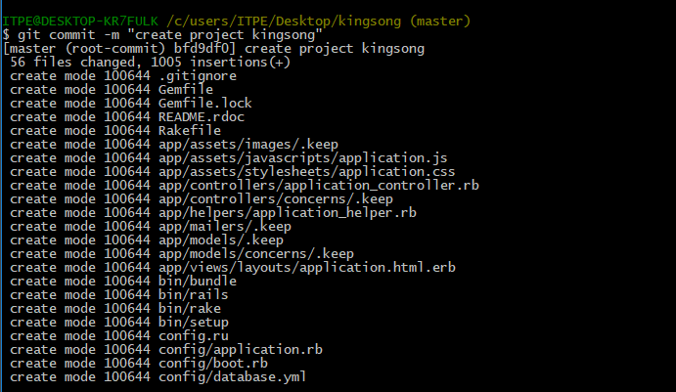
19.git commit –m “create project kingsong”

Slide 14
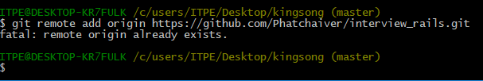
20. git remote add origin “git repo”

Slide 15
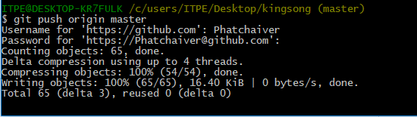
21. git push -u origin master

Slide 16
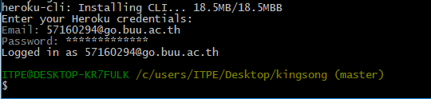
22.heroku login

Slide 17
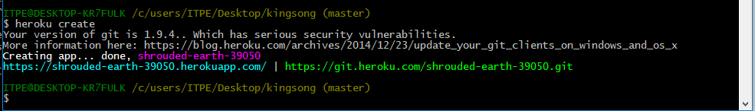
23. heroku create

Slide 18
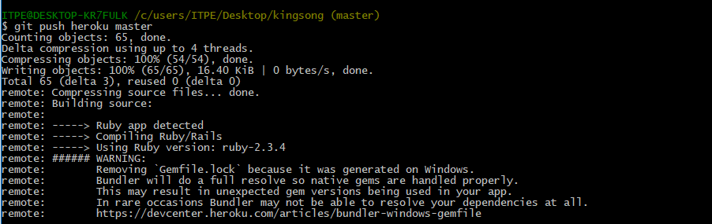
24.git push heroku master

Slide 19

25.git checkout -b static-pages

Slide 20
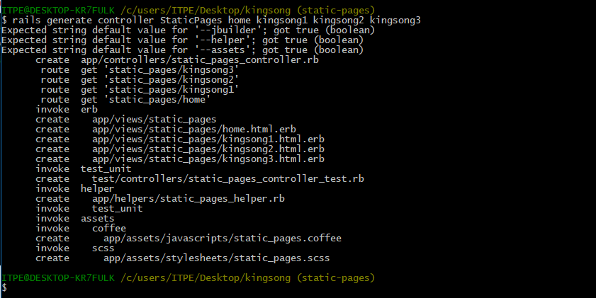
26. rails generate controller StaticPages home kingsong1 kingsong2 kingsong3

Slide 21
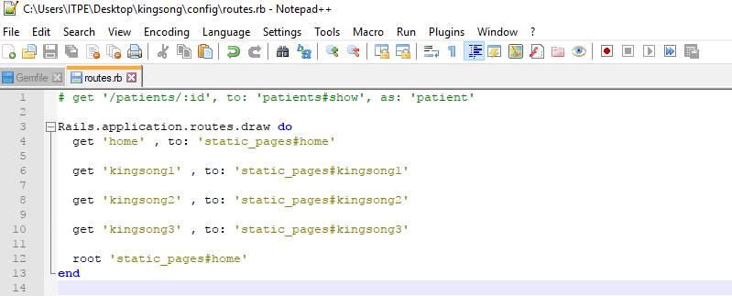
27. edit config/routes

Slide 22
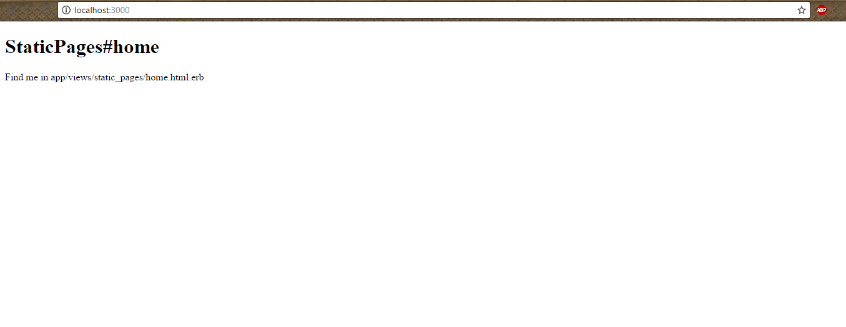
28.Look localhost:3000

Slide 23
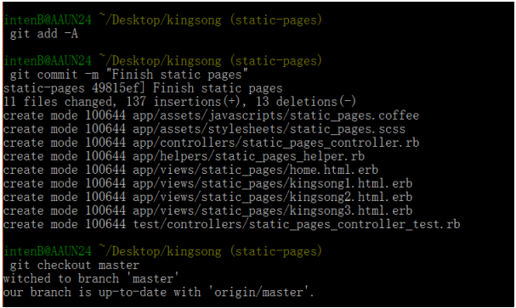
29.Edit app/views/static_pages/home.html.erb
30.Edit app/views/static_pages/kingsong1.html.erb
31.Edit app/views/static_pages/ kingsong2.html.erb
32.Edit app/views/static_pages/ kingsong3.html.erb
33.Edit Readme
34.git add –A
35.git commit -m "Finish static pages"
36.git checkout master

Slide 24
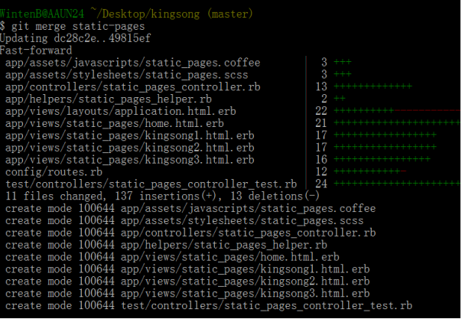
37.git merge static-pages

Slide 25
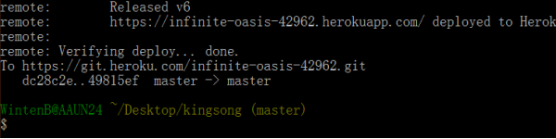
38. git push 39.git push heroku

Slide 26


40.git checkout –b presentation
41.create powerpoint

Slide 27
finish

