Slide 1
Market Entry Strategy
Your Business Name Here

Slide 2
Our Market Entry Journey: 4 Phases
1
Are You
Ready?
2
Where to
Play?
3
How to
Win?
4
How to
Launch?

Slide 3
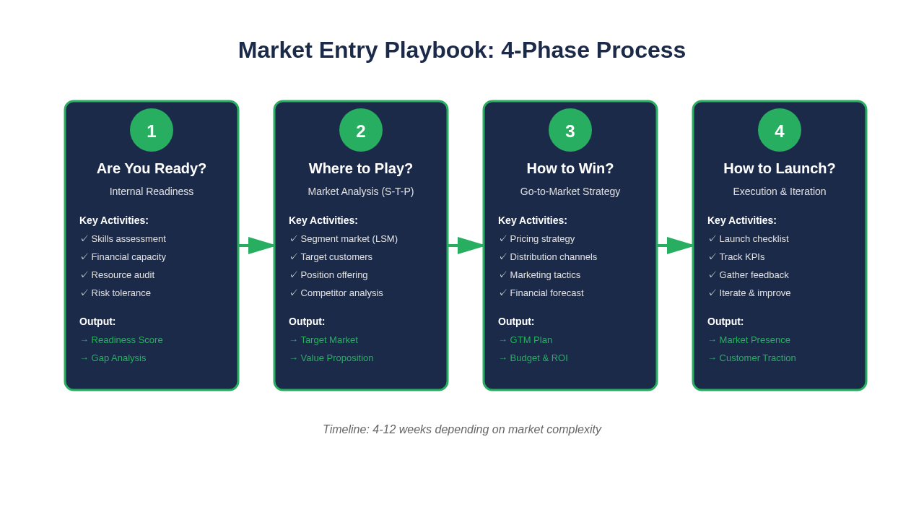
The 4-Phase Market Entry Process

Slide 4
PHASE
1
Are You Ready?

Slide 5
Phase 1: Internal Readiness Assessment
Business Stability ✅
• Consistently profitable for [X months]
• Standardized processes in place
• Can operate without daily owner presence
Team Readiness ✅
• Skilled and motivated team
• Deputy/2iC identified and trained
Financial Health ✅
• R[Amount] cash reserves ([X] months runway)
• Healthy profit margins
• Funding secured: [Source]

Slide 6
PHASE
2
Where to Play?

Slide 7
Phase 2: Segmentation-Targeting-Positioning (S-T-P)
S
T
P
Segmentation
Targeting
Positioning
Divide market
into groups
Choose best
segment
Define unique
value

Slide 8
Our Target Market
Geographic: [City/Province/Region]
Demographic: [LSM level, Age, Income]
Psychographic: [Lifestyle, Values]
Behavioural: [Purchase patterns, Benefits sought]
Market Attractiveness Score: [X.X / 5.0]

Slide 9
PHASE
3
How to Win?

Slide 10
Phase 3: Our Go-to-Market Strategy
Product
[What we're selling]
Price
[Pricing strategy]
Place
[Distribution channels]
Promotion
[Marketing tactics]

Slide 11
Financial Plan
Startup Costs: R[Amount]
• [Key expense 1]
• [Key expense 2]
• [Key expense 3]
Monthly Operating Costs: R[Amount]
• [Key expense 1]
• [Key expense 2]
Revenue Forecast (Month 3): R[Amount]
Break-Even: Month [X]

Slide 12
PHASE
4
How to Launch?

Slide 13
Phase 4: Pilot Launch & KPIs
Pilot Launch Approach:
[Describe your low-risk pilot - e.g., pop-up shop, online campaign, partnership]
Key Performance Indicators (KPIs):
• Revenue: R[Target]
• New Customers: [Target number]
• Customer Acquisition Cost: R[Target]
• Customer Satisfaction: [Target score]
Review Date: [Date - 3 months after launch]
Decision Criteria: If we achieve [X]% of targets, we will scale up.

Slide 14
Next Steps & Timeline
Week 1-2: Finalize preparations
• [Action item 1]
• [Action item 2]
Week 3-4: Launch pilot
• [Action item 1]
• [Action item 2]
Month 2-3: Measure and iterate
• Track KPIs weekly
• Gather customer feedback
Month 4: Review and decide
• Scale, Pivot, or Pull Out

Slide 15
Let's Make This Happen!
Thank You 🚀

