Slide 1
SWOT Analysis Pack
South African Edition

Slide 2
Complete Your SWOT Analysis
Use the following slides to identify your business position

Slide 3
SWOT Analysis
Strengths
Weaknesses
• Add your strengths here
• Add your strengths here
• Add your strengths here
• Add your weaknesses here
• Add your weaknesses here
• Add your weaknesses here
Opportunities
Threats
• Add your opportunities here
• Add your opportunities here
• Add your opportunities here
• Add your threats here
• Add your threats here
• Add your threats here

Slide 4
STRENGTHS
S
• What do customers consistently compliment you on?
• What unique skills or resources do you have?
• What do you do better than competitors?
• Do you have strong B-BBEE credentials?
• What are your competitive advantages?

Slide 5
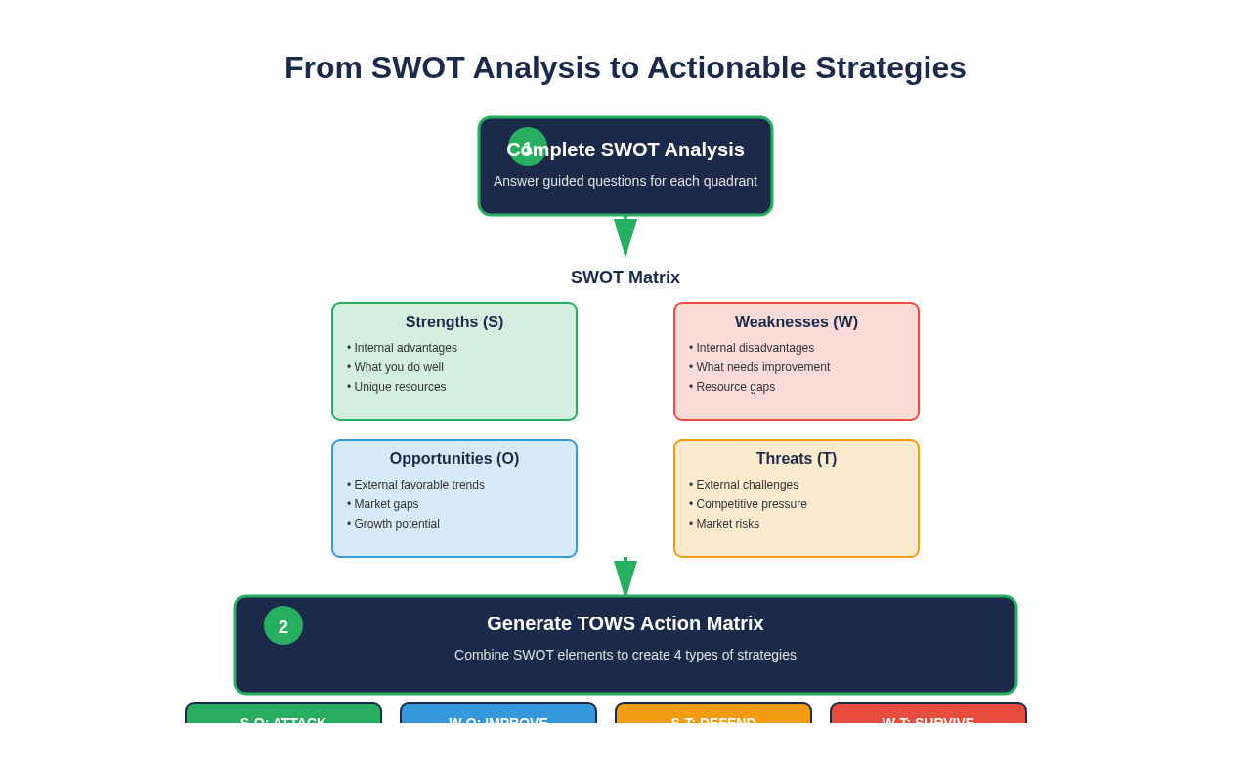
From SWOT Analysis to Actionable Strategies

Slide 6
WEAKNESSES
W
• How many hours/sales lost to loadshedding?
• Do you track income and expenses formally?
• What skills or resources are you missing?
• What do competitors do better than you?
• What do customers complain about?

Slide 7
OPPORTUNITIES
O
• Are there affordable digital tools you could use?
• Are you aware of SEDA, SEFA, NEF funding?
• Are there new markets you could enter?
• Could you partner with other businesses?
• What trends could benefit your business?

Slide 8
THREATS
T
• How does crime/theft impact your business?
• Are competitors offering better prices?
• Are regulations changing (tax, labor, etc.)?
• Is your market shrinking?
• What external risks keep you up at night?

Slide 9
TOWS Action Matrix
Attack Strategies
Defend Strategies
Use Strengths to capture Opportunities
Use Strengths to counter Threats
• Strategy 1
• Strategy 2
• Strategy 1
• Strategy 2
Improve Strategies
Survive Strategies
Fix Weaknesses to capture Opportunities
Minimize Weaknesses and avoid Threats
• Strategy 1
• Strategy 2
• Strategy 1
• Strategy 2

Slide 10
Your Next Steps
1. Complete the SWOT worksheet in Excel
2. Develop 2-3 strategies for each TOWS quadrant
3. Prioritize your top 3 strategies
4. Create action plans with deadlines
5. Review quarterly and update

Slide 11
Ready to Take Action?
Use this SWOT analysis to drive your business forward

