Slide 1
CHAT Business Model Framework
Customer • How • Assets • Tools

Slide 2
The CHAT Triangle
7 Components of Your Business Model

Slide 3
The CHAT Framework
Outcome
Object
Differentiator
Key Activities
Subject
Barriers to Entry
Customer

Slide 4
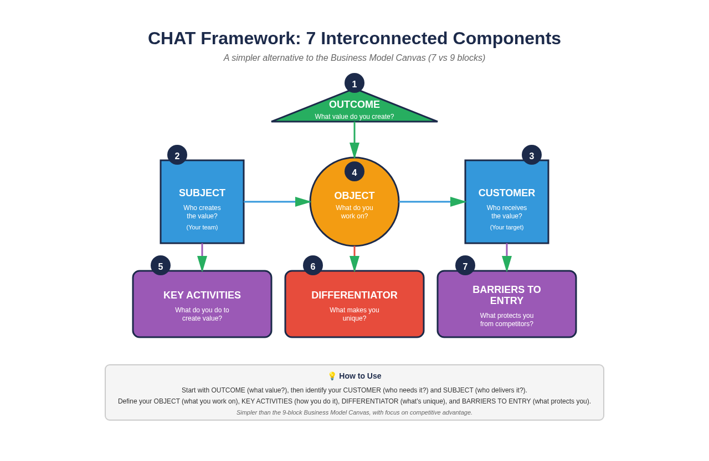
The 7 Interconnected Components

Slide 5
SUBJECT
1
Your company/business
• What is your company name?
• What industry are you in?
• What is your core business?
• Who are the key people in your business?

Slide 6
OBJECT
2
Assets and resources you buy (not make)
• What raw materials do you purchase?
• What equipment or tools do you buy?
• What services do you outsource?
• What licenses or software do you pay for?

Slide 7
OUTCOME
3
Your final product or service
• What do customers actually receive?
• What problem does it solve?
• What value does it deliver?
• How is it packaged or delivered?

Slide 8
DIFFERENTIATOR
4
Your secret sauce - what makes you unique
• What do you do that competitors don't?
• What is your niche or specialty?
• What gives you an unfair advantage?
• Why do customers choose you over others?

Slide 9
BARRIERS TO ENTRY
5
What protects you from competition
• Do you have patents, trademarks, or IP?
• Do you have exclusive supplier relationships?
• Do you have regulatory licenses?
• What makes it hard for others to copy you?

Slide 10
CUSTOMER
6
Who pays for and uses your product
• Who is your ideal customer?
• Who actually pays (if different from user)?
• What community or market do they belong to?
• How do you reach them?

Slide 11
KEY ACTIVITIES
7
What you actually do (division of labor)
• What are your main business activities?
• What processes do you follow?
• Who does what in your team?
• What activities create the most value?

Slide 12
How to Complete Your CHAT
1. Start with Subject - Define your business
2. Identify your Object - What you buy/source
3. Define your Outcome - What customers get
4. Clarify your Differentiator - Your unique edge
5. List Barriers to Entry - Your protection
6. Describe your Customer - Who pays
7. Map Key Activities - What you do

Slide 13
Build Your CHAT Today
Visualize your business model in 7 components

