Slide 1
Levels of Work Organogram Builder
Structure your business for growth

Slide 2
The 4 Levels Framework
From operations to strategy

Slide 3
The 4 Levels of Work
Level 4: Decides Value
Strategy
Level 3: Controls Value
Management
Level 2: Coordinates Value
Supervision
Level 1: Added Value
Operations (Do the work)

Slide 4
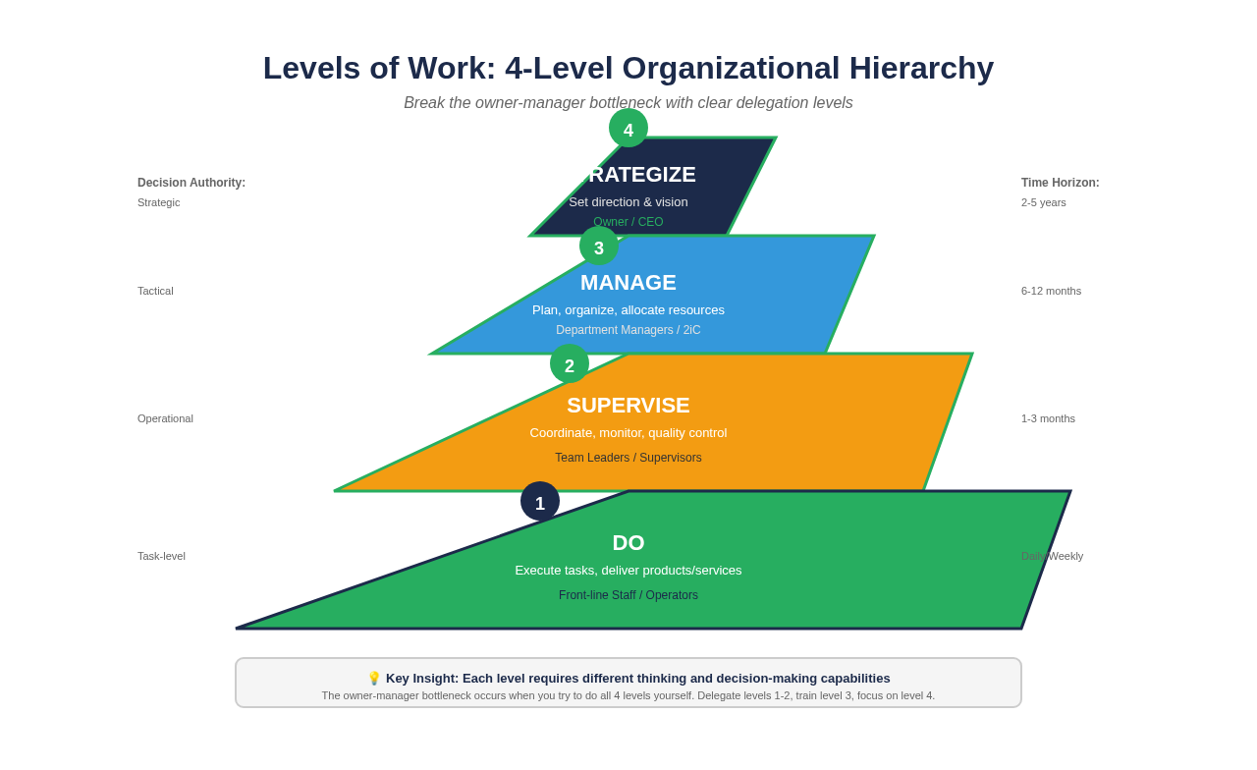
The 4-Level Organizational Hierarchy

Slide 5
ADDED VALUE
LEVEL
1
DO the work
Operational workers who directly create value for customers
• Who physically makes the product or delivers the service?
• Who interacts directly with customers?
• Who operates equipment or tools?
• Examples: Bakers, drivers, sales assistants, technicians

Slide 6
COORDINATES VALUE
LEVEL
2
SUPERVISE the work
Supervisors who coordinate Level 1 workers and ensure quality
• Who makes sure Level 1 workers have what they need?
• Who handles day-to-day problems and questions?
• Who checks quality and fixes immediate issues?
• Examples: Shift supervisors, team leaders, floor managers

Slide 7
CONTROLS VALUE
LEVEL
3
MANAGE the systems
Managers who control systems, processes, and resources
• Who designs the systems and processes?
• Who manages budgets and resources?
• Who hires, trains, and develops staff?
• Examples: Operations manager, HR manager, finance manager

Slide 8
DECIDES VALUE
LEVEL
4
SET the strategy
Leaders who set strategic direction and make key decisions
• Who decides what products/services to offer?
• Who sets the business vision and goals?
• Who makes major investment decisions?
• Examples: CEO, owner, managing director, board

Slide 9
Why Levels of Work Matter
✓ Breaks the owner-manager bottleneck
✓ Clarifies who does what at each level
✓ Helps you delegate effectively
✓ Identifies gaps in your structure
✓ Guides hiring and promotion decisions
✓ Scales your business beyond yourself

Slide 10
Build Your Organogram
1. List all activities in your business
2. Assign each activity to a level (1-4)
3. Group activities into roles
4. Map reporting relationships
5. Identify gaps and overlaps
6. Create your visual organogram

Slide 11
Structure for Success
Use the 4 Levels to scale your business

