Slide 1
Outline
Why were Transformers needed and what are they?
Why was BERT needed?
What is BERT and how does it work?
When and how can we use BERT?
DAIS

Slide 2
Why were Transformers needed and what are they?
RNNs, LSTMs and GRUs were the main architectures for all NLP tasks until Transformers came along
RNN-based models performed well, and even with Attention mechanism
However, they had two limitations:
It was difficult to deal with long-range dependencies between words
They process the input sequentially
The Transformers architecture address both limitations and got rid of RNNs relying exclusively on Attention mechanism
DAIS

Slide 3
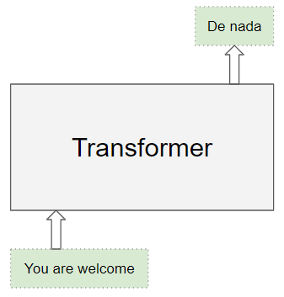
Why were Transformers needed and what are they?
Transformers were introduced in 2017 by Vaswani et al., (Attention Is All You Need)
The Transformer architecture excels at handling text data which is inherently sequential
They take a text sequence as input and produce another text sequence as output
Transformers Explained Visually (Part 1): Overview of Functionality | by Ketan Doshi | Towards Data Science
DAIS

Slide 4
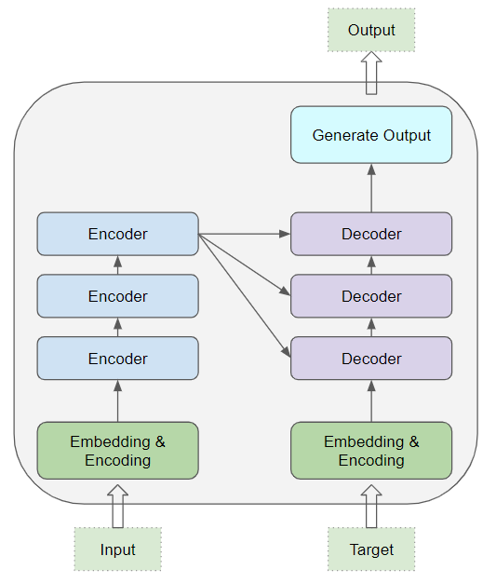
Why were Transformers needed and what are they?
At the core, Transformers contain a stack of Encoder layers and Decoder layers
The Encoder stack and the Decoder stack each have their corresponding Embedding layers for their respective inputs as well an output layer to generate the final output
All the Encoders are identical to one another. Similarly, all the Decoders are identical
DAIS

Slide 5
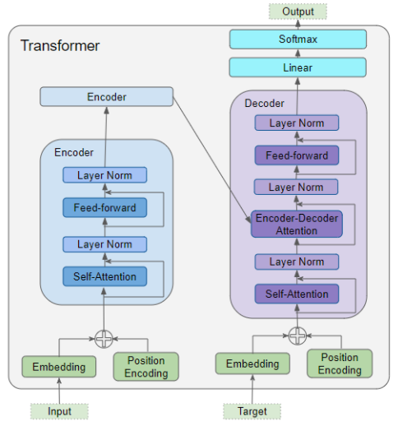
Why were Transformers needed and what are they?
The Encoder contains the Self-attention layer that computes the relationship between different words in the sequence, as well as a Feed-forward layer.
The Decoder contains the Self-attention layer and the Feed-forward layer, as well as a second Encoder-Decoder attention layer.
Each Encoder and Decoder has its own set of weights.
DAIS

Slide 6
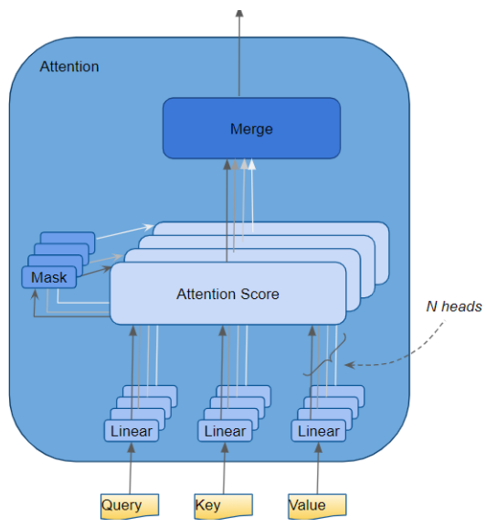
Why were Transformers needed and what are they?
The Attention layer takes its input in the form of three parameters, known as the Query, Key, and Value.
DAIS

Slide 7
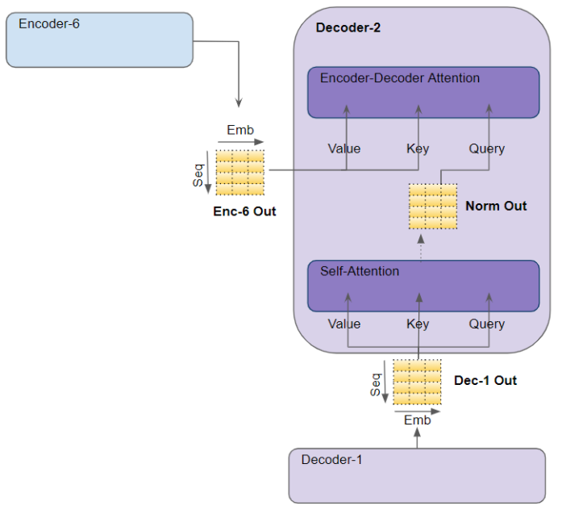
Why were Transformers needed and what are they?
In the Decoder’s Self-attention, the Decoder’s input is passed to all three parameters, Query, Key, and Value.
In the Decoder’s Encoder-Decoder attention, the output of the final Encoder in the stack is passed to the Value and Key parameters. The output of the Self-attention module below it is passed to the Query parameter.
DAIS

Slide 8
BERT – Bidirectional Encoder Representation from Transformers Pre-training of Deep Bidirectional Transformers for Language Understanding (Google AI, 2018)
https://arxiv.org/abs/1810.04805
DAIS

Slide 9
Why was BERT needed?
In natural language processing (NLP), words need representation
Earlier representation methods such as TF-IDF, Bag-of-word, one-hot encoding were introduced
The rise of neural network/deep learning led to better word representations such as word embeddings with Word2vec, Glove etc.
DAIS

Slide 10
Why was BERT needed?
Word embeddings have a major problem – they are applied in a context-free manner
Open a bank account
On the river bank
The solution: Train contextual word representations on text corpus
This led to contextual word representation language models
DAIS

Slide 11
Why was BERT needed?
ELMo: Embeddings from Language Model
Described in the paper – Deep Contextualized Word Representations (https://arxiv.org/pdf/1802.05365.pdf)
It is unidirectional
Trains separate Left-to-Right and Right-to-Left LMs
Uses LTSM architecture
GPT: Generative Pre-trained Transformer
Improving Language Understanding by Generative Pre-Training (https://s3-us-west-2.amazonaws.com/openai-assets/research-covers/language-unsupervised/language_understanding_paper.pdf)
It is unidirectional
Trains deep (12-layer) transformer LM
DAIS

Slide 12
Why was BERT needed?
Those contextual LMs have a problem: They only use left context or right context
But language understanding is bidirectional
The reason for unidirectionality: Words can “see themselves” in a bidirectional encoder
BERT came to the rescue!
DAIS

Slide 13
What is BERT and how does it work?
BERT generates a language model by training in both directions which gives words more context
BERT provided a way to more accurately pre-train models with less data
It involved a pre-training and fine-tuning stages
It is based on the Transformer architecture (encoders)
DAIS

Slide 14
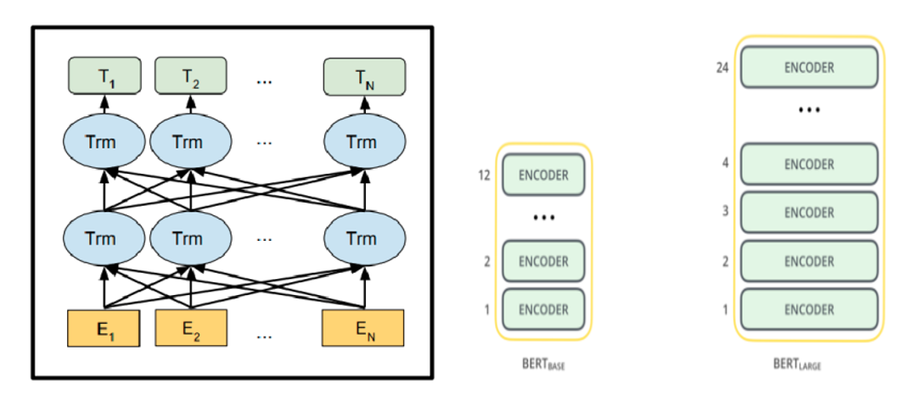
What is BERT and how does it work?
BERT Language Model Structure
DAIS

Slide 15
What is BERT and how does it work?
BERT works by taking inputs (sequence of tokens), which are converted into vectors and then processed in the neural network
3 transformative operations are first performed on the input tokens before feeding to the network
Token embeddings: Add [CLS] and [SEP] to the input tokens
Segment embeddings: Add sentence markers to the input tokens
Positional embeddings: Add position indicators to the input tokens
DAIS

Slide 16
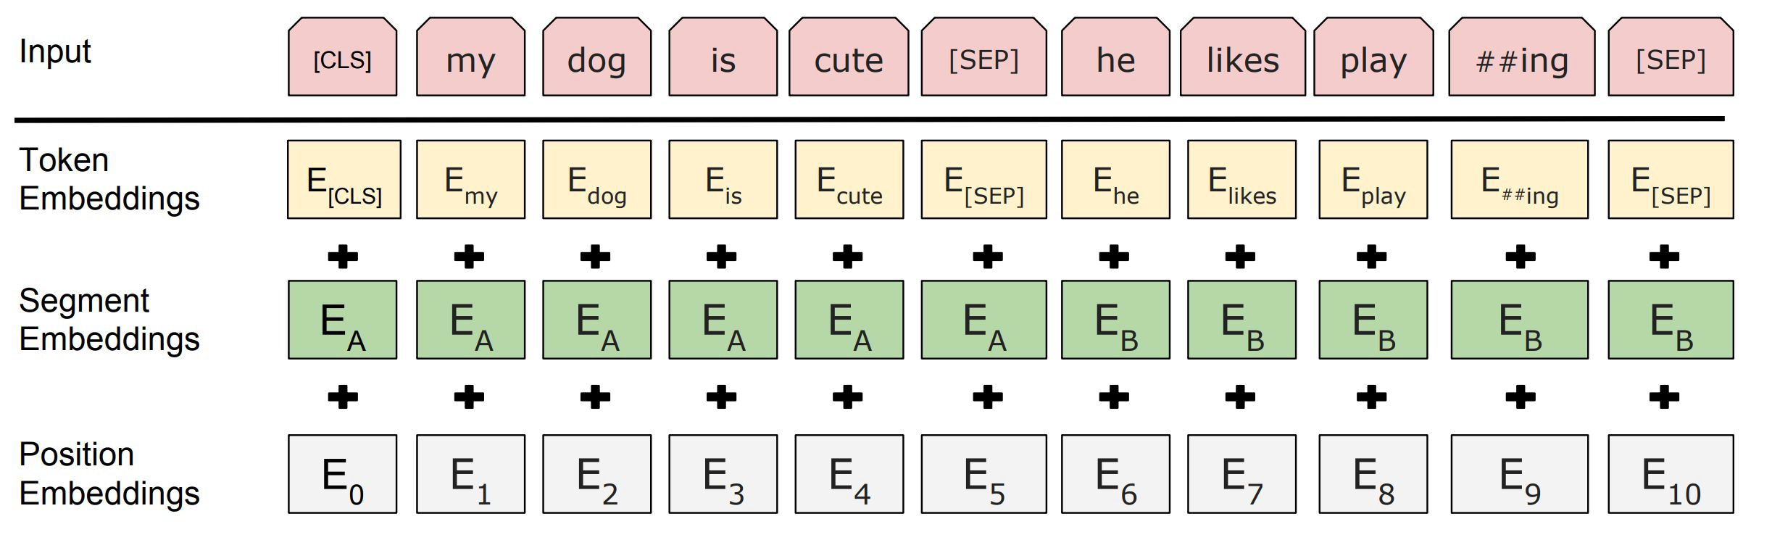
What is BERT and how does it work?
Each token is represented by summing the corresponding token, segment and position embeddings
DAIS

Slide 17
What is BERT and how does it work?
The pre-training of BERT makes use of two strategies: MLM and NSP
In MLM (Masked Language Model), BERT randomly masks out 15% of words in the input (replacing them with a [MASK] token)
Problem: Mask token never seen at fine-tuning
Solution: 15% of the words to predict, but do not replace with [MASK] 100% of the time. Instead:
80% of the time, replace with [MASK]
went to the store → went to the [MASK]
10% of the time, replace random word
went to the store → went to the running
10% of the time, keep same
went to the store → went to the store
DAIS

Slide 18
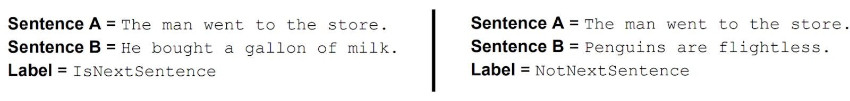
What is BERT and how does it work?
BERT uses NSP (Next Sentence Prediction) to understand the relationship between two sentences.
To learn relationships between sentences, BERT predict whether Sentence B is actual sentence that follows Sentence A, or a random sentence
50% of the time the second sentence comes after the first one.
50% of the time it is a a random sentence from the full corpus.
DAIS

Slide 19
What is BERT and how does it work?
Data: Wikipedia (2.5B words) + BookCorpus (800M words)
Batch Size: 131,072 words (1024 sequences * 128 length or 256 sequences * 512 length)
Training Time: 1M steps (~40 epochs)
Optimizer: AdamW, 1e-4 learning rate, linear decay
BERT-Base: 12-layer, 768-hidden, 12-head
BERT-Large: 24-layer, 1024-hidden, 16-head
Trained on 4x4 or 8x8 TPU slice for 4 days
DAIS

Slide 20
When and how can we use BERT?
BERT can be used for most NLP tasks such text classification, question answering, sentiment analysis, NER, paraphrase detection etc.
The process of using BERT for a specific task is known as fine-tuning.
To fine-tune the BERT pre-trained model on our dataset, we do so by just adding a single layer on top of the core model.
DAIS

Slide 21
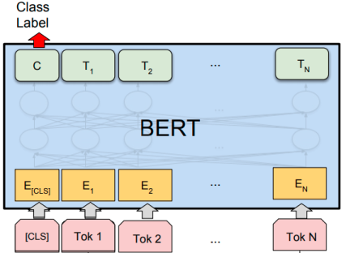
When and how can we use BERT?
DAIS

Slide 22
When and how can we use BERT?
You can use BERT by downloading the pre-trained model files from the official BERT GitHub page (https://github.com/google-research/bert#pre-trained-models)
The BERT pre-trained models are either Cased or Uncased
You can choose which BERT pre-trained model you want depending on the task and computing resource
DAIS

Slide 23
Conclusion
Empirical results from BERT are great
BERT added more generalization to existing NLP methods by using bidirectional architecture
BERT model also added more contribution to the NLP field. Fine-tuning BERT model will now tackle a lot of NLP tasks.
DAIS

