Slide 1

Say goodbye to IConfiguration and embrace the power of the IOptions pattern
Notes:
Hi all, nice to see you coming up for this session about saying goodbye to Iconfigurations and embrace the power of the IOptions pattern.

Slide 2

About me
Name: Pieter Samyn
Title: Technology lead
Company: ZF
Professional Background:
Backend development
AWS serverless ecosystem
Performance
Maintainabilty
Notes:
My name is Pieter Samyn. I’m a technology lead at ZF in Belgium.
My main focus is backend development with the AWS stack. I try to do my best to keep up with the evolutions and I’m always on the lookout for increasing the performance and maintainabilty of our projects.
I guess that is enough about me, if you would like to know more catch me after the session and have a chat or find me on linkedon.

Slide 3

Audience knowledge
Notes:
Before we begin, please raise your hand if you have worked with
IConfiguration
IOptions
Both
If many raise just mention that I can’t promise they learn a lot of knew things but I will try at least confirm the existing knowledge
If you don’t understand a thing or have a question please don’t wait until the end as the session will continuously build upon further. So if I lose me you’ll most likely be lost for the remainder of the session.

Slide 4

Introduction
Notes:
Say goodbye to IConfiguration and embrace the power of the IOptions pattern
The title could be misleading as actually they chain together. But if you are only using IConfiguration, I hope you reconsider after this session and embrace it with the Ioptions
This will not be a rocket science session, but I will try to show you the beauty of this basic functionality and when the session nears its end we will reach to a more advanced demo.
Which is the reason why I created this presentation as I stumbled upon it myself by accident not knowing that this was in there for free all along.
But it helped our team solving complex configuration in an easy to grasph fashion and adhering to the DRY principles.
I got your attention with this statement I hope? yes?

Slide 5
IConfiguration
Concept
Providers
Binding
Notes:
IConfiguration acts as a base for when we will touch IOptions.
I tried to divide it into concept, providers & binding

Slide 6
IConfiguration: Concept
Settings: timeout, uri’s, secrets, …
Read only, view
When applied, static vs dynamic
Notes:
IConfiguration what is it?
Settings
---------
It could be settings which you use to configure timeouts, uri’s, backof times or event secrets like connnectionstring, api keys.
But these should be treated with extra caution so that these aren’t visualized for everyone who is able to pull your repository.
Read only, view
-----------------
The data coming from this source should be treated as being a readonly view in a single representation
When applied, Static / Dynamic
----------------
A lot of the configuration is historically applied at compile time.
Each environment has its own baked in configuration at compile time, this resembles a bit like how the TerraGrunt configuration is working with the Terraform configuration.
This doesn’t mean however that this configuration can’t respond to changes unless it is reloaded. Some configuration providers do allow it to be reloaded with new data at runtime. Which could make it a candidate for a simple feature toggles approach.
Although suites like LaunchDarkly, Unleash are more advanced, I’m just mentioning it as it could be simplified to just a configuration section.
If you recall web.config or app.config from the .NET framework, I’ve noticed in our organization, a lot of project configurations still approach it with this mindset.
For the ones who don’t remember it anymore, this was an XML based approach using the ConfigurationManager.
There was no possibility to do an easy transformation of your configuration to an object. There were tools like Slow Cheetah for transformations. But they were very hard to test and learn.

Slide 7
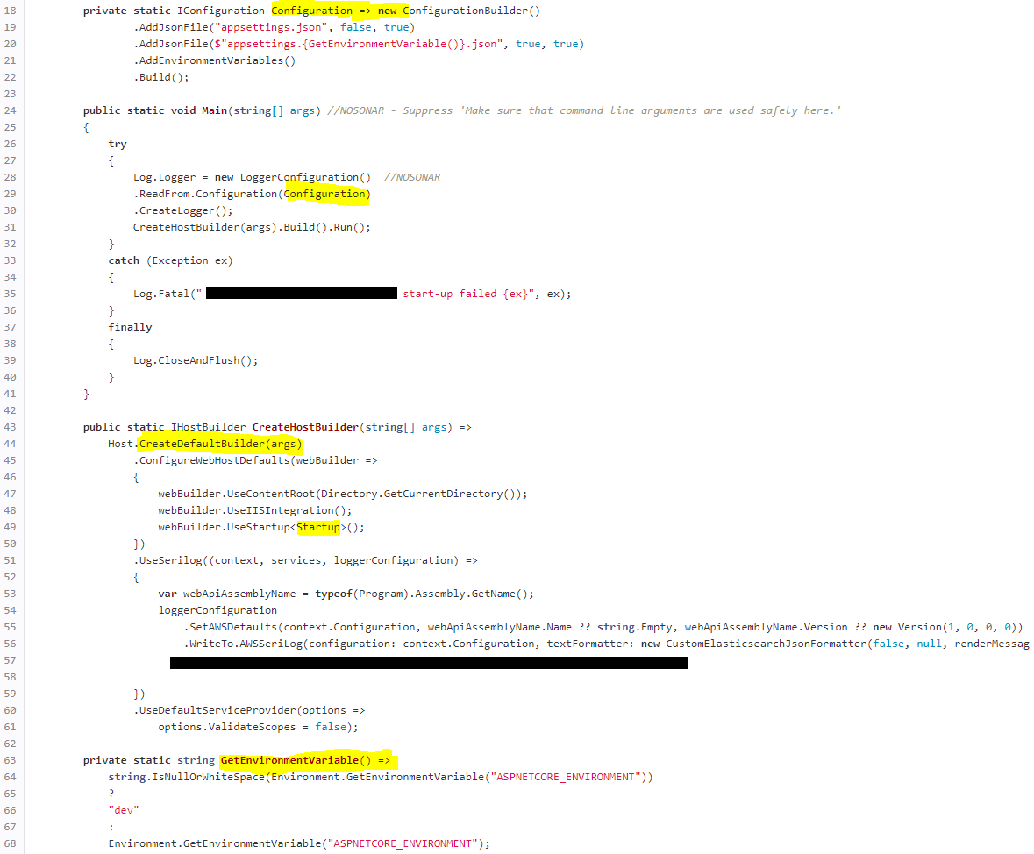
IConfiguration: Existing Example
Notes:
I took a random project which I encountered in on of our projects.
I highlighted the parts which were done manually, and where the framework already provided a default implementation.
The IConfiguration is created separately => Configuration (rule 18)
The environment detection determination is not using the default mechanics => GetEnvironmentVariable (rule 63)
The custom IConfiguration is loaded twice in this case, rule 29 and rule 49

Slide 8
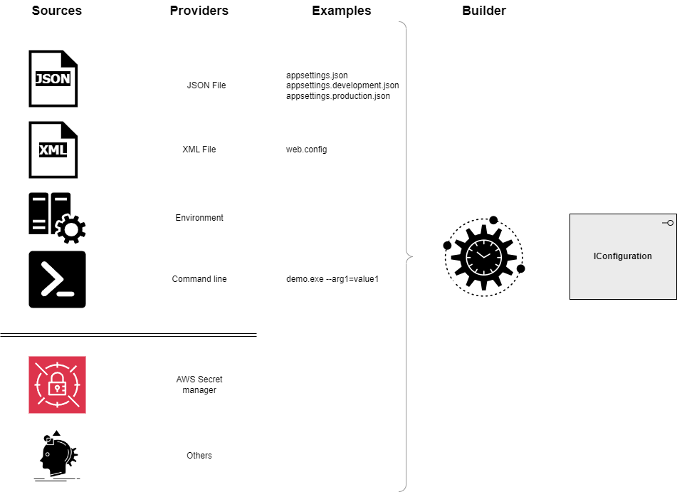
IConfiguration: Providers
Notes:
When an application created with host or web application starts up, it typically loads resources in the following order
DOTNET_ or ASPNETCORE_ environment variable (this is used to determine the environment)
appsettings.json
appsettings.{environment}.json
secrets.json (if you are in dev)
Environment variables
Command line variables
Custom providers, which could be coming from AWS Secret Manager or other sources.
When they are loaded, they load in order on how they were configured and parsed to a layered view which results in the IConfiguration.
There is no need to load all these things yourselves manually if you’ve applied it yourselves.

Slide 9

IConfiguration: Providers
Notes:
ConfigurationExplorer
DEV
/configuration
This endpoint writes out the entire content of the IConfiguration. But let’s take a look in particular to the AppSettings values.
I prepared these value to demonstrate the layering of the providers.
LaunchSettings.json → ASPNETCORE_
Appsettings.json
Appsettings.Development.json
Secrets.json (highlight the importance of this file)
Environment variables (simulated by the LaunchSettings.json environmentVariables)
Command line args (simulated by the LaunchSettings.json commandLineArgs)
Program.cs (in memory dictionary)
PRD
This startup is the same as the previous one, but we removed the ASPNETCORE_ENVIRONMENT environment variable. Anyone any idea which environment you get then?
You’ll get the Production environment even if the ASPNETCORE_ENVIRONMENT isn’t present.
But it also has another consequence, by default you will also lose the support for the secrets.json as this usage is only intended for local development.
/configuration-providers
Reveals the order of the currently loaded configuration providers, you can clearly see that some are added multiple times,
In dev mode you clearly see that secrets.json is loaded but when you switch to production its not loaded by default.

Slide 10
IConfiguration: Provider flavors
Each provider is different
Custom providers
Notes:
For the file-based providers, if they are changeable where they are deployed, they can allow a hot reload, thus without the need for you application to restart. Containers for instance could have read-only disks.
Environment variables can target a specific prefix and load that part as a separate provider.
A double underscore will be translated to a colon. Giving it a way of participating in the hierarchical mapping.
Key per file, targets a directory and each filename is a key and the content of it is then the value.
In memory provider, is a dictionary.
If the regular providers from Microsoft or third parties doesn’t suit your needs, a custom provider can always be added. Reference the yml file in this case.

Slide 11
IConfiguration: Custom provider
Notes:
Demo time, I will highlight a piece of code I, which I got inspired by the idea of Andrew Lock.
He suggested to only write the parts which matters for your situation, and he got a point why would you want to reinvent the wheel.
For this custom provider I created a secret manager on AWS.
It will retrieve the information using the AWS CLI and SSO so that we don’t need to provide any password or store other sensitive data.
In the secrets manager I stored my value as a JSON string. This way I can read them out and load them as if it were a JSON file.
Now keep in mind that I wanted to recycle things, so the AmazonSecretsManagerConfigurationProvider is inheriting from the JsonConfigurationProvider this way I don’t need to write the custom hierachy flattening code to get from
{
"AppSettings": {
"Setting8": "SecretsManagerValue8"
}
}
To AppSettings:Setting8 → SecretsManagerValue8
The GetSecret Method is where the heavy lifting is done. We attach it to the Load method by overriding it. And in the case if a load exception happens and we want to try to reload it a bit later we run the task asynchronously.
This in turn will trigger the load and the OnReload method.
The OnReload method will inform the Configuration that this providers needs to be reloaded for the interested parties. But we will dig deeper on this matter a bit later.
Although the provider is doing the work, we need a configuration source to add it to the Configuration manager in this case the AwsSecretsManagerConfigurationSource.
For the final part we introduce an extension method which then passes through the AwsSecretsManagerConfigurationSource we do this as the add needs to be done on the IConfigurationBuilder, this is inherited by the IConfigurationManager and implemented by the ConfigurationManager which is accessable via builder.Configuration.
Builder.Configuration.Add() does also exists but this starts of with an IConfigurationManager and forces some additional steps you can skip safely by using an extension method like this.

Slide 12
IConfiguration: Binding
Notes:
All fine, we now have our flat hierarchical key value pairs. But how do we extract these value?
The environment: show the launchsettings.json and highlight the environment variable.
These are the ways I’ve noticed currently in use with an IConfiguration:
/config/1 This is an optimistic way of configuring the object.
/config/2 This one deals with everything itself; each value is extracted as a nullable string and must be transformed and validated before it can be used
/config/3 Already a bit more advanced as we are no longer responsible for the transformation from string to another datatype. To make this work we need however to introduce the NuGet package “Microsoft.Extensions.Configuration.Binder”
/config/4 Up the anti a bit again as now we only need to point to the JSON property who is representing our object. Advantage of this approach is that new values are automatically being picked up if they are added. Only the validation step still needs to occur. They must be at least public settable (Init, set or via the constructor)
I must be honest with these examples as they are biased, most of the time when I see IConfiguration being used and it is not with options they are rarely passed to an in between object, but directly to the service which needs to be configured. So actually a variation of the optimistic example 1.

Slide 13
IOptions
Concept
Types
Validation
Configure
Notes:
With the base set for IConfiguration we can now start at looking for IOptions.
You could create options without an IConfiguration off course. But I rarely encounter those situations.

Slide 14
IOptions: Concept
Interface Segregation Principle (ISP)
Separation of Concerns
Validation
DI resolving
Notes:
IOptions
With this pattern you can avoid that you need to make your entire solution aware about your configuration and as a bonus you get a strong typed class for accessing your configuration.
It makes a clear separation between different parts of your application and thereby it offers you 2 important software principles
Interface Segregation Principle (ISP)
Separation of Concerns
e.g.: Your database infrastructure doesn’t need to know anything about outgoing connections and vice versa.
If you would have multiple different databases, you can also separate it on their name.
Each piece of your application only receives the options it need to do its work.
There is a build in mechanism to validate your configuration data.
And the DI integration for resolving configurational dependencies, it is this small feature which made me love the IOptions pattern. But this one will be revealed in the last demo when all the dots are getting connected and will result in an advanced configuration.

Slide 15


IOptions: Types
 | Singleton | Reloadable | Named support
IOptions<T>
IOptionsSnapshot<T>
IOptionsMonitor<T>
Notes:
If you are reading information about the IOptions pattern you could be overwhelmed by the different flavors. When your request it into your services.
The reason for these choices is so you could choose the best lifetime semantics which fit for your needs.
The easiest one to grasp if you’re coming from an IConfiguration background is the IOptions<T>
Once it is loaded it will never change until the application is reloaded. There can also only be one if it for the entire application if you would define it again it would just overwrite the previously configured one.
If you have multiple different database connections, you could opt for creating an abstract base Option class and then let each configuration inherit from it. This means you’ll have for each database a custom object. This is not always desired or needed. Another option is to opt for an IOptionsMonitor<T>.
Besides monitoring the configuration for changes, it also supports named options granting you the ability to reuse the option object for each different database, it comes as a singleton and support reload natively.
IOptionsSnapshot<T> is on each request recreated using a scope, so this could come with a performance hit if it is in hot path construct. And because of it being scoped it cannot be used in a singleton.

Slide 16
IOptions: Types
Notes:
The MyOptions class is a very simple class, but it holds all the properties to visualize the differences between the different options types.
Each time a new options is created a new Id will be generated and otherwise the already existing one will be reused.
In the MapGet endpoint has 3 different option implementations.
When we launch the application all 3 of them are resolved each displaying their unique id. When you launch a new request, you see only the snapshot has a changed id.
Since this is in the appsettings file, if we update the configuration, we will see that also the monitor will change its id now as the file is reloaded.

Slide 17
IOptions: Validation
Microsoft.Extensions.Options.DataAnnotations
On first usage
On startup
Custom validation
Validation in a separate class
Source generated
Notes:
Just like with the configuration binding, validation can be added. In this case it’s easier to do it via data annotations. ********* Anyone familiar with it? ************
By annotating the properties via attributes, we can instruct the rules for loading the options.
Just setting the options is not enough the ValidateDataAnnotations must be set as well. This will not validate the option on startup, but at first usage.
If you want to have the options validated on startup and throwing a startup error rather than a runtime error add ValidateOnStart. Since .NET8 there is a new AddOptionsWithValidateOnStart which register the option and validate it on startup. But it still needs the ValidateDataAnnotations to be called as well.
When you have some advanced validation requirements you could use a custom validation, this can be done via a delegate or a dedicated class.
The last few years they’ve put a lot of effort in source generating things upfront this can be done for these validations as well. Reducing the need for reflection resolving the validations at design time.
It requires to register a partial class, and annotate it with the options validator attribute, then it needs to be registered as a singleton in the container and in the csproj file must be set <EnableConfigurationBindingGenerator>true</EnableConfigurationBindingGenerator>

Slide 18
IOptions: Validation
Notes:
Are there people still using .NET6 or .NET7?
This demo will depend on the .NET8 syntax, you will see why I didn’t consider the previous LTS and STS versions.
For this demo I had to create multiple files just to avoid confusion and to be able to build this one up with the different flavors which are available.
We will start this one easy, with focusing first on the MyOptions class, it’s the same class as the previous demo but now it’s annotated.
When we spin the solution up as is, although annotated nothing odd happens.
To enable the usage of the annotations, we must add the ValidateDataAnnotations. This can give us runtime errors which I personally like to avoid as much as possible.
When we also enable ValidateOnStart we get this functionality as well. You could also use the commented syntax below which does the same thing and it still needs the ValidateDataAnnotations. You like this? Anyone already started using the baked in source generation functionalities which came available in the latest releases?
We can source generate these validation and reduce reflection expensive reflection calls. Create a public partial class and let it inherith the IValidateOptions interface and point it to the MyOptions in this case. Also decorate it with the [OptionsValidator]
This class must be added as a singleton to your di container in order to be able to be used.
Once you apply this validator class you don’t longer need the ValidateDataAnnotations. It will happen now automatically. Do you want some more?
We can also source generate the binding, this removes the reflection from going from the configuration to the options object. In the csproj file enable the property EnableConfigurationBindingGenerator when you now look back at the program.cs file you will see an icon appearing. When you hover over it is indicating that this is an intercepted call. We now have the binding and the validation source generated. This brings us quite close to an AOT point. Anyone already toyed with this? I will show you how you get this working on AOT
If you are using controllers you’re in luck if the documentation is right, if you are using minimal apis like this demo not so much. Enable the property PublishAot in the csproj The intercepted call is now also appearing at this location as well. We’ll go into this one and we search for the IOptions<JsonOptions>, if not provided the fall back is used which uses reflection.
To resolve this a custom JsonSerializerContext must be used where we then can point to the MyOptions.
Now we can add it to the default json serializer using the TypeInfoResolver and add the newly created context to it.
I will open a terminal now and create the AOT build using dotnet publish If you’ve never done this before you must enable the .NET desktop development under the workloads, it will not work otherwise dotnet publish
Go to the AOT folder and start it: dotnet .\OptionValidation.dll --urls https://localhost:7030
Go to the release folder and start it: dotnet .\OptionValidation.dll --urls https://localhost:7030
If you lost me this code will become available on my github so don’t worry about it.
This concludes the optimization of the validation with the source generation part. But this code also has another angle.
First demonstrate the first 3 with the default value, then show the named options and reveal the “” case.
Does anyone know what will happen when we launch the Get(“X”) call?
For the validation pay attention that this will also be applied for the unnamed and named options.
Meaning if you register only named options but when you request an IOption<T> it will resolve a default options and apply the validation upon. If this validation can’t pass by default, then you will still face a runtime failure.
Does anyone know what will happen when we launch the Get(“”) call?
Now make the AddOptions a named “X” and show the difference highlighting a thing which still needs some attention although you configured validation on startup.
When validation is set at startup time you will have the guarantee that the startup configuration was valid at that point in time for the registered options.
Pay attention though if you would register named options only and request an unnamed it will try to honor the request and return a default option, if this can’t pass validation a runtime error will happen.

Slide 19
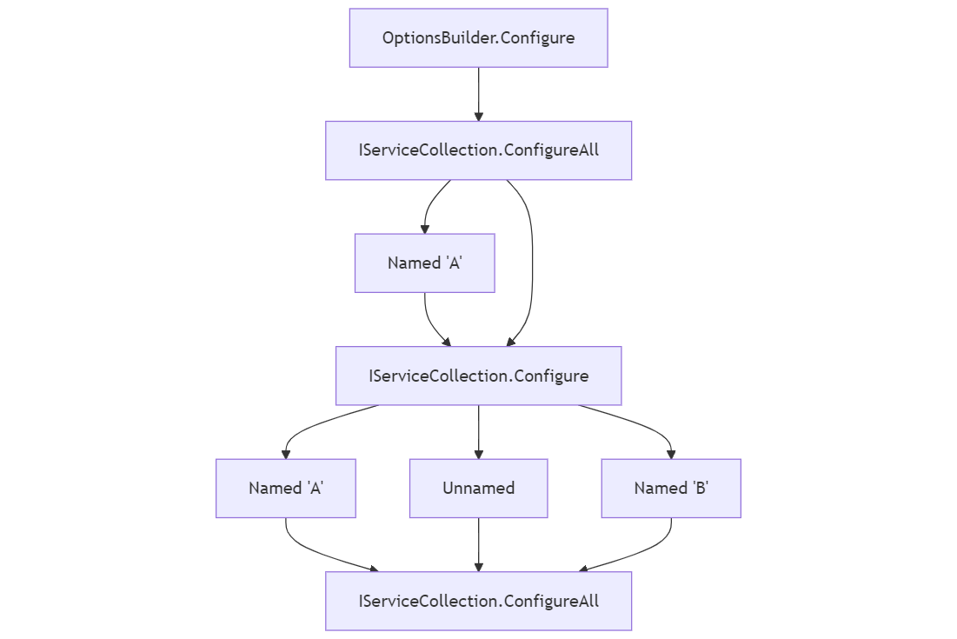
IOptions: Configure
Notes:
We arrived at the last part Configure, make no mistakes this is the hardest one to get all the ins & outs
but when it comes to specialized configuration this last step is where you can do magic with options.
The execution order can be a though one if you would start combining the different executions, but if you do, you will most likely have your reasons but pay attention order matters in this case.
All the configure steps, Configure, ConfigureAll<T> & Configure<T>, no matter where they are, are executed before the post configure step in the order they were added.
The same applies for the post configure.
All the configure steps are done before the validation takes places, so if there is a common thing that will make your configuration valid this can be applied upfront.
For the IServiceCollection PostConfigure and Configure step, there is a distinct difference between named and unnamed, meaning if you configure one named it will only be applied for the named one. An unnamed one is only targeted by the one added without name.

Slide 20
IOptions: Configure
Notes:
This time we use the MyOptions class again, but I’ve added all the flavors I could think of to demonstrate how this would behave. I had to add the console writelines so that it would immediately be printed when it was executed without losing ourselves in breakpoints.
At startup you can clearly see we have three uniqueidentifiers pointing to the three configured options in this case.
Hit the order monitor endpoint → this reveals that these options were configured during the startup.
Do the same for the snapshot endpoint → this reveals that these options are always validated on the endpoint request as the documentation also suggested and that all configuration steps are done as well.
With all this combined knowledge we can now go for the final thing and this one is what made me fond of this implementation.
We will now load the previously configured monitored options and retrieve them into the FinalOptions.
TODO: Demonstrate a bad final options to show the load with a named (“bad”) and then the good one (“good”)
It is just a simple case where we create some options where each has a custom configure step, in this example they are all the same, but they could be different.
The finaloptions is picking up configuration as well and in its configuration phase where it is referencing the other options.
So, this is not just an option created by an IConfiguration, it also requires some features specific from your DI container in so that it can resolve itself.
If you think this is an odd case out. We needed this for some health checks which depended upon the options of other options, but those had an additional configuration check which could only be resolved after data was injected via the pipeline.
We could have duplicated this logic in the in the final option. But it felt wrong as it was not the responsibility of the final options to correct one of its dependent options as this was also environment dependent.

Slide 21
Summary
IConfiguration
Providers
Binding
IOptions
Types
Validation
Configuration
Notes:
So lets wrap this up, we started by discussing IConfiguration, highlighting its shortcomings as well.
We demonstrated how you could create a custom provider if needed.
We then moved on to binding the configuration to an object, which set the stage for introducing IOptions.
We highlighted the benefits of using options and demonstrated the different types available.
We also covered how to validate them and briefly touched on preparing for an AOT build.
Finally, we ended with a configuration demo on the options to showcase the possibilities.
This revealed that to fully benefit from IOptions, you also need to understand and utilize IConfiguration.

Slide 22

Q&A
Notes:
Thank you for your attention. Now, let's open the floor for any questions you might have.
If you would like to go through the slides or source code at your own pace, feel free to scan the QR code.

