Slide 1
Assignment – 7 (GitHub)
Labs
Create Github account.
Complete Hello world practical with GUI and CLI both.

Slide 2
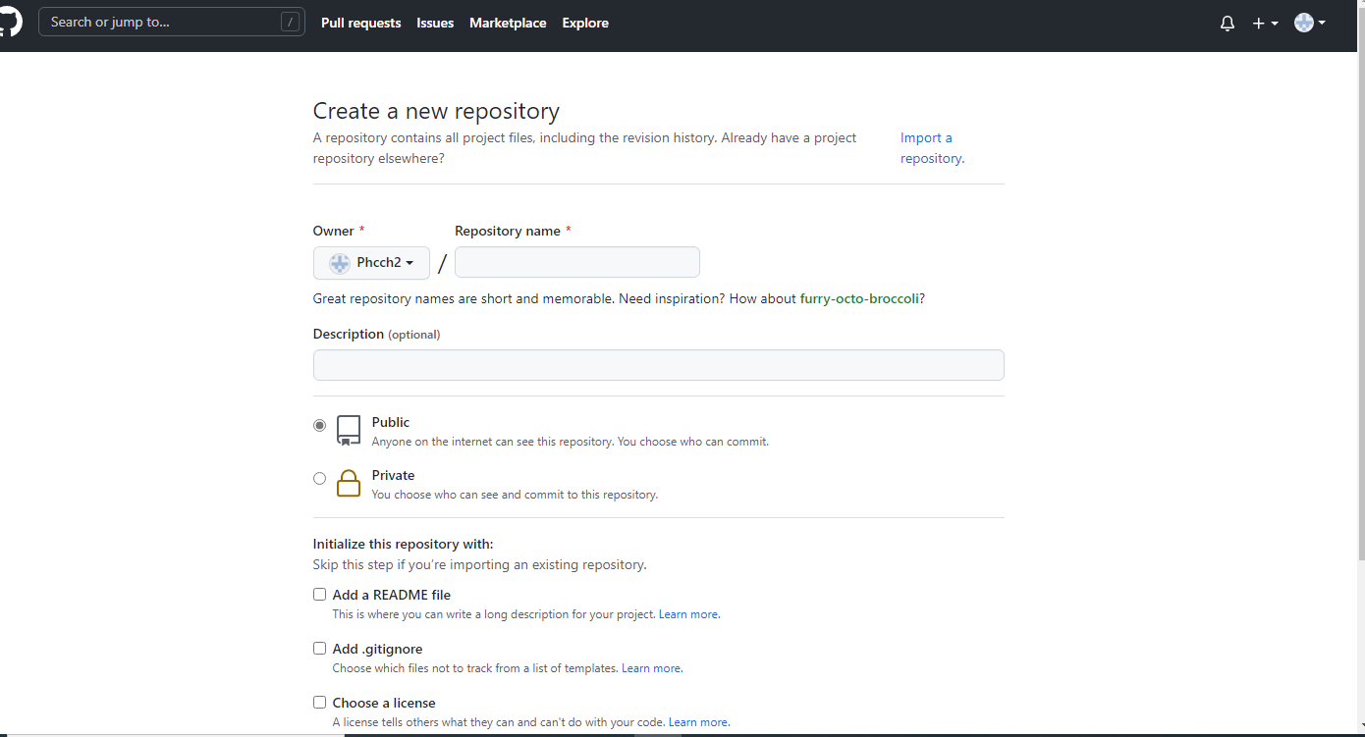
Account owner– Phcch2(GitHub)

Slide 3
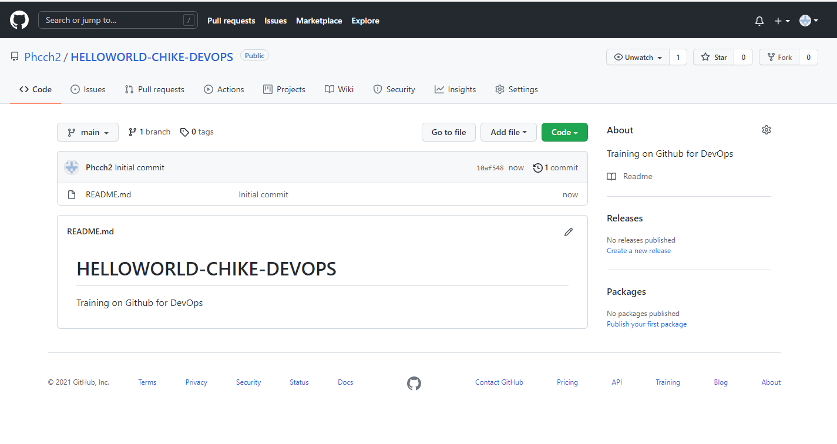
Helloworld repository– (GitHub)

Slide 4
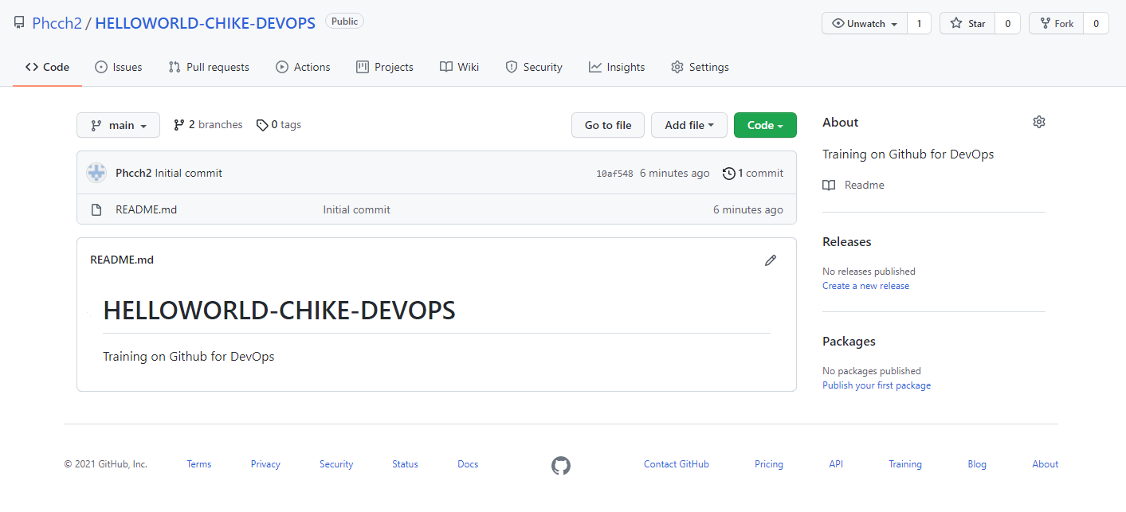
Main & readme-edits branches– (GitHub)

Slide 5
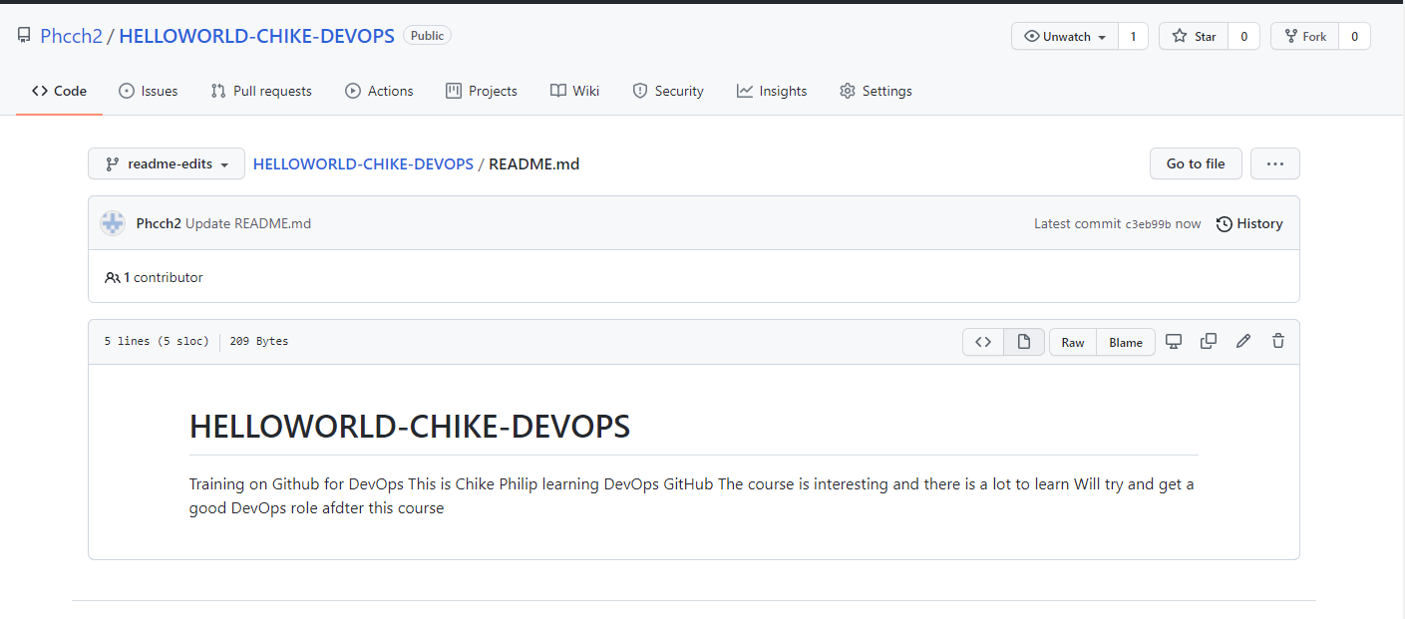
Commit new code changes on readme-edits– (GitHub)

Slide 6
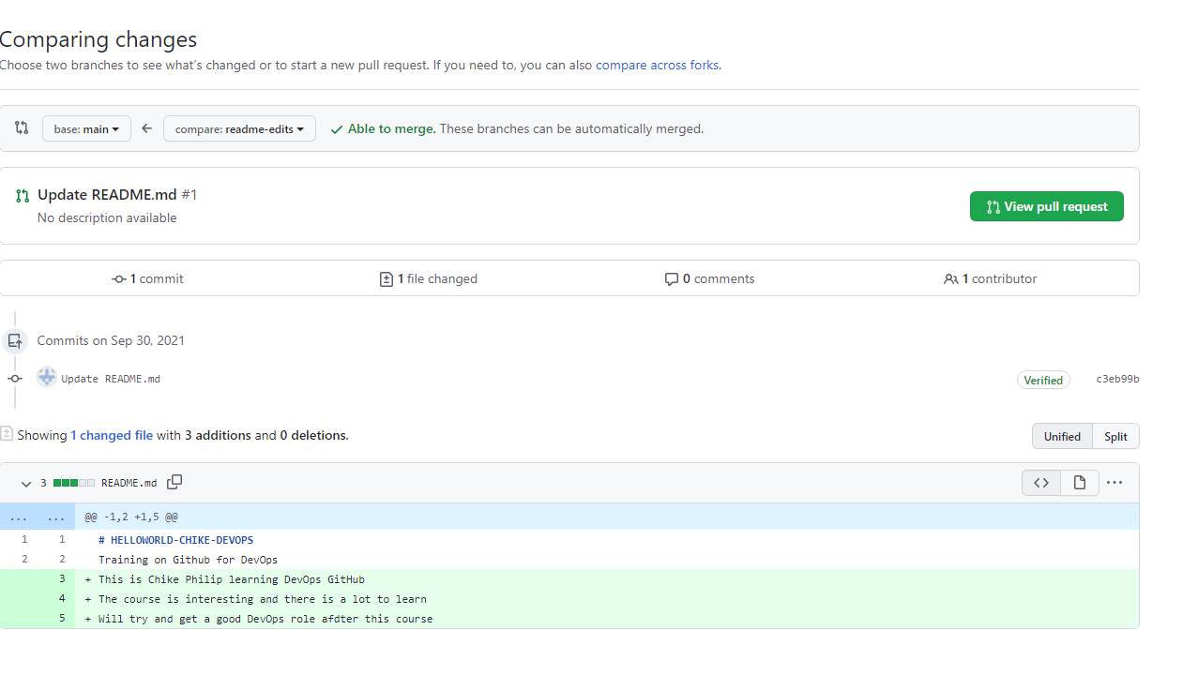
Comparing code between the 2 branches after a pull request

Slide 7
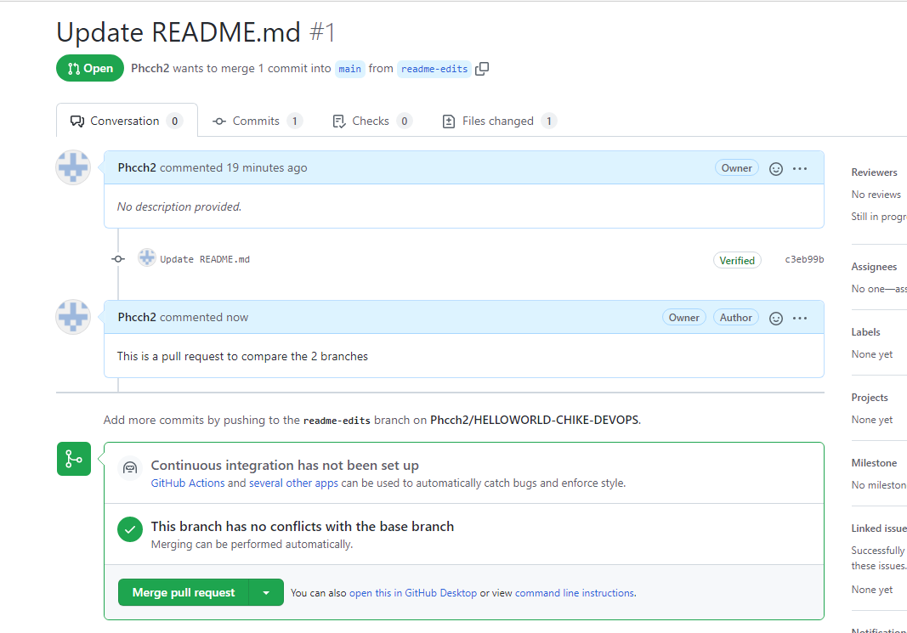
Pull request Title Edit

Slide 8
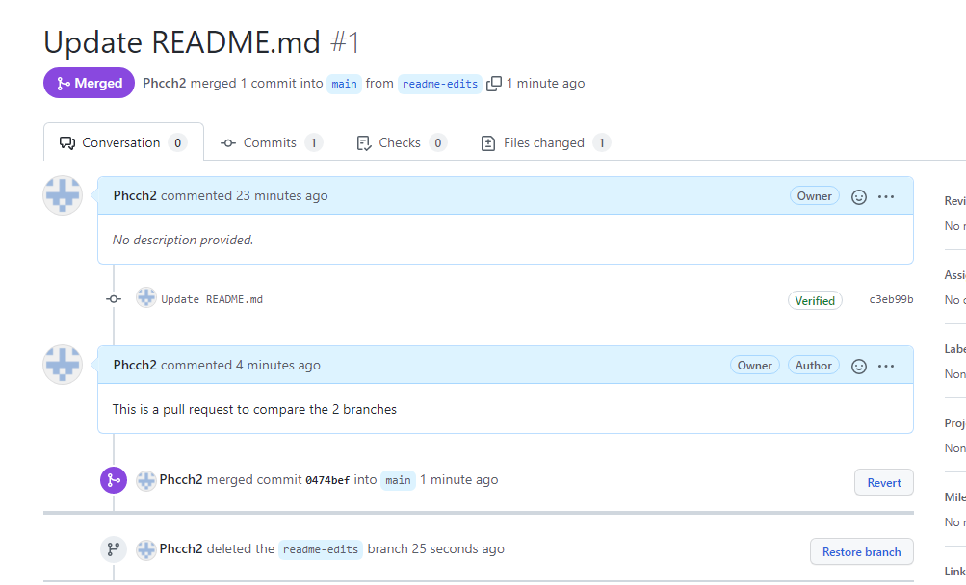
Merge completed and readme-edits branch deleted

Slide 9
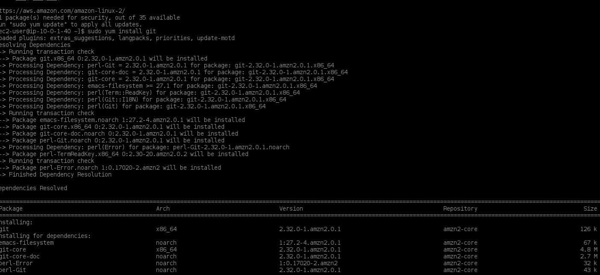
Sudo yum install git

Slide 10
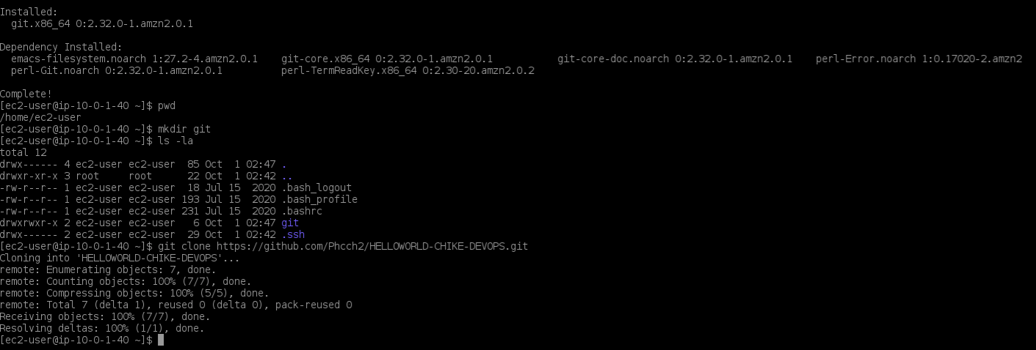
Git clone https://&.git

Slide 11
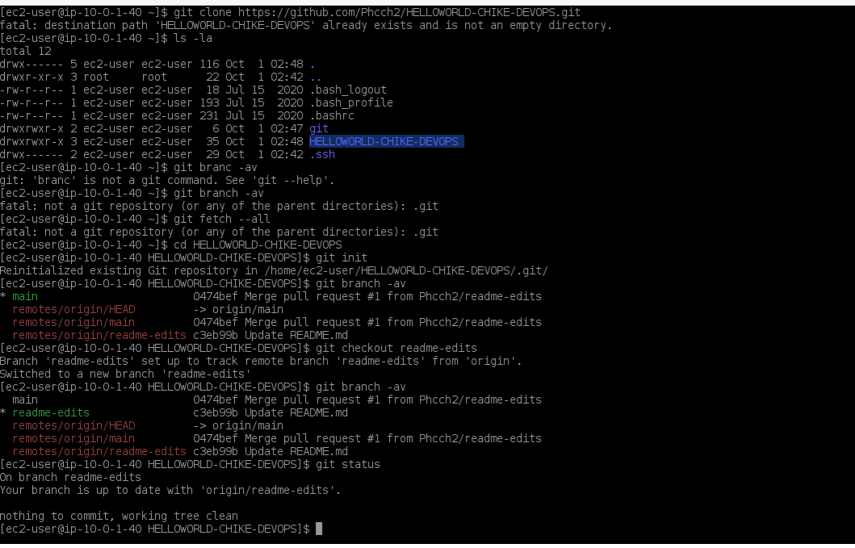
Git commands – branch, checkout & status

Slide 12
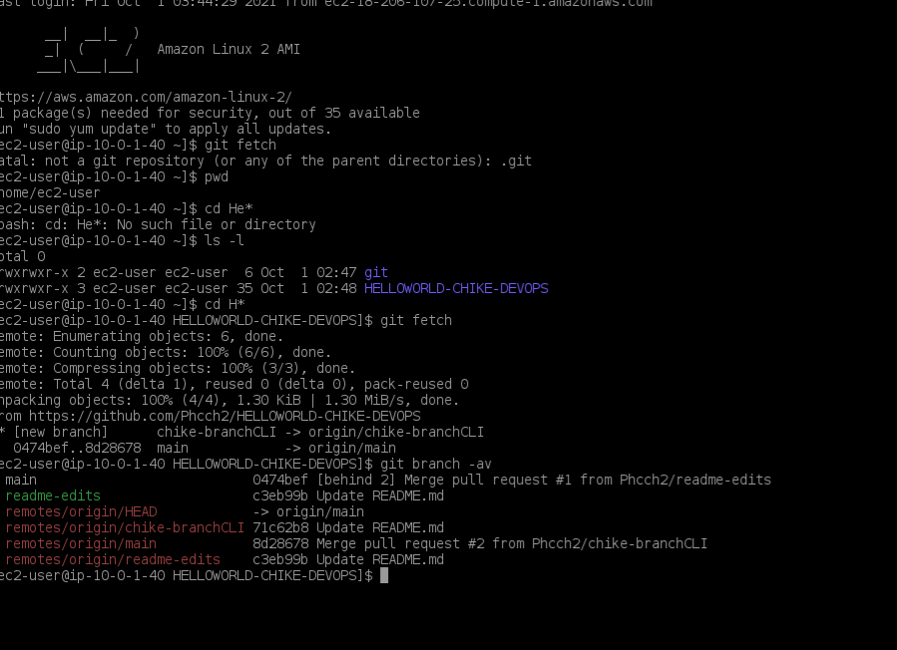
Git commands – Fetch

Slide 13
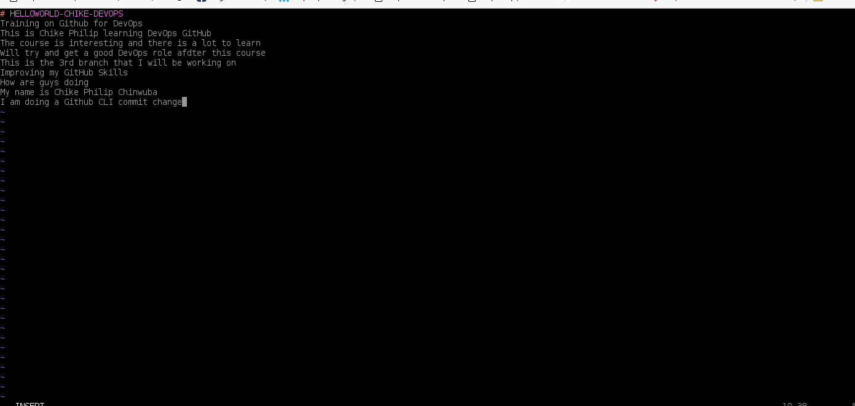
VIM edit chike-branchCLI

Slide 14
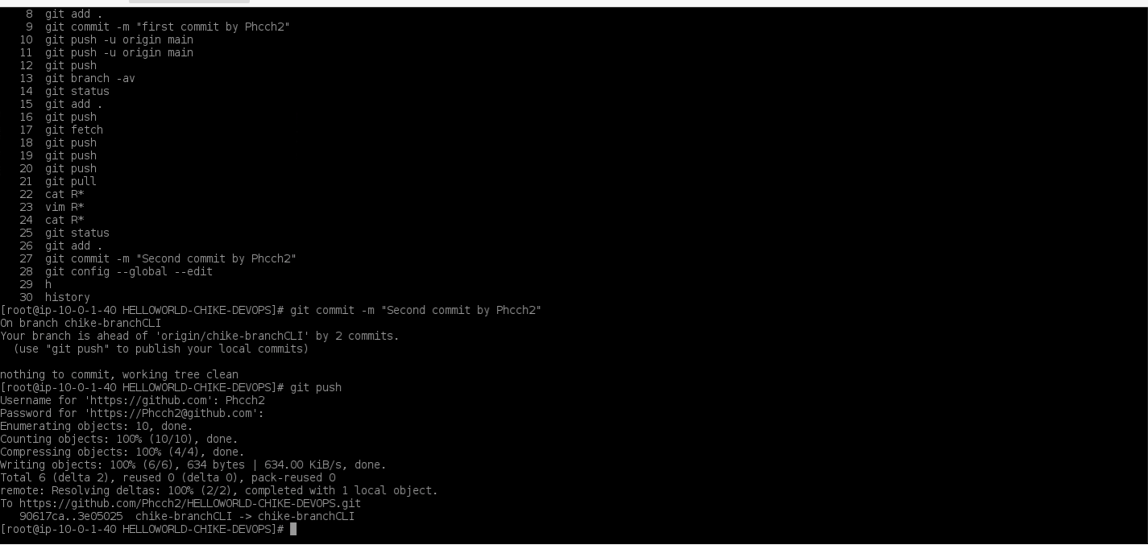
Git commit and push using git access token

Slide 15
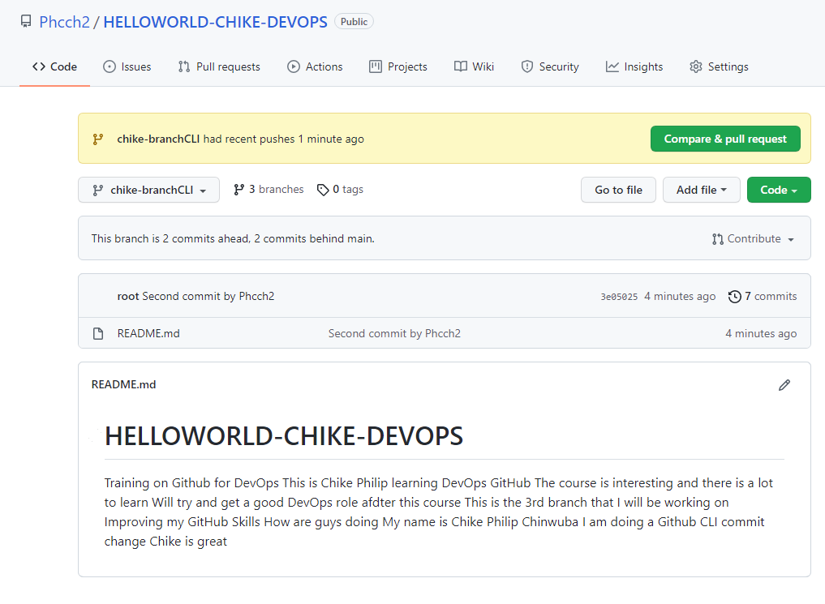
Git commit effected using CLI command on chike-branchCLI

Slide 16
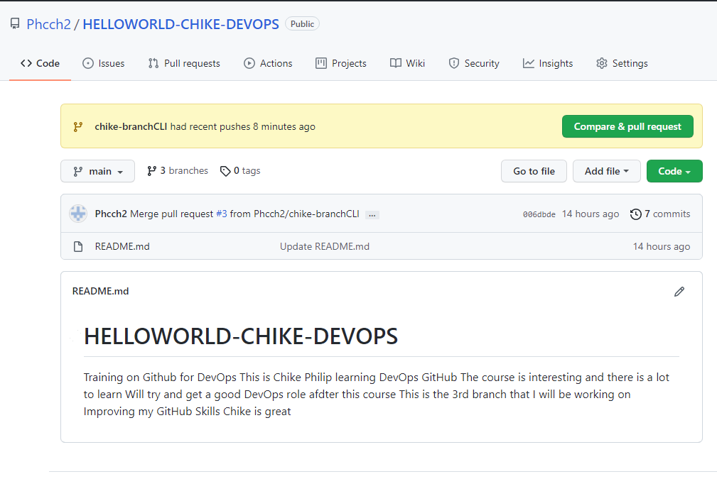
Git push on chike-branchCLI commit not effected on Main

Slide 17
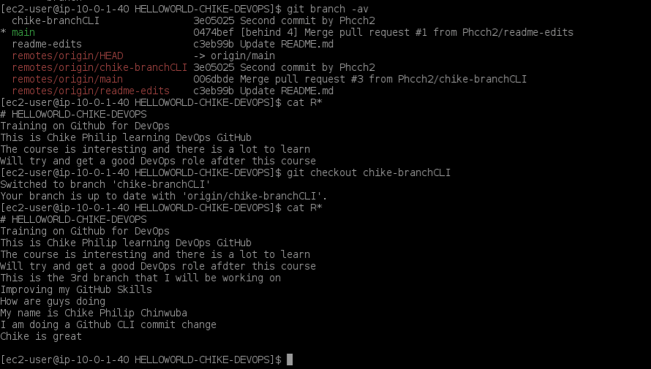
Comparison between chike-branchCLI and Main

Slide 18
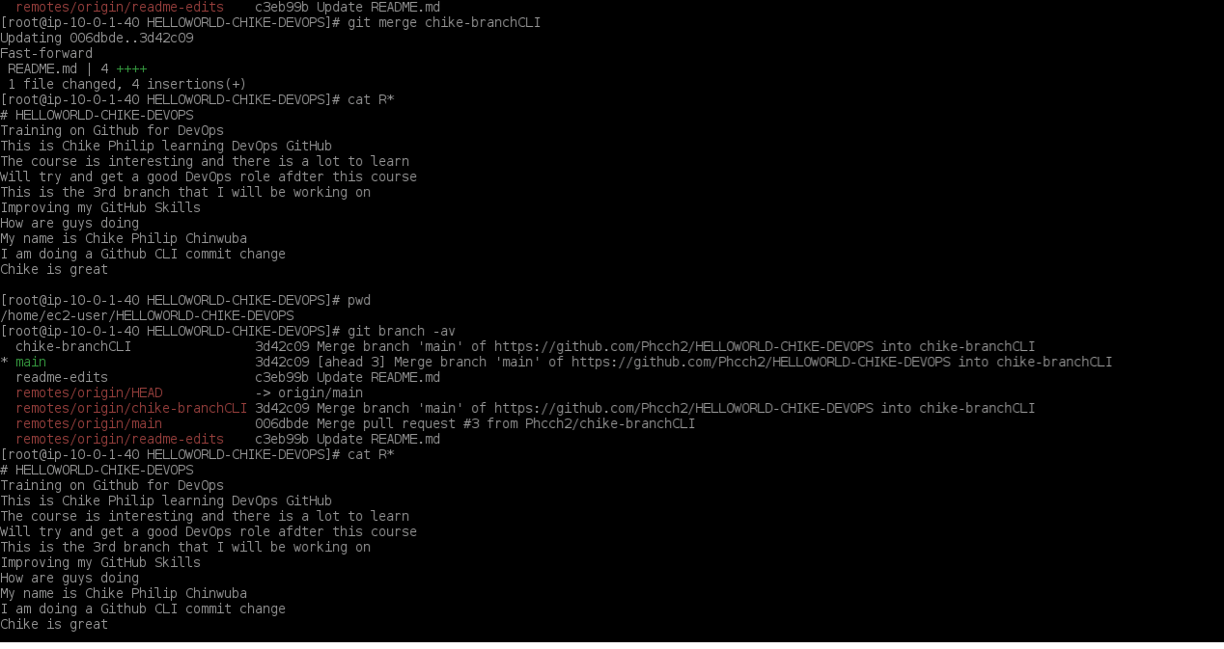
Git merge to the Main

Slide 19
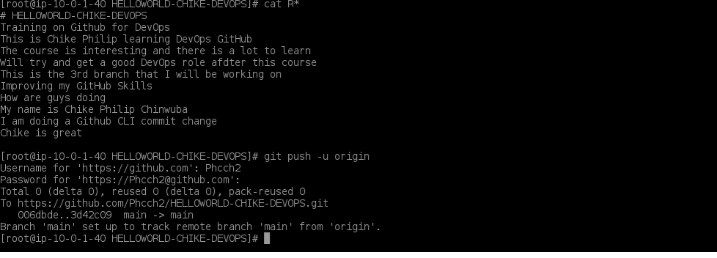
Git push to the Main

Slide 20
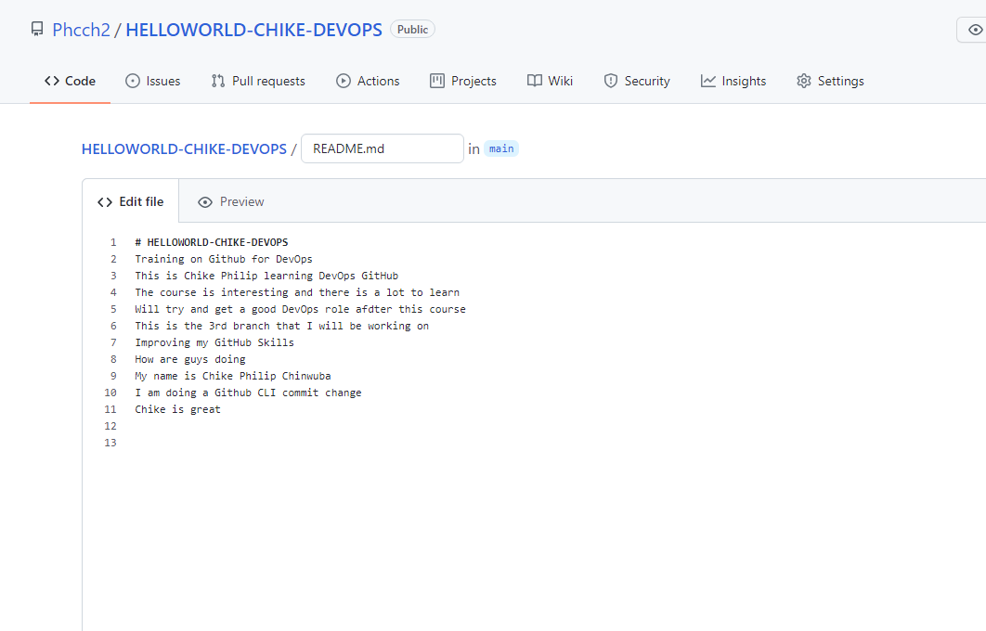
Main up to date with remote branch

