Slide 1
Conference Paper
Integrating Predictive and Generative AI for Explainable Credit Risk
Ravi Kumar Jain
IIFT Delhi

Slide 2
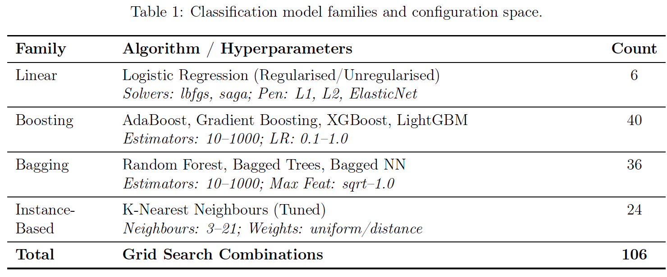
Classification model families and configuration space
Banking & Risk

Slide 3
Agenda
01 Introduction
02 Literature Review
03 Objectives
04 Research Questions
05 Methodology Overview
06 Datasets & Variables
07 Expected Contributions
08 References

Slide 4
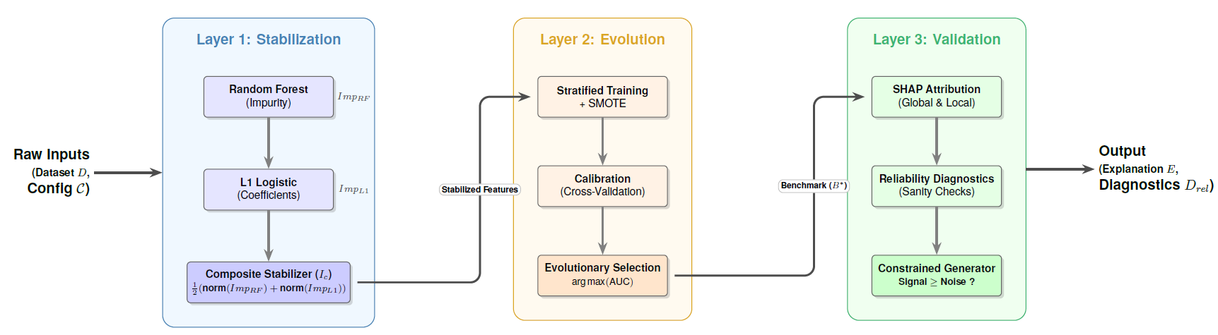
Algorithm
Banking & Risk
  Banking underpins economic stability and growth through financial intermediation.
  Systemic shocks (e.g. the 2008 crisis) expose vulnerabilities and underline the need for resilient risk frameworks.

Slide 5
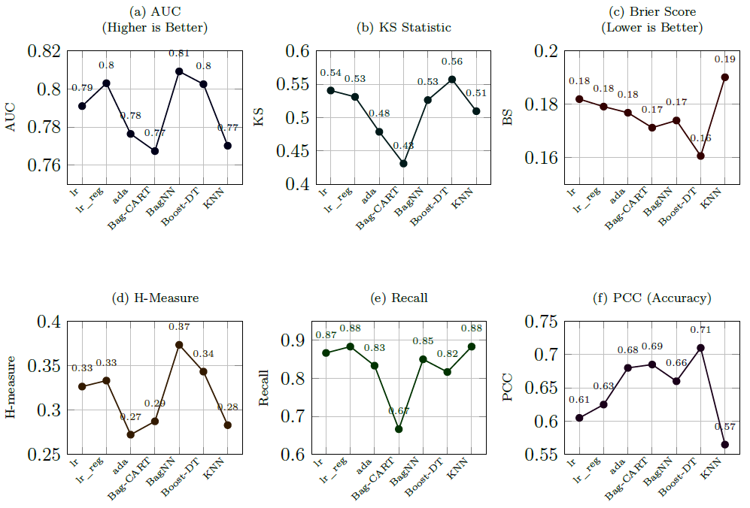
Algorithm
Banking & Risk
Banking underpins economic stability and growth through financial intermediation.
Systemic shocks (e.g. the 2008 crisis) expose vulnerabilities and underline the need for resilient risk frameworks.

Slide 6
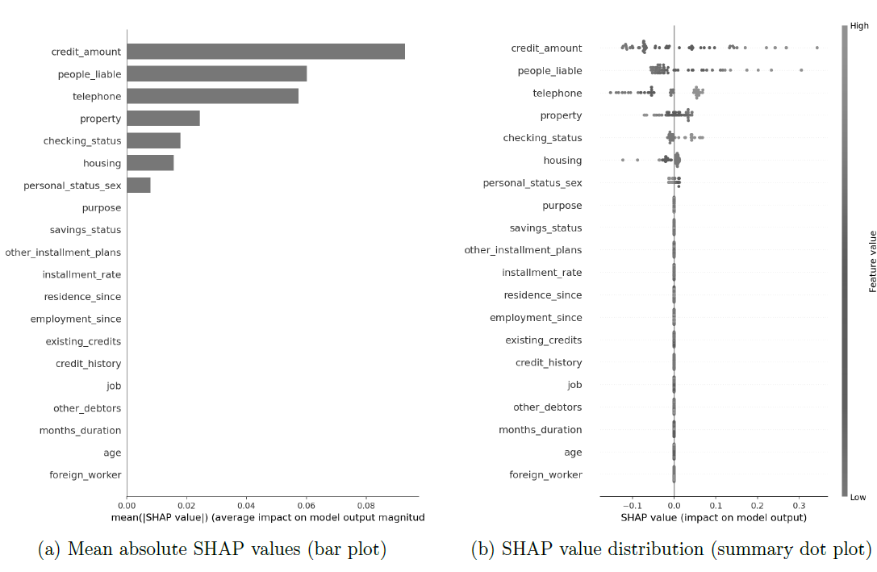
Algorithm
Banking & Risk
Banking underpins economic stability and growth through financial intermediation.
Systemic shocks (e.g. the 2008 crisis) expose vulnerabilities and underline the need for resilient risk frameworks.

Slide 7
Algorithm
Banking & Risk
Banking underpins economic stability and growth through financial intermediation.
Systemic shocks (e.g. the 2008 crisis) expose vulnerabilities and underline the need for resilient risk frameworks.

Slide 8
Algorithm
Banking & Risk
  Banking underpins economic stability and growth through financial intermediation.
  Systemic shocks (e.g. the 2008 crisis) expose vulnerabilities and underline the need for resilient risk frameworks.

Slide 9
Table 2: Generative AI for Basel 3.1
Author / Institution (Year) | Contribution | Model / Method | Data / Input | Outcome
Vaswani et al. (2017) | Introduced Transformer architecture | Transformer | WMT’14 English–German, English–French translation | Outperformed RNNs/CNNs; parallel training; foundation for modern LLMs
Devlin et al. (2018) | Contextual embeddings, bidirectional | BERT | Wikipedia + BookCorpus | Set new SOTA on GLUE, QA, NER
Radford et al. (2018) | Generative pretraining for NLP | GPT | Web text corpus | Demonstrated transfer learning in NLP
Brown et al. (2020) | Few-shot learning with large models | GPT-3 | 570GB curated web + books | Strong zero/few-shot reasoning; breakthrough in scaling
Raffel et al. (2020) | Unified NLP as text-to-text | T5 | C4 dataset | Simplified task framing; strong multi-task performance
OpenAI (2022) | Alignment with human intent | InstructGPT / ChatGPT (GPT-3.5) | RLHF on web + human feedback | Improved usability, safe deployment at scale
Touvron et al. (2023) | Efficient open-source LLMs | LLaMA | Curated multilingual datasets | Enabled broader research, efficient fine-tuning
OpenAI (2023) | Multimodal, aligned reasoning | GPT-4 | Proprietary | Stronger reasoning, multimodal capability

Slide 10
Objectives
To investigate methods for integrating borrower-level credit risk assessments with Basel 3.1 regulatory capital computations to enable real-time evaluation of capital impact at the point of credit origination.
To analyse how the application of predictive and generative AI in credit risk management influences decision quality, risk sensitivity, and compliance with Basel 3.1 regulatory requirements.
To evaluate methods for embedding explainability and fairness into AI-based credit risk models, with particular emphasis on ensuring transparency and auditability in line with supervisory expectations.
To critically assess model interpretation techniques—such as feature attribution, fairness metrics, and counterfactual reasoning—to determine their effectiveness in clarifying model behaviour without undermining predictive performance.

Slide 11
Objectives
To investigate the potential of generative AI for operationalising Basel 3.1 clauses by converting complex regulatory provisions into structured, machine-readable logic suitable for integration with predictive model outputs.
To contribute to the research literature on regulatory alignment by examining both the methodological feasibility and the supervisory implications of combining predictive and generative AI for credit risk assessment under Basel 3.1.
Central Research Hypothesis:
An integrated, explainable AI framework that combines predictive modelling with Generative AI–based regulatory logic translation can improve the timeliness, transparency, and Basel 3.1 compliance alignment of credit risk assessment more effectively than existing batch-based or siloed approaches.

Slide 12
Research Questions
To what extent can borrower-level credit risk assessments be integrated with Basel 3.1 RWA computations, as demonstrated through simulated frameworks that are auditable and reproducible against supervisory standards?
How does the application of predictive and generative AI in credit risk assessment affect decision quality, risk sensitivity, and regulatory compliance, as measured by changes in timeliness, capital impact accuracy, and alignment with Basel 3.1 provisions?
In what ways can explainability and fairness be embedded within AI-based credit risk models, and how can their adequacy be assessed using regulatory audit criteria such as transparency, traceability, and absence of bias?
How effective are interpretation techniques—such as feature attribution, fairness metrics, and counterfactual reasoning—in clarifying model behaviour, and how can their effectiveness be quantified without compromising predictive performance benchmarks?

Slide 13
Research Questions
Can generative AI techniques reliably operationalise Basel 3.1 clauses by converting complex provisions into machine-readable logic, and how can this reliability be evaluated in terms of translation accuracy, consistency across models, and resulting impact on RWA computations?
What are the methodological feasibility and supervisory implications of combining predictive and generative AI within credit risk assessment, as evidenced through comparative experiments, error analysis, and alignment with regulatory expectations under Basel 3.1?

Slide 14
Proposed Methodology
The methodology comprises two interconnected research modules designed to evaluate, in a simulated academic environment, how predictive and generative AI can be jointly applied for credit risk assessment and Basel 3.1 capital impact computation.
Two interconnected research modules tested in a simulated academic environment:
Module 1 – Credit Risk Prediction Layer
  Estimate borrower-level default risk using ML models (gradient boosting, deep learning, others).
  Public datasets with demographics, loan characteristics, repayment histories.
  Evaluation: ROC-AUC, F1, precision/recall, SHAP consistency, fairness indicators.

Slide 15
Proposed Methodology
Module 2 – RWA & Capital Impact Engine
  Use Generative AI to translate Basel 3.1 provisions into machine-readable rules.
  Variables include exposure class indicators, LTV buckets, Basel default definitions, unrated obligor flags.
  Integration with Module 1 outputs to compute RWAs and capital impact.
  Evaluation: consistency with Basel worked examples, reconciliation across exposure classes, computational efficiency.

Slide 16
Proposed Methodology
Integration of Basel 3.1 Variables with Public Credit Risk Datasets
  Module 1 outputs feed Module 2, enabling end-to-end evaluation of risk prediction and Basel-aligned capital outcomes.
  This enables a two-level evaluation:
    Predictive gain – whether the inclusion of Basel-aligned variables improves accuracy in estimating borrower default risk.
    Regulatory alignment – whether the resulting outputs, when reconciled with Basel risk weights, provide more policy-relevant insights into capital adequacy.

Slide 17
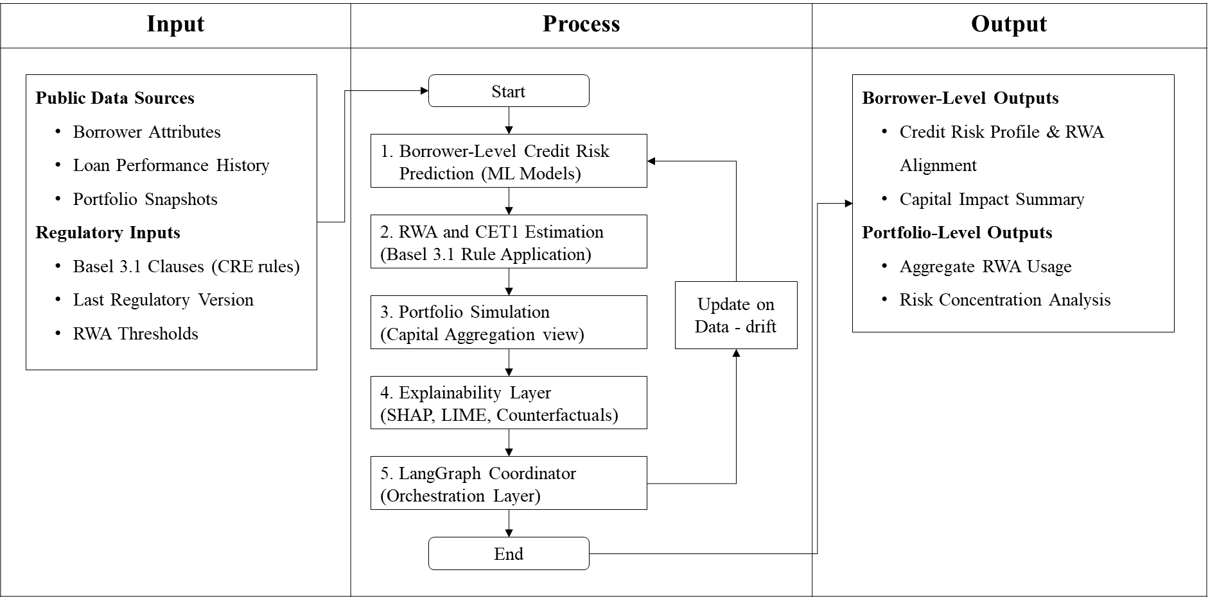
Methodology – System Architecture

Slide 18
Table 7: Datasets in Credit Risk Modelling
Dataset | Country / Origin | Size / Features | Papers | Database links
German Credit Data | Germany | 1,000 instances, 20 attributes (credit history, purpose, amount, etc.); binary risk label | Quan et al. (2024); Lessmann et al. (2015) | Link
Australian Credit Approval | Australia | ~690 instances, mixed-type attributes | Quan et al. (2024); Baesens et al. (2003); Lessmann et al. (2015) | Link
AMEX Credit Default Dataset | USA | 458,913 training records, 924,621 test records; >200 multi-temporal features across delinquency, spend, balance, etc.; default label over 18-month window | Hu & Yeo (2025) | Link
Default of Credit Card Clients | Taiwan | ~30,000 instances; demographic + credit history + repayment records | Yeh & Lien (2009); Quan et al. (2024); Hu & Yeo (2025) | Link
Credit borrowers’ data | USA | 150,000 borrowers; 10 numerical features (income, debt ratio, age, etc.); default label | Kozodoi et al. (2022) | Link
Home Credit Default Risk | Europe | 307,511 loan applications; ~200 features (demographics, credit history, behavioral data) | Kozodoi et al. (2022) | Link
PAKDD 2010 Credit Scoring | Taiwan | ~50,000 instances; 18 features; loan default prediction competition | Kozodoi et al. (2022) | Link
Wilful Loan Defaulters | India | Public lists (names, amounts, etc.) of loanees from Indian banks who are declared willful defaulters. | Jayadev & Padma (2019) | Link

Slide 19
High-Level Types of Variables in Credit Risk Research
Borrower- and transaction-level variables (from open datasets like German, Taiwan Credit, AMEX etc.).
Regulatory and Basel-defined variables (exposure class, LTV, default flag, SME adjustment, etc.).
Category | Type of variables
Borrower / Application Characteristics | Demographics (age, gender, education, dependents, employment) Financial attributes (income, debt ratio, savings, loan amounts) Behavioural data (credit history, repayment patterns, delinquencies, utilization of credit lines)
Transaction & Account Features | Payment history (monthly bills, past dues, default indicators) Credit product details (credit card limits, mortgage terms, installment plans) Derived ratios (loan-to-value, revolving utilization, balance-to-risk measures)
Regulatory Risk Drivers (Basel 3.1) | Exposure class (sovereign, bank, corporate, retail, real estate, equity) Collateral and guarantees SME adjustment Risk weight assignment (SA/IRB alignment) Default flag (90+ days overdue / unlikeliness to pay)
Supervisory Constraints & Calibration | Unrated obligor indicators Output floor (72.5% on modelled RWAs) Retail segmentation rules (residential mortgages, QRR, other retail)

Slide 20
Table 8: Variables Details: Datasets in Credit Risk Modelling
Dataset | Country / Origin | Input Variables (Columns) | Output Variable
German Credit Data | Germany | 20 inputs: Checking account status, Duration in months, Credit history, Purpose, Credit amount, Savings account/bonds, Employment since, Installment rate (% income), Personal status/sex, Other debtors/guarantors, Residence duration, Property, Age, Other installment plans, Housing, Existing credits, Job, Dependents, Telephone, Foreign worker | Credit risk classification (good / bad)
Australian Credit Approval | Australia | 14 anonymised attributes (A1–A14); a mix of categorical and numeric variables. | Credit approval decision (approved / rejected)
AMEX Default Prediction | USA | ~190 anonymised features grouped into categories: D_* (delinquency), S_* (spend), P_* (payment), B_* (balance), R_* (risk). Features are temporal (monthly profiles). | Binary default indicator (1 = default, 0 = non-default)
Default of Credit Card Clients | Taiwan | 23 inputs: Limit_bal, Gender, Education, Marriage status, Age, Pay_0–Pay_6 (repayment status for past 6 months), Bill_Amt1–Bill_Amt6 (bill amounts), Pay_Aamt1–Pay_Amt6 (payment amounts) | default.payment.next.month (1 = default, 0 = no default)
Credit borrowers’ data | USA | 10 inputs: RevolvingUtilizationOfUnsecuredLines, age, NumberOfTime30-59DaysPastDueNotWorse, DebtRatio, MonthlyIncome, NumberOfOpenCreditLinesAndLoans, NumberOfTimes90DaysLate, NumberRealEstateLoansOrLines, NumberOfTime60-89DaysPastDueNotWorse, NumberOfDependents | Serious delinquency within 2 years (SeriousDlqin2yrs)
Home Credit Default Risk | Europe | ~122 static application features (e.g., demographics, income, loan terms, credit history, external risk scores) plus derived features from related tables (bureau history, previous applications, balances, etc.) | TARGET — whether applicant will default or not (binary)
India Wilful Loan Defaulters | India | Basic exposure info: Defaulter name, Bank name, Amount owed | Wilful default status (all records are defaults)

Slide 21
Table 9: Variables Details: Regulatory variables
Variable | Description | Purpose in Study
Exposure Class | Sovereign, Bank, Corporate, Retail, Real Estate, Equity | Segments borrower-level exposures per Basel rules
Loan-to-Value (LTV) Bucket | Ratios: e.g., ≤50%, 50–60%, 60–80%, >80% | Determines RWA for real estate exposures
Default Flag (Basel Definition) | “90+ days past due” or “unlikeliness to pay” | Aligns predictive defaults with regulatory definition
Unrated Obligor Indicator | Flags exposures without external ratings | Triggers prescribed risk weights
SME Adjustment | Applies lower risk weights for qualifying SME retail | Tests fairness + Basel compliance
Collateral / Guarantee Recognition | Identifies secured vs unsecured exposures | Adjusts RWAs based on credit risk mitigation
Risk Weight Assignment | Numeric % based on exposure class + LTV | Computes final RWA from borrower outputs
Output Floor Variable | 72.5% floor on modelled RWAs | Reconciles IRB vs SA comparability
Retail Exposure Segmentation | Classifies exposures into regulatory retail categories: Residential mortgages, Qualifying revolving retail (QRR, e.g. credit cards), and Other retail. Includes SME retail adjustment. | Ensures predictive models can be tested not only for corporates/sovereigns but also for retail borrowers, aligning with Basel’s distinct risk weights.

Slide 22
Expected Outcomes
Integrated Framework
  Empirically validated framework: predictive modelling + Basel 3.1 RWA computation.
  Goal: Improve timeliness and regulatory alignment of credit decisions.
Explainability & Governance
  Design of an explainability framework for AI-based credit risk.
  Evaluate feature attribution, fairness checks, counterfactuals against regulatory standards.
  Goal: Support supervisory transparency and auditability.
Generative AI for Basel Alignment
  Explore Generative AI methods to structure Basel 3.1 clauses into compliance logic.
  Measure outcomes in terms of accuracy, interpretability, and computational efficiency.

Slide 23
Appendix

Slide 24
Predictive AI for Credit Risk
1968 / 1994
Foundations: Statistical methods (Altman)
2003 / 2009
Early ML: SVM, RF (Baesens; Bellotti & Crook)
2010 / 2015
Ensembles & Benchmarks: Decision trees (Khandani; Lessmann)
2016 / 2022
Hybrid & Fairness: Logit + Trees, Gradient boosting + fairness (Louzada; Kozodoi)
2023 / 2024
Deep Learning & Transformers: DL frameworks (DeRisk; Transformer Study)

Slide 25
Table 2: Generative AI for Basel 3.1
1. Foundations of Transformers (2017–2018)
Vaswani et al. (2017): Transformer architecture → foundation for modern LLMs.
Devlin et al. (2018): BERT → contextual embeddings, new state-of-the-art in NLP tasks.
2. Generative Pretraining (2018–2020)
Radford et al. (2018): GPT → demonstrated transfer learning in NLP.
Brown et al. (2020): GPT-3 → few-shot reasoning, scaling breakthroughs.
Raffel et al. (2020): T5 → unified text-to-text framework, multi-task performance.
3. Alignment & Scaling (2022–2023)
OpenAI (2022): InstructGPT / ChatGPT (RLHF) → alignment with human intent.
Touvron et al. (2023): LLaMA → efficient, open-source LLMs.
OpenAI (2023): GPT-4 → multimodal, stronger reasoning, broad adoption.
4. Domain Adaptation for Regulation (2024–2025)
Cao & Feinstein (2024): Prompt engineering for Basel market risk clauses.
Nazemi & Fabozzi (2024): Supervisory explainability with GenAI.
Fazlija et al. (2025): Reasoning with Basel provisions (CoT/ToT, Claude/GPT-4o).
Haeri et al. (2025): RiskEmbed: domain-specific embeddings for regulatory QA.
Joshi (2025): End-to-end GenAI regulatory architecture, integrating LLMs into compliance pipelines.

Slide 26
Final Local Comaprison
Integrated Framework
  Empirically validated framework: predictive modelling + Basel 3.1 RWA computation.
  Goal: Improve timeliness and regulatory alignment of credit decisions.
Explainability & Governance
  Design of an explainability framework for AI-based credit risk.
  Evaluate feature attribution, fairness checks, counterfactuals against regulatory standards.
  Goal: Support supervisory transparency and auditability.
Generative AI for Basel Alignment
  Explore Generative AI methods to structure Basel 3.1 clauses into compliance logic.
  Measure outcomes in terms of accuracy, interpretability, and computational efficiency.

Slide 27
References
Stabilization (Feature Screening, Structural Signal, Pre-Model Discipline)
This layer concerns feature relevance, model structure, statistical grounding, and robustness before optimisation.
Baesens, B., Van Gestel, T., Viaene, S., Stepanova, M., Suykens, J., & Vanthienen, J. (2003). Benchmarking state-of-the-art classification algorithms for credit scoring. Journal of the Operational Research Society, 54(6), 627–635. https://doi.org/10.1057/palgrave.jors.2601553
Desai, V. S., Conway, M., Crook, J., & Overstreet, G. (1996). Credit-scoring models in the credit union environment using genetic algorithms and neural networks. IMA Journal of Mathematics Applied in Business and Industry, 7(2), 151–164.
Hand, D. J. (2009). Measuring classifier performance: A coherent alternative to the area under the ROC curve. Machine Learning, 77(1), 103–123. https://doi.org/10.1007/s10994-009-5119-5
Louzada, F., Ara, A., & Fernandes, G. B. (2016). Binary classification methods for credit scoring: A systematic review and empirical analysis. Expert Systems with Applications, 59, 117–136. https://doi.org/10.1016/j.eswa.2016.02.039
Louzada, F., Ara, A., & Fernandes, G. B. (2016). Classification methods applied to credit scoring: Systematic review and new perspectives. Computational Economics, 48(4), 729–750. https://doi.org/10.1007/s10614-015-9517-9
Yeh, I.-C., & Lien, C.-H. (2009). The comparisons of data mining techniques for the predictive accuracy of probability of default of credit card clients. Expert Systems with Applications, 36(2), 2473–2480. https://doi.org/10.1016/j.eswa.2007.12.020
Zeng, G., Su, W., & Hong, C. (2024). Ensemble learning with feature optimization for credit risk assessment. Research Square (Preprint). https://doi.org/10.21203/rs.3.rs-4665987/v1

Slide 28
References
Evolution (Training, Calibration, Model Selection)
This layer corresponds to stratified learning, imbalance handling, optimisation, and comparative benchmarking.
Chawla, N. V., Bowyer, K. W., Hall, L. O., & Kegelmeyer, W. P. (2002). SMOTE: Synthetic minority over-sampling technique. Journal of Artificial Intelligence Research, 16, 321–357. https://doi.org/10.1613/jair.953
Lessmann, S., Baesens, B., Seow, H.-V., & Thomas, L. C. (2015). Benchmarking state-of-the-art classification algorithms for credit scoring: An update of research. European Journal of Operational Research, 247(1), 124–136. https://doi.org/10.1016/j.ejor.2015.05.030
Verbraken, T., Verbeke, W., Baesens, B., & Bravo, J. (2014). Profit-driven classification using Bayesian networks. Expert Systems with Applications, 42(3), 1354–1362.
Dua, D., & Graff, C. (1994). German credit data. UCI Machine Learning Repository. https://archive.ics.uci.edu/ml/datasets/statlog+(german+credit+data)

Slide 29
References
Layer 3: Validation (Explainability, Reliability, Adversarial Stress, Governance)
This layer aligns with SHAP attribution, sanity checks, explanation fragility, and constrained interpretation.
Lundberg, S. M., & Lee, S.-I. (2017). A unified approach to interpreting model predictions. Advances in Neural Information Processing Systems, 30, 4765–4774. https://papers.nips.cc/paper/7062-a-unified-approach-to-interpreting-model-predictions
Ribeiro, M. T., Singh, S., & Guestrin, C. (2016). “Why should I trust you?”: Explaining the predictions of any classifier. Proceedings of the 22nd ACM SIGKDD International Conference on Knowledge Discovery and Data Mining, 1135–1144. https://doi.org/10.1145/2939672.2939778
Slack, D., Hilgard, S., Jia, E., Singh, S., & Lakkaraju, H. (2020). Fooling LIME and SHAP: Adversarial attacks on post-hoc explanation methods. Proceedings of the AAAI/ACM Conference on AI, Ethics, and Society, 180–186. https://doi.org/10.1145/3375627.3375830
Hassija, V., Chamola, V., Mahapatra, A., et al. (2024). Interpreting black-box models: A review on explainable artificial intelligence. Cognitive Computation, 16(1), 45–74. https://doi.org/10.1007/s12559-023-10187-8
Wang, L., Yu, Z., Ma, J., Chen, X., & Wu, C. (2025). A two-stage interpretable model to explain classifier in credit risk prediction. Journal of Forecasting. https://onlinelibrary.wiley.com/journal/1099131x

