Slide 1

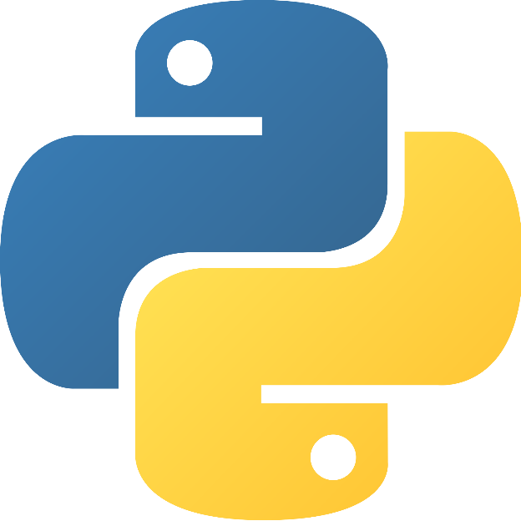
Python for beginners
Saeede Anbaee Farimani
Phd Candidate @ IAUM
Supervisor : Dr Majid Vafaei Jahan

Slide 2

Our plan ?
Python for beginners
Python for data science ( pandas, numpy, skit-learn )
Bayesian theory and Bayesian network in python

Slide 3
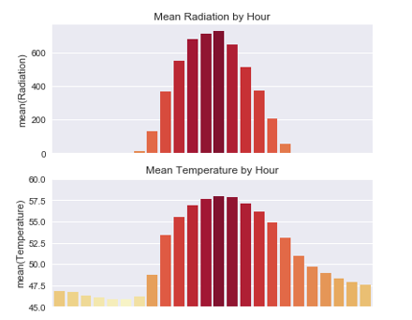
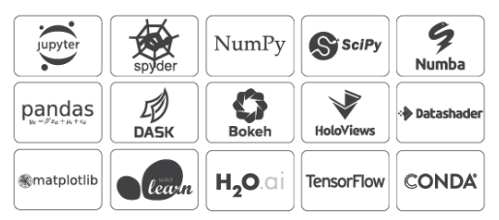
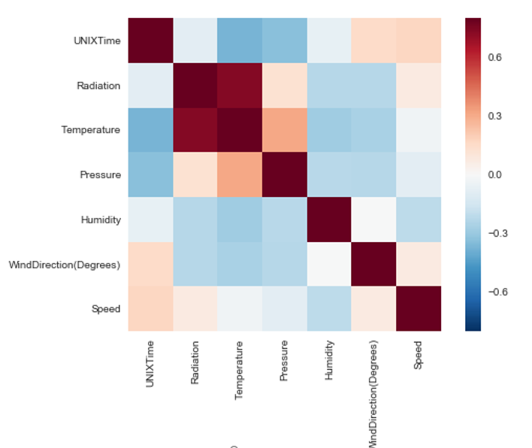

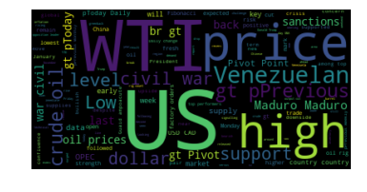
Why python?

Slide 4
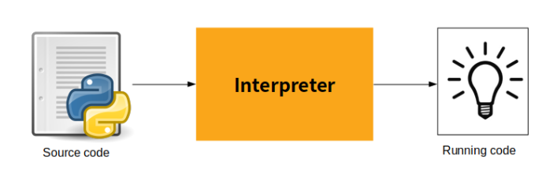
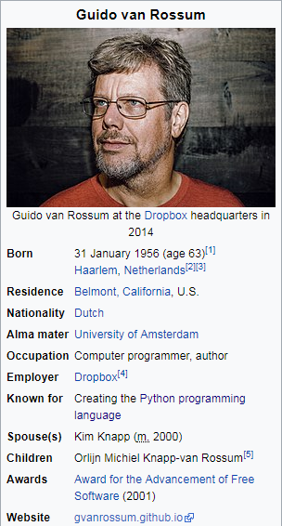
How Python work ?
Highly readable language
Less syntactic exceptions
Superior string manipulation
Elegant and dynamic typing
Ideal for scripting and rapid application
Fit for many platforms
Free and free IDE
Interesting Podcast : python past, present and future with Guido Van Rossum

Slide 5


How install, what IDE?

Slide 6
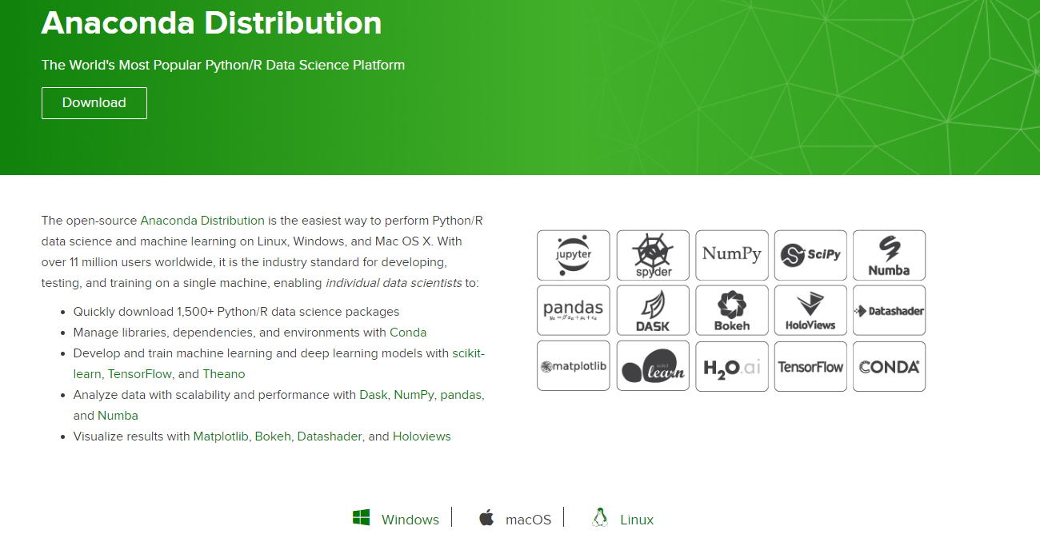
ANACONDA installation
https://www.anaconda.com/distribution/

Slide 7
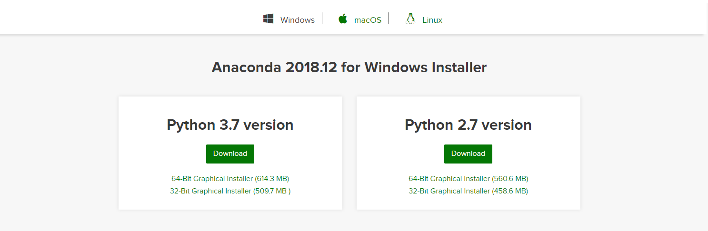
What Version Of Python ?

Slide 8
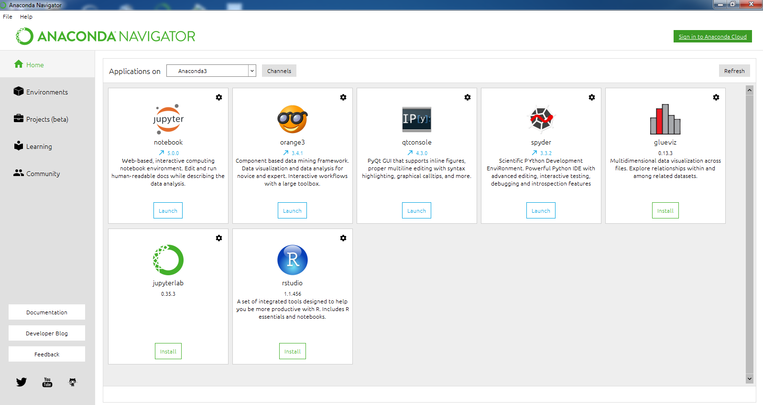
Anaconda Navigator

Slide 9
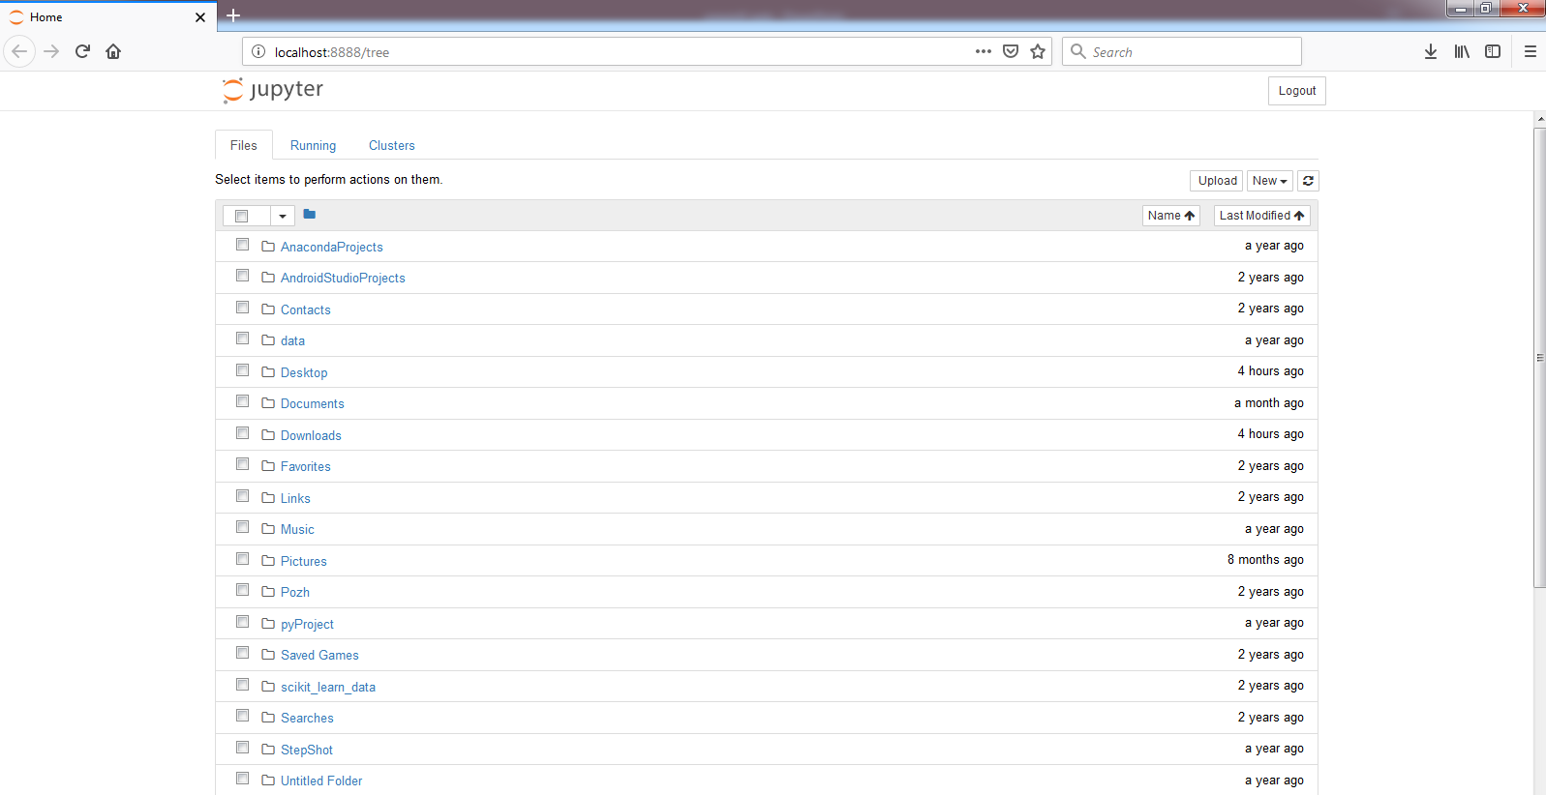
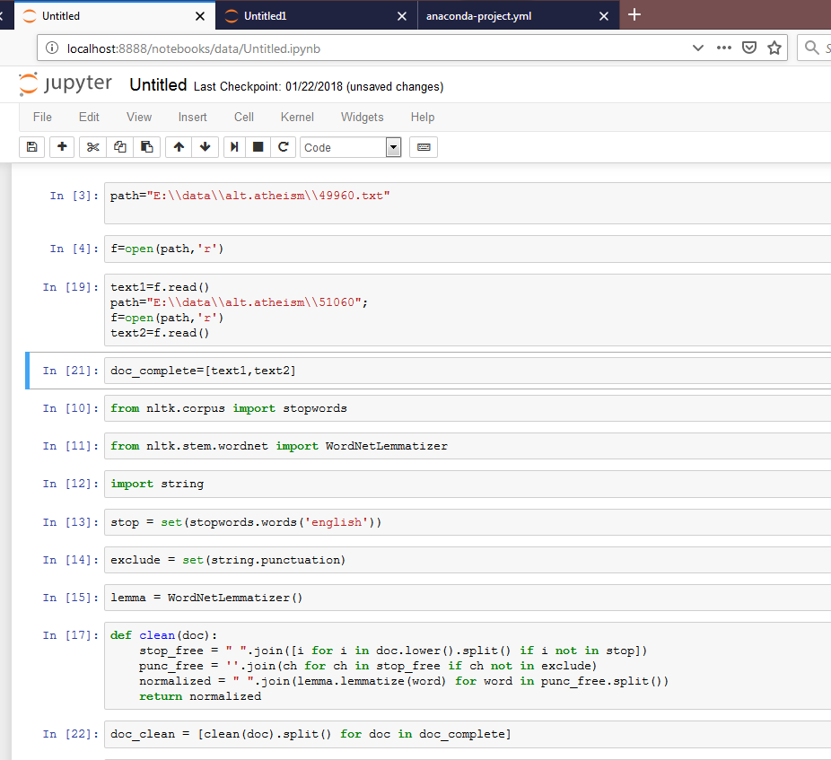
Jupiter Notebook

Slide 10
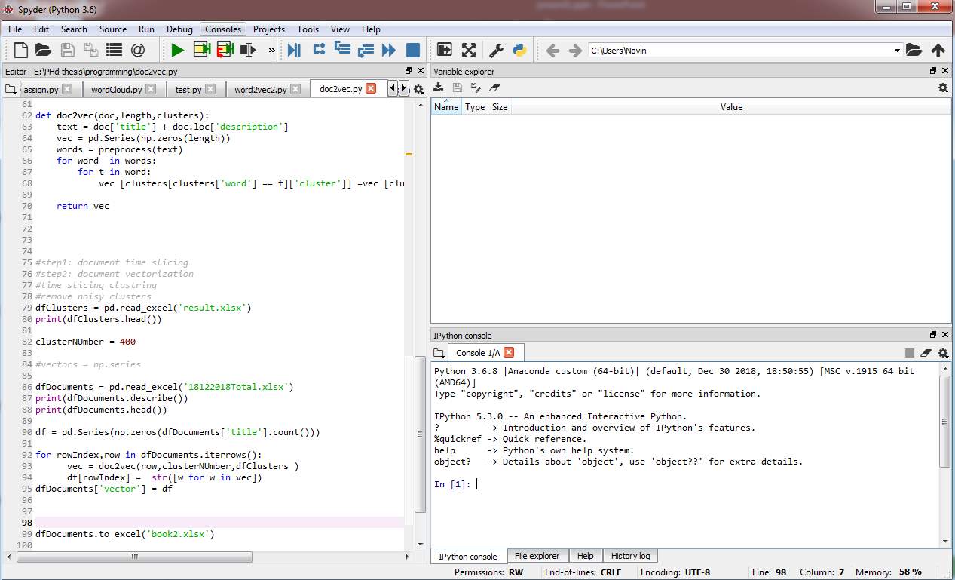
Spyder IDE

Slide 11
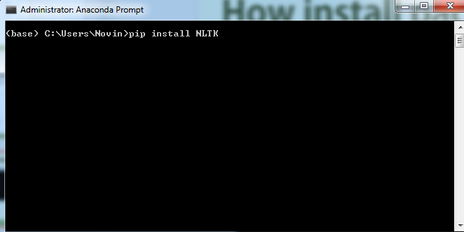
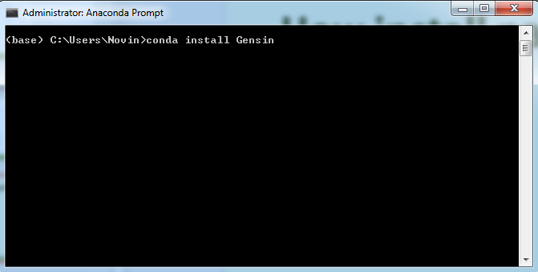
How install packages?
Pip package manager
Anaconda Conda package manager

Slide 12

What Reference for starting?
www.w3schools.com

Slide 13
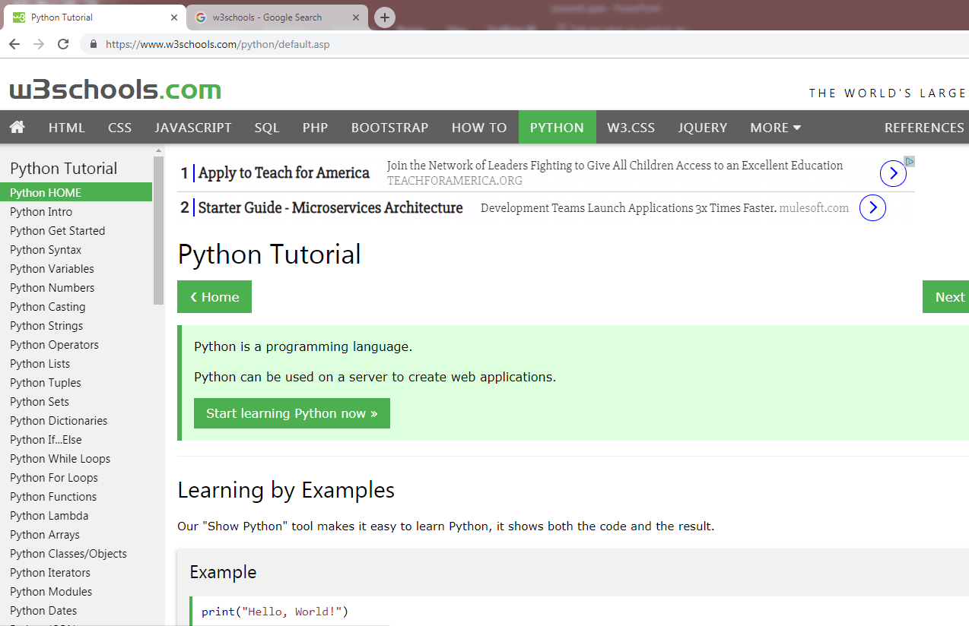
What Reference for starting?
www.w3schools.com

Slide 14
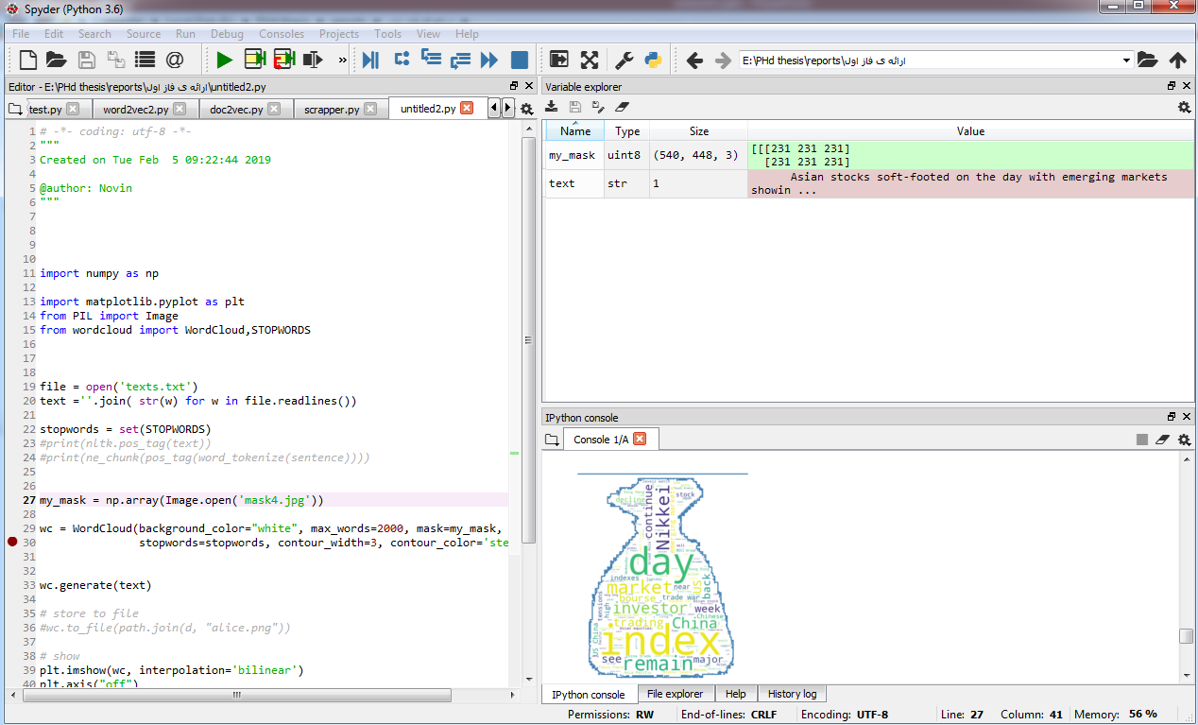
How develop code in spyder?

Slide 15
Examples
Hello world
Variables
Python collections( list , tuples , set , dictionaries)
Conditions
Loops
Function declaration
class
File Handling
Word Cloud visualization
Text preprocessing with NLTK

Slide 16
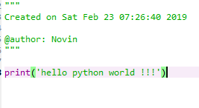
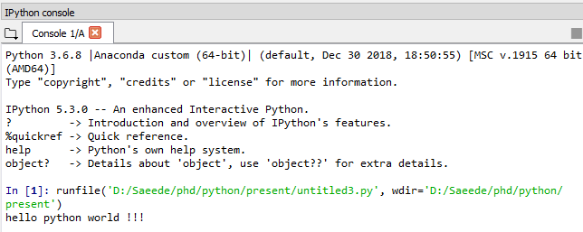
Hello world !
Very Simple
Useful video about Python Graphical User Interface

Slide 17
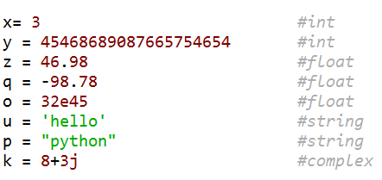
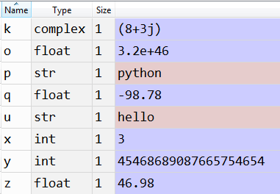
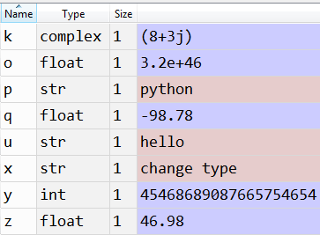
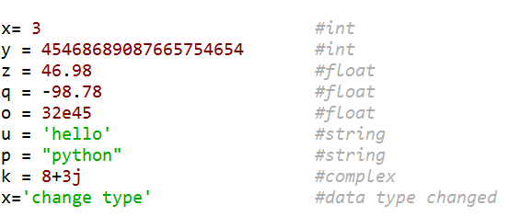
Variables
Variable types in python

Slide 18
Python collections
List is a collection which is ordered and changeable. Allows duplicate members.
thislist = [‘apple’, ’banana’, ’cherry’]
Tuple is a collection which is ordered and unchangeable. Allows duplicate members.
thistuple = (‘apple’, ’banana’, ’cherry’)
Set is a collection which is unordered and unindexed. No duplicate members.
thisset = {‘apple’, ’banana’, ’cherry’}
Dictionary is a collection which is unordered, changeable and indexed. No duplicate members.
thisdict = { "brand": "Ford", "model": "Mustang", "year": 1964 }
Collections in python

Slide 19
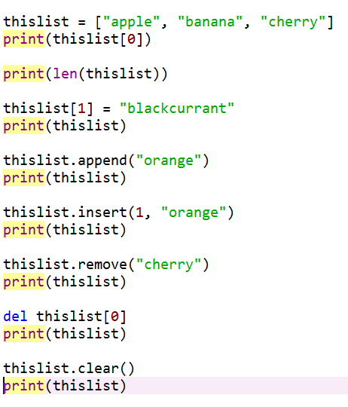
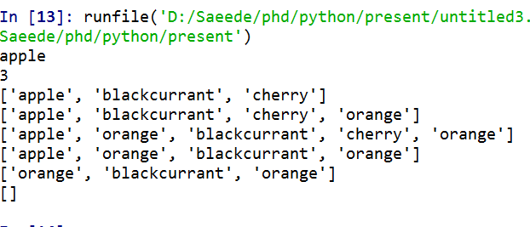
List in python
List in python

Slide 20
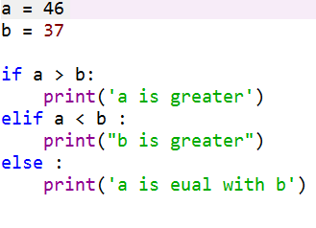
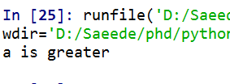
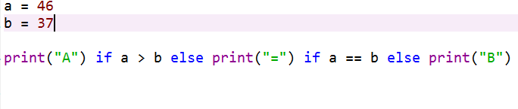



conditions
Python relies on indentation, using whitespace, to define scope in the code
Do not forget ‘:’ at the end of condition
condition in python

Slide 21

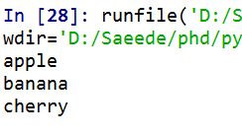
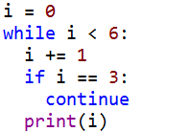
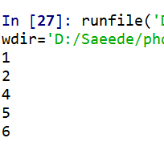

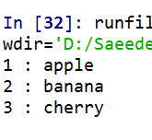
Loops
for
While , break , continue
for
Do not forget ‘ : ’
Do not forget indented block
loops in python

Slide 22
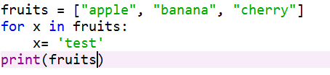

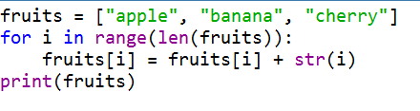

Loops
for
Remind that Change in x does not causes change in List
for
For change in List use index of items
loops in python

Slide 23
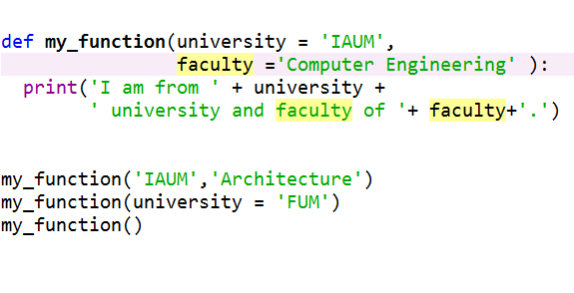
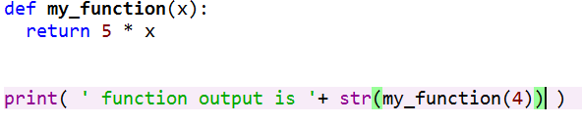

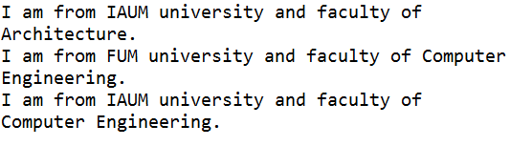
Function Declaration
functions in python

Slide 24
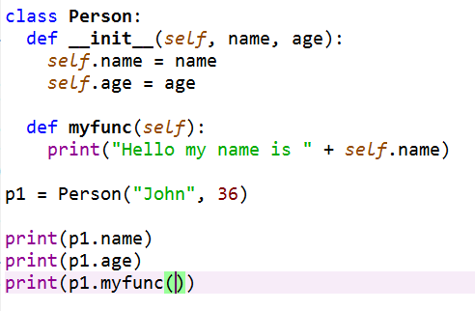

Class
Python is Object Oriented Programming language
Almost everything in Python is an object, with its properties and methods
Used class for your own type declaration
class in python

Slide 25
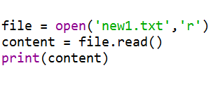
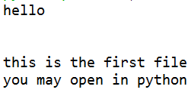
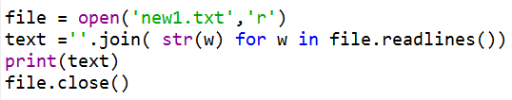
File handling
Don’t forget close your file
read all file
Read line
File opening

Slide 26
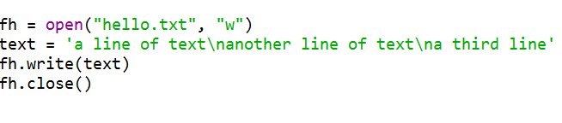
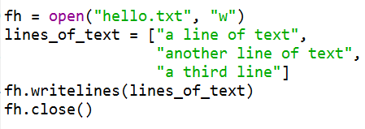
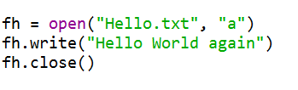
File handling
write
Write line
Do not forget close your file
append
File writing and appending

Slide 27
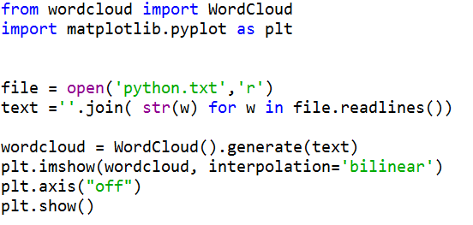
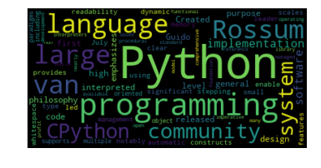
First visualization
Matplotlib help you to draw some chart
World cloud
Useful video for Matplotlib python library

Slide 28
Text preprocessing
word tokenize
[ 'Learn', 'the', 'Basics', 'of', 'Python', 'Programming', 'in', 'Weeks', ‘.' ]
Stop word removal
['Learn', 'Basics', 'Python', 'Programming', 'Weeks']
stemming
['learn', 'basic', 'python', 'program', 'week']
POS tagging
[('learn', 'NN'), ('basic', 'JJ'), ('python', 'NN'), ('program', 'NN'), ('week', 'NN')]
sentence
Learn the Basics of Python Programming in Weeks.
NLTK library
text preprocessing steps

Slide 29

Learn the Basics of Python Programming in Weeks.
word tokenize
NLTK tokenization

Slide 30
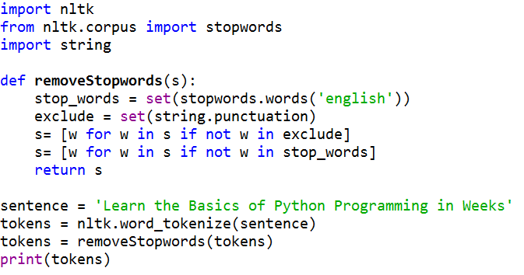
Learn the Basics of Python Programming in Weeks.
Stop word removal
NLTK remove stop words

Slide 31
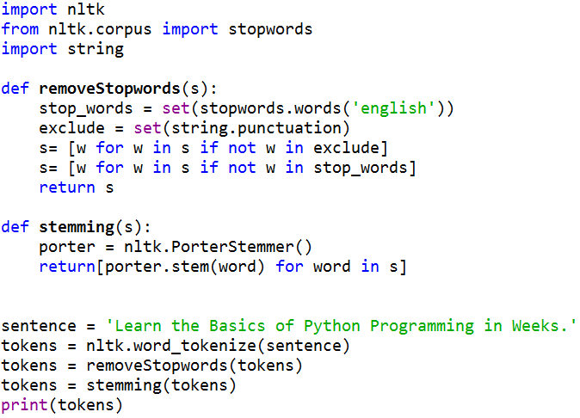

Learn the Basics of Python Programming in Weeks.
stemming
NLTK porter stemmer

Slide 32
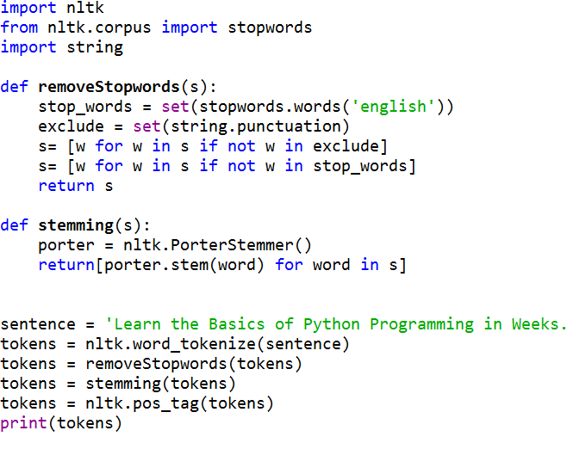

Learn the Basics of Python Programming in Weeks.
POS tagging
NLTK Part Of Speech tagging

Slide 33


Thanks
Please send comments to @SAnbaee or anbaee.ac@gmail.com

