Slide 1

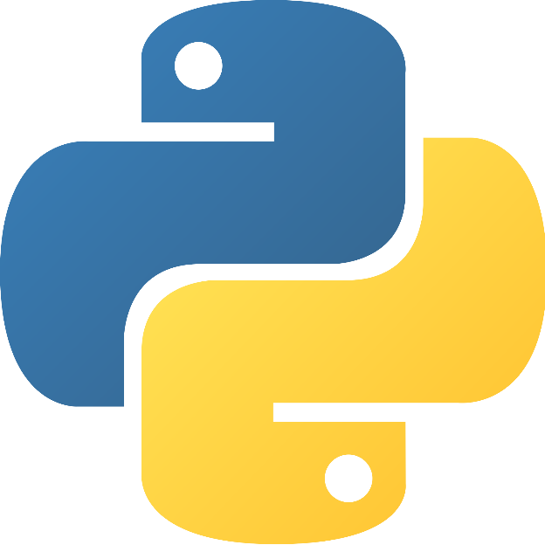
Python for beginners
Saeede Anbaee Farimani
Phd Candidate @ IAUM
Collections

Slide 2

Collections
List
Tuples
Sets
Dictionaries

Slide 3


Collections (list)
List : list in python differ from array in C# or C++

Slide 4

Collections (list)
List : list in python differ from array in C# or C++

Slide 5


collections
list.append(x)
Add an item to the end of the list. Equivalent to a[len(a):] = [x].

Slide 6


collections
list.extend ( iterable )
Add an item to the end of the list. Equivalent to a[ len(a) : ] = iterable .

Slide 7

collections
list.insert( index , value )
Insert an item at a given position.

