Slide 1


Python for beginners
Saeede Anbaee Farimani
Phd Candidate @ IAUM
Conditions

Slide 2

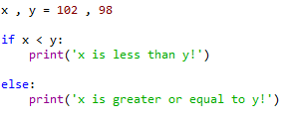

Condition in python
Python relies on indentation, using whitespace, to define scope in the code
Do not forget ‘:’ at the end of condition

Slide 3
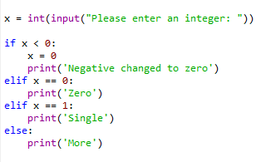

Condition in python

Slide 4


Condition in python

Slide 5

Condition in python

Slide 6
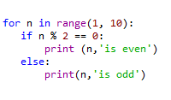


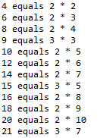
Condition in python
Odd and even numbers
non-prime numbers

