Slide 1


Python for beginners
Saeede Anbaee Farimani
Phd Candidate @ IAUM

Slide 2

Loop operation in python
The for statement in Python differs a bit from what you may be used to in C or Pascal
Python’s for statement iterates over the items of any sequence (a list or a string), in the order that they appear in the sequence

Slide 3
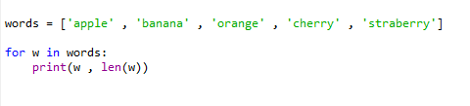

Loop

Slide 4




Loop

Slide 5








Loop
range ( 5 ) output : 0, 1, 2, … , 5
range ( 2 , 7 ) output : 2, 3, 4, 5, 6, 7
range ( 2, 10, 2) output: 2, 4, 6, 8
range ( -30, -50, -2) output:-30, -32 , … , -48

Slide 6
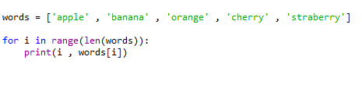

Loop

Slide 7




Loop
Reversed ( iter ) : return itteratable object in reversed order
sorted( iter ) : sort itteratable object

Slide 8




Loop
enumerate( ittratableObj , start ) : return enumerate starting from start as tuple

Slide 9





Loop
Zip( iter1, iter2 ) : return zip format of iter1 and iter2 as tuple

Slide 10
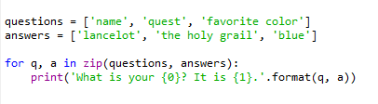

Loop
Zip( iter1, iter2 ) : return zip format of iter1 and iter2 as tuple

Slide 11

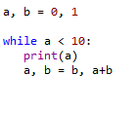


Loop
while
Fibonacci series:

