Slide 1
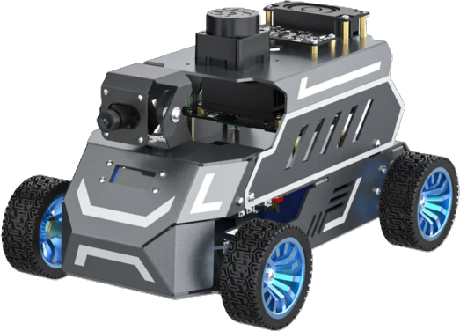
ROSMASTER CRASH COURSE
What is
ROS 2?
Week 1 of 4. From zero to a robot that drives itself.
Phan Phearamony
KAMAL Laboratory, Gunma University
Yahboom ROSMASTER A1
Notes:
Hi everyone. Welcome to the ROSMASTER crash course.
This is the robot we will use for the next four weeks. It is the ROSMASTER A1 from Yahboom. It has four wheels, it steers like a car, and it has a LiDAR on top so it can see around itself.
Today is Week 1. The question for today is simple: what is ROS 2? By the end of today you will know what ROS 2 is, what Gazebo is, and you will have a simulated A1 driving around on your own laptop.
You do not need to understand everything today. I will explain things roughly first. We go deeper in the next weeks.

Slide 2
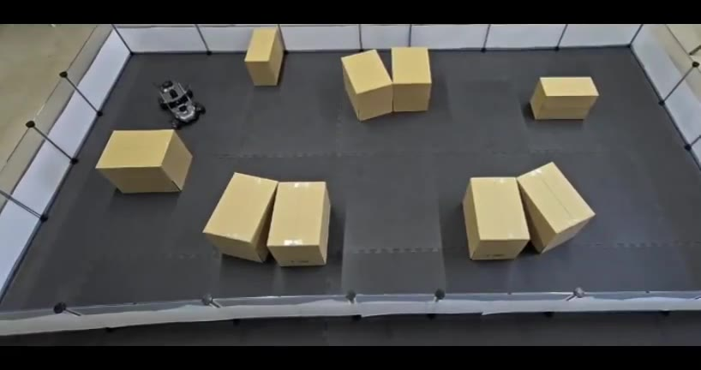
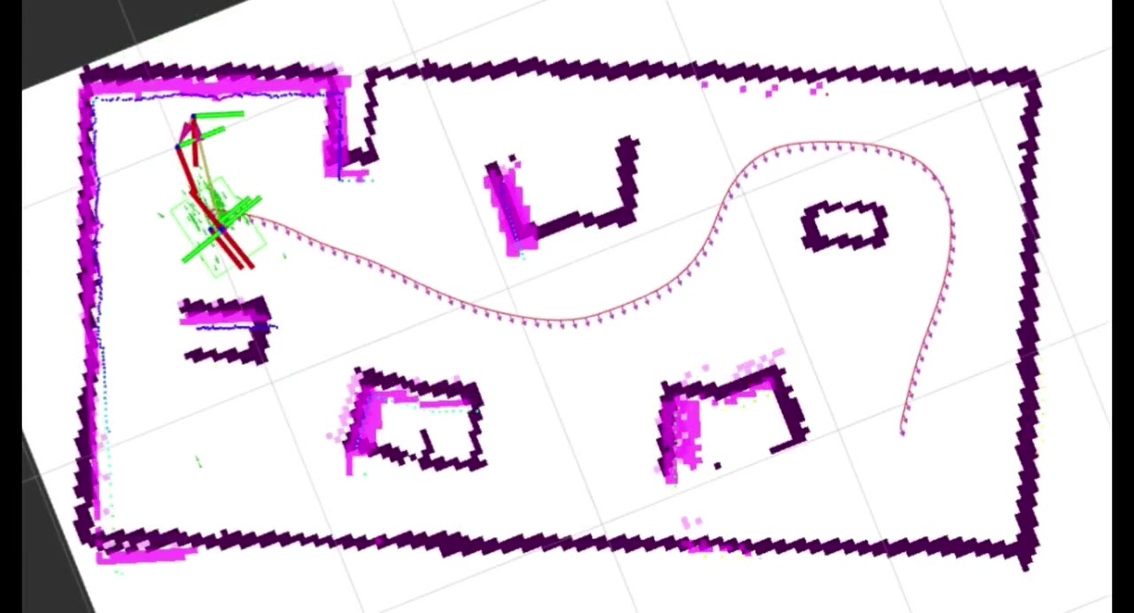
THE GOAL
By Week 4, you will understand how a robot moves like this
Real ROSMASTER A1
What the robot sees (RViz2)
Scenario 1: Known map
Known map
Surprise obstacles
Unknown room
The robot already has a map of the room. It plans a path and drives to the goal.
Notes:
Before we start, let me show you where we are going.
This is the ROSMASTER A1 at our lab, driving by itself. On the left is the real robot. On the right is what the robot sees on the computer, in a tool called RViz2. The dark lines are the walls and boxes the LiDAR found. The dotted line is the path it planned.
Scenario 1: the robot already has a map of the room. It plans a path from start to goal and drives there by itself.
By Week 4, you will understand how a robot can move like this: how it sees, how it decides, and how it drives.

Slide 3
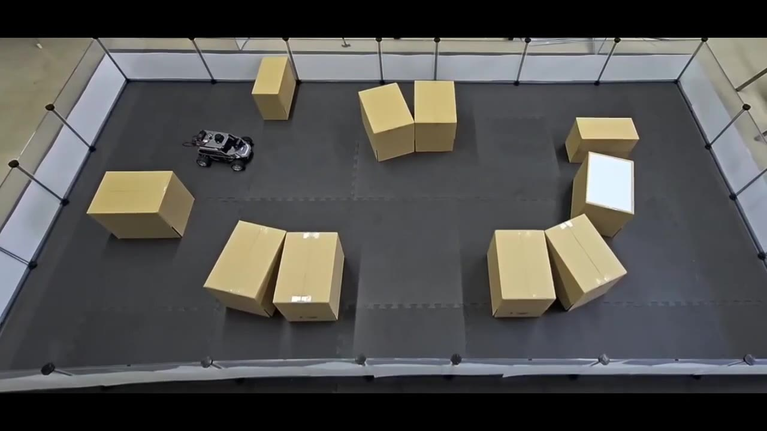
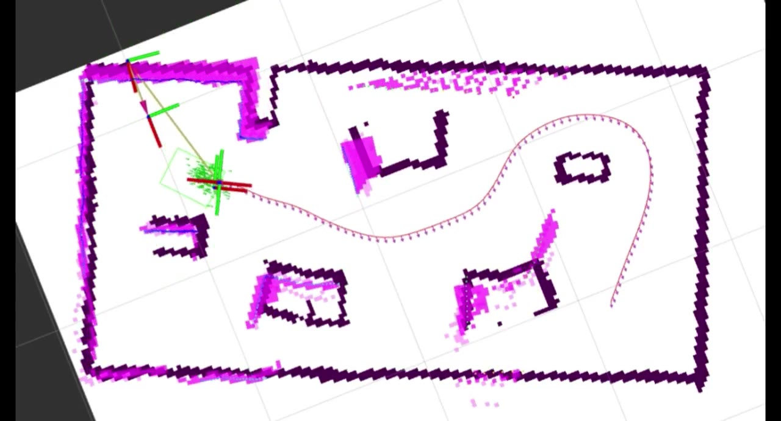
THE GOAL
By Week 4, you will understand how a robot moves like this
Real ROSMASTER A1
What the robot sees (RViz2)
Scenario 2: Surprise obstacles
Known map
Surprise obstacles
Unknown room
Same map, but we add boxes the map does not know about. The robot sees them with LiDAR and goes around.
Notes:
Scenario 2. Same room, same map. But now we put extra boxes in the way, and the map does not know about them.
Watch the right side. The LiDAR sees the new boxes, they appear on the map, and the robot changes its path and goes around them.

Slide 4
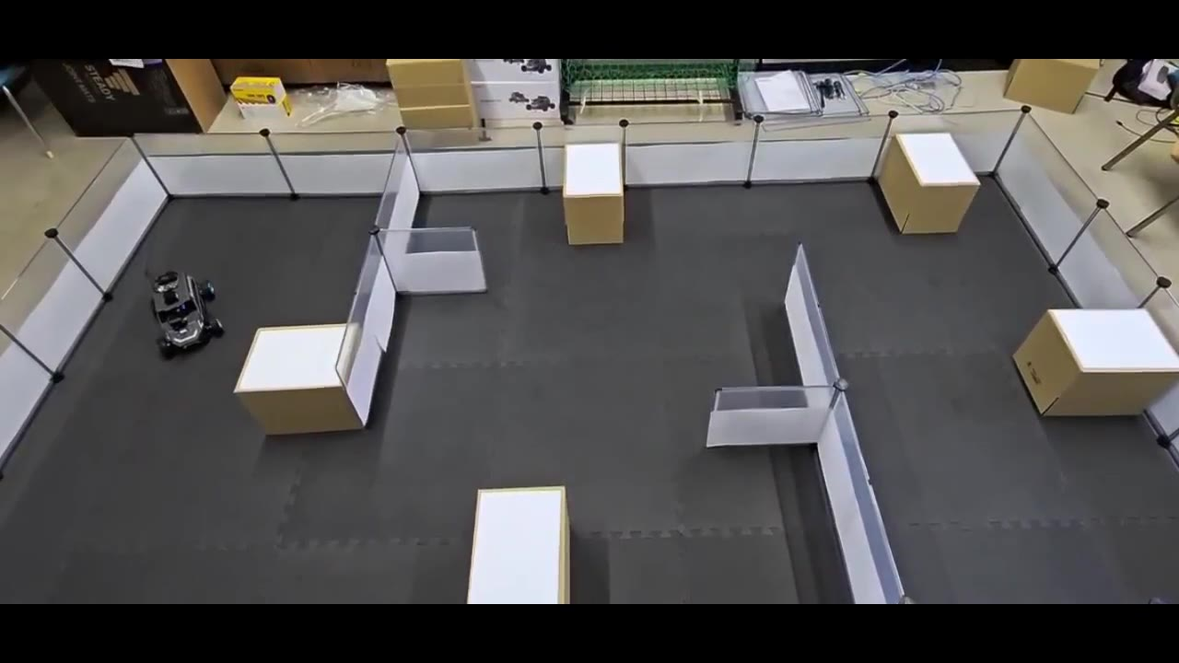
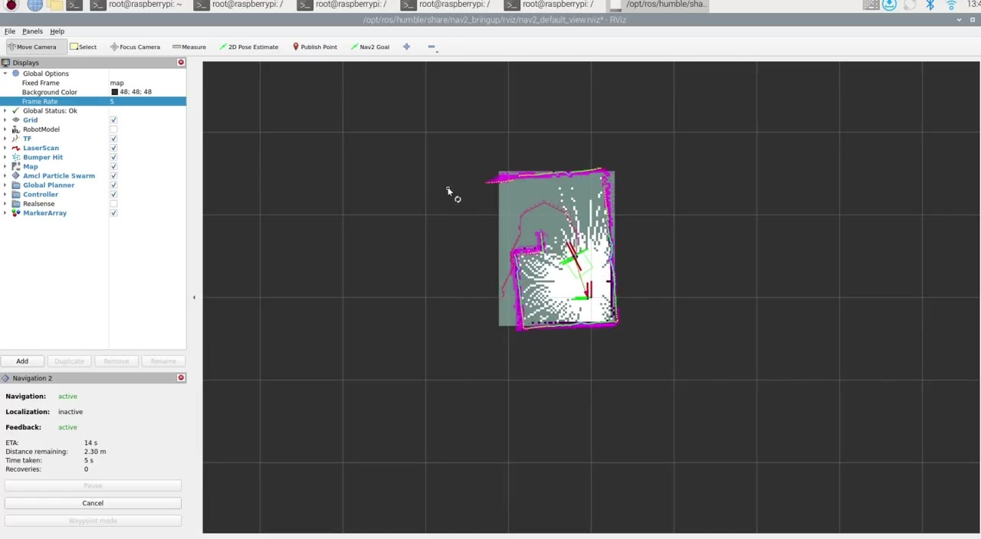
THE GOAL
By Week 4, you will understand how a robot moves like this
Real ROSMASTER A1
What the robot sees (RViz2)
Scenario 3: Unknown room
Known map
Surprise obstacles
Unknown room
No map at all. The robot builds the map while it drives, and still finds the goal.
Notes:
Scenario 3 is the hardest. A completely new room and no map at all.
The robot builds the map while it drives. You can see the map grow on the right. It still finds its way to the goal.
Every week adds one piece toward understanding this. Let me show you the plan.

Slide 5
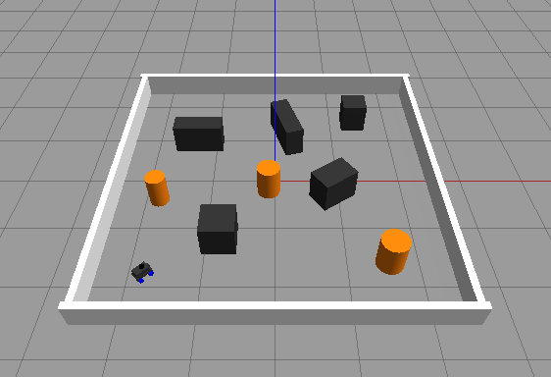
COURSE ROADMAP
Four weeks, one robot
WEEK 1
WEEK 2
WEEK 3
WEEK 4
ROS 2 Introduction
Reading the Code
Control and Sensors
ROSMASTER Functions
01
What ROS 2 is and why robots use it
Nodes, topics and messages
ROS vs ROS 2, and the versions
Gazebo, the robot simulator
Hands-on: a simulated A1 avoids obstacles with LiDAR
Notes:
Here is the plan for four weeks. The dot shows where we are.
Week 1 is today. We learn what ROS 2 is, how the parts of a robot talk to each other, what Gazebo is, and we run our first simulation. The simulated A1 will drive around a room and avoid obstacles using only its LiDAR.
Today is mostly ideas plus one hands-on part at the end.

Slide 6
COURSE ROADMAP
Four weeks, one robot
WEEK 1
WEEK 2
WEEK 3
WEEK 4
ROS 2 Introduction
Reading the Code
Control and Sensors
ROSMASTER Functions
02
Linux: files, folders and the terminal
Bash commands you use every day: cd, ls, nano, source, sudo apt
Python basics: variables, if, functions, classes
Read the Week 1 avoidance node line by line
def scan_callback(...):
front = ...
if front < safe:
turn()
Notes:
Week 2. Today you will run code that I wrote. Next week we open that code and read it line by line.
To do that, you need a little Linux, a little bash, and a little Python. Not a full course. Just enough to understand the robot code. Things like cd, ls, nano, if statements, functions and classes.

Slide 7
COURSE ROADMAP
Four weeks, one robot
WEEK 1
WEEK 2
WEEK 3
WEEK 4
ROS 2 Introduction
Reading the Code
Control and Sensors
ROSMASTER Functions
03
How the A1 moves: /cmd_vel, Ackermann steering, odometry
Its sensors: LiDAR, camera, IMU, wheel encoders
Example: LiDAR obstacle avoidance on the real A1, like Week 1
Homework: use the A1's built-in AI (YOLO) to recognize objects
Notes:
Week 3 is control and sensors, on the real robot.
How does the A1 actually move? We look at /cmd_vel again, at Ackermann steering, which means it steers like a car, and at odometry, which is how the robot estimates where it is from its wheels.
Then the sensors: LiDAR, camera, IMU and wheel encoders. What each one measures.
The example will be LiDAR obstacle avoidance on the real A1, the same idea as today in simulation.
Homework that week: use the AI that comes built into the robot to recognize objects with the camera, using YOLO.

Slide 8
COURSE ROADMAP
Four weeks, one robot
WEEK 1
WEEK 2
WEEK 3
WEEK 4
ROS 2 Introduction
Reading the Code
Control and Sensors
ROSMASTER Functions
04
Tour the A1's built-in functions from the Yahboom docs
Mapping (SLAM) and Nav2 navigation
LiDAR follow and patrol, line following, color tracking
AI functions: object recognition and voice or text commands
Notes:
Week 4 is everything the ROSMASTER A1 can do.
Yahboom's documentation comes with many built-in functions. We go through them and run them ourselves: mapping with SLAM, navigation with Nav2, LiDAR following and patrol, line following, color tracking, and the AI functions like object recognition and giving the robot commands by text or voice.
By the end, the videos from the start will make sense: you will know how the robot maps, plans and drives.
OK. Let's start with the basics.

Slide 9
01
What is ROS 2?
The ideas behind every ROS robot, including ours.
Notes:
Part 1. What is ROS 2?
I will keep this rough. I just want you to get the main idea. Everything here you will see again in the code later.

Slide 10
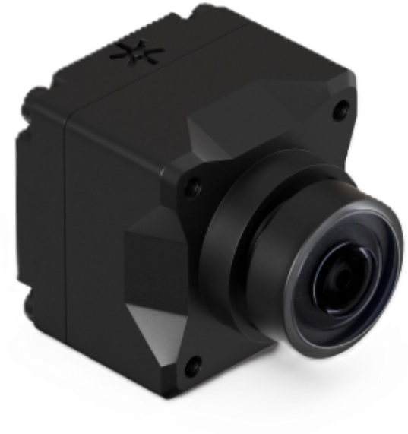
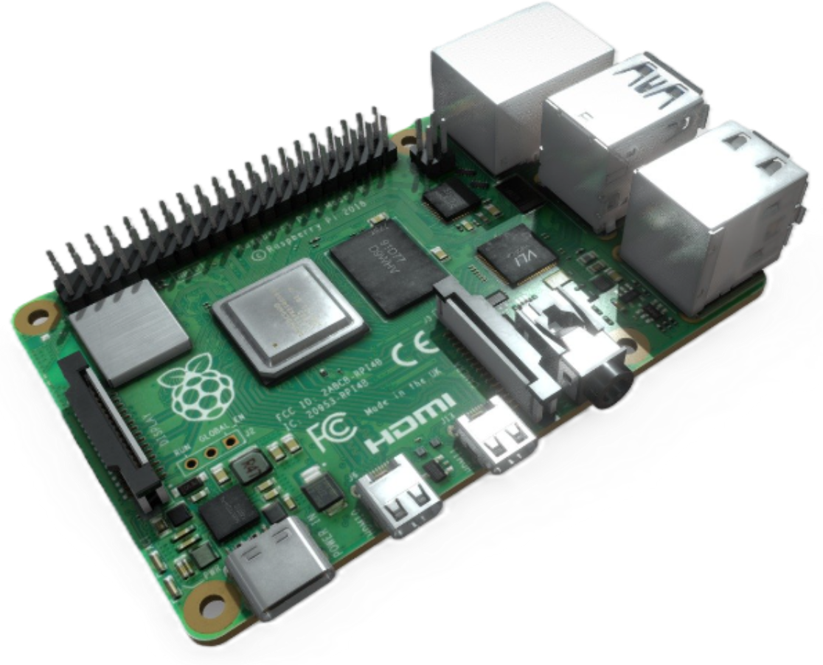
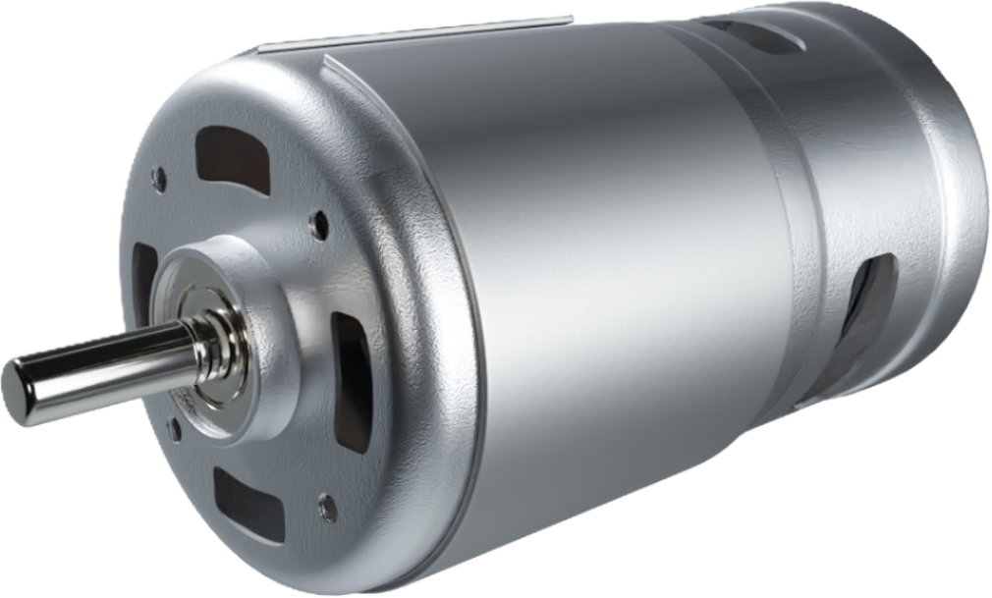
WHAT IS ROS 2
Every robot does three things
Sense
Think
Act
LiDAR, camera, IMU
Raspberry Pi or Jetson
Motors and steering servo
The hard part is not each piece. It is getting all the pieces to talk to each other.
Notes:
Every robot does three things. It doesn't matter if it is a vacuum cleaner, a robot arm, or a self-driving car.
First, sense. It uses sensors like a LiDAR, a camera, or an IMU to see the world.
Second, think. A small computer, like a Raspberry Pi or a Jetson, decides what to do.
Third, act. Motors and a steering servo move the robot.
Each of these parts is easy alone. The hard part is making them all talk to each other. The camera driver is written by one company, the motor driver by another, your code by you. They all need to share data. That is the problem ROS solves.

Slide 11
WHAT IS ROS 2
In ROS 2, each part is a program called a node
ROS 2 is not an operating system. It is a set of tools and libraries that runs on Linux and lets small programs on a robot send data to each other.
/scan
/cmd_vel
Sense node
Think node
Act node
LiDAR, camera, IMU
Raspberry Pi or Jetson
Motors and steering servo
Why this matters: you can swap one node without touching the others. New LiDAR? Change the sense node. Better algorithm? Change the think node. The motor node does not care.
Notes:
In ROS 2, each of those parts is a small program. We call each program a node.
The sense node reads the LiDAR and sends the distances out. The think node receives the distances and decides how to move. The act node receives the speed command and drives the motors.
The data travels on named channels. Here, /scan carries the LiDAR data, and /cmd_vel carries the speed command. These channels are called topics.
One important thing: ROS stands for Robot Operating System, but it is not really an operating system. It runs on top of Linux. It is a set of tools and libraries that lets these small programs talk to each other.
Why is this nice? Because you can swap one node without touching the others. New LiDAR? Change only the sense node. Better algorithm? Change only the think node.

Slide 12
WHAT IS ROS 2
Nodes talk through topics
Node
A program that does one job.
LaserScan
ranges:
[1.2, 0.8, 3.4, ...]
LiDAR node
publisher
Topic
A named channel, like /scan. Anyone can listen.
Message
The data sent on a topic, with a fixed type.
/scan
topic
Publisher
A node that sends messages to a topic.
Subscriber
A node that receives messages from a topic.
Avoidance node
subscriber
Notes:
Five words you need to remember. Node, topic, message, publisher, subscriber.
A node is a program that does one job. A topic is a named channel, like /scan. A message is the data on that topic, and every topic has a fixed message type. For /scan, the type is LaserScan.
A publisher is a node that sends messages. Here, the LiDAR node publishes LaserScan messages on /scan, about 10 times every second.

Slide 13
WHAT IS ROS 2
Nodes talk through topics
Node
A program that does one job.
LiDAR node
publisher
Topic
A named channel, like /scan. Anyone can listen.
Message
The data sent on a topic, with a fixed type.
/scan
topic
Publisher
A node that sends messages to a topic.
Subscriber
A node that receives messages from a topic.
LaserScan
ranges:
[1.2, 0.8, 3.4, ...]
Avoidance node
subscriber
Notes:
A subscriber is a node that listens to a topic.
Our avoidance node subscribes to /scan, so every message the LiDAR sends arrives here. Watch the blue box move from the LiDAR to the avoidance node.
The LiDAR node does not know who is listening. It just publishes. Zero, one, or ten nodes can subscribe. This is why ROS systems are easy to grow.

Slide 14
OUR ROBOT
The ROSMASTER A1 is a ROS 2 graph
/scan
/cmd_vel
LiDAR driver
laser_Avoidance_A1
Ackman_driver_A1
sllidar / ydlidar
decides where to go
motors, servo, IMU
These are the real node names on the A1. In Week 3 you start them yourself:
# start the chassis (motors + servo)
ros2 run yahboomcar_bringup Ackman_driver_A1
# start the LiDAR (C1 model)
ros2 launch sllidar_ros2 sllidar_c1_launch.py
# start obstacle avoidance
ros2 run yahboomcar_laser laser_Avoidance_A1
Notes:
Now let's look at our real robot. The ROSMASTER A1 works exactly like this.
The LiDAR driver publishes /scan. Yahboom's avoidance program, laser_Avoidance_A1, reads /scan and publishes /cmd_vel. The chassis driver, Ackman_driver_A1, reads /cmd_vel and turns it into wheel speed and steering angle.
These are the real names from Yahboom's course for the A1. In Week 3 you will type these commands yourself.
Today, in simulation, we build our own version of the middle box.

Slide 15
OUR ROBOT
Topics you will see on the A1
Topic | Message type | What it carries
/scan | sensor_msgs/LaserScan | LiDAR distances, 360 degrees
/cmd_vel | geometry_msgs/Twist | Speed and turning command to the robot
/odom | nav_msgs/Odometry | Where the robot thinks it is
/imu | sensor_msgs/Imu | Rotation and acceleration
/map | nav_msgs/OccupancyGrid | 2D map: free, wall, or unknown
/camera/image_raw | sensor_msgs/Image | Camera picture
Today we only need the first two: read /scan, write /cmd_vel.
Notes:
These are the topics you will see on the A1. Don't memorize this table.
Just notice two things. Every topic has a name, like /scan, and a type, like sensor_msgs/LaserScan. And for today, we only need the first two: we read /scan, and we write /cmd_vel. That is all our robot needs to avoid obstacles.

Slide 16
VERSIONS
ROS and ROS 2 are different systems
ROS 1
ROS 2
Started in 2007
Needs one central master (roscore). If it dies, everything stops.
Built for one robot on a good network
Last version Noetic. End of life May 31, 2025.
First release December 2017
No master. Nodes find each other on the network by themselves (DDS).
Built for many robots, Wi-Fi, and real products
Actively developed. The A1 runs ROS 2.
Notes:
When you search online, you will find two different things: ROS, which we call ROS 1, and ROS 2. They are different systems, not just a new version.
ROS 1 started in 2007. It needs one central program called roscore. If roscore dies, everything stops. Its last version, Noetic, reached end of life on May 31, 2025.
ROS 2 first came out in December 2017. There is no central program. Nodes find each other on the network by themselves. It works better with many robots and with Wi-Fi, which is why the A1 uses ROS 2.
Tip: if a tutorial says roscore, rospy, or catkin_make, it is ROS 1. It won't work on our robot. Look for ROS 2, rclpy, and colcon.

Slide 17
VERSIONS
ROS 2 has a new version every year
2020
2021
2022
2023
2024
2025
2026
Foxy
Galactic
Humble
Iron
Jazzy
Kilted
Lyrical
LTS · 5 years
LTS · 5 years
LTS · 5 years
Newest: Lyrical Luth
Released May 22, 2026. Supported until May 2031.
Each year a new version comes out on May 23, World Turtle Day. Even years are LTS (long-term support, 5 years).
Notes:
ROS 2 also has versions, and each one has a turtle name. A new one comes out every year on May 23, which is World Turtle Day.
The newest one is Lyrical Luth, released May 22, 2026. The versions from even years are LTS, long-term support, which means they get updates for 5 years.
But newest is not what we use.

Slide 18
VERSIONS
ROS 2 has a new version every year
2020
2021
2022
2023
2024
2025
2026
Foxy
Galactic
Humble
Iron
Jazzy
Kilted
Lyrical
LTS · 5 years
LTS · 5 years
LTS · 5 years
We use Humble Hawksbill
Ubuntu 22.04 · supported until May 2027
The ROSMASTER A1 ships with Humble, and our lab containers use it too. Each version is tied to one Ubuntu version, so match them when you install.
Notes:
We use Humble Hawksbill. It came out in 2022 and is supported until May 2027.
Why Humble? Because the ROSMASTER A1 ships with Humble, and our lab setup uses it too.
Each ROS 2 version goes with one Ubuntu version. Humble goes with Ubuntu 22.04. So when you install, match them: Ubuntu 22.04 plus ROS 2 Humble. The robot, your laptop and the lab should all use the same version, or nodes may not talk to each other.

Slide 19

HOW CODE IS ORGANIZED
A workspace is just a folder
rosmaster_ws/
Everything for one robot project lives in one folder: the workspace.
src/
your code
Inside it, src/ (source) is where all your code goes. You can name the workspace anything.
# make both folders at once
mkdir -p ~/rosmaster_ws/src
Notes:
Now, how is ROS code organized on your computer? It's simpler than it sounds. Everything is just folders.
A workspace is a folder that holds everything for one project. Here we call it rosmaster_ws, but you can name it anything.
Inside it there is a folder called src, short for source. That is where all your code goes.
One command makes both folders at once: mkdir -p ~/rosmaster_ws/src.

Slide 20

HOW CODE IS ORGANIZED
Inside src/ live packages
rosmaster_ws/
A package is a folder that does one job. ROS 2 builds, installs and runs your code one package at a time.
src/
your code
rosmaster_sim/
a package
Think of the workspace as your phone, and packages as the apps on it.
rosmaster_avoidance/
a package
rosmaster_sim
The A1 robot model, the Gazebo world, and the launch file that starts them.
rosmaster_avoidance
Our Python node: reads /scan, publishes /cmd_vel.
Notes:
Inside src, we put packages.
A package is a folder that does one job. ROS 2 builds, installs, and runs your code one package at a time.
Think of it like this: the workspace is your phone, and packages are the apps on it.
Our course has two packages. rosmaster_sim has the A1 robot model, the Gazebo world, and the launch file that starts them. rosmaster_avoidance has our Python node, the brain that reads /scan and publishes /cmd_vel.

Slide 21


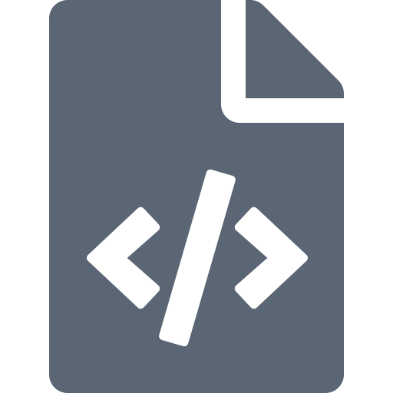
HOW CODE IS ORGANIZED
What is inside a package
rosmaster_ws/
package.xml
The ID card: name, version, and which other packages it needs (rclpy, sensor_msgs...).
src/
your code
rosmaster_sim/
a package
setup.py
rosmaster_avoidance/
a package
Tells ROS which nodes this package has, so ros2 run can find them.
package.xml
info + dependencies
setup.py
which nodes to install
lidar_avoidance.py
setup.cfg
The real code. This is the file we read in Week 2.
resource/
rosmaster_avoidance/
You do not write these by hand. One command makes the whole package:
lidar_avoidance.py
the actual code
ros2 pkg create --build-type ament_python \
rosmaster_avoidance
Notes:
Let's open the rosmaster_avoidance package and see what's inside.
package.xml is like the package's ID card. It has the name, the version, and which other packages it needs, like rclpy and sensor_msgs.
setup.py tells ROS which nodes this package has, so that ros2 run can find them.
And lidar_avoidance.py is the real code. That is the only file with robot logic. It is the file we read in Week 2.
You don't write package.xml and setup.py by hand. One command, ros2 pkg create, makes the whole package for you.

Slide 22
HOW CODE IS ORGANIZED
Build, source, run
rosmaster_ws/
colcon reads every package in src/ and makes three new folders. You never edit them.
src/
your code
rosmaster_sim/
a package
1
Build
colcon build
rosmaster_avoidance/
a package
build/
made by colcon
2
Source
install/
made by colcon
source install/setup.bash
log/
made by colcon
3
Run
ros2 run / ros2 launch
Forgot to source? ROS says "package not found". Every new terminal needs it.
Notes:
Last step: build, source, run.
colcon build reads every package in src and builds them. It creates three new folders: build, install and log. You never edit these.
Then source install/setup.bash. This tells the terminal where your built programs are.
Then you run them with ros2 run or ros2 launch.
The most common mistake: forgetting to source. If ROS says "package not found", you forgot. Every new terminal needs it.

Slide 23
HOW CODE IS ORGANIZED
Commands you will use today
ros2 run <package> <node> # start one node
ros2 launch <package> <file> # start many nodes at once
ros2 node list # which nodes are running?
ros2 topic list # which topics exist?
ros2 topic echo /scan # print messages live
ros2 topic hz /scan # how fast are they coming?
rqt_graph # draw the node graph
Stuck? Press Ctrl+C to stop a running node.
Notes:
These are the commands you will use today.
ros2 run starts one node. ros2 launch starts many nodes at once from a launch file.
ros2 node list shows which nodes are running. ros2 topic list shows which topics exist. ros2 topic echo prints the messages on a topic live. ros2 topic hz tells you how fast messages are coming. And rqt_graph draws the whole picture of nodes and topics.
ros2 topic echo is your best friend. If the robot does something strange, look at the data first.
And if anything gets stuck, press Ctrl+C to stop it.

Slide 24
02
Gazebo
Test the robot in a virtual world before touching the real one.
Notes:
Part 2. Gazebo.
Before we touch the real robot, we test in a virtual world.

Slide 25
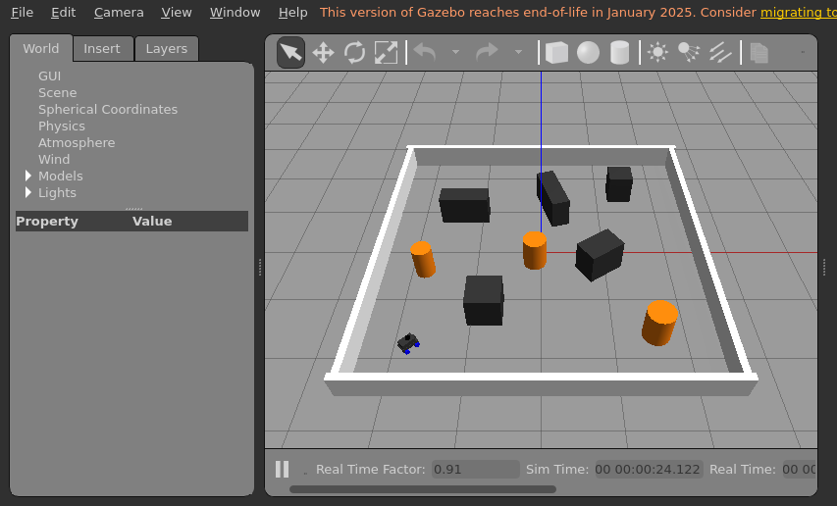
GAZEBO
A virtual world with real physics
Physics
Gravity, friction and collisions behave like the real world.
Virtual sensors
A simulated LiDAR, camera or IMU produces realistic data.
Same topics
Gazebo plugins publish /scan and listen to /cmd_vel, just like the real robot.
Free crashes
Hit a wall a hundred times. Nothing breaks, no batteries die.
Our room and our A1 model in Gazebo Classic 11, which comes with ROS 2 Humble. Classic reached end of life in January 2025; the newer Gazebo (Harmonic and later) is the next step after this course.
Notes:
Gazebo is a 3D robot simulator.
It has real physics: gravity, friction, and collisions work like in the real world. It has virtual sensors: a simulated LiDAR gives distances just like a real one. And it talks to ROS 2 through plugins, using the same topics. Gazebo publishes /scan and listens to /cmd_vel, just like the real A1.
The best part: crashes are free. You can hit a wall a hundred times and nothing breaks, and no battery dies.
This picture is our room for today. Five by five meters, with boxes and orange barrels. The little robot in the corner is our A1 model.
We use Gazebo Classic 11 because it comes with ROS 2 Humble. It reached end of life in January 2025, and the newer Gazebo is the next step after this course. For learning, Classic is perfect.

Slide 26
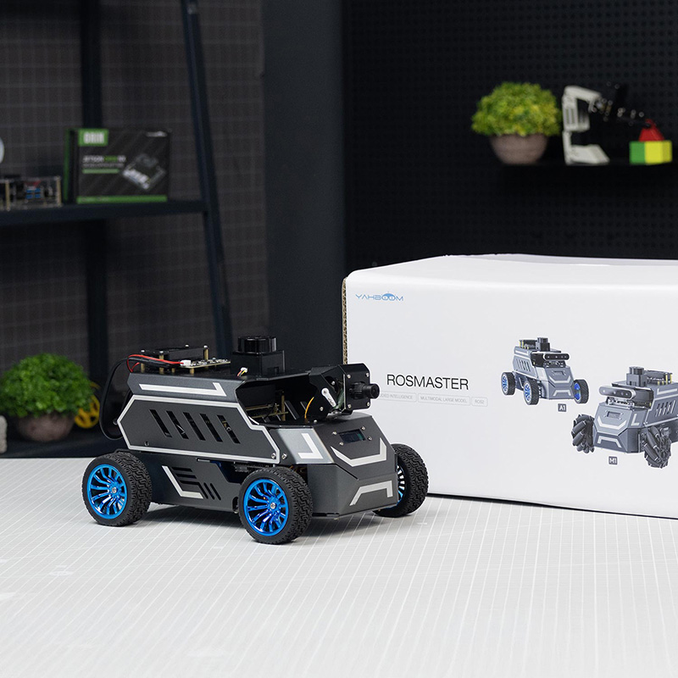
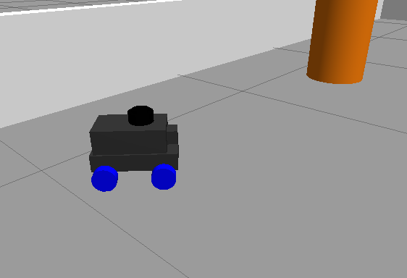
GAZEBO
Same node. Simulation or real robot.
Gazebo
Real ROSMASTER A1
Week 1 and 2
Week 3 and 4
lidar_avoidance
your node, unchanged
/scan in
/cmd_vel out
Notes:
This is the most important idea of today.
Our node, lidar_avoidance, gets /scan in and sends /cmd_vel out. Today it talks to Gazebo.

Slide 27
GAZEBO
Same node. Simulation or real robot.
Gazebo
Real ROSMASTER A1
Week 1 and 2
Week 3 and 4
lidar_avoidance
your node, unchanged
/scan in
/cmd_vel out
Notes:
In Week 3, we unplug Gazebo and plug in the real robot. The node does not change at all. Not one line.
Why? Because the real A1 also publishes /scan and also listens to /cmd_vel. Same topics, same messages.
So everything you test in simulation, you can run on the real robot. That is why we learn simulation first.

Slide 28
03
Hands-on
Make the simulated A1 drive around without hitting anything.
Notes:
Part 3. Hands-on.
Our mission today: make the simulated A1 drive around the room without hitting anything, using only its LiDAR.
First, let's make sure your PC is ready.

Slide 29
SET UP YOUR PC
Install on Windows, step by step
1. Install Ubuntu (WSL2)
2. Prepare Ubuntu
3. Add the ROS 2 source
4. Install ROS 2 + Gazebo
5. Load ROS 2 + test
6. Test Gazebo
Windows PowerShell (Run as administrator)
# Right click PowerShell > Run as administrator
wsl --install -d Ubuntu-22.04
# Restart the PC. Open "Ubuntu 22.04" from the Start menu.
# Make a username and password. The password is invisible while you type.
# Check, inside Ubuntu:
lsb_release -a # should say Ubuntu 22.04
What this does
Watch out
WSL2 runs a real Ubuntu 22.04 inside Windows. ROS 2 Humble needs Ubuntu 22.04.
Needs Windows 11, or Windows 10 build 19044+ (press Win+R, type winver). Already have WSL? Run wsl --update first.
Notes:
Most of you use Windows. ROS 2 Humble needs Ubuntu 22.04. So we run Ubuntu inside Windows with WSL2. There are six steps. The dot at the top shows where we are.
Step 1. Open PowerShell as administrator: right click it, then "Run as administrator". Type wsl --install -d Ubuntu-22.04 and press Enter.
When it finishes, restart your PC. Then open "Ubuntu 22.04" from the Start menu. It asks you to make a username and password. When you type the password, nothing shows on screen. That is normal, just type and press Enter.
To check, type lsb_release -a. It should say Ubuntu 22.04.
You need Windows 11, or Windows 10 build 19044 or newer. To check, press Windows key plus R, type winver. If you already had WSL before, run wsl --update first.

Slide 30
SET UP YOUR PC
Install on Windows, step by step
1. Install Ubuntu (WSL2)
2. Prepare Ubuntu
3. Add the ROS 2 source
4. Install ROS 2 + Gazebo
5. Load ROS 2 + test
6. Test Gazebo
Ubuntu terminal
sudo apt update && sudo apt upgrade -y
sudo apt install -y locales software-properties-common curl git
# ROS 2 needs a UTF-8 language setting
sudo locale-gen en_US en_US.UTF-8
sudo update-locale LC_ALL=en_US.UTF-8 LANG=en_US.UTF-8
export LANG=en_US.UTF-8
sudo add-apt-repository -y universe
What this does
Watch out
Updates Ubuntu, installs a few tools we need (curl, git), sets the language to UTF-8, and turns on Ubuntu's universe packages.
sudo asks for your Ubuntu password. Type it and press Enter, even though nothing shows.
Notes:
Step 2. Prepare Ubuntu. From now on, everything is typed in the Ubuntu terminal.
The first line updates Ubuntu. The second line installs a few tools we need, like curl and git.
The next three lines set the language to UTF-8. ROS 2 needs this.
The last line turns on Ubuntu's universe packages, because some ROS dependencies live there.
Any command with sudo asks for your Ubuntu password. Same as before, nothing shows while you type.

Slide 31
SET UP YOUR PC
Install on Windows, step by step
1. Install Ubuntu (WSL2)
2. Prepare Ubuntu
3. Add the ROS 2 source
4. Install ROS 2 + Gazebo
5. Load ROS 2 + test
6. Test Gazebo
Ubuntu terminal
export ROS_APT_SOURCE_VERSION=$(curl -s \
https://api.github.com/repos/ros-infrastructure/ros-apt-source/releases/latest \
| grep -F "tag_name" | awk -F'"' '{print $4}')
V=$ROS_APT_SOURCE_VERSION
curl -L -o /tmp/ros2-apt-source.deb \
https://github.com/ros-infrastructure/ros-apt-source/releases/download/$V/ros2-apt-source_$V.jammy_all.deb
sudo dpkg -i /tmp/ros2-apt-source.deb
What this does
Watch out
apt does not know where ROS 2 is yet. This downloads a small package that adds the official ROS 2 download source.
Copy it exactly, or copy from the README. This is the method in the official ROS 2 Humble install guide.
Notes:
Step 3. Tell apt where ROS 2 lives.
apt is how Ubuntu installs software, but it doesn't know about ROS 2 yet. These lines find the latest version of a small package called ros2-apt-source, download it, and install it. That package adds the official ROS 2 download source.
The lines are long, so copy them exactly. They are also in the README. This is the same method as the official ROS 2 Humble install guide.

Slide 32
SET UP YOUR PC
Install on Windows, step by step
1. Install Ubuntu (WSL2)
2. Prepare Ubuntu
3. Add the ROS 2 source
4. Install ROS 2 + Gazebo
5. Load ROS 2 + test
6. Test Gazebo
Ubuntu terminal
sudo apt update && sudo apt upgrade -y
# ROS 2 Humble with RViz and demos, plus build tools (colcon)
sudo apt install -y ros-humble-desktop ros-dev-tools
# Gazebo + its ROS plugins, robot model tools, keyboard driving
sudo apt install -y ros-humble-gazebo-ros-pkgs ros-humble-xacro \
ros-humble-teleop-twist-keyboard
What this does
Watch out
Installs everything the course uses: ROS 2 Humble, colcon, Gazebo 11 and its ROS plugins, xacro, and keyboard teleop.
A few GB. It can take 20 to 40 minutes. Do it at home on fast Wi-Fi, before class.
Notes:
Step 4. Install ROS 2 and Gazebo.
First update again, because now apt knows about ROS 2.
ros-humble-desktop is ROS 2 plus RViz plus the demos. ros-dev-tools gives us colcon, which builds our code.
The second install gets Gazebo and its ROS plugins, xacro, which reads our robot model file, and teleop twist keyboard, so you can drive with the keyboard.
This is a few GB and can take 20 to 40 minutes. Please do it at home on fast Wi-Fi, before class.

Slide 33
SET UP YOUR PC
Install on Windows, step by step
1. Install Ubuntu (WSL2)
2. Prepare Ubuntu
3. Add the ROS 2 source
4. Install ROS 2 + Gazebo
5. Load ROS 2 + test
6. Test Gazebo
Ubuntu terminal
# Load ROS 2 in every new terminal automatically
echo "source /opt/ros/humble/setup.bash" >> ~/.bashrc
source ~/.bashrc
# Test. Terminal 1:
ros2 run demo_nodes_cpp talker
# Terminal 2 (open a second Ubuntu window):
ros2 run demo_nodes_py listener
What this does
Watch out
~/.bashrc runs every time a terminal opens, so ROS 2 is always ready. The talker and listener are two nodes talking on a topic.
Listener prints "I heard: [Hello World: 1]"? ROS 2 works. Stop both with Ctrl+C.
Notes:
Step 5. Load ROS 2 and test it.
The echo line adds "source /opt/ros/humble/setup.bash" to a file called .bashrc. Every new terminal reads this file when it opens, so ROS 2 is always ready. You only do this once.
Now test. In terminal 1, run the talker. Open a second Ubuntu window and run the listener. If the listener prints "I heard: Hello World", your ROS 2 works. These are two nodes talking on a topic, exactly what we learned today.
Stop both with Ctrl+C.

Slide 34
SET UP YOUR PC
Install on Windows, step by step
1. Install Ubuntu (WSL2)
2. Prepare Ubuntu
3. Add the ROS 2 source
4. Install ROS 2 + Gazebo
5. Load ROS 2 + test
6. Test Gazebo
Ubuntu terminal
gazebo
# An empty Gazebo world opens on your Windows desktop. Close it.
# Black window or crash? Use software graphics:
echo "export LIBGL_ALWAYS_SOFTWARE=1" >> ~/.bashrc
source ~/.bashrc
What this does
Watch out
WSL2 shows Linux windows (WSLg) right on your Windows desktop, so Gazebo opens like a normal app.
First start is slow. Update your Windows graphics driver (Intel, AMD or NVIDIA) for smoother Gazebo.
Notes:
Last step. Test Gazebo.
Type gazebo and press Enter. An empty Gazebo world should open as a window on your Windows desktop. The first time is slow, give it a minute. Then close it.
If the window is black or Gazebo crashes, add LIBGL_ALWAYS_SOFTWARE=1 to your .bashrc like on the slide. This makes Gazebo use software graphics. Updating your Windows graphics driver also helps.
If Gazebo opens, your PC is fully ready for the course.

Slide 35
HANDS-ON
Run it yourself, step by step
# 1. Get the code
mkdir -p ~/rosmaster_ws/src && cd ~/rosmaster_ws/src
git clone https://github.com/Phearamony/ROSMASTER_crash_course.git
# 2. Build it
cd ~/rosmaster_ws && colcon build --symlink-install
source install/setup.bash
# 3. Terminal 1: open Gazebo with the A1
ros2 launch rosmaster_sim sim.launch.py
# 4. Terminal 2 (source first!): start the brain
ros2 run rosmaster_avoidance lidar_avoidance
Step 1
Download the course
mkdir makes the workspace and its src/ folder. git clone copies both course packages from GitHub into src/.
After this, src/ holds rosmaster_sim and rosmaster_avoidance.
Notes:
Now let's run the course code. Four steps.
Step 1, get the code. mkdir -p makes the workspace and its src folder. Then cd goes into src, and git clone downloads the course repo from GitHub.
After this, src has our two packages: rosmaster_sim and rosmaster_avoidance.

Slide 36
HANDS-ON
Run it yourself, step by step
# 1. Get the code
mkdir -p ~/rosmaster_ws/src && cd ~/rosmaster_ws/src
git clone https://github.com/Phearamony/ROSMASTER_crash_course.git
# 2. Build it
cd ~/rosmaster_ws && colcon build --symlink-install
source install/setup.bash
# 3. Terminal 1: open Gazebo with the A1
ros2 launch rosmaster_sim sim.launch.py
# 4. Terminal 2 (source first!): start the brain
ros2 run rosmaster_avoidance lidar_avoidance
Step 2
Build and source
colcon build turns the packages into programs inside install/. --symlink-install links your .py files, so a code change works without rebuilding.
source install/setup.bash tells this terminal where those programs are.
Notes:
Step 2, build.
Go back to the workspace folder and run colcon build. The --symlink-install part means: if you change the Python file later, you don't need to build again.
Then source install/setup.bash. Remember, every new terminal needs this.

Slide 37
HANDS-ON
Run it yourself, step by step
# 1. Get the code
mkdir -p ~/rosmaster_ws/src && cd ~/rosmaster_ws/src
git clone https://github.com/Phearamony/ROSMASTER_crash_course.git
# 2. Build it
cd ~/rosmaster_ws && colcon build --symlink-install
source install/setup.bash
# 3. Terminal 1: open Gazebo with the A1
ros2 launch rosmaster_sim sim.launch.py
# 4. Terminal 2 (source first!): start the brain
ros2 run rosmaster_avoidance lidar_avoidance
Step 3
Open the simulation
One launch file starts three things: Gazebo with the obstacle room, the A1 model with its LiDAR, and a node that publishes the robot's shape.
The robot sits still. It is publishing /scan, and waiting for someone to send /cmd_vel.
Notes:
Step 3, in terminal 1, launch the simulation.
This one launch file starts three things. Gazebo with our obstacle room. A node called robot_state_publisher that shares the robot's shape. And spawn_entity, which puts the A1 into the room.
The first time can take 30 seconds. When it's ready, you see the robot in the corner. It doesn't move yet. It is publishing /scan and waiting for someone to send /cmd_vel.

Slide 38
HANDS-ON
Run it yourself, step by step
# 1. Get the code
mkdir -p ~/rosmaster_ws/src && cd ~/rosmaster_ws/src
git clone https://github.com/Phearamony/ROSMASTER_crash_course.git
# 2. Build it
cd ~/rosmaster_ws && colcon build --symlink-install
source install/setup.bash
# 3. Terminal 1: open Gazebo with the A1
ros2 launch rosmaster_sim sim.launch.py
# 4. Terminal 2 (source first!): start the brain
ros2 run rosmaster_avoidance lidar_avoidance
Step 4
Start the brain
Our node subscribes to /scan, decides 10 times per second, and publishes /cmd_vel. The robot starts driving.
Terminal shows what it decides: FORWARD front=2.31 left=1.05 right=0.88
Notes:
Step 4. Open a second terminal. Source first! Then run our node with ros2 run rosmaster_avoidance lidar_avoidance.
Now the robot starts driving. Watch the terminal. It prints what the robot decides: FORWARD, TURN LEFT, TURN RIGHT, and the distances it sees in front, left, and right.

Slide 39

HANDS-ON
Is it working? Check with ROS 2 tools
# Terminal 3 (source first!)
ros2 node list # see lidar_avoidance?
ros2 topic list # see /scan and /cmd_vel?
ros2 topic echo /cmd_vel # the speeds our node sends
rqt_graph # draw the graph
rqt_graph should show the same picture as earlier in this deck:
Course repo
/scan
github.com/Phearamony/ ROSMASTER_crash_course
/gazebo
/lidar_avoidance
/cmd_vel
Full guide + fixes in the README
Notes:
If something is not working, check with the ROS 2 tools. Open a third terminal and source it.
ros2 node list should show lidar_avoidance. ros2 topic list should show /scan and /cmd_vel. ros2 topic echo /cmd_vel shows the speed commands our node sends.
And rqt_graph should draw the same picture we saw before: Gazebo sends /scan to our node, and our node sends /cmd_vel back to Gazebo. If the arrow is missing, you probably forgot to source in one of the terminals.
The QR code goes to the repo. Everything is also written in the README.

Slide 40
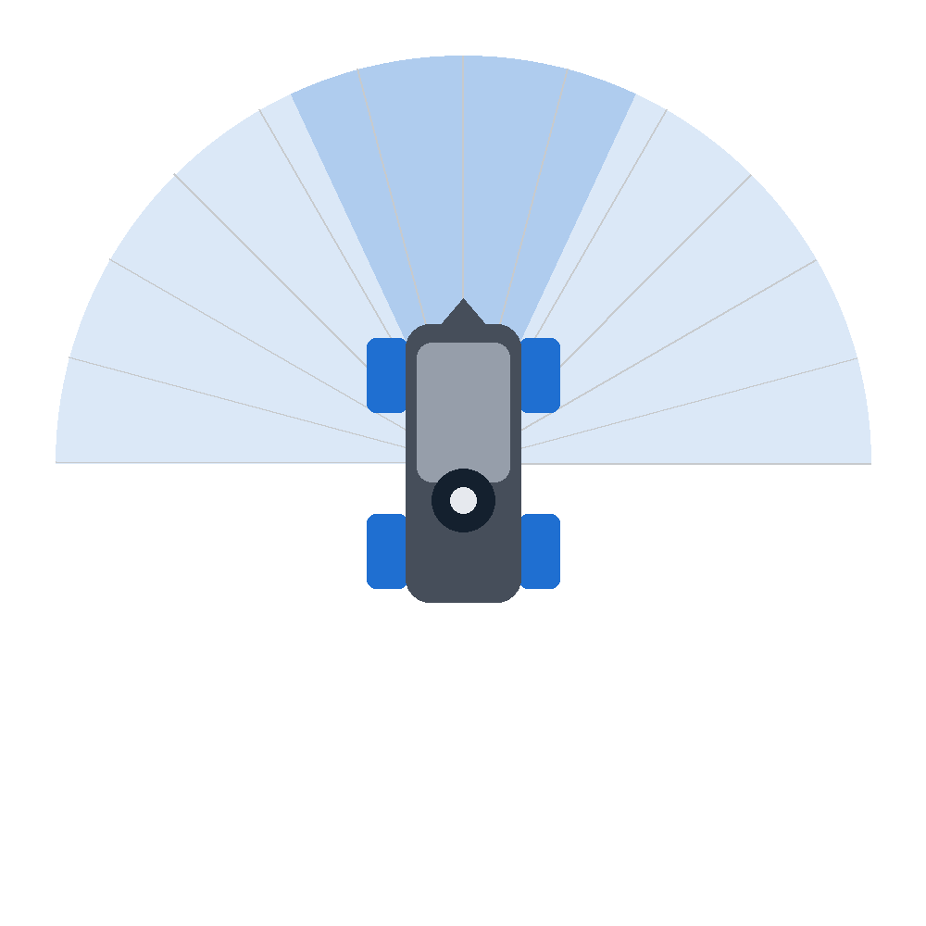
HANDS-ON
How the robot sees: 360 LiDAR distances
FRONT
The LiDAR spins and measures the distance to the nearest thing in every direction, about 10 times per second. That list of numbers is the /scan message.
Our node splits it into three zones and keeps only the closest distance in each:
LEFT
RIGHT
front
-25° to 25°
left
25° to 90°
right
-90° to -25°
0° is straight ahead. Positive angles are to the left.
Notes:
So how does the robot actually see?
The LiDAR spins and measures the distance to the closest thing in every direction. It gives 360 numbers, about 10 times per second. That list of numbers is the /scan message.
Our node doesn't use all 360. It splits them into three zones. Front is from -25 to 25 degrees. Left is from 25 to 90. Right is from -90 to -25. From each zone it keeps only the closest distance.
0 degrees is straight ahead, and positive angles are to the left. That is the ROS standard.

Slide 41
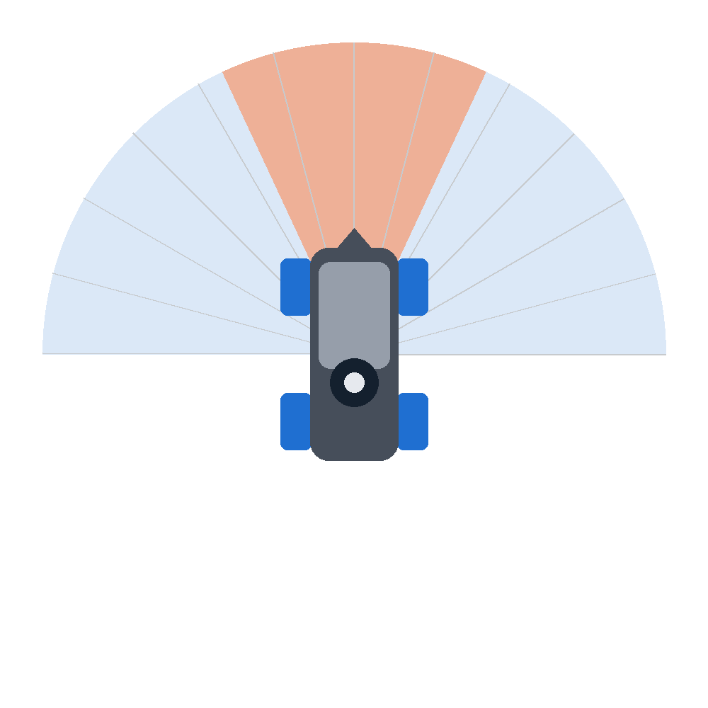
HANDS-ON
Three rules, checked 10 times per second
1
Front is clear
obstacle
Drive forward.
2
Front is blocked
Slow down and steer toward the side with more space.
3
Too close
Back up for a moment, then try again.
Notes:
With those three numbers, the robot follows three rules, 10 times per second.
Rule 1: if the front is clear, drive forward.
Rule 2: if something in front is closer than the safe distance, slow down and steer toward the side with more space.
Rule 3: if something is way too close, back up for a moment.
Here, the obstacle is in front. The right side has more space, so rule 2: steer right.

Slide 42
HANDS-ON
Three rules, checked 10 times per second
1
Front is clear
obstacle
Drive forward.
2
Front is blocked
Slow down and steer toward the side with more space.
3
Too close
Back up for a moment, then try again.
Notes:
After the turn, the front is clear again. So rule 1: drive forward.
Why do we back up instead of turning in place? Because the A1 steers like a car. It can't spin on the spot. A car that is too close to a wall has to reverse first. Same here.
That's the whole brain. Three rules.

Slide 43
HANDS-ON
Inside lidar_avoidance.py
class LidarAvoidance(Node):
def __init__(self):
super().__init__('lidar_avoidance')
self.declare_parameter('forward_speed', 0.25)
self.declare_parameter('safe_distance', 0.7)
...
self.scan_sub = self.create_subscription(
LaserScan, '/scan', self.scan_callback, 10)
self.cmd_pub = self.create_publisher(
Twist, '/cmd_vel', 10)
def scan_callback(self, scan):
front = self.sector_min(scan, -25, 25)
left = self.sector_min(scan, 25, 90)
right = self.sector_min(scan, -90, -25)
cmd = Twist()
if front < stop: # rule 3: back up
cmd.linear.x = -0.15
elif front < safe: # rule 2: turn
cmd.linear.x = forward_speed * 0.6
cmd.angular.z = turn_speed if left > right else -turn_speed
else: # rule 1: go
cmd.linear.x = forward_speed
self.cmd_pub.publish(cmd)
Part 1 of 4
Listen and talk
The node subscribes to /scan and creates a publisher for /cmd_vel. Every time a scan arrives, ROS calls scan_callback for us.
We never write a loop that waits for data. ROS 2 calls our function.
Simplified. The full file is in the repo.
Notes:
Let's take a quick look inside the code. This is a simplified version, the full file is in the repo. Don't worry about every word, we read it properly in Week 2.
Part 1: listen and talk. The node subscribes to /scan and creates a publisher for /cmd_vel.
Notice that we never write a loop that waits for data. Every time a scan arrives, ROS calls our function, scan_callback, for us.

Slide 44
HANDS-ON
Inside lidar_avoidance.py
class LidarAvoidance(Node):
def __init__(self):
super().__init__('lidar_avoidance')
self.declare_parameter('forward_speed', 0.25)
self.declare_parameter('safe_distance', 0.7)
...
self.scan_sub = self.create_subscription(
LaserScan, '/scan', self.scan_callback, 10)
self.cmd_pub = self.create_publisher(
Twist, '/cmd_vel', 10)
def scan_callback(self, scan):
front = self.sector_min(scan, -25, 25)
left = self.sector_min(scan, 25, 90)
right = self.sector_min(scan, -90, -25)
cmd = Twist()
if front < stop: # rule 3: back up
cmd.linear.x = -0.15
elif front < safe: # rule 2: turn
cmd.linear.x = forward_speed * 0.6
cmd.angular.z = turn_speed if left > right else -turn_speed
else: # rule 1: go
cmd.linear.x = forward_speed
self.cmd_pub.publish(cmd)
Part 2 of 4
Knobs you can turn
Parameters are settings with a default value. You change them from the terminal without editing code.
--ros-args -p safe_distance:=1.0
Notes:
Part 2: parameters. These are settings with a default value, like forward speed 0.25 meters per second, and safe distance 0.7 meters.
The nice thing is you can change them from the terminal without editing the code, using --ros-args -p. We'll do that in the experiments.

Slide 45
HANDS-ON
Inside lidar_avoidance.py
class LidarAvoidance(Node):
def __init__(self):
super().__init__('lidar_avoidance')
self.declare_parameter('forward_speed', 0.25)
self.declare_parameter('safe_distance', 0.7)
...
self.scan_sub = self.create_subscription(
LaserScan, '/scan', self.scan_callback, 10)
self.cmd_pub = self.create_publisher(
Twist, '/cmd_vel', 10)
def scan_callback(self, scan):
front = self.sector_min(scan, -25, 25)
left = self.sector_min(scan, 25, 90)
right = self.sector_min(scan, -90, -25)
cmd = Twist()
if front < stop: # rule 3: back up
cmd.linear.x = -0.15
elif front < safe: # rule 2: turn
cmd.linear.x = forward_speed * 0.6
cmd.angular.z = turn_speed if left > right else -turn_speed
else: # rule 1: go
cmd.linear.x = forward_speed
self.cmd_pub.publish(cmd)
Part 3 of 4
Look
sector_min goes through all 360 distances and returns the closest one inside each zone.
front=0.62 left=1.80 right=0.45
Notes:
Part 3: look. Inside scan_callback, a helper function called sector_min goes through all 360 distances and returns the closest one in each zone.
So after these three lines we have three numbers: front, left, and right. For example front 0.62, left 1.80, right 0.45.

Slide 46
HANDS-ON
Inside lidar_avoidance.py
class LidarAvoidance(Node):
def __init__(self):
super().__init__('lidar_avoidance')
self.declare_parameter('forward_speed', 0.25)
self.declare_parameter('safe_distance', 0.7)
...
self.scan_sub = self.create_subscription(
LaserScan, '/scan', self.scan_callback, 10)
self.cmd_pub = self.create_publisher(
Twist, '/cmd_vel', 10)
def scan_callback(self, scan):
front = self.sector_min(scan, -25, 25)
left = self.sector_min(scan, 25, 90)
right = self.sector_min(scan, -90, -25)
cmd = Twist()
if front < stop: # rule 3: back up
cmd.linear.x = -0.15
elif front < safe: # rule 2: turn
cmd.linear.x = forward_speed * 0.6
cmd.angular.z = turn_speed if left > right else -turn_speed
else: # rule 1: go
cmd.linear.x = forward_speed
self.cmd_pub.publish(cmd)
Part 4 of 4
Decide and act
A Twist message holds the command. linear.x is forward speed (m/s). angular.z is turning (rad/s, positive = left). Then we publish it.
The A1 steers like a car, so angular.z becomes a steering angle.
Notes:
Part 4: decide and act. This if, elif, else is exactly our three rules.
The command is a Twist message. linear.x is the forward speed in meters per second. Negative means backwards. angular.z is turning. Positive means left, negative means right.
The last line publishes the command. In Gazebo, the simulated wheels move. In Week 3, the real wheels move. On the A1, angular.z becomes a steering angle because it steers like a car.

Slide 47
HANDS-ON
Your turn: four small experiments
1
Drive it yourself
2
Look at the data
Stop the avoidance node, then:
Move the robot near a box and watch the numbers:
ros2 run teleop_twist_keyboard teleop_twist_keyboard
ros2 topic echo /scan --once
3
Change its behavior
4
Make it harder
Make it more careful:
In Gazebo, use the Insert tab or the box tool to add obstacles. Does the robot still escape?
ros2 run rosmaster_avoidance lidar_avoidance \
--ros-args -p safe_distance:=1.0
Notes:
Now it's your turn. Four small experiments.
1. Drive it yourself. Stop the avoidance node with Ctrl+C, then run teleop_twist_keyboard. Keep that terminal selected and use the i, j, l, and comma keys to drive. k stops.
2. Look at the data. Drive close to a box and run ros2 topic echo /scan --once. Find the small numbers. That's the box.
3. Change its behavior. Run the node with safe_distance 0.4, then with 1.0. Compare. With 0.4 the robot gets very close and has to back up a lot. With 1.0 it is careful, but it turns all the time and doesn't explore much.
4. Make it harder. In Gazebo, use the box or cylinder button on the top toolbar to drop new obstacles. Can the robot still escape?
Try them in order. Ask me if you get stuck.

Slide 48
NEXT WEEK
Week 2: read every line of the code you just ran
def scan_callback(self, scan):
front = self.sector_min(scan, -25, 25)
left = self.sector_min(scan, 25, 90)
right = self.sector_min(scan, -90, -25)
cmd = Twist()
if front < safe:
cmd.linear.x = forward_speed * 0.6
cmd.angular.z = turn_speed if left > right else -turn_speed
Python
variables, if, functions, classes
Bash
cd, ls, nano, source, sudo apt
Linux
files, folders, permissions, the terminal
Homework: run the four experiments. Bring one question.
Notes:
That's Week 1. Today you learned what ROS 2 is: nodes that talk through topics. You learned what Gazebo is. And you ran a robot that avoids obstacles by itself.
This code on the left is a real piece of what you ran today. Next week, we read it line by line. We'll learn just enough Python, bash and Linux to understand every line.
Homework: finish the four experiments, and bring one question to the next class.
Thank you.

