Slide 1
5 python libraries you probably aren’t using but should

Slide 2
Overview
hypothesis (better unit testing)
hugs (CLI + API in one package)
begins (for when you’re too lazy to use argparse)
psutil (monitor system usage from within python)
cython ( C + python)
Bonus: redis (redis-py)

Slide 3
hypothesis
Hypothesis = automated unit testing
Most unit testing is manual and centered around example-based testing.
Why should you use it?
Automates the most time consuming part of writing tests - coming up with the specific examples using property-based tests.
Not related to statistical hypothesis testing

Slide 4
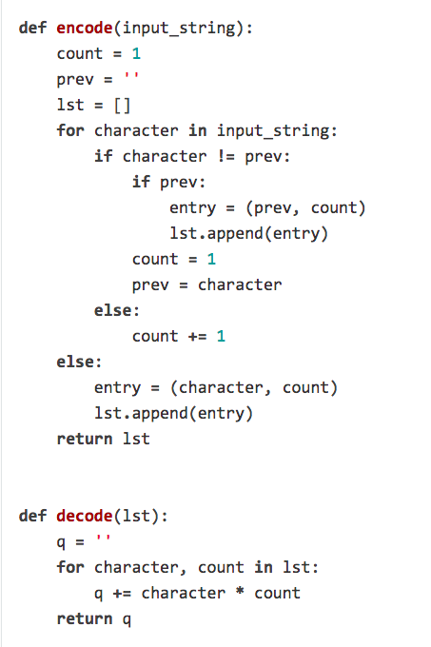
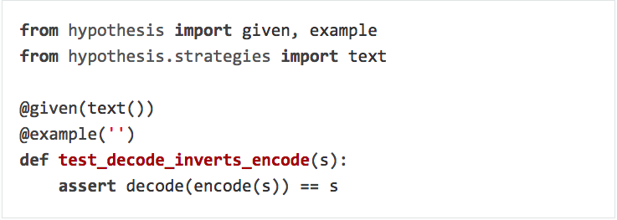
Hypothesis - Example
Example based testing: assert encode(‘x’) == ‘y’
assert decode(‘y’) == ‘x’
….

Slide 5
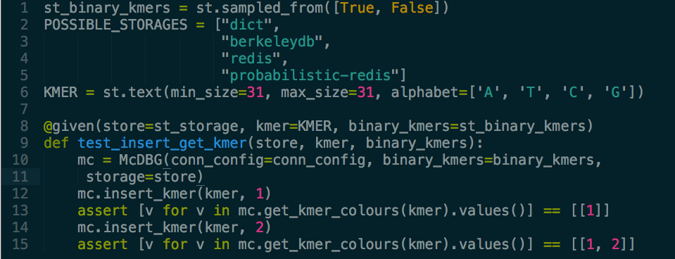
Hypothesis – real world example

Slide 6
Hypothesis - summary
Automates large numbers of example test cases based on “strategies”.
Useful for testing nondeterministic functions + corner cases.
http://hypothesis.works/

Slide 7
Hugs
Very simple API + CLI development.
Design/develop API and expose to HTTP/CLI
http://www.hug.rest/

Slide 8
hug example
Notes:
source ~/Documents/git/atlas-seq/venv/bin/activate
python hug_cli_only.py pull –help
hug --port 8080 -f hug_cli_api.py
http://localhost:8080/pull?k=12&branch=master2

Slide 9
Hugs - summary
Extend your CLI application with an API (or vice versa) with little effort.

Slide 10
Begins
Small argparse API based on function decorators.
Automatically convert command line arguments to expected types.
Use environment variables and command line files to set defaults.
http://begins.readthedocs.io/en/latest/

Slide 11
Begins example
Notes:
eg_begins.py eg_begins_env.py eg_begins_log.py

Slide 12
psutil
Psutil provides complete access to system information.

Slide 13
psutil example

Slide 14
cython
Why might you want to use cython:
You want to wrap a C/C++ library, and use it from Python.
You want to speed up Python code.

Slide 15
Example – speeding up python code
Notes:
time python cython_demo_slow.py
time python cython_demo_fast.py

Slide 16
Example - Wrap a C library and use it from Python.
https://github.com/Phelimb/pyseqfile

