Slide 1
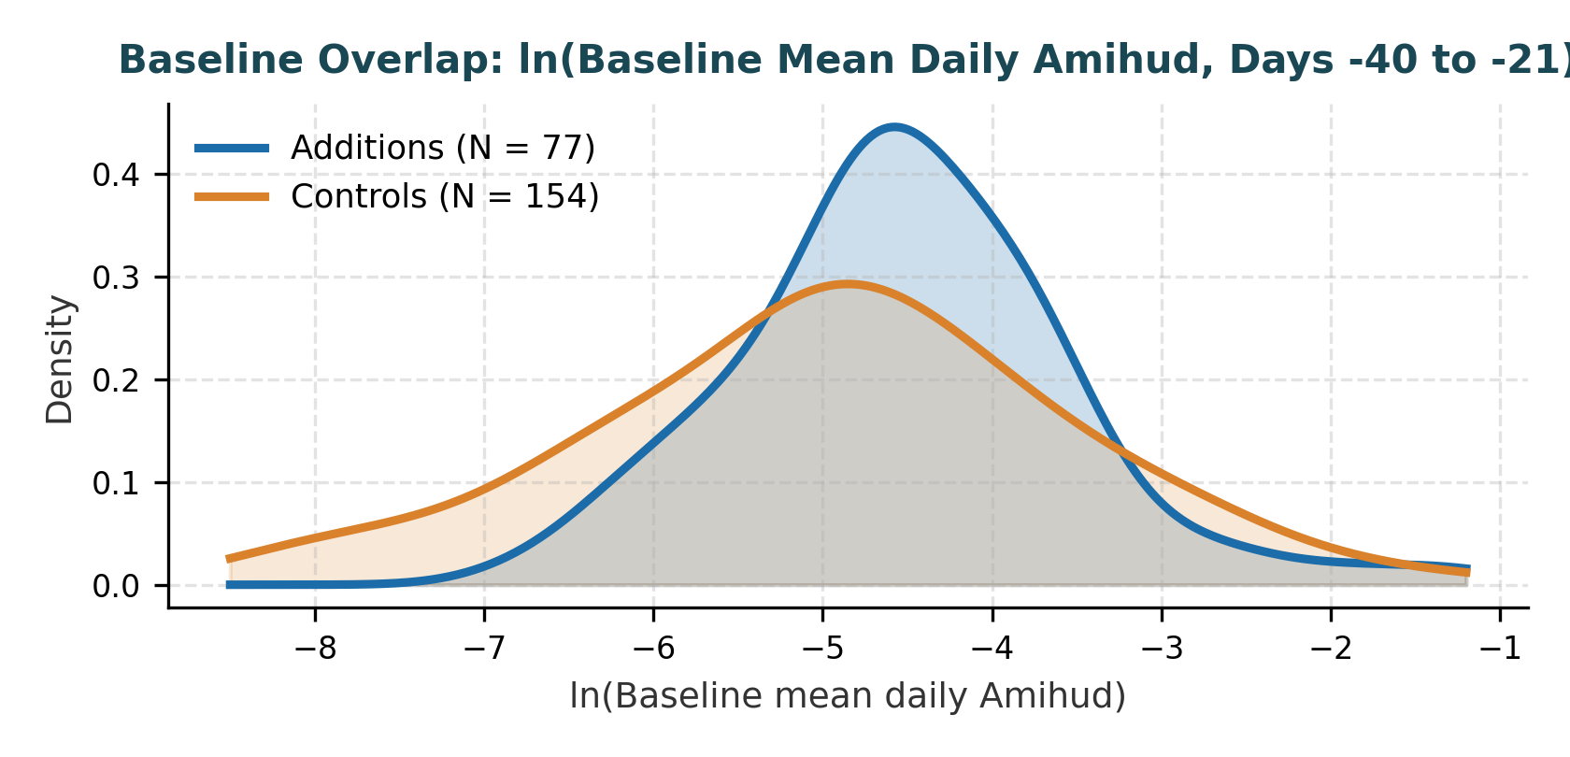
1. Control Selection & Baseline Comparability
Ex-ante 1:2 sector-and-size matching across six semi-annual reviews (77 additions : 154 control slots)
The 5 Ex-Ante Control Selection Rules
Ex-Ante Principle: All rules use only information available at or before the reference date; Amihud levels never enter selection.
1. Index & Event Exclusion: Must be an ASX Common Stock in AUD with no same-review S&P/ASX index additions or deletions (and not one of the 84 additions).
2. Exact GICS Sector Match: Control must share the addition GICS sector at the reference date (154 / 154 slots match).
3. Reference Market-Cap Band [0.5x, 2.0x]: Select the two closest size matches by |ln(Cap_ctrl / Cap_add)| within [0.5, 2.0] (153 / 154 slots meet Tier 1; 1 Tier-2 exception MAQ-NEC at 2.12x).
4. Zero Control Reuse: Each control stock is used at most once within any review (90%+ price coverage across the 121-day window).
5. Baseline Traded-Value Floor (>= A,000): Baseline median daily traded value (Close x Volume) must exceed A,000 (with A fallback). Removes thinly traded secondary listings where tiny volume creates extreme Amihud spikes.
Matching Criterion | Achieved in Sample
Retained Additions : Matched Controls | 77 : 154 (231 units)
Exact GICS Sector Match | 154 / 154 (100.0%)
Reference Cap Ratio in [0.5x, 2.0x] | 153 / 154 (99.4%)
Control Reuse Within Any Review | 0 / 154 (0.0%)
Baseline Med. Traded Value >= A | 154 / 154 (100.0%)
ETF5560 Case Studies in Econometrics | S&P/ASX 300 Inclusion & Liquidity | Slide 1 of 3
Notes:
[0:00 - 1:00 | Slide 1 Script (101 words @ 100 wpm)]
To identify the causal effect of ASX 300 inclusion, we match each of our 77 retained additions with two non-member controls from the same review—giving 154 control slots across 231 stock-review units.
[pause]
All matching rules use only information available at or before the reference date, and Amihud levels never enter selection. Controls must share the addition exact GICS sector, fall within 0.5 to 2 times its reference market cap, have no same-review index changes, and never be reused within a review.
[pause]
Crucially, we require baseline median daily traded value above 100,000 Australian dollars. This removes thinly traded secondary listings where tiny volume creates extreme Amihud spikes, yielding strong baseline overlap on the log scale.

Slide 2
2. Identification Assumption 1: No Anticipation in the Baseline
Separating the clean reference baseline B (-40 to -21) from pre-announcement positioning PA (-20 to 0)
EP (-60 to -41)
20d: Volatility & Pre-test
B (-40 to -21)
20d: Clean Baseline Ref
PA (-20 to 0)
21d: Anticipation Allowed
AP (+1:+10)
10d: Rebalance
SP (+11 to +30)
20d: Short Post
LP (+31 to +60)
30d: Later Post-Effective
Stage | Trading Days | Days | Role in Identification Strategy
EP | -60 to -41 | 20 | Earlier pre-period: pre-event return volatility control (SD x 100) and pre-trend check
B (Baseline) | -40 to -21 | 20 | Clean reference period: assumed free of expected-inclusion anticipation (omitted benchmark)
PA | -20 to 0 | 21 | Pre-announcement window: spans S&P reference cut-off (~day -11) to Friday announcement (day 0); anticipation allowed
AP | +1 to +10 | 10 | First tradable post-announcement session (+1) through implementation rebalance close (+10)
SP | +11 to +30 | 20 | Short post-effective period: first 20 trading sessions under new ASX 300 membership
LP | +31 to +60 | 30 | Later post-effective period: tests whether liquidity gains persist after rebalancing trades settle
Why Anticipation Arises Before Announcement Day 0
• S&P/ASX 300 eligibility rules (market cap rank + liquidity) are public.
• S&P locks in eligibility data at the reference cut-off date (~trading day -11, the second-to-last Friday of Feb/Aug).
• Arbitrageurs can therefore predict likely additions before the official Friday announcement after the close on Day 0.
Why Baseline B Moved from [-30:-11] to [-40:-21]
• Earlier Spec (B = -30 to -11): Sat immediately adjacent to the day -11 reference cut-off; days -20 to -11 may already contain early positioning.
• Updated Spec (B = -40 to -21): Moves Baseline B prior to the cut-off and explicitly allows anticipation in PA (-20 to 0).
• Justification: Grounded in institutional review timing, not chasing a higher pre-test p-value.
ETF5560 Case Studies in Econometrics | S&P/ASX 300 Inclusion & Liquidity | Slide 2 of 3
Notes:
[1:00 - 2:00 | Slide 2 Script (99 words @ 100 wpm)]
Turning to identification, our first key assumption is no anticipation in the baseline.
Because S&P eligibility rules are public and the reference cut-off falls around trading day minus 11, arbitrageurs can predict likely additions before the official Friday announcement on day zero.
[pause]
In our earlier specification, baseline ran from day minus 30 to minus 11. However, if traders position around the reference cut-off, days minus 20 to minus 11 may already reflect anticipation.
[pause]
We therefore define Baseline B earlier—from day minus 40 to minus 21—and allow anticipation across days minus 20 to zero in window PA, while measuring pre-event volatility in EP from minus 60 to minus 41.

Slide 3
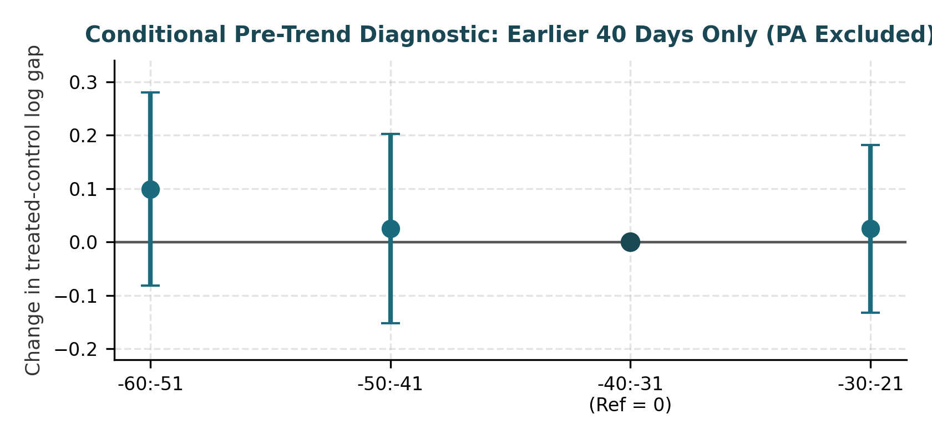
3. Identification Assumption 2: Conditional Parallel Trends
Four-bin pre-trend diagnostics over days -60 to -21 (PA excluded) and baseline sensitivity check
Conditional Parallel Trends Assumption:
Absent ASX 300 inclusion, additions and matched controls would follow similar log Amihud changes from Baseline B, conditional on stock-review fixed effects, matched-group x window fixed effects, log reference market cap, and pre-event return volatility (EP, -60:-41).
Pre-Test Interpretation (Roth, 2022 — Pretest with Caution)
• Four 10-day bins over -60 to -21 (reference = -40:-31); PA (-20:0) is deliberately excluded.
• Pre-trend differences are small and jointly insignificant: event-weighted p = 0.743; all 18 review-specific coefficients p = 0.146.
• Non-rejection supports plausibility rather than proving parallel trends.
• Because the earlier baseline followed diagnostic inspection, we verify that post-inclusion effects hold under both baselines below.
Pre-Bin Test (-60:-21, Ref = -40:-31) | Restrictions | p-value
Pooled common pre-bin changes = 0 | 3 | 0.771
Event-weighted pre-bin changes = 0 | 3 | 0.743
All review-specific changes = 0 (6 reviews) | 18 | 0.146
Baseline Specification | AP (+1:+10) | SP (+11:+30) | LP (+31:+60)
Version 2: B = -40 to -21 (Main) | -44.1% (p < 0.001) | -36.4% (p < 0.001) | -26.6% (p < 0.001)
Version 1: B = -30 to -11 (Orig.) | -42.0% (p < 0.001) | -33.6% (p < 0.001) | -24.3% (p < 0.001)
ETF5560 Case Studies in Econometrics | S&P/ASX 300 Inclusion & Liquidity | Slide 3 of 3
Notes:
[2:00 - 3:00 | Slide 3 Script (100 words @ 100 wpm)]
Our second assumption is conditional parallel trends: absent inclusion, additions and matched controls would follow similar log Amihud changes, conditional on group-by-window fixed effects, log market cap, and pre-event return volatility.
[pause]
We assess plausibility using four 10-day bins from day minus 60 to minus 21, with minus 40 to minus 31 as reference, deliberately excluding the anticipation window.
[pause]
Pre-trend differences are small and jointly insignificant: the event-weighted p-value is 0.743, and the joint test across all 18 review-specific coefficients is 0.146.
[pause]
Following Roth, non-rejection supports plausibility rather than proving parallel trends—and importantly, our post-inclusion liquidity findings remain robust under both baseline definitions.

