Slide 1


Inferential Methods: MANOVA (and GLMs put in context)
Advanced Course
Multivariate Statistics for Ecology and Evolution
CIBIO, 20-24 January 2020
Antigoni Kaliontzopoulou

Slide 2
GLMs: MANOVA | Asking questions to data | Slide 2
Are males and females different in morphology?
Does the ecological niche differ between my species?
Does growth depend on climate?
Are species A and B different in physiology when taking their body size into account?
…
There is a hypothesis to test
We are making an inference

Slide 3
GLMs: MANOVA | Outline | Slide 3
Types of GLMs
GLMs in matrix format
Design matrices for groups
Testing for group differences
One-way MANOVA
Post-hoc comparisons
Factorial MANOVA
Types of Sums of Squares

Slide 4
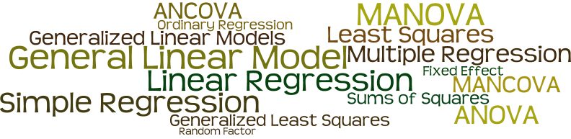
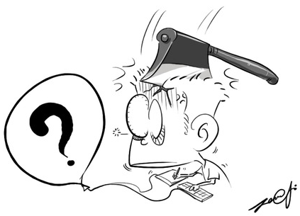
GLMs: MANOVA | Some thoughts on nomenclature | Slide 4

Slide 5
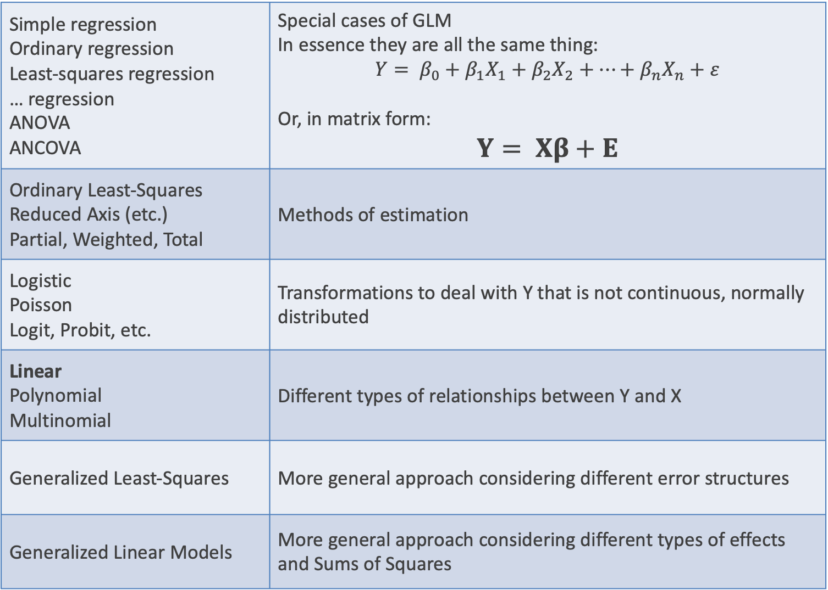
GLMs: MANOVA | Some thoughts on nomenclature | Slide 5
Simple regression Ordinary regression Least-squares regression … regression ANOVA ANCOVA | Special cases of GLM In essence they are all the same thing: $$Y= β_{0}+β_{1}X_{1}+β_{2}X_{2}+…+β_{n}X_{n}+ε$$ Or, in matrix form: $$Y= Xβ+E$$
Ordinary Least-Squares Reduced Axis (etc.) Partial, Weighted, Total | Methods of estimation
Logistic Poisson Logit, Probit, etc. | Transformations to deal with Y that is not continuous, normally distributed
Linear Polynomial Multinomial | Different types of relationships between Y and X
Generalized Least-Squares | More general approach considering different error structures
Generalized Linear Models | More general approach considering different types of effects and Sums of Squares

Slide 6
GLMs: MANOVA | General Linear Models | Slide 6
$$Y= β_{0}+β_{1}X_{1}+β_{2}X_{2}+…+β_{n}X_{n}+ε$$
Matrix of measured values
Matrix of unexplained values
Model design matrix n subjects and k parameters
Model coefficients for k parameters, p times

Slide 7

GLMs: MANOVA | General Linear Models | Slide 7
$$Y= Xβ+E$$
ANOVA: categorical X
H₀: no difference among groups
represented by X
Regression: continuous X
H₀: no relationship between X and Y
ANCOVA: a combination of both
H₀: no difference among groups
represented by X₁, while accounting for
the relationship between X₂ and Y
4
3
2
1

Slide 8
GLMs: MANOVA | More thoughts on nomenclature | Slide 8
Multivariate refers to the response variable(s) Y
Sometimes the term “multiple” is used to denote > 1 explanatory variables (X)
 |  | Explanatory variable(s) (X)
 |  | 1 Categorical | >1 Categorical | 1 Continuous | >1 Continuous | Both
Response variable(s) Y | 1 Continuous | ANOVA | Factorial ANOVA | Regression | Multiple Regression | ANCOVA
 | >1 Continuous | MANOVA | Factorial MANOVA | Multivariate Regression | Multivariate Multiple Regression | MANCOVA

Slide 9

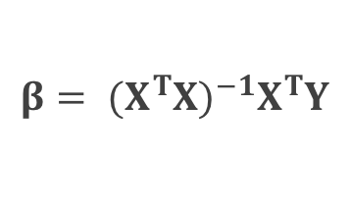



GLMs: MANOVA | General Linear Models | Slide 9
$$Y= β_{0}+β_{1}X_{1}+β_{2}X_{2}+…+β_{n}X_{n}+ε$$
$$Y= Xβ+E$$
They are all the same model!
Only difference: type of data in X
Works the same for univariate and multivariate Y
Dependent variable(s)
Independent (predictor) variables(s)
Solve for coefficients
found as
$$Y= \left[\begin{matrix}Y_{11} & ⋯ & Y_{1p} \\ ⋮ & & ⋮ \\ Y_{n1} & ⋯ & Y_{np}\end{matrix}\right]$$
$$X= \left[\begin{matrix}1 & X_{11} & ⋯ & X_{1k} \\ 1 & ⋮ & & ⋮ \\ 1 & X_{n1} & ⋯ & X_{nk}\end{matrix}\right]$$
$$β= \left[\begin{matrix}β_{0} \\ ⋮ \\ β_{p}\end{matrix}\right]$$
$$β= {(X^{T}X)}^{−1}X^{T}Y$$

Slide 10
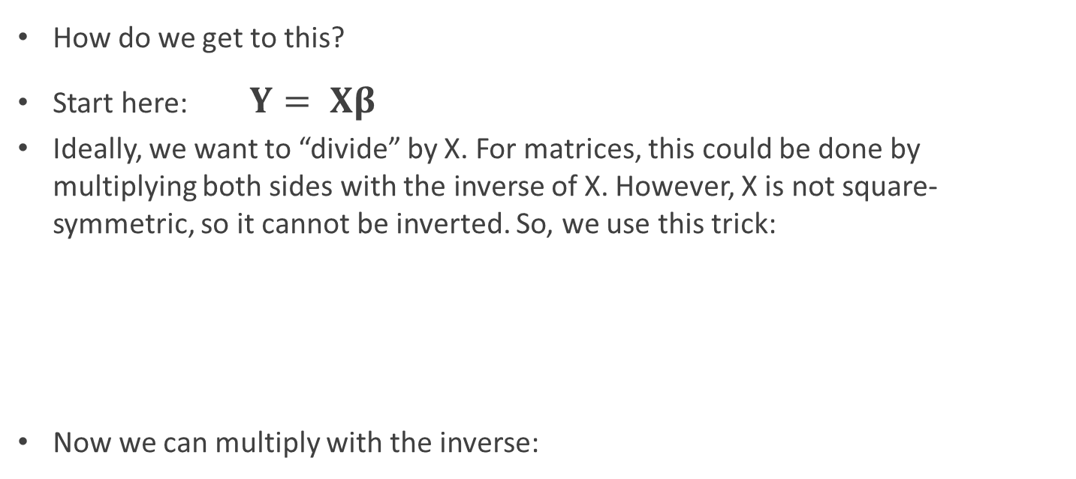
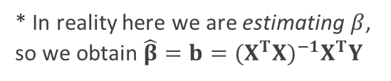
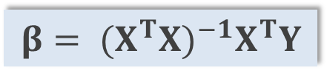



GLMs: MANOVA | Solving for β | Slide 10
$$β= {(X^{T}X)}^{−1}X^{T}Y$$
How do we get to this?
Start here: $Y= Xβ$
Ideally, we want to “divide” by X. For matrices, this could be done by multiplying both sides with the inverse of X. However, X is not square-symmetric, so it cannot be inverted. So, we use this trick:
Now we can multiply with the inverse:
$$X^{T}Y= X^{T}Xβ$$
k×n
n×p
(k×n)·(n×k) → k×k
Square-symmetric → can be inverted ;)
$${{(X^{T}X)}^{−1}X}^{T}Y={(X^{T}X)}^{−1}X^{T}Xβ$$
$$β= {(X^{T}X)}^{−1}X^{T}Y$$
* In reality here we are estimating $β$, so we obtain ${\hat{β}=b=(X^{T}X)}^{−1}X^{T}Y$

Slide 11
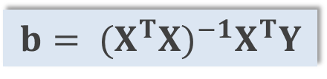
GLMs: MANOVA | General Linear Model | Slide 11
$$b= {(X^{T}X)}^{−1}X^{T}Y$$
This expresses ALL types of General Linear Models! It is modified by including different types of data in X
X may include categorical variables (factors), continuous predictors (covariates), combinations of the two, and interactions between them
Solving b this way minimizes the sum of squared residuals (error) and it is usually referred to as “Least-Squares” estimation
As such, the error is an indication of how good the fit of the model is

Slide 12
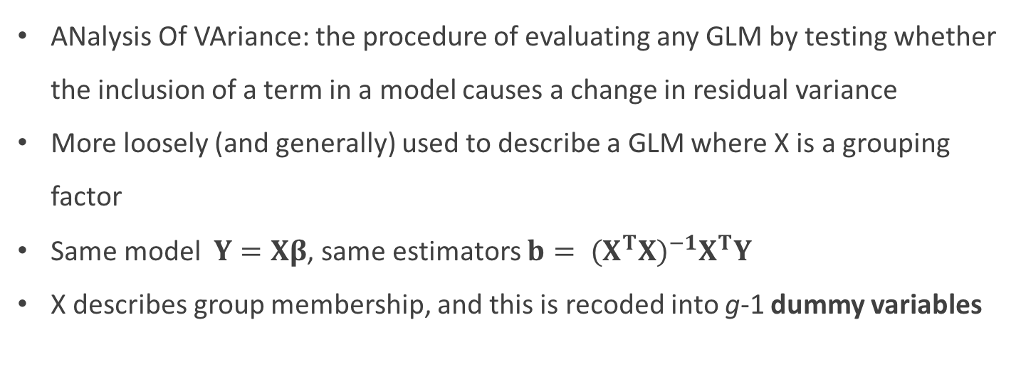
GLMs: MANOVA | ANOVA | Slide 12
ANalysis Of VAriance: the procedure of evaluating any GLM by testing whether the inclusion of a term in a model causes a change in residual variance
More loosely (and generally) used to describe a GLM where X is a grouping factor
Same model $Y=Xβ$, same estimators $b= {(X^{T}X)}^{−1}X^{T}Y$
X describes group membership, and this is recoded into g-1 dummy variables
GROUP | X1 | X2 | X3
1 | 0 | 0 | 0
1 | 0 | 0 | 0
2 | 1 | 0 | 0
2 | 1 | 0 | 0
3 | 0 | 1 | 0
3 | 0 | 1 | 0
4 | 0 | 0 | 1
4 | 0 | 0 | 1

Slide 13
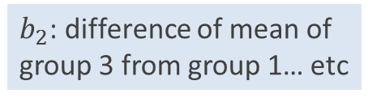
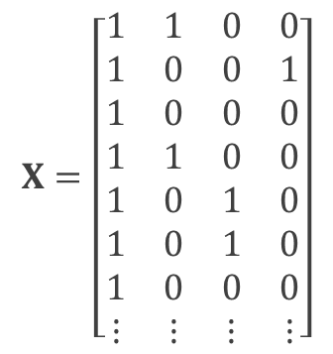
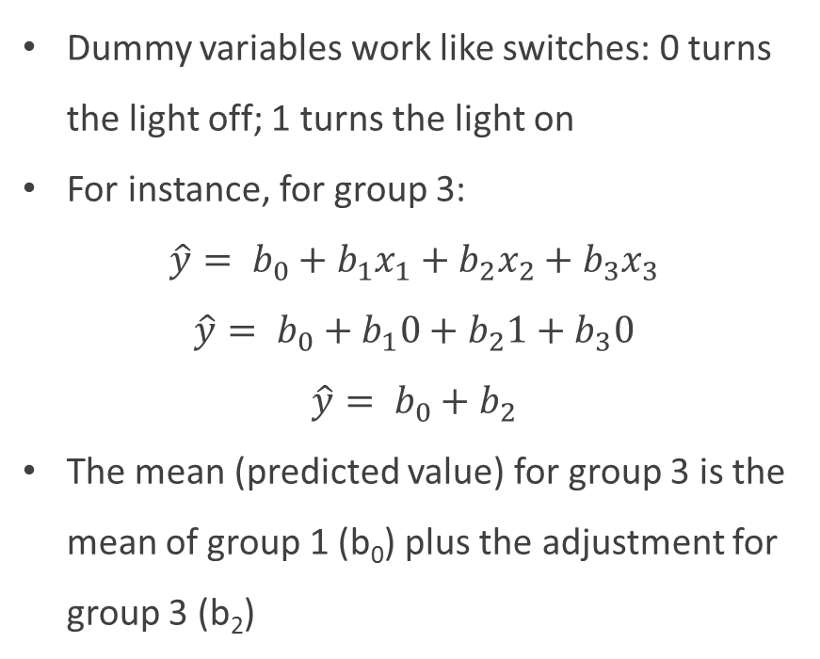
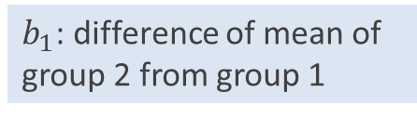

GLMs: MANOVA | ANOVA: the meaning of b | Slide 13
In ANOVA designs, the estimated parameters represent the mean of the first group and the difference of the means of other groups from it
$b_{1}$: difference of mean of group 2 from group 1
$b_{2}$: difference of mean of group 3 from group 1… etc
$b_{0}$: mean for group 1
Dummy variables work like switches: 0 turns the light off; 1 turns the light on
For instance, for group 3:
$$\hat{y}= b_{0}+b_{1}x_{1}+b_{2}x_{2}+b_{3}x_{3}$$
$$\hat{y}= b_{0}+b_{1}0+b_{2}1+b_{3}0$$
$$\hat{y}= b_{0}+b_{2}$$
The mean (predicted value) for group 3 is the mean of group 1 (b₀) plus the adjustment for group 3 (b₂)
$$X=\left[\begin{matrix}1 & 1 & 0 & 0 \\ 1 & 0 & 0 & 1 \\ 1 & 0 & 0 & 0 \\ 1 & 1 & 0 & 0 \\ 1 & 0 & 1 & 0 \\ 1 & 0 & 1 & 0 \\ 1 & 0 & 0 & 0 \\ ⋮ & ⋮ & ⋮ & ⋮\end{matrix}\right]$$

Slide 14
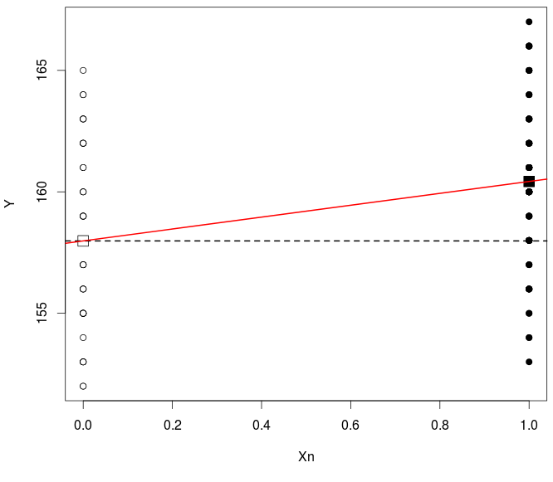
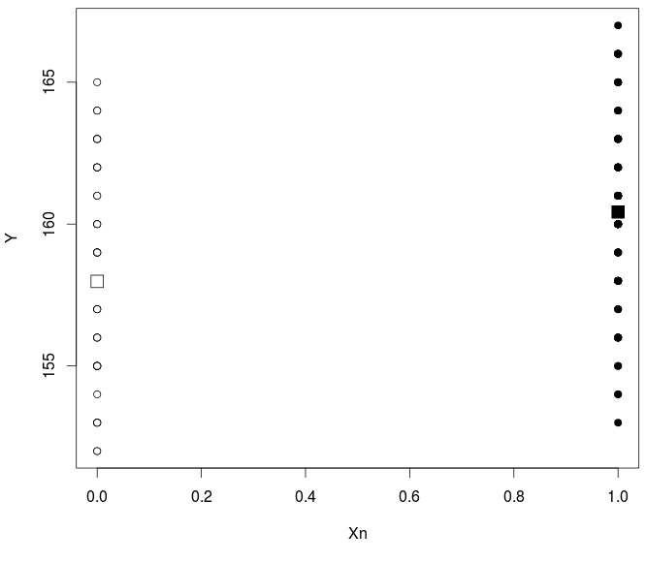
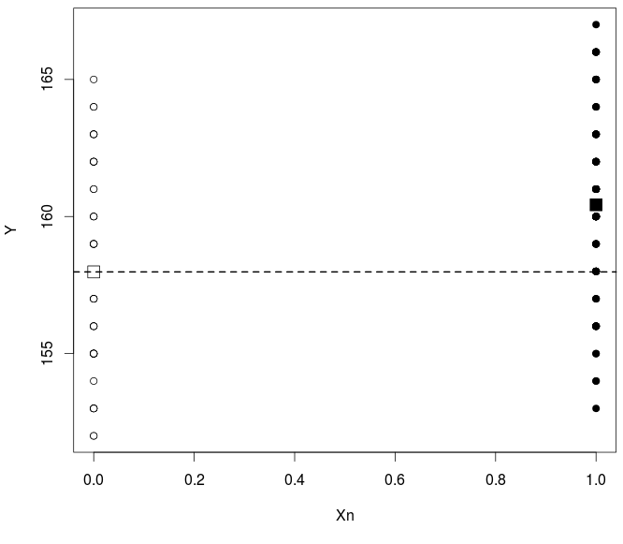
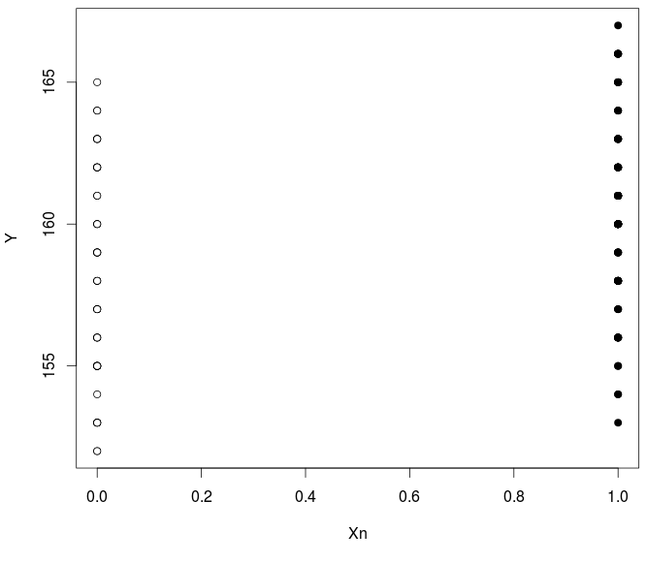


GLMs: MANOVA | ANOVA: the meaning of b | Slide 14
> Y <- bumpus$TL
> X <- as.numeric(bumpus$sex)-1
> lm(Y~X)
Call:
lm(formula = Y ~ X)
Coefficients:
(Intercept) Xn
157.980 2.446
$$\hat{y}=b_{0}+b_{1}$$
$$\hat{y}=b_{0}$$

Slide 15
GLMs: MANOVA | Data as points in multivariate space | Slide 15
Imagine a data space with one observation. It is defined by its location in the space, maybe from a reference (origin)

Slide 16
GLMs: MANOVA | Data as points in multivariate space | Slide 16
Imagine a second observation.
It can be defined as a vector from the origin, or from the first point

Slide 17
GLMs: MANOVA | Data as points in multivariate space | Slide 17
Imagine a third observation.
This can also be described as a vector from the origin or any of the other points.

Slide 18
GLMs: MANOVA | Data as points in multivariate space | Slide 18
If we know the location of the first point (as a vector from the origin), we can describe the location of the other points as vectors of change from the first point.
This is how linear models work to define group differences.

Slide 19
GLMs: MANOVA | Group differences in GLMs | Slide 19
When there is only a column of ones, the vector of coefficients is the mean vector
When there are additional columns of dummy variables, the first column vector of coefficients is the mean for group 1; the rest are change vectors to describe other group means.

Slide 20
GLMs: MANOVA | Group differences in GLMs | Slide 20
Predicted values are group means, whether there is one group or more.

Slide 21
GLMs: MANOVA | Error terms and model comparison | Slide 21
Residuals describe within-group dispersion.
Diagonal of outer-product of error represents distances from mean
Anderson MJ (2001). Austral Ecology 26: 32-46

Slide 22
GLMs: MANOVA | Hypothesis testing | Slide 22
Null Hypothesis
Viable test statistics
* If the reduced model is different, the coefficient of determination is evaluated using a null model
Anderson MJ (2001). Austral Ecology 26: 32-46

Slide 23

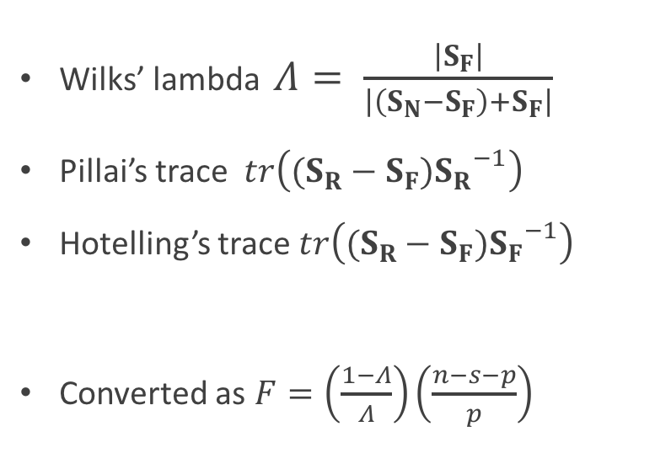
GLMs: MANOVA | Hypothesis testing | Slide 23
However: there is no multivariate F distribution! Solutions:
Use multivariate approximations and then apply a conversion to an approximate F-value
Use randomizations to obtain an empirical distribution
Wilks’ lambda $Λ= \frac{\left|S_{F}\right|}{\left|\left(S_{N}−S_{F}\right)+S_{F}\right|}$
Pillai’s trace $tr\left((S_{R}−S_{F}){S_{R}}^{−1}\right)$
Hotelling’s trace $tr\left((S_{R}−S_{F}){S_{F}}^{−1}\right)$
Converted as $F=\left(\frac{1−Λ}{Λ}\right)\left(\frac{n−s−p}{p}\right)$
“Traditional” test statistics
Require n >> p
Use randomization procedures, which are more powerful for high-dimensional data
n: total sample size, s: ncol(Xr), ncol(Y)
Anderson MJ, Ter Braak CJF (2003). Journal of Statistical Computation and Simulation 73: 85-113

Slide 24
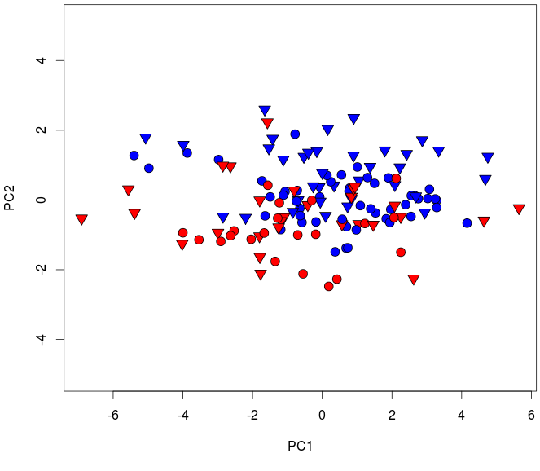
GLMs: MANOVA | One-way ANOVA: example | Slide 24
Do groups of birds differ in body proportions?
Groups: defined based on sex and survival (Msurv, Fsurv, Mdied, Fdied)
> Y <- as.matrix(bumpus[,5:13])
> summary(manova(Y ~ gp))
Df Pillai approxF numDf denDf Pr(>F)
gp 3 0.86771 5.6971 27 378 5.362e-16 ***
Residuals 132
> summary(manova(Y ~ gp), test = "Wilks")
Df Wilks approxF numDf denDf Pr(>F)
gp 3 0.32297 6.3493 27 362.79 <2.2e-16 ***
Residuals 132
> library(vegan)
> adonis(Y ~ gp, method = "euclidean")
Df SumsOfSqs MeanSqs F.Model R2 Pr(>F)
gp 3 1585.2 528.40 13.95 0.24072 0.001 ***
Residuals 132 5000.1 37.88 0.75928
Total 135 6585.3 1.00000
Males – survived
Females – survived
Males – died
Females – died

Slide 25
GLMs: MANOVA | Multiple (pairwise) comparisons | Slide 25
If a null hypothesis is rejected, and alternative hypothesis supported,
It might be of interest to ascertain why the the alternative hypothesis is supported. In other words, which means are different?
The null hypothesis for a pairwise comparison of means can be stated as:
This is the same as saying the inner-product (squared distance) between means is equal to 0, which is a multivariate analog of saying the difference between means is 0.

Slide 26
GLMs: MANOVA | Multiple (pairwise) comparisons | Slide 26
If a null hypothesis is rejected, and alternative hypothesis supported,
The null hypothesis for a pairwise comparison of means can be stated as:
Viable test statistics:

Slide 27
GLMs: MANOVA | Multiple (pairwise) comparisons | Slide 27
The null hypothesis for a pairwise comparison of means can be stated as
Viable test statistics
Traditional test statistics (involves a couple of transformations)
These steps are calculation of squared Mahalanobis distances, conversion to Hotelling T² statistics, and subsequent conversion to F-values.
If the number of variables exceeds the number of observations, this approach will not work.
Again, resampling-based statistics solve this problem ☺
f_FALSE f_TRUE m_FALSE m_TRUE
f_FALSE 1.000 0.541 0.001 0.001
f_TRUE 0.541 1.000 0.001 0.001
m_FALSE 0.001 0.001 1.000 0.027
m_TRUE 0.001 0.001 0.027 1.000

Slide 28
GLMs: MANOVA | Factorial models | Slide 28
TWO IMPORTANT NOTES:
Merging biological factors to “simplify” statistical designs should be done with caution (if at all!). Following this practice one may miss on interesting biological signal.
i.e. in the example above, sex and survival may each have effects on their own right on body proportions.
Some caution is needed if one starts designing randomizations by hand, as these assume that the randomized units are actually biologically interchangeable. Because of this, they need to be adjusted for factorial or other, more complex, designs.

Slide 29
GLMs: MANOVA | Factorial models | Slide 29
In the example, it looks like males and females are differentiated (across PC2), but surviving and dying birds not that much.
Also, the post-hoc comparisons suggest that different things may be happening when we compare males (different?) and when we compare females (not different?)
Males – survived
Females – survived
Males – died
Females – died
In reality, the true biology of our system is described by two different factors: sex and survival
The interaction term is the most interesting one, as it will tell us whether the levels of one factor (sexes) “behave” differently across the levels of the second (survival)
f_FALSE f_TRUE m_FALSE m_TRUE
f_FALSE 1.000 0.541 0.001 0.001
f_TRUE 0.541 1.000 0.001 0.001
m_FALSE 0.001 0.001 1.000 0.027
m_TRUE 0.001 0.001 0.027 1.000

Slide 30
GLMs: MANOVA | Factorial models – design matrix | Slide 30
2nd column: changes dying to surviving
Intercept: females that died
Binary description for all possible population-sex groups
Parameter allows to determine if e.g., die-survive change is greater or less in males than in females
3rd column: changes females to males
4th column: multiplies the other three

Slide 31
GLMs: MANOVA | Factorial models – design matrix | Slide 31
Sequentially removing the columns from the factorial model design matrix produces another viable model; doing the same with the single-factor model does not.
Factorial MANOVA is a system of comparing “reduced” and “full” models in a logical way (we will present a sequential method of comparison).
Single-factor design matrix:

Slide 32
GLMs: MANOVA | Sequential Sums of Squares and Cross-Products | Slide 32
Calculating SSCPs with factorial models is a paradigm of comparisons between reduced and full models
Factorial MANOVA is simply calculating SSCPS and test statistics for each model comparison and evaluating their significance
(based on the appropriate null [reduced] model, in each case.)
Effect | Reduced | Full
Sex
Survival
Sex × Survival
Males – survived
Females – survived
Males – died
Females – died

Slide 33


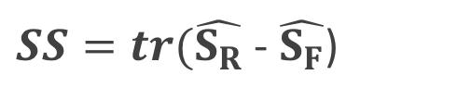





GLMs: MANOVA | Sequential Sums of Squares and Cross-Products | Slide 33
Calculating SSCPs with factorial models is a paradigm of comparisons between reduced and full models
$$\hat{E_{R}}=Y−X_{R}B_{R}$$
$$\hat{E_{F}}=Y−X_{F}B_{F}$$
$$\hat{S_{R}}= {\hat{E_{R}}}^{t}\hat{E_{R}}$$
$$\hat{S_{F}}= {\hat{E_{F}}}^{t}\hat{E_{F}}$$
Effect | Reduced | Full
Sex
Survival
Sex × Survival
$SS=tr(\hat{S_{R}}$ - $\hat{S_{F}}$)
$${SS}_{Sex}$$
$${SS}_{Survival}$$
$${SS}_{SexSurvival}$$

Slide 34
GLMs: MANOVA | Sequential Sums of Squares and Cross-Products | Slide 34
Calculating SSCPs with factorial models is a paradigm of comparisons between reduced and full models
There are other paradigms for calculating SSCPs. The sequential method is often called “type I” SSCP estimation.
This is the method we will use in examples (and the default in R).
Note: This is the only SSCP paradigm that produces the same effect SSCPs that sum to the model SSCP.
Effect | Reduced | Full
Sex
Survival
Sex × Survival
Effect | Reduced | Full
Sex
Survival
Sex × Survival
Effect | Reduced | Full
Model

Slide 35
GLMs: MANOVA | Type II Sums of Squares and Cross-Products | Slide 35
Calculating SSCPs with factorial models is a paradigm of comparisons between reduced and full models
Type II SSCP estimation:
Like Type I for the second factor, except the order is readjusted.
If more than one interaction, “main effects” and all interactions including main effects are linked (i.e., removing a main effect means removing all interactions that include it).
Note: interaction effect is the same as type I.
Effect | Reduced | Full
Sex
Survival
Sex × Survival
Effect | Reduced | Full
Model

Slide 36
GLMs: MANOVA | Type III Sums of Squares and Cross-Products | Slide 36
Calculating SSCPs with factorial models is a paradigm of comparisons between reduced and full models
Type III (marginal) SSCP estimation:
This paradigm does not link main effects and interactions. It evaluates effects by the subtraction of parameters, rather than their addition. The reduced models are somewhat meaningless, other than for estimating effects.
Note: interaction effect is the same as types I and II.
Effect | Reduced | Full
Sex
Survival
Sex × Survival
Effect | Reduced | Full
Model

Slide 37
GLMs: MANOVA | Sequential Sums of Squares and Cross-Products | Slide 37
Calculating SSCPs with factorial models is a paradigm of comparisons between reduced and full models
It should be obvious that type I SSCP is the most straightforward, but it does mean considering the order of model effects. The order can change the significance of the effects.
Regardless, the sum of the effects is equal to the overall model effect.
Effect | Reduced | Full
Sex
Survival
Sex × Survival
Effect | Reduced | Full
Model

Slide 38


GLMs: MANOVA | Concluding remarks | Slide 38
GLMs are all one and the same thing
Changes in the type of X, or the number of variables in Y, do not change the main concepts
Hypothesis tests are based on comparisons of “reduced” and “full” linear models
The reduced model is the null model for sampling (probability) distributions of MANOVA test stats
$$Y= Xβ+E$$
$$b= {(X^{T}X)}^{−1}X^{T}Y$$

