Slide 1


Application of a Lightweight Protocol to Visualize the Behavior of Autonomous Vehicle in a Virtual Environment
Dr.Vaidehi M Vaibhav Magadum Sharadhi Hegde
Professor Student Student
Shravya R Sahaj Gupta
Student Student
Department of Information Science and Engineering
Dayananda Sagar College of Engineering
Shavige Malleshwara Hills, Kumaraswamy Layout, Bengaluru
NCCT Conference
Notes:
1

Slide 2

Abstract
Presents a virtual IoT-based environment for studying autonomous vehicle communication.
Implements a lightweight MQTT protocol for real-time data exchange between vehicles and server.
Each vehicle (via Termux mobile simulation) transmits GPS, speed, and battery data to a FastAPI backend.
WebSocket integration enables continuous live updates and visualization on interactive dashboards.
Eliminates need for physical testbeds — providing a safe, scalable, and cost-effective simulation platform.
Results show low-latency communication, effective vehicle coordination, and potential for fleet management and data-driven decision support.
NCCT Conference
Notes:
2

Slide 3
Introduction
The autonomous vehicle industry is rapidly growing worldwide.
To enhance performance, vehicles must support Vehicle-to-Vehicle (V2V) and Vehicle-to-Environment (V2E) communication.
Despite major advancements, there is still a lack of real-time connectivity between vehicles and central monitoring systems.
This work proposes a virtual environment dominated by autonomous vehicles connected through a V2V network.
Each vehicle shares GPS, speed, and battery data with a centralized server.
The system uses the MQTT protocol for efficient, real-time data transmission.
The central server functions as a fleet management hub, enabling organizations to: Track vehicles in real-time, Monitor performance and safety, Make data-driven decisions for efficiency improvement.
NCCT Conference

Slide 4
Background
V2X Communication for Collaborative Intelligence
Autonomous vehicles rely on Vehicle-to-Everything (V2X) to exchange data with other vehicles (V2V) and infrastructure (V2I), enabling safer, more efficient, and coordinated driving beyond onboard sensors.
MQTT Protocol for Real-Time Data Exchange
MQTT’s lightweight publish-subscribe model efficiently handles frequent, small data packets like GPS and speed, making it ideal for real-time vehicle telemetry.
Virtual Testbeds for Safe Validation
Virtual environments allow safe, scalable testing of autonomous systems, validating communication and behaviour in realistic digital simulations before real-world deployment.
NCCT Conference

Slide 5
Related works
F. Oliva et al. [3] developed and tested V2I communication for emergency vehicle priority and pedestrian safety in cities, showing the role of connected infrastructure in improving traffic efficiency.
S. G. Dharani et al. [4] proposed a secure, efficient MQTT-based protocol for autonomous vehicles, demonstrating low-latency communication for V2X data exchange.
I. Argui et al. [6] surveyed mixed-reality environments for testing AVs and ADAS, highlighting the use of virtual testing to ensure safety before deployment.
S. Lakshminarayana, et al [8] reviewed MQTT security challenges at the IoT application layer and discussed lightweight approaches for safe, efficient communication.
M. A. Al-Shareefi et al. [9] proposed an adaptive QoS framework for MQTT in V2I communication, improving reliability and latency under varying network conditions.
NCCT Conference

Slide 6
Problem Formulation
Although much advancement has been made in self-driving technologies, real-time vehicle communication with centralized monitoring systems exists as a gap.​
There is a need for a flexible and scalable virtual environment to study vehicle behaviour across a range of conditions.​
Using autonomous vehicles in the real-world environment typically comes with high costs, safety concerns and challenges with scaling.​
A lightweight solution for continuously communicating small updates in real-time is necessary.​
NCCT Conference

Slide 7
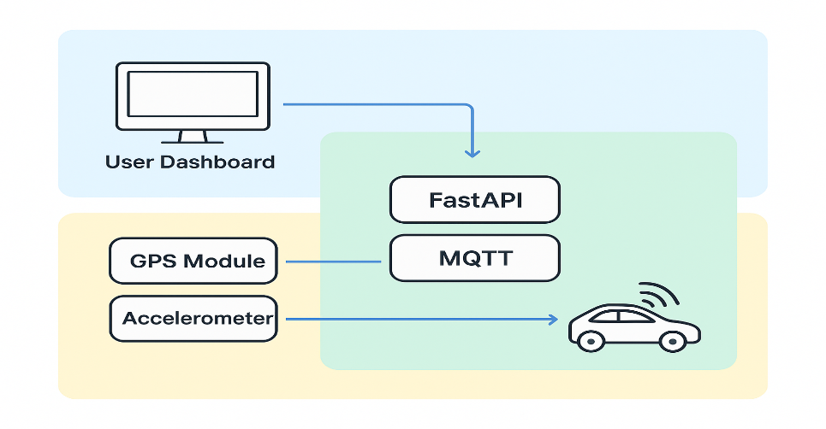
Proposed System
Figure 1. System Architecture
Client–Server Architecture: Vehicles act as clients; FastAPI backend as centralized server.
Frontend (React):
  User Dashboard: Real-time map, SOS alerts, geofencing, weather updates.
  Production Dashboard: Analytics via charts and reports.
Simulation: Mobile devices emulate vehicles, sending GPS & velocity data.
Communication:
  MQTT – Lightweight vehicle-to-server data exchange.
  WebSocket’s – Real-time UI updates.
NCCT Conference

Slide 8
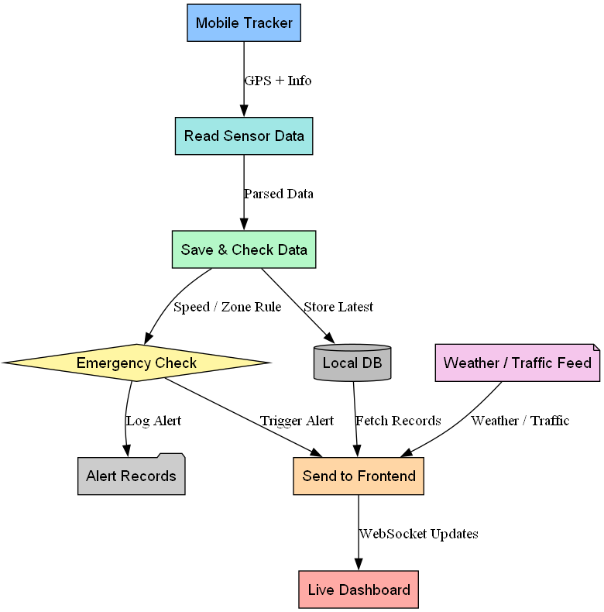
Proposed System
Input: The Mobile Tracker sends GPS and sensor data.
Processing: The data is read, parsed, and checked.
Storage & Alerts:
    Latest data is saved to the Local DB.
    Data is also sent for an Emergency Check (for speed/zone rules), which logs and triggers alerts.
Frontend: The system collects data from the DB, emergency alerts, and external weather/traffic feeds.
Output: This combined information is sent via WebSocket to the Live Dashboard for visualization.
Figure 2. Dataflow diagram
NCCT Conference

Slide 9
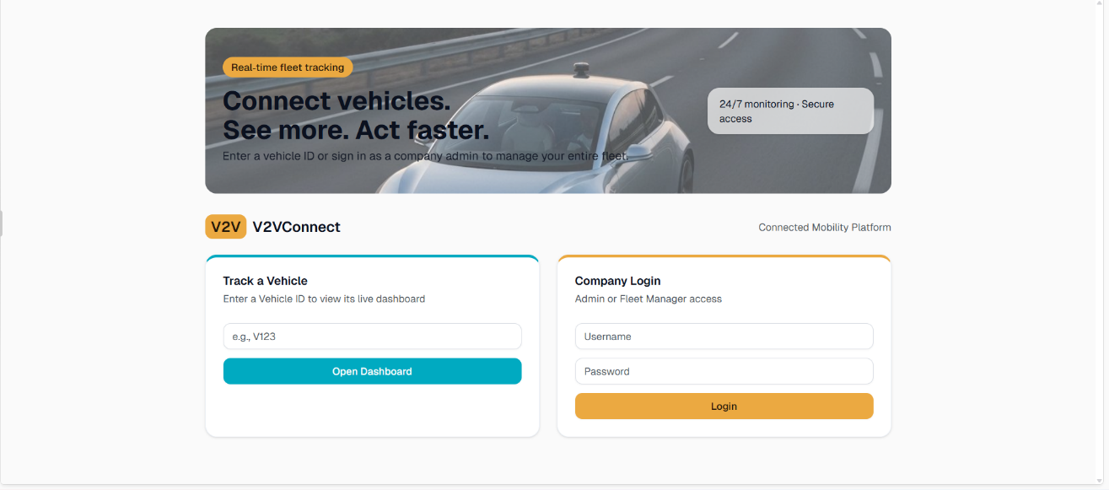
Results
Figure 4. Landing Page​
The system features two dedicated dashboards: a User Dashboard for individual drivers and a Production Dashboard for fleet administrators.​
NCCT Conference

Slide 10
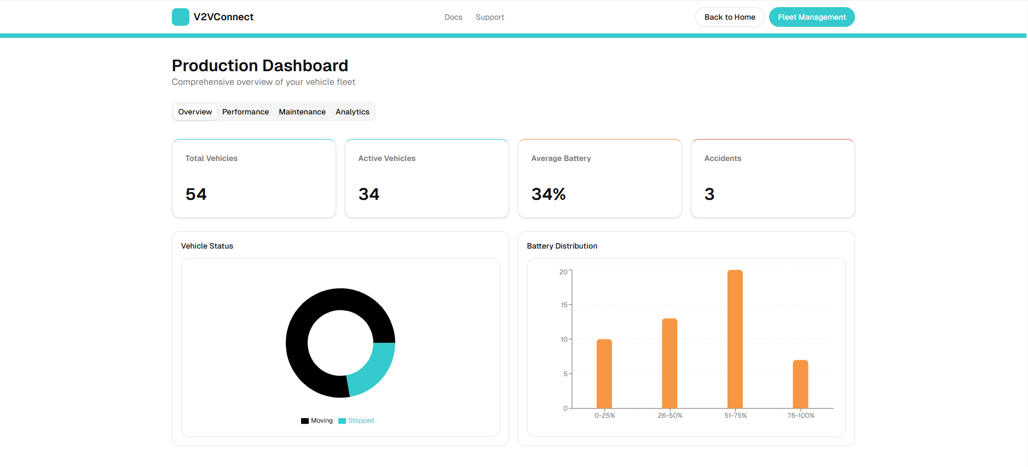
Results
Figure 5. Production Mode Dashboard​
The Production Mode Dashboard offers a comprehensive view of the vehicle fleet’s performance through various visualizations that provide insights into overall fleet efficiency and operational trends. ​
NCCT Conference

Slide 11
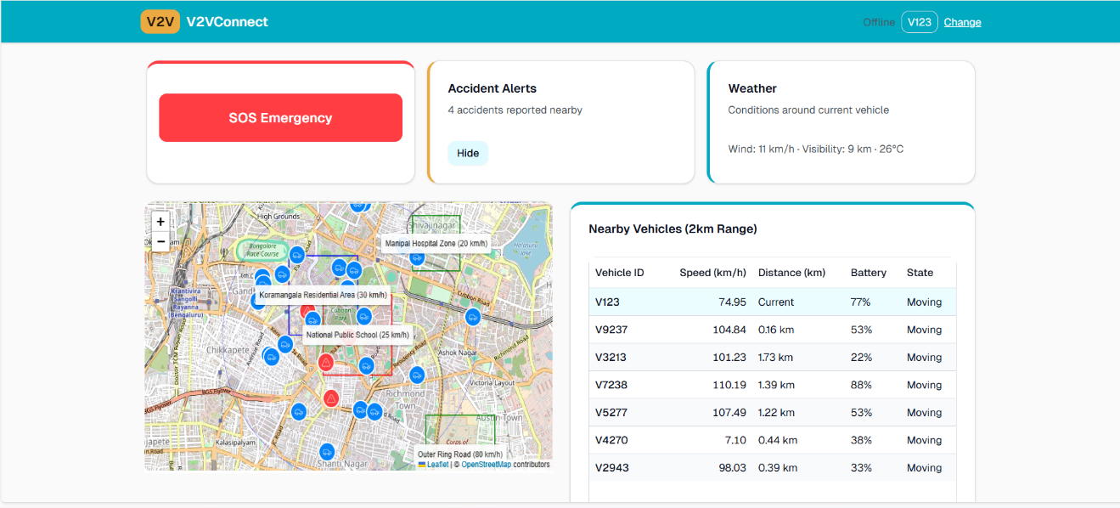
Results
Figure 6. User Mode Dashboard​
The User Mode Dashboard features an interactive map displaying all vehicles in the system, allowing users to monitor their battery status, motion status and also nearby vehicles in real time. Also, users can view current weather conditions and report accidents by specifying their intensity​
NCCT Conference

Slide 12
Comparison
Reference Paper | Existing Work | Our Contribution
[1] Ali et al., Navigating the Challenges and Opportunities of Securing Internet of Autonomous Vehicles With Lightweight Authentication (2025) ​ | A lightweight authentication framework for securing communication. | A design of a communication framework that is aware of its environment to support dynamic changes.
[2] Balcerek & Pawłowski, Interaction-Based Vehicle Automation Model for Intelligent Vision Systems (2025)​ | An interaction-based vehicle automation model for intelligent vision systems (onboard perception). | Vehicles will be able to monitor the actions of surrounding vehicles, beyond their immediate local surroundings.
[3] Oliva et al., Implementation and Testing of V2I Communication Strategies for Emergency Vehicle Priority and Pedestrian Safety (2025)​ | Implementation and testing of V2I communication strategies using real infrastructure for specific safety use cases. | A flexible and scalable virtual environment to study vehicle behaviour across a range of conditions.
NCCT Conference

Slide 13
Comparison
Reference Paper | Existing Work | Our Contribution
[4] S. G. Dharani et al., A Novel MQTT-Based Secure and Efficient Data Transmission Protocol for Autonomous Vehicles (2024) ​ | Design of a new, secure variant of the MQTT protocol for autonomous vehicles. | Practical validation of standard MQTT as a viable and efficient backbone for building a real-time autonomous vehicle monitoring and management system.
[5] L. Zhang et al., Digital Twin-Driven Fleet Management for Smart Logistics: A Cloud-Edge Framework (2024)​ | A conceptual cloud-edge digital twin framework for high-level fleet optimization in logistics. | A working, lightweight foundation that provides the essential real-time data pipeline and visualization necessary for such advanced digital twin systems.
NCCT Conference

Slide 14
Discussion
Centralized monitoring enables both users and fleet operators to view and manage all vehicles in real time from a unified dual-dashboard system.
The system uses MQTT for lightweight, low-latency, and scalable data transmission, unlike traditional heavy protocols such as HTTP.
Mobile devices act as virtual vehicles, removing the need for costly physical hardware or simulators and allowing safe, rapid prototyping.
Dynamic geofencing and speed-limit monitoring provide instant alerts, ensuring proactive safety and improved operational control.
NCCT Conference

Slide 15
Conclusions
This work explains how real-time GPS tracking, accident monitoring, and fleet management can be applied to autonomous and semi-autonomous vehicles in a virtual environment
By making use of technologies such as MQTT, Termux, FastAPI, and WebSocket, the system makes communication and data sharing between vehicles and a central server simple and reliable
The platform comes with two main modes: User Mode for everyday users and Production Mode for fleet managers, each designed to give helpful insights into vehicle behavior and performance
By recreating vehicle interactions inside a controlled environment, this research offers a cost-friendly and scalable method for testing autonomous systems before they are deployed on real roads .
With live data visualization and a dashboard that supports fleet operations, the system aims to improve both safety and efficiency
This paper builds an important step towards reliable autonomous driving, and with stronger technology and development, it could be expanded into real-world use, supporting wider adoption
NCCT Conference

Slide 16
Future Scope
The current system provides a foundational framework that can be extended in several impactful directions. First, the alert module can be enhanced by integrating with local emergency services. By enabling users to trigger direct calls to police, fire, or ambulance departments from the alert interface, the system could reduce emergency response times and significantly improve road safety.
Second, large-scale deployment requires extensive validation. Future efforts will focus on migrating the architecture to a cloud-based infrastructure to evaluate performance under thousands of concurrent vehicle nodes, ensuring scalability for urban fleet operations.
Finally, while the prototype effectively simulates a virtual environment, the ultimate goal is real-world deployment. The next phase will involve implementation on a fleet of physical test vehicles to collect field data, validate system behavior under real conditions, and refine algorithms for operational reliability and accuracy
NCCT Conference

Slide 17
References
[1] H. I. Ali, H. Kurunathan, M. H. Eldefrawy, F. Gruian, and M. Jonsson, "Navigating the Challenges and Opportunities of Securing Internet of Autonomous Vehicles With Lightweight Authentication," IEEE Access, vol. 13, pp. 24207-24222, 2025, doi: 10.1109/ACCESS.2025.3537800.
[2] J. Balcerek and P. Pawłowski, "Interaction-Based Vehicle Automation Model for Intelligent Vision Systems," Electronics, vol. 14, no. 17, p. 3406, 2025, doi: 10.3390/electronics14173406.
[3] F. Oliva, E. Landolfi, G. Salzillo, A. Massa, S. M. D’Onghia, and A. Troiano, "Implementation and Testing of V2I Communication Strategies for Emergency Vehicle Priority and Pedestrian Safety in Urban Environments," Sensors, vol. 25, no. 2, p. 485, 2025, doi: 10.3390/s25020485.
[4] S. G. Dharani, R. K. Megalingam, and A. K. K., "A Novel MQTT-Based Secure and Efficient Data Transmission Protocol for Autonomous Vehicles," in 2024 IEEE International Conference on Communications (ICC), Denver, CO, USA, 2024, pp. 1-6, doi: 10.1109/ICC.2024.10578890.
[5] L. Zhang, W. Li, and C. Wang, "Digital Twin-Driven Fleet Management for Smart Logistics: A Cloud-Edge Framework," IEEE Internet of Things Journal, vol. 11, no. 5, pp. 8624-8637, 1 March1, 2024, doi: 10.1109/JIOT.2023.3324322.
NCCT Conference

Slide 18
References
[6] I. Argui, M. Gueriau, and S. Ainouz, "Advancements in Mixed Reality for Autonomous Vehicle Testing and Advanced Driver Assistance Systems: A Survey," IEEE Trans. Intell. Transp. Syst., vol. 25, no. 12, pp. 19276-19294, Dec. 2024, doi: 10.1109/TITS.2024.3473740.
[7] I. Ud Din, A. Almogren, and J. J. P. C. Rodrigues, "AIoT Integration in Autonomous Vehicles: Enhancing Road Cooperation and Traffic Management," IEEE Internet Things J., vol. 11, no. 22, pp. 35942-35949, 15 Nov. 2024, doi: 10.1109/JIOT.2024.3387927.
[8] S. Lakshminarayana, A. Praseed, and P. S. Thilagam, "Securing the IoT Application Layer From an MQTT Protocol Perspective: Challenges and Research Prospects," IEEE Commun. Surv. Tutor., vol. 26, no. 4, pp. 2510-2546, Fourthquarter 2024, doi: 10.1109/COMST.2024.3372630.
[9] M. A. Al-Shareefi, S. H. Al-Majidi, and H. A. Al-Raweshidy, "An Adaptive QoS Framework for MQTT Protocol in Vehicle-to-Infrastructure (V2I) Communication," IEEE Transactions on Intelligent Transportation Systems, vol. 24, no. 8, pp. 8878-8892, Aug. 2023, doi: 10.1109/TITS.2023.3268445.
[10] S. R. Pokhrel, "Modeling and Performance Analysis of Multipath Transport in Connected Autonomous Vehicles," IEEE Trans. Mob. Comput., vol. 22, no. 6, pp. 3620-3635, 1 June 2023, doi: 10.1109/TMC.2022.3168311.
NCCT Conference

Slide 19
THANK YOU
NCCT Conference

