Slide 2
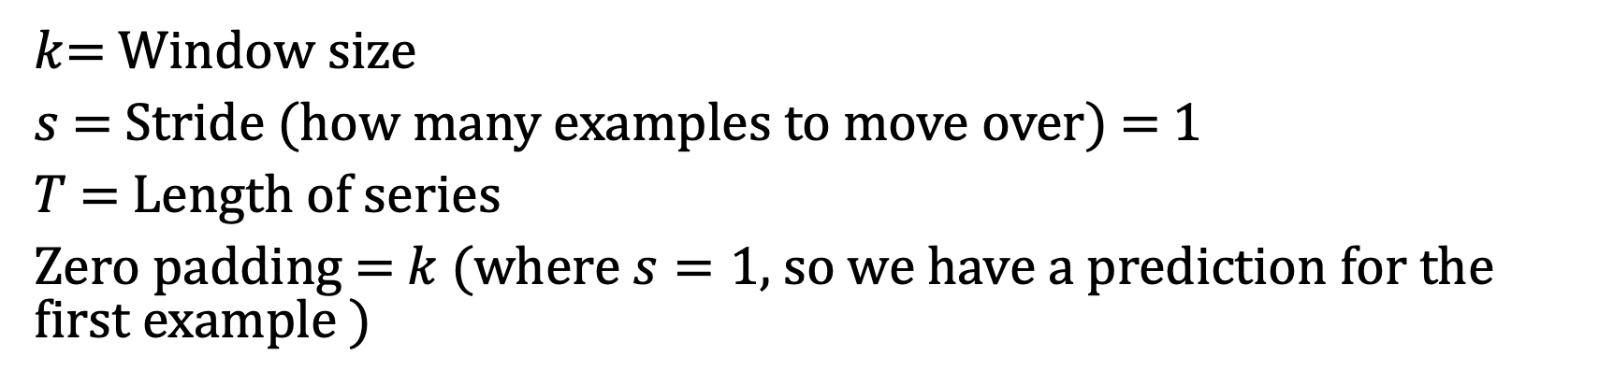
Autoregression
$k$= Window size
$s$= Stride (how many examples to move over) = 1
$T$ = Length of series
Zero padding = $k$ (where $s=1$, so we have a prediction for the first example )

Slide 3
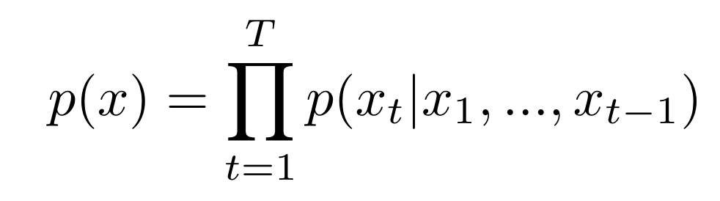
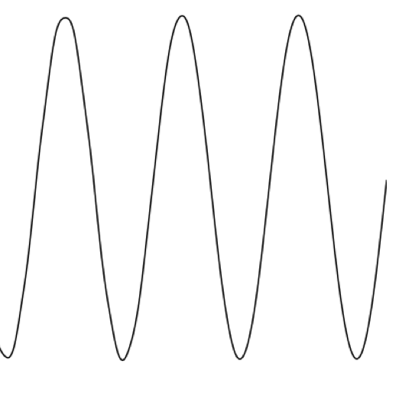
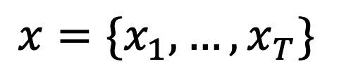
current timestep
All previous timesteps
$$x=\{x_{1},…, x_{T}\}$$

Slide 4

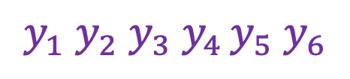

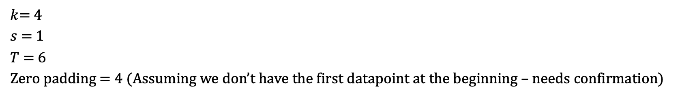




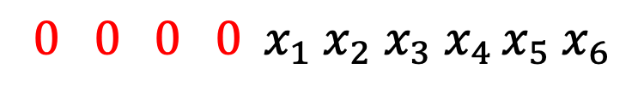

Windowing
$k$= 4
$s$= 1
$T$ = 6
Zero padding = 4 (Assuming we don’t have the first datapoint at the beginning – needs confirmation)
$$y_{1} y_{2}{ y}_{3}{ y}_{4 }y_{5} y_{6}$$
(Labels)
Zero padding
$${0 0 0 0 x}_{1} x_{2}{ x}_{3}{ x}_{4 }x_{5} x_{6}$$
(Data)
$${ex.}_{1}$$
$${ex.}_{2}$$
$${ex}_{.3}$$
$${ex.}_{4}$$
$${ex.}_{5}$$
$${ex.}_{6}$$
e${x.}_{7}$

Slide 5
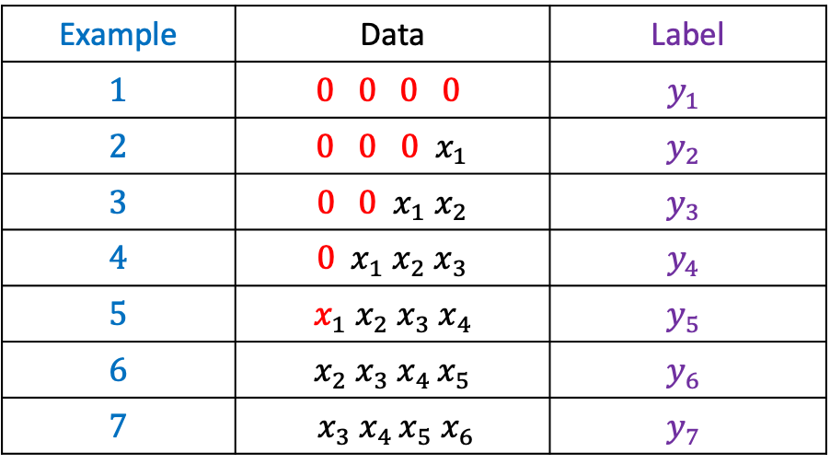
Example – Label config
Example | Data | Label
$$1$$ | $$0 0 0 0$$ | $$y_{1}$$
$$2$$ | $${ 0 0 0 x}_{1}$$ | $$y_{2}$$
$$3$$ | $${0 0 x}_{1} x_{2}$$ | $$y_{3}$$
$$4$$ | $${0 x}_{1} x_{2}{ x}_{3}$$ | $$y_{4}$$
$$5$$ | $${ x}_{1} x_{2}{ x}_{3}{ x}_{4 }$$ | $$y_{5}$$
$$6$$ | $$x_{2}{ x}_{3}{ x}_{4 }x_{5}$$ | $$y_{6}$$
$$7$$ | $${ x}_{3}{ x}_{4 }x_{5} x_{6}$$ | $$y_{7}$$

