Slide 1
Fake Currency Detection

Slide 2
Introduction:
Today in the modern digitalization world, we are surrounded by various technologies and these technologies are growing day by day in rapid manner.
Some people are utilizing the advantages of such technology to fulfill their bad purposes.
Fake currency notes are one of the most important examples of such things.
So the system is designed such that any person can use it easily and detect the authenticity of the currency he has by using the visual features of the currency.
The technology of currency recognition basically aims for identifying and extracting visible and invisible features of currency notes.
The system is based on Image processing where the number of steps are used to process the image of a currency note and outputs the result to the user whether the currency is genuine or not.
But the best way is to use the visible features of the note. For example, color and size. But this way is not helpful if the note is dirty or torn. So it is important that we extract the features of the image of the currency note and apply proper algorithms to improve accuracy to recognize the note.

Slide 3
Problem Statement:
Fake currency notes are increasing day by day and are affecting Indian economy severely. In order to minimize them, easy detection is necessary. Build an application to detect counterfeit currency notes with maximum accuracy using deep leaning.

Slide 4
Literature Review:
Fake currency detection is a serious issue worldwide, affecting the economy of almost every country including India. The use of counterfeit currency is one of the major issues faced throughout the world nowadays. The counterfeiters are becoming harder to track down because of their use of highly advanced technology One of the most effective methods to stop counterfeiting can be the use of counterfeit detection software that is easily available and is efficient.
Our project will recognize Indian currency notes using a real-time image obtained from a webcam. The background of our topic is image processing technology and applying it for the purpose of verifying valid currency notes. The software will detect fake currency by extracting features of notes The success rate of this software can be measured in terms of accuracy and speed.

Slide 5
Objectives:
The main objectives of this project are:
To abstract out accurate aspect ratio, thread-line and color of Currency image taken using Image processing technique and feature extraction with help of region-based CNN algorithm.
To detect accurately whether the note image provided to application is counterfeit or real.
To achieve more speed and accuracy as well as ease in use by common people than many other older currency detection techniques available.

Slide 6
Requirement Specification:
HARDWARE REQUIREMENTS
Processor Type : Pentium-IV
Speed : 2.4 GHz
RAM : 2 GB RAM
Hard disk : 20 GB HDD
SOFTWARE REQUIREMENTS
Operating System : Windows XP or above
Software Programming Package : Python, Tensor flow, Keras.

Slide 7
Functional Requirements:
This should be able to retrieve results accurately from classifier.
The Android application must capture the image of Currency note properly and successfully transforms it to image processing and classification algorithm.
The application should be able to relay the result to the user using audio feedback along with normal window display for visually challenged peoples.
The system should provide a vast and easily accessible dataset to deal with deep learning properly.
The CNN architecture(MobileNetV2) used must be appropriate according to parameters we extract.
Region selection must be done in very accurate and proper manner by classifier.

Slide 8
Non-Functional Requirements:
The camera should be clear and capable to capture image with clarity above some minimum threshold clarity size.
There should be minimal lag between capturing the image and the result.
The dataset must be well trained and validated enough.
The classification technique used must be chosen according to need and ease of use.
The image processing should be done with desirable accuracy.
The system should give valid result for positive as well as negative test cases.
The system should try to get more and more accurate with maximum use.

Slide 9
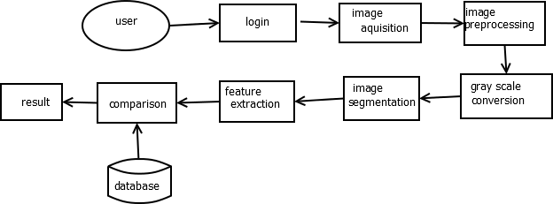
Architecture Design of System:

Slide 10
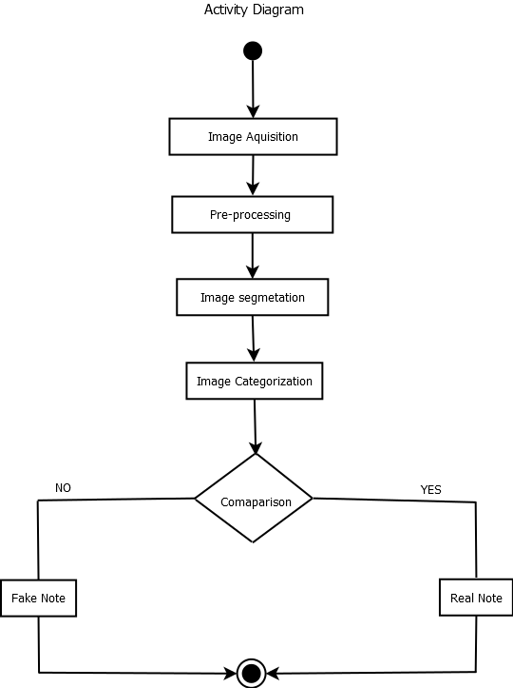
Activity Diagram:

Slide 11
Methodology:
Acquisition of currency note using digital scanner
Pre-process the captured image
Perform segmentation on the image and extract feature
Categorization of note on basic of colour and denomination
UV validation for presence of dashed metal strip
Watermark Validation for presence of Watermark image of Mahatma Gandhi on the note
Based on results classify the note as Real or Fake

Slide 12
Expected Input and Output:
Input-
Image of Currency note such as 100 Rupee Note, 200 Rupee Note, 500 Rupee Note and 2000 Rupee Note.
Output-
The mean intensity of both color components of currency note and extracted features of currency note are compared with threshold value to conclude that the currency is real or fake.
If the currency is fake the system concludes that “currency is fake” and shows where the differences are in the currencies otherwise if currency is not fake the system concludes that “currency is original”.

Slide 13
Testing:
Test CaseNo. | Test Case | Input | ExpectedOutput | Actual Output | Status
1 | Upload Image | Image | Image Uploaded | Image Uploaded | Pass
2 | Finding Denomination and basic classification | Image | Denomination Identified | Denomination Identified | Pass
3 | Ultraviolet Validation | Contrast Adjusted Image | Checked for presence of metal strip | Checked for presence of metal strip | Pass
4 | Watermark Validation | Image with backlight | Checked for presence of watermark | Checked for presence of watermark | Pass
5 | Final Result(Fake or Real) | Output of above three steps | Note Classified(Fake or Real) | Note Classified(Fake or Real) | Pass

Slide 14
Installation Guide:
Step 1 – Create a virtual environment for flask.
Step 2 – Install Flask.
Step 3 – Install all the python packages mentioned in provided text files
Step 4 – Download zip folder provided on the google drive. Extract folder and copy all the files present in the folder to the folder created for virtual environment.
Step 5 – Now go to command prompt and run gui-trial.py file using Python gui-trial.py
Now after successful execution of the command you will be provided with a link(http://127.0.0.1:5000/).
Copy this link and paste it in your browser and click on go. You will be sent to home page of our project and you can use our program to check whether your currency notes are real or fake.

Slide 15
Conclusion:
This project helps to detect the fake currency using image processing.
This would eliminate the circulation of fake note in the system to some extent.
It would provide an opportunity for the user to properly detect the authenticity of note actually without going to the banks. This project discussed a technique for verifying Indian paper currency
By using digital image processing, analysis of Currency Image is more accurate as well as this method is efficient in terms of cost and time consuming as compared to existing techniques.
The work will surely be very useful for minimizing the fake currency. Mobile app is developed which would be useful for normal as well as visually impaired persons, the same system can be developed for the remaining Indian currency notes and other country’s currency notes. An efficient approach is proposed to extract the features of Indian currency notes and recognize it.

Slide 16
Applications:
As the new currencies are used in the market, the proposed system seems to be useful to detect the currency to be genuine or not.
This system compares more features for feature extraction than other proposed systems.
It shows where the differences are in the currencies instead of simply displaying the result.
This system is useful to common people.

Slide 17
ETHICS:
As A Computer Science & Engineering Student, I believe it is Unethical To,
1. Surf the internet for personal interest and non-class related purposes during classes
2. Make a copy of software for personal or commercial use
3. Make a copy of software for a friend
4. Loan CDs of software to friends
5. Download pirated software from the internet
6. Distribute pirated software from the internet
7. Buy software with a single user license and then install it on multiple Computers
8. Share a pirated copy of software
9. Install a pirated copy of software

Slide 18
References:
[1]“Indian Currency Denomination Identification Using Image Processing Technique” by Vipin Kumar Jain, Dr. Ritu Vijay .
[2]P. D. Deshpande and A. Shrivastava,“ Indian Currency Recognition and Authentication using Image Processing ,” IJARSE, Vol. 07, No. 7, pp. 1107-1119, 2018.
[3]K. Sawant and C. More, “Currency Recognition Using Image Processing and Minimum Distance Classifier Technique,” IJAERS, Vol. 3, No. 3, pp. 1-8, 2016.
[4]K. B. Zende, B. Kokare, S. Pise and P. S. Togrikar, “Fake Note Detection System,” IJIRT, Vol. 4, No. 1, pp. 46-49, 2017.
[5]Eshita Pilania, Bhavika Arora, ― “Recognition of Fake Currency Based on Security Thread Feature of Currency” International Journal Of Engineering And Computer Science, ISSN: 2319-7242
[6]P. Julia Grace, Ph.D., A. Sheema, “A survey on Fake Indian Paper Currency Identification System” Grace et al., International Journal of Advanced Research in Computer Science and Software Engineering (6-7), July- 2016, pp. 340-345 ISSN: 2277 128X
[7]Komal Vora, Ami Shah, Jay Mehta, “A Review Paper on Currency Recognition System”International Journal of Computer Applications (0975 – 8887), Volume 115 – No. 20, April 2015
[8]Yanyan Qin, Hongke Xu , Huiru Chen, “Image Feature Points Matching via Improved ORB”, ICPIC, Vol. 14, pp. 204-208, 2014.

Slide 19
Thank You

