Slide 1
ARBITRUM OPEN HOUSE SINGAPORE · ROBINHOOD CHAIN
Batpilot
Your US stocks, managed while you sleep.
Recurring buys + stop-loss protection on tokenized stocks — settled in USDG, verifiable onchain.
github.com/PhiBao/batpilot · batpilot.vercel.app

Slide 2
01 · PROBLEM
Asia sleeps through every US session
• US market hours are 21:30–04:00 in Singapore — holders sleep through every session.
• Tokenized stocks trade 24/7 but are priced 24/5: feeds go stale on weekends.
• No onchain DCA exists; only perps have stop-losses. Spot holders babysit broker apps at 3am.

Slide 3
02 · INSIGHT
Treat market sessions as onchain state
• A guard screens every fill: freshness, volatility-adaptive bands, corporate actions.
• Refusals emit events — the fill it refuses is the proof it is safe.
• After any protection sale, the plan cools down instead of buying back the crash.

Slide 4
03 · PRODUCT
Set once. Covered around the clock.
• Fund a plan: $50 NVDA every 15 min, −8% stop, +20% take, 2% slip, 2h cooldown.
• Permissionless keeper executes; contracts decide. Idle USDG earns in Steakhouse Earn.
• Every fill, refusal and protection links to its transaction.

Slide 5
04 · LIVE PROOF
Real money, reconciled to the cent
• Mainnet plan filled by keeper: $5 NVDA @ $228.82 — tx 0x12e29b94…db5689.
• Equity decoded word-by-word: $34 cash + 0.0665 NVDA + $14.99 value. Exact.
• Testnet loop filling on 15-min cadence, fully verified on Blockscout.

Slide 6
05 · TECHNICAL DEPTH
A real engine, honestly benchmarked
• Volatility-adaptive bands from Chainlink round history — no trusted inputs.
• Ported to Stylus Rust, deployed onchain: bit-identical outputs at 41% less gas.
• 31 Foundry tests + 7 Stylus tests, incl. mainnet-fork proofs.

Slide 7
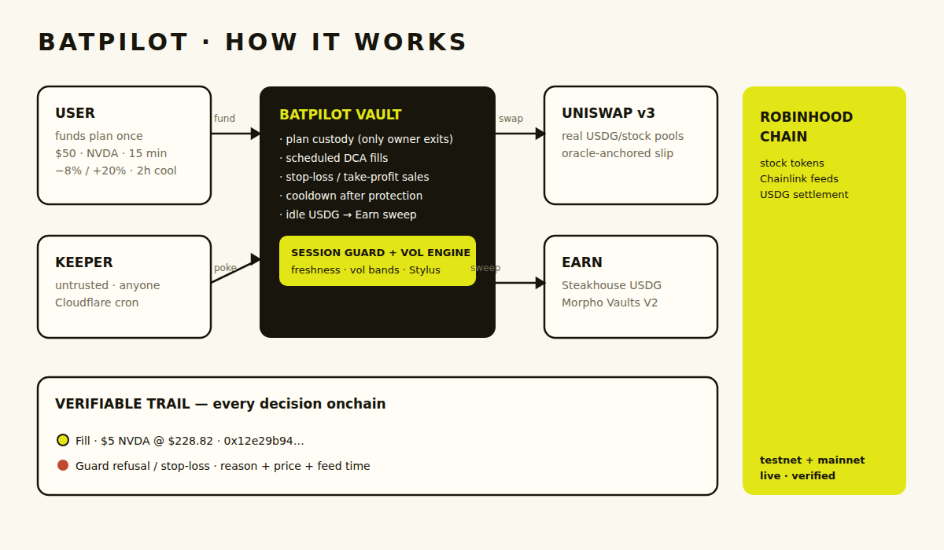
06 · ARCHITECTURE
Four boxes and a trail
Vault + guard onchain · Uniswap v3 + Steakhouse Earn venues · permissionless keeper · everything verifiable.

Slide 8
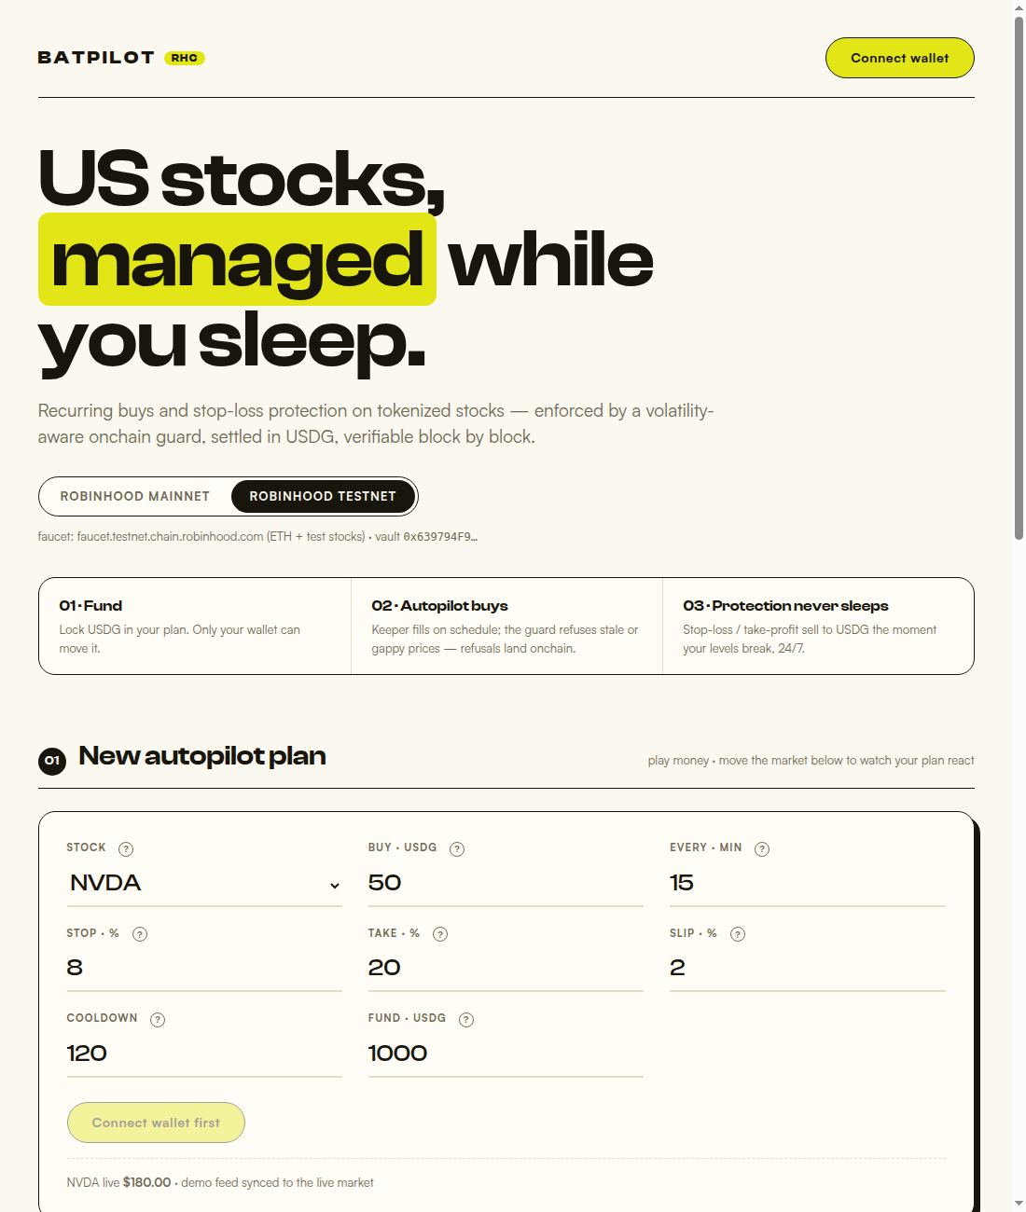
07 · PRODUCT
Designed like an editorial, not a dashboard
batpilot.vercel.app — chain switcher, living plan sentences, sparklines, infinite verifiable trail.

Slide 9
08 · GO-TO-MARKET
From sleep-deprived holders to family offices
• Wedge: SG/MY retail holding US stocks — concierge onboarding, track-record cards.
• Expand: autopilot baskets, SGD rail, advisor white-label.
• Money: freemium fills + yield take-rate, aligned with Global Dollar Network.

Slide 10
09 · ROADMAP
Milestone-ready
• Funded mainnet plan + public track record → oraclePaused hardening → TWAMM + baskets.
• Multisig + audit before scaling external funds.
• Ask: buildathon prize funds the audit; Founder House turns it into family-office rails.

Slide 11
BATPILOT
Arcus gives you a venue. Batpilot gives you sleep.
github.com/PhiBao/batpilot · batpilot.vercel.app · Set it once. Verified onchain.

