Slide 1
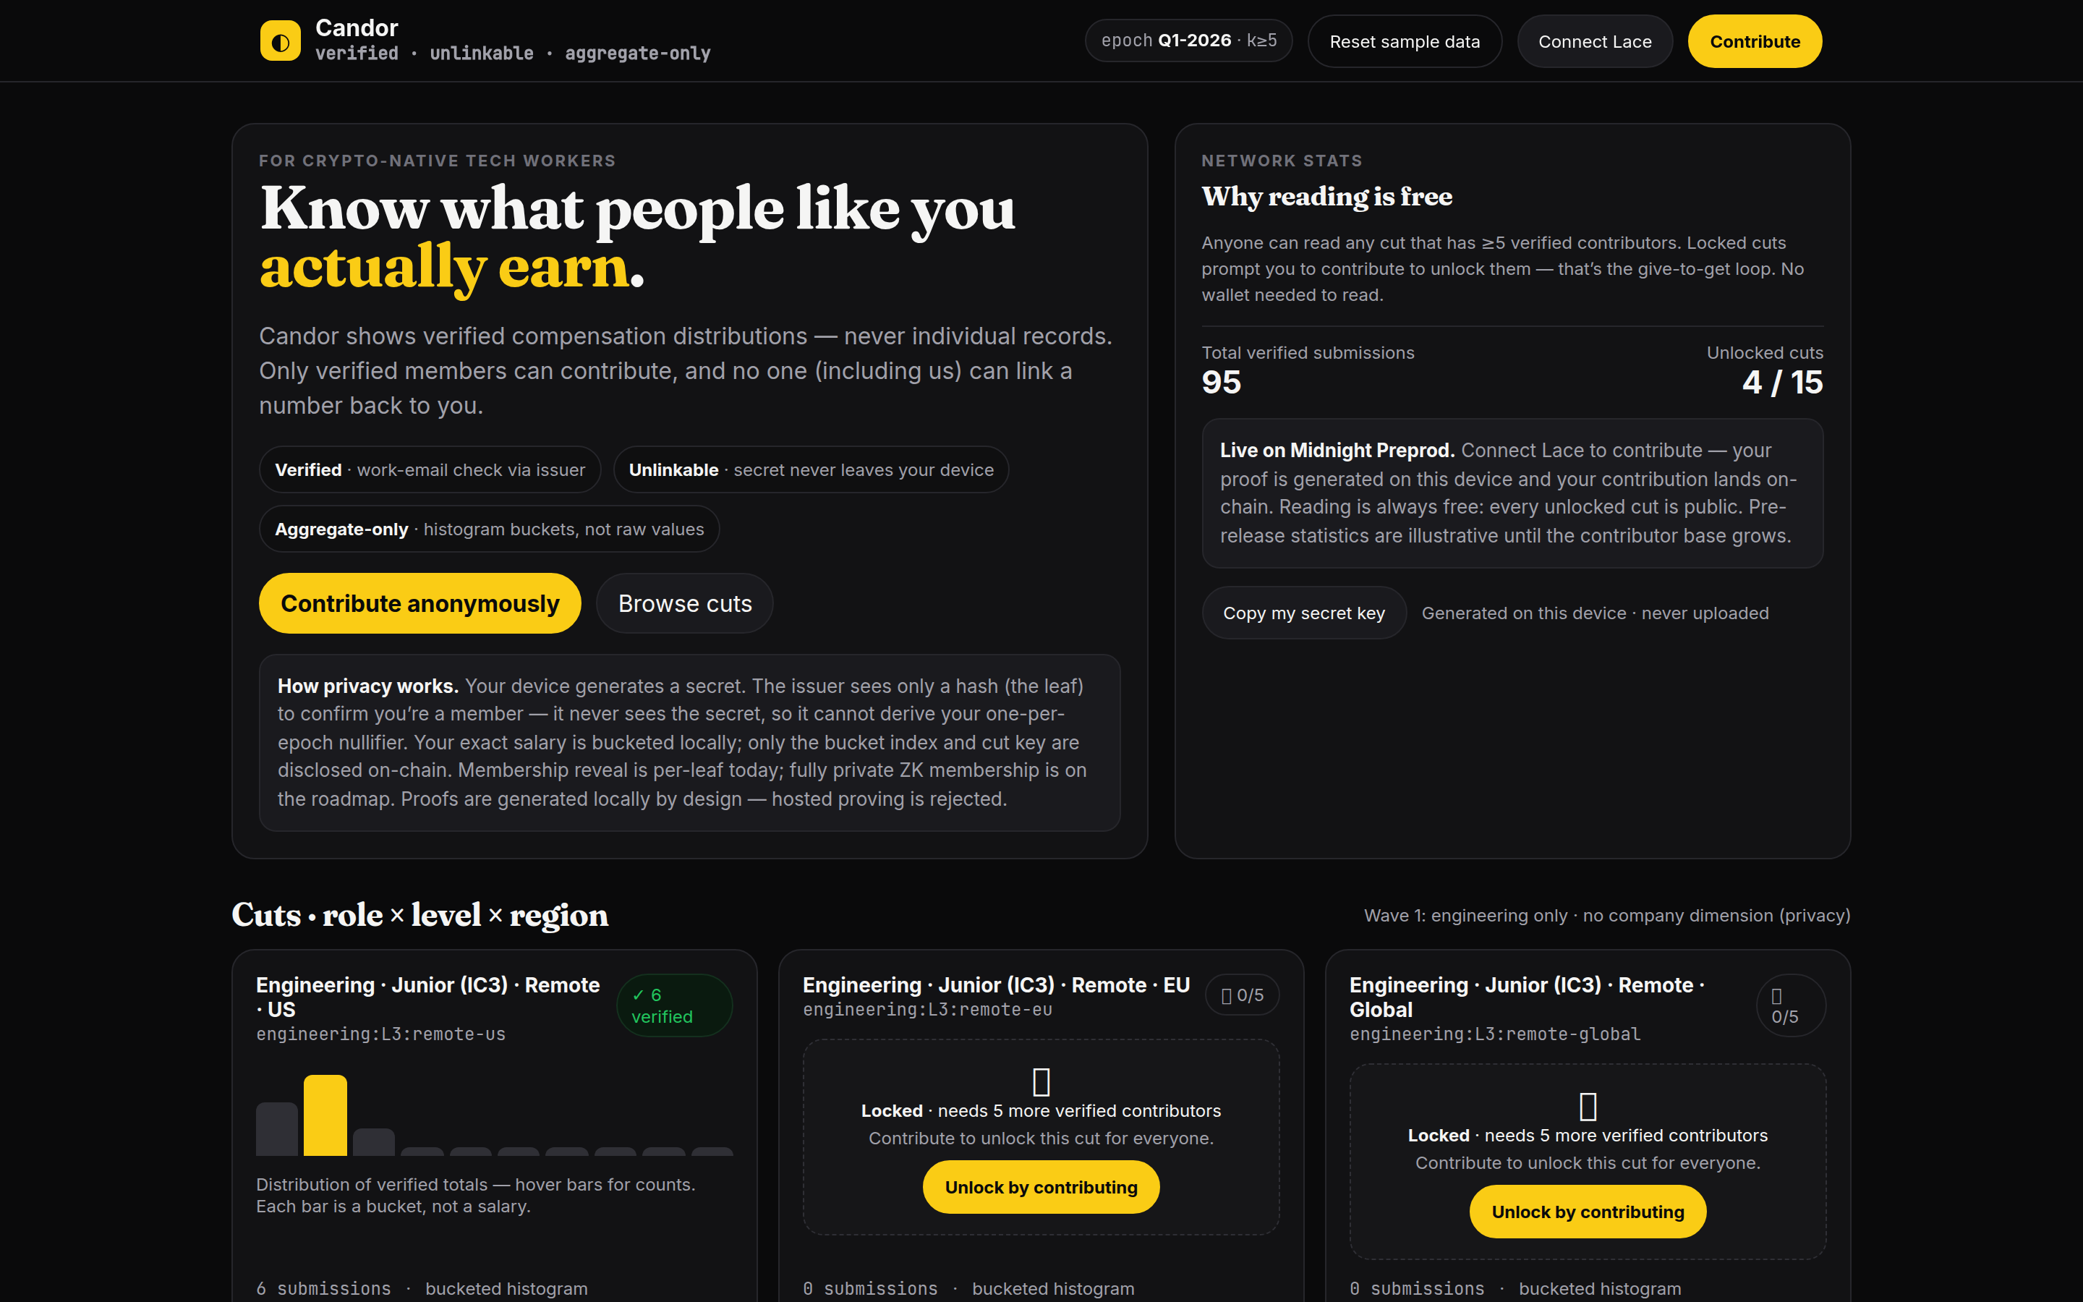
MIDNIGHT NETWORK · PRIVACY-FIRST
Candor
Verified, unlinkable
compensation truth.
● LIVE ON PREPROD
github.com/PhiBao/candor

Slide 2
THE PROBLEM
Salary data is broken
three different ways.
Glassdoor / Levels.fyi
Blind
Pave / OpenComp
Self-reported.
Verified — but tied to a
persistent handle.
Verified — but owned
by the employer.
Gameable by employers.
Not anonymous.
Workers never see it.
Without zero-knowledge proofs, “verified” and “unlinkable” are mutually exclusive.

Slide 3
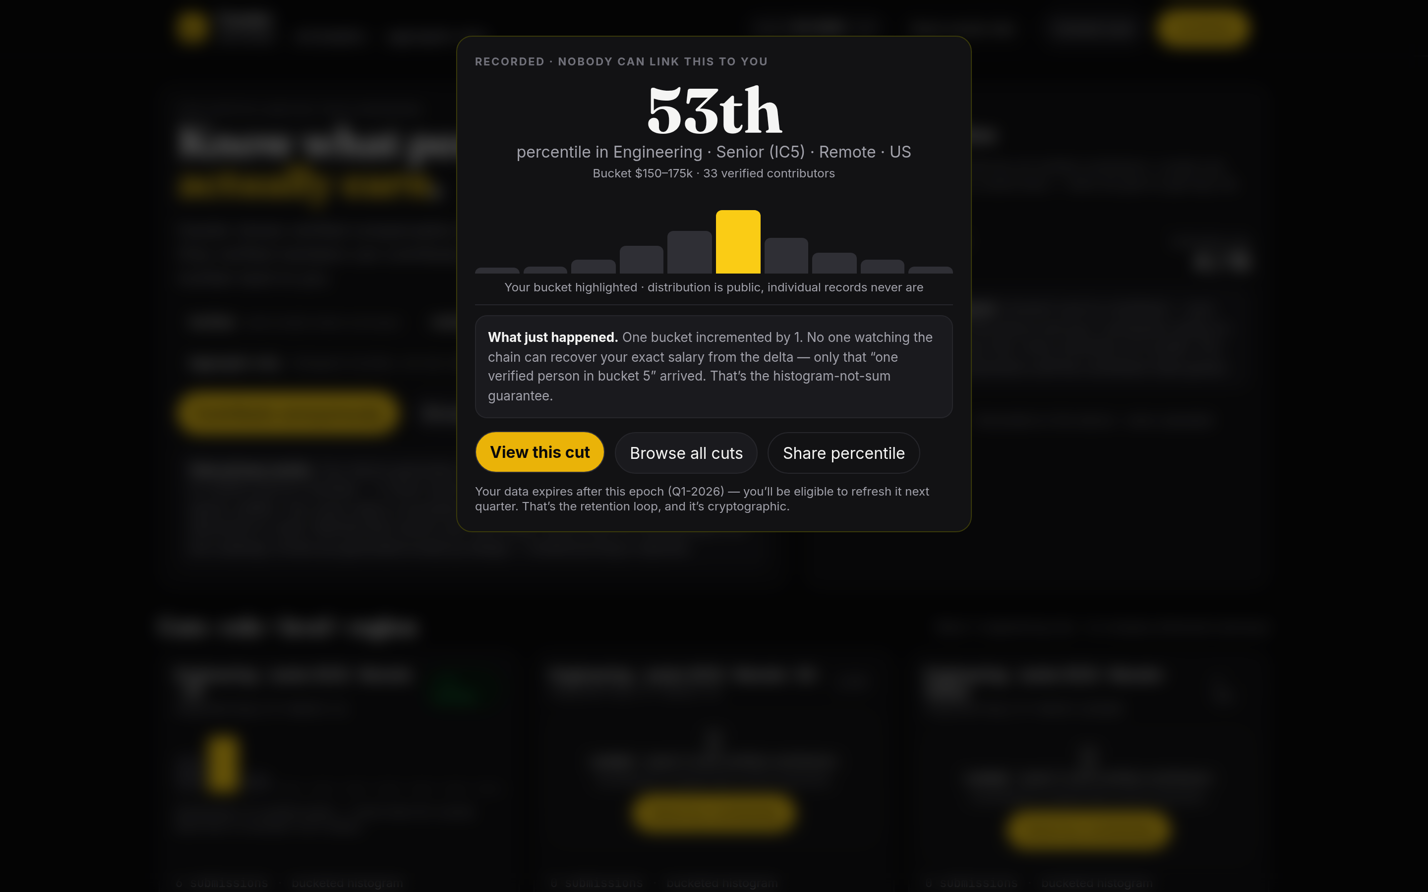
CANDOR
One verified human.
One bucketed contribution. Per epoch.
VERIFIED
UNLINKABLE
AGGREGATE-ONLY
work email, one human
secret never leaves your device
distributions, never records
The moment you came for:
your percentile — from
verified data, anonymously.

Slide 4
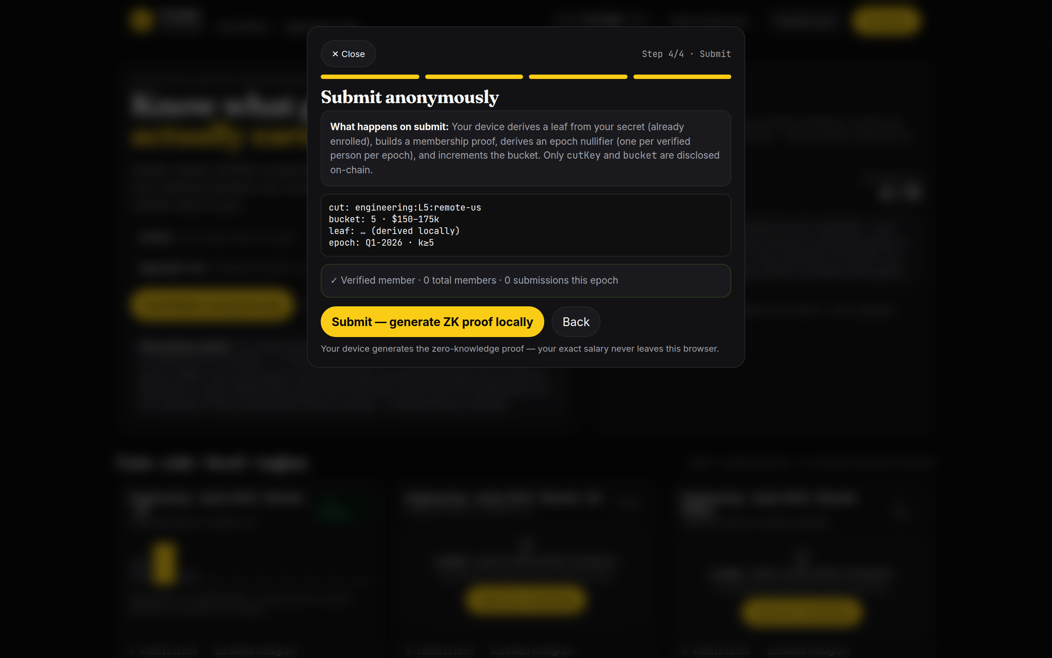
HOW IT WORKS
Four steps. Your salary never leaves your device.
1 · VERIFY
2 · DESCRIBE
3 · PROVE
4 · RECORD
work email →
membership leaf
role, level, salary —
bucketed locally
zero-knowledge proof
generated in your browser
one bucket increments
on-chain
Enforced by the circuit: one contribution per verified person per epoch.

Slide 5
THE DESIGN
Built privacy-first,
by constraint.
Proof on your device.
Hosted proving is rejected — the witness is your salary.
Only two numbers go on-chain.
A cut key and a bucket index. Nothing else.
Histograms, never sums.
Deltas reveal a bucket — never an exact value. Regression-tested.
Epoch nullifiers.
One contribution per person per epoch. Spam is cryptographically impossible.
k ≥ 5 · cuts stay locked until the crowd fills them

Slide 6
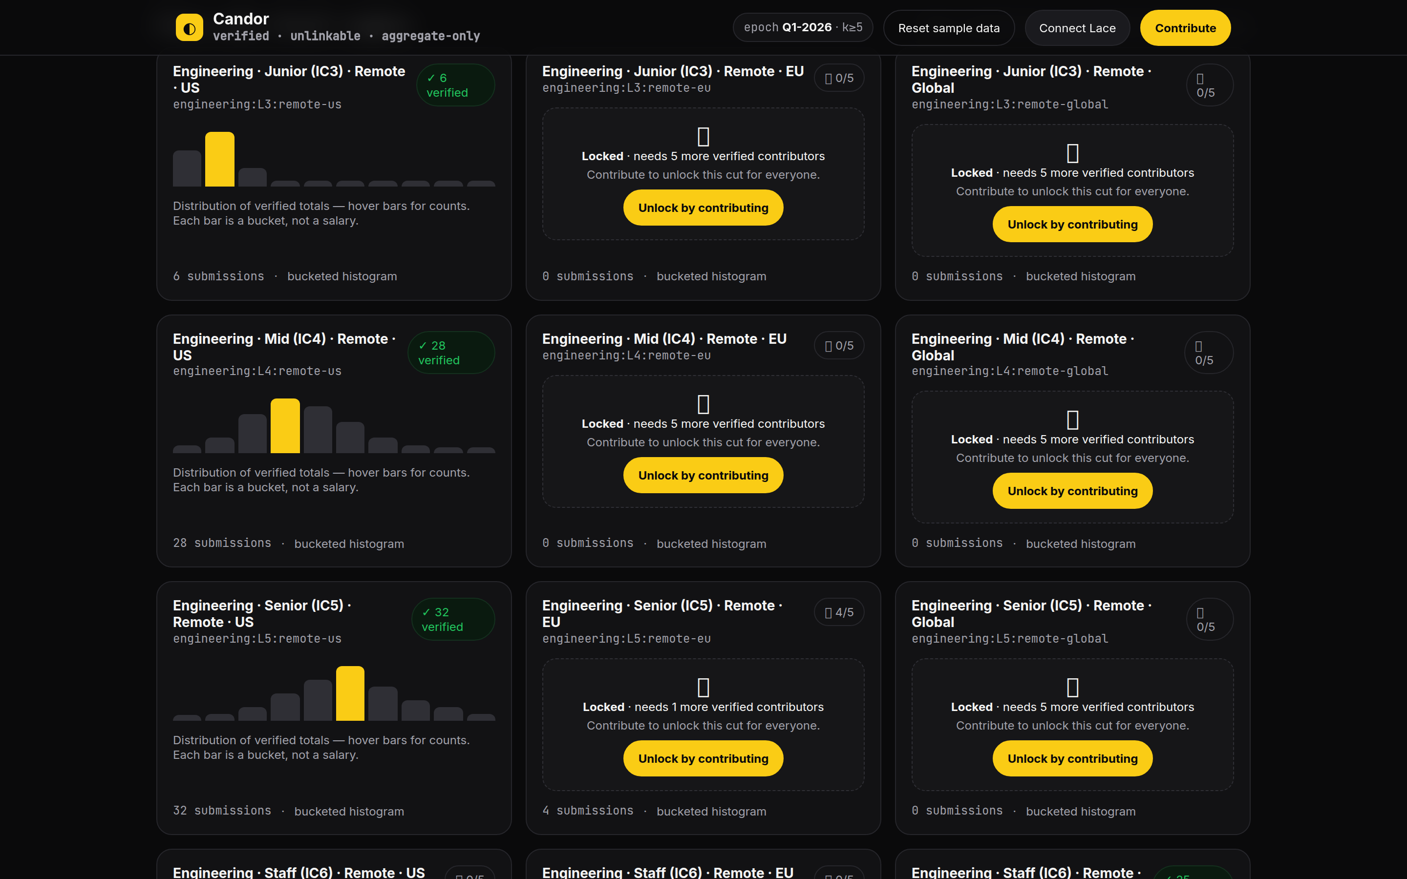
LIVE · PREPROD VERIFIED
Live on Midnight Preprod.
● DEPLOYED + END-TO-END VERIFIED
contract
e7cf6ffc48eb…c21dd53d
— Deploy → enroll → contribute, all real transactions
— Public cut pages — free to read, no wallet
— Issuer console: enrollment + epoch advancement
— 13 circuit tests incl. privacy regression

Slide 7
MARKET
Free for workers.
Companies pay for the layer.
The wedge
The model
Crypto-native ICs — already run Lace, paid in tokens,
invisible to every existing tool.
Reachable: Midnight & Cardano Discords, Farcaster, crypto X.
Workers: free forever — give-to-get unlocks deeper cuts.
Companies & DAOs: cut access, pay-band analytics,
compliance-grade aggregates.
Growth loop: data goes stale quarterly → natural re-contribution → more cuts unlock → more value.

Slide 8
ROADMAP
Roadmap — Trusted slice to trustless scale
✓ DONE
NEXT
LATER
WAVE 1
WAVE 2
WAVE 3
The trusted slice
Trustless membership
Scale
· Live on Preprod ✓
· ZK Merkle — no leaf disclosure
· Mobile (prove from a phone)
· 15 cuts · k ≥ 5 gate
· Issuer federation
· zkEmail — no trusted issuer
· One seeded community
· Historical epochs · trends
· Employer surface · token comp

Slide 9
Every salary shared
makes the next one safer to share.
ASK · SEED ONE REAL EPOCH
github.com/PhiBao/candor · Built on Midnight Network · Apache-2.0

