Slide 1
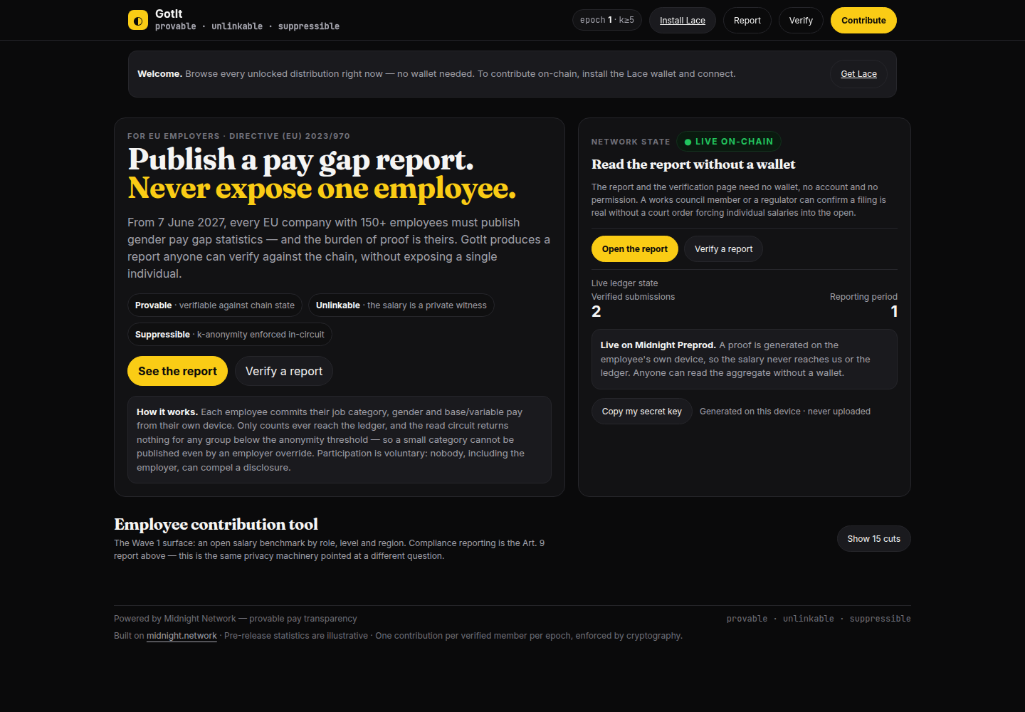
MIDNIGHT BUILDATHON · WAVE 2
GotIt
Publish a pay gap report.
Never expose one employee.
Provable pay transparency for EU employers
under Directive (EU) 2023/970
The deployed app — no wallet needed to read

Slide 2
THE PROBLEM
Compliance asks you to do two things
that contradict each other.
PUBLISH
PROTECT
Art. 9 requires mean and median gaps, base vs variable pay, and the quartile distribution — by category of worker.
GDPR and data-minimisation forbid letting those same statistics identify a person. A 12-person quartile table is a privacy incident.
A group of three cannot be published without publishing three people's pay. The employer is the one holding both legal duties.
From 7 June 2027. First reports due for every EU employer with 150+ staff. An unjustified gap of 5% triggers a joint pay assessment.
GotIt · Midnight Buildathon · Directive (EU) 2023/970 Art. 9
2

Slide 3
WHAT IT DOES
A pay gap report that proves itself.
Four steps, and three of them are privacy properties rather than features.
01
02
03
04
Employees commit privately
Only counts reach the ledger
Small groups cannot be read out
The employer ships proof, not assertions
Each person enters job category, gender and base/variable pay in a form on their own device. The salary is a private witness.
A count per (category × gender × component × bucket) rises on-chain, computed by the employee's own proof.
The read circuit returns 0 for any group below the threshold. It is enforced in the contract, so an employer cannot override it.
Anyone can verify the report against chain state — with no wallet and no court order.
The result: an auditor, a works council or a journalist can confirm the report is real — without any individual's salary ever leaving their device.
GotIt · Midnight Buildathon · Directive (EU) 2023/970 Art. 9
3

Slide 4
BACKEND ENGINEERING
Disclosure control lives in the circuit,
not in the interface.
This is the part a competitor cannot copy with a UI toggle.
Circuit
What it guarantees
Enforced
getHistogram(category, gender, component, bucket)
returns 0 when the group is below k
enforced
groupCount(category, gender, component)
one counter per group, so a full team never lifts a team of one
per group
kThreshold
fixed at deploy, readable on-chain via readK()
public
nullifiers
hash(secret, period) — one submission per person, per period
cryptographic
members
hash(secret), issuer-gated. The issuer never sees the secret.
issuer-gated
7 circuits · 34 tests running the generated contract off-chain · hash parity between the browser and the circuits asserted on every build
GotIt · Midnight Buildathon · Directive (EU) 2023/970 Art. 9
4

Slide 5
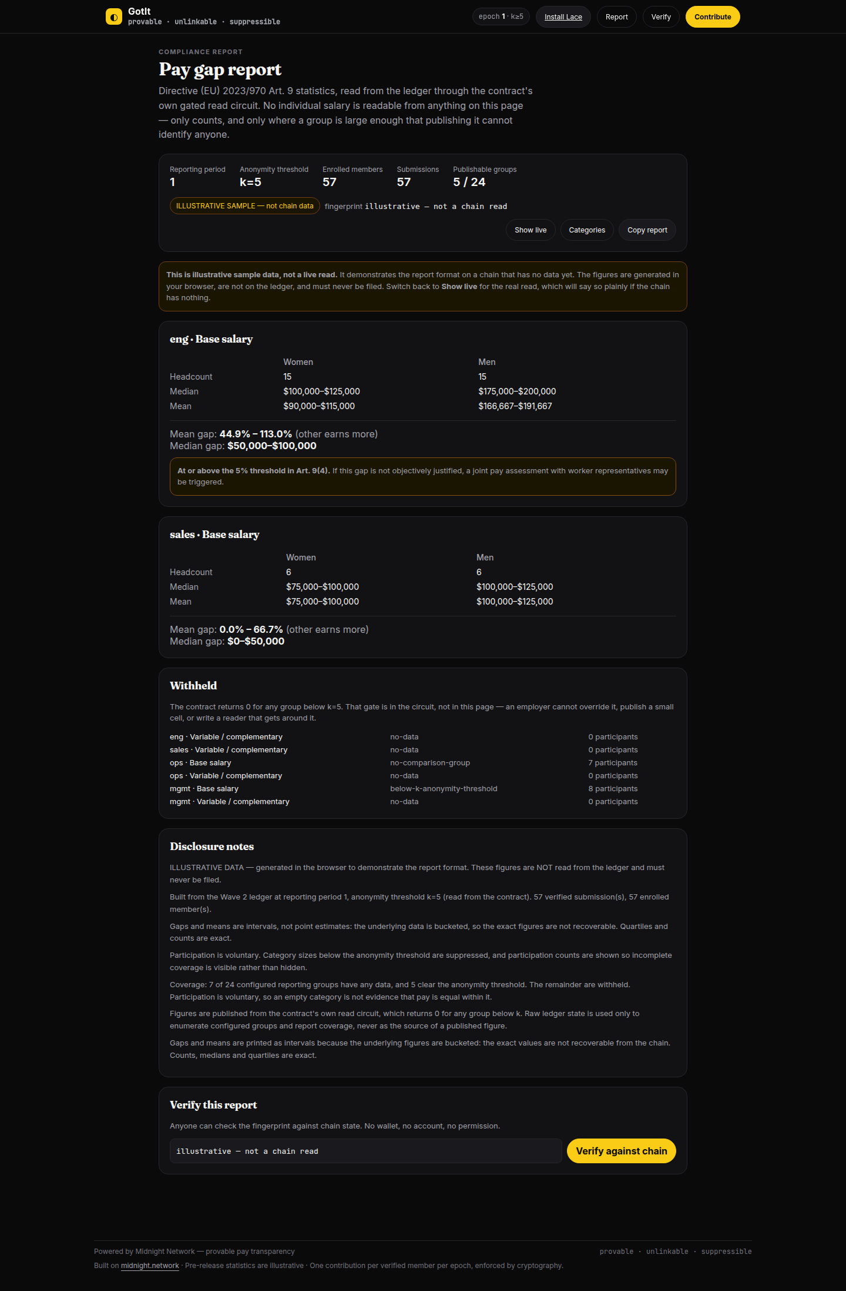
THE DELIVERABLE
The report a compliance officer
actually files.
Directive (EU) 2023/970 Art. 9
Art. 9(1)(a)–(e) — mean gap, median gap, variable-component gap, and the share receiving variable pay.
Quartile distribution across each category of worker.
Means are intervals, not point estimates. Bucketed data only bounds the truth; pretending otherwise is a rounding error dressed as a statistic.
Materiality uses the bound nearest zero, not the midpoint. A range of [−33%, +50%] has a +8.3% midpoint but no provable sign — flagging it would trigger a joint pay assessment on a compliant category.
Illustrative data — the live report reads live chain state
GotIt · Midnight Buildathon · Directive (EU) 2023/970 Art. 9
5

Slide 6
THE PART WE ARE MOST PLEASED WITH
Art. 9(1)(e) cannot be computed.
We can prove why — and what we refused.
THE QUESTION THE DIRECTIVE ASKS
WHY OURS CANNOT
The proportion of each group receiving complementary or variable pay.
Every published report answers it with a single number.
The ledger keeps base-pay and variable-pay submissions in separate, unlinkable cells — which is the property everything else depends on. So |base| and |variable| are exact, but their intersection is not known.
LINK A PERSON'S BASE AND VARIABLE PAY
COUNT DISTINCT CONTRIBUTORS PER GROUP
Reveals both figures for one individual. Refused: it defeats the design.
A second nullifier would reveal that one person submitted both. Refused.
So we publish the interval the model bounds, and the reason it cannot be tightened. A reviewer can check the reasoning rather than take a number on trust.
GotIt · Midnight Buildathon · Directive (EU) 2023/970 Art. 9

Slide 7
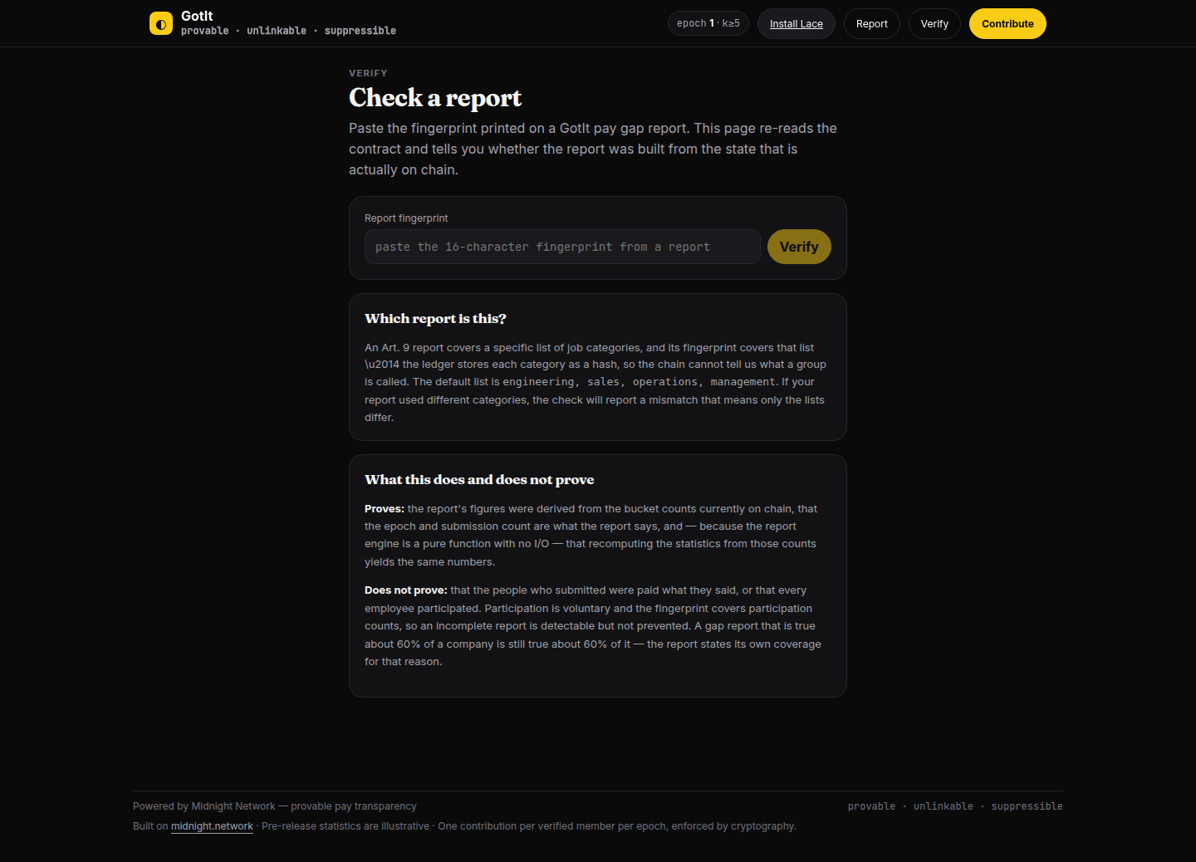
TRUST
Anyone can check it. No wallet, no account.
The employer publishes
Anyone pastes that fingerprint
a report plus a fingerprint taken over the exact bucket counts it was built from.
into the verify page. It re-reads chain state and answers match or mismatch.
What this does and does not prove — stated on the page itself.
Proves the figures were derived from the counts on chain, and that recomputing them yields the same numbers.
Does not prove that anyone was paid what they said, or that everyone participated. Participation is voluntary, so the report states its own coverage.
Verification needs no wallet
GotIt · Midnight Buildathon · Directive (EU) 2023/970 Art. 9
7

Slide 8
WHY US
Without ZK you can have one or the other.
With it, you can have both.
Approach
Proves the data is real
Protects individuals
Note
Payroll spreadsheet
no
no
— it is the raw records
HR survey
no
no
gameable, uneven
“Anonymised” CSV export
no
no
small cells re-identify
Employer attestation
no
depends
it is a promise
Equilux · Wave 1 winner
partial
partial
12 circuits; judge asked for an HRIS plugin
GotIt
yes
yes
verified, gated in-circuit
The honest gap: our issuer still learns who works where. It cannot link a person to their figure, because it never receives the secret that derives the nullifier — but removing it entirely is Wave 3.
GotIt · Midnight Buildathon · Directive (EU) 2023/970 Art. 9
8

Slide 9
CHALLENGES
Five things that were genuinely hard.
Counting meant giving up a Counter. Counter is not readable inside Compact 0.23 circuits — the contract could count but never report. Replaced with a readable singleton cell.
A bucketed mean is not a mean. The first version published point estimates. $124,900 and $100,000 land in the same bucket but are not the same number. Every mean and gap is now an interval.
A midpoint is not a defensible materiality test. Flagging against a midpoint would cry wolf on a compliant category and trigger a joint pay assessment. Only a proven 5% disparity counts.
Hash parity between the browser and the circuits. One drift and a salary lands in the wrong cell, silently. 34 tests run the generated contract to make it impossible.
Our own test suite was validating a stale build. The web tests resolved the shared package to its committed dist/ rather than its source, so 42 of them passed against engine code that had since changed — which is exactly why two headline bugs were invisible to the entire web suite. A green suite that tests the wrong artefact is worse than no suite.
GotIt · Midnight Buildathon · Directive (EU) 2023/970 Art. 9
9

Slide 10
HOW WE LOST WAVE 1
We scored zero of 159. The build was fine.
The submission was not.
An empty section
A placeholder profile
One tag, wrong category
Our “Challenges I ran into” section shipped as five bold headings with no text under them — the only one of 159 like it. Nobody re-reads their own pitch like a judge does.
Community bio: “chill but cool.” No website, no socials. All seven funded teams had a website.
A single `TypeScript` tag, filed under the most crowded category. The field median was five tags.
What changed: a pre-submission gate now fails a pitch with an empty section, a jargon tagline, too few tags or a missing community link. It reports 21 errors against our real Wave 1 draft.
The post-mortem is in the repo: docs/WAVE1-POSTMORTEM.md
GotIt · Midnight Buildathon · Directive (EU) 2023/970 Art. 9
10

Slide 11
ROADMAP
Pay transparency stops being a compliance chore
and becomes infrastructure.
When
What
Status
Wave 2 · due 19 Oct
Deploy v2, the report surface, a public verification page, and named EU pilots.
in progress
Wave 3
Replace the trusted issuer with a Merkle membership proof — so no company learns its own employees' salaries even to verify them.
planned
Wave 3
Read-only connector for the payroll exports companies already produce. Nobody re-keys a year of payroll by hand.
planned
US
EO 14173 pay-scale reporting is back in force since the Fourth Circuit vacated its injunction in Feb 2026, plus ~15 state laws.
opening
Buyer: the Head of Total Rewards at a 150–2,500 person European company. Their project starts now, because they must report on last year.
Live on Midnight Preprod · github.com/PhiBao/gotit · Apache-2.0
gotit · github.com/PhiBao/gotit
11

