Slide 1

Escaper
Phi Bao

Slide 2
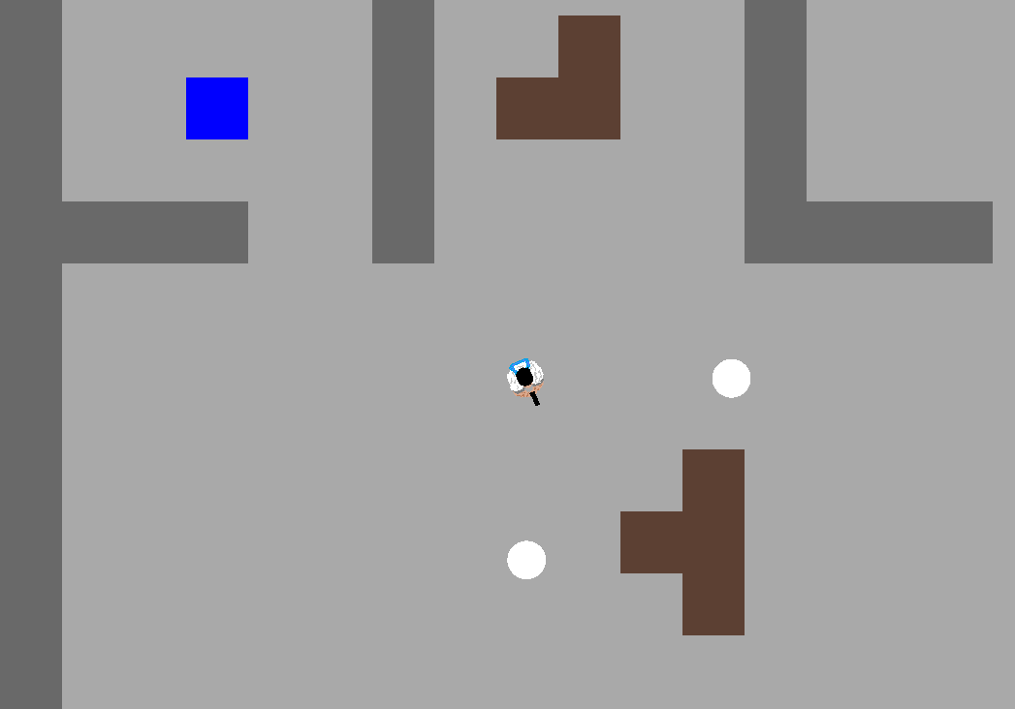
Gameplay
The main object in Escaper is you must find the goal tile which is somewhere in the map.
There will be enemies trying to reach you, and they can travel through wall moving faster compared to the player.
You will have a set of gun to defend yourself from
the swam of enemies.
Current gameplay

Slide 3


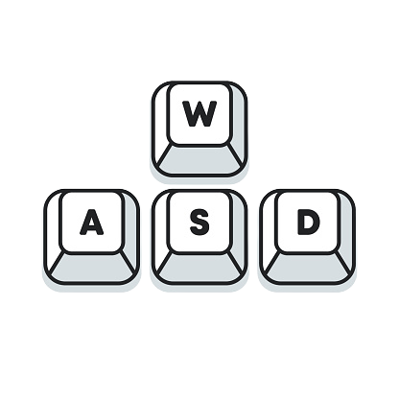
Some of the current basic control
Shoot
Change weapon
Moving Character

Slide 4
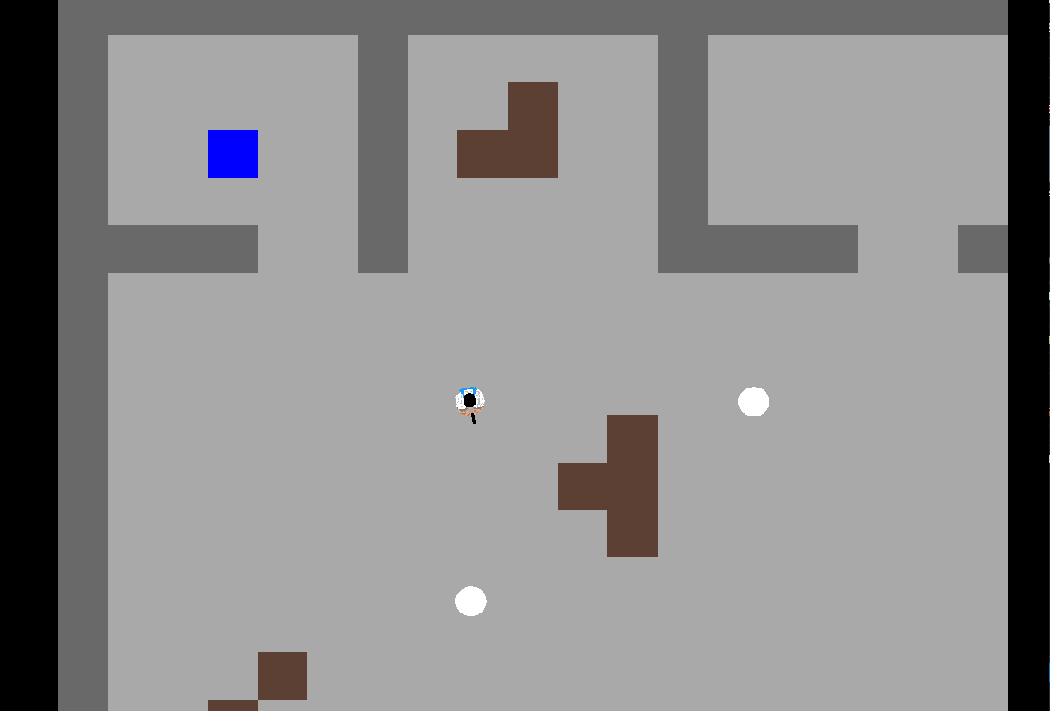

Camera

Slide 5
Thing planning to add
More sprites/ animations
More type of enemies
Gun pickup system
Variety type of gun
Enemy AI

