Slide 1
Use Git
Or any other version control system

Slide 2
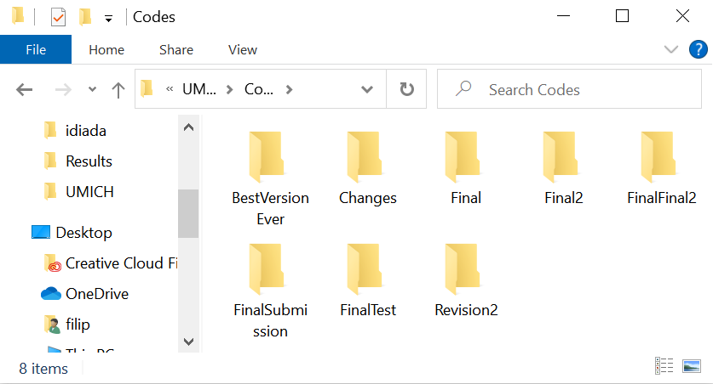
Project organization

Slide 3

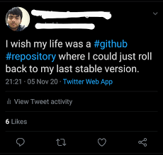
Oh snap!
Made a big oops?
Overwrote an important file?
The project JUST does not run?

Slide 4
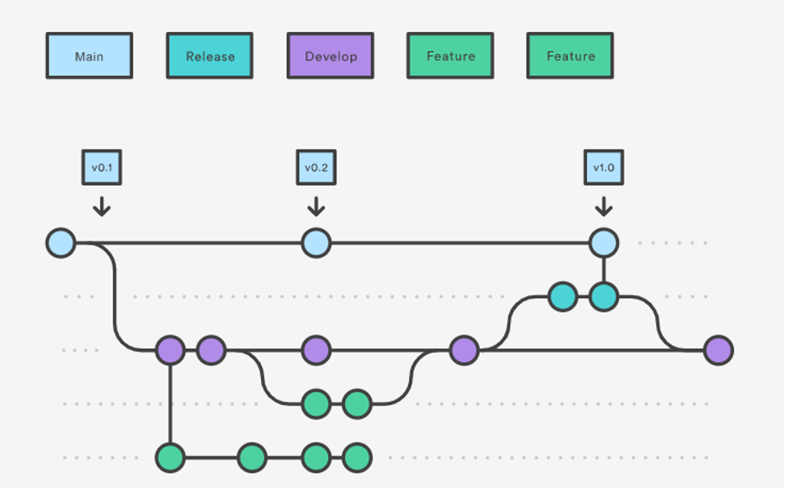
Version hell
Some experiments are dead ends
Still good to keep track of them or reuse just a part
Hell to maintain

Slide 5

No backup

Slide 6
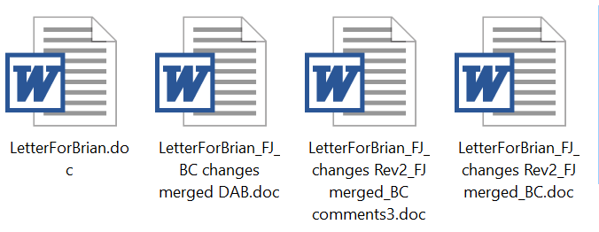

Collaborating nightmare

Slide 7
Making your research „public“
Science must be repeatable
Describe methods, attach source code
  Bug in the methods or in the code
About half of published ODE models are not directly reproducible (Tiwari et al., Mol Syst Biol 2021; 222/455)
  links to old, hard-to-find papers
  Missing equations
  Missing values
  Typos
“The model enclosed is the earliest I have in my files, so it may not duplicate what is in my paper.”
Undisclosed author,
personal communication,
01/05/2022

Slide 8

Version control system
Tracks all the revisions, creates safe „Checkpoints“
Allows organizing the project in multiple (concurrent) branches
Simplifies cooperation
Tag the release version and back it up!

Slide 9
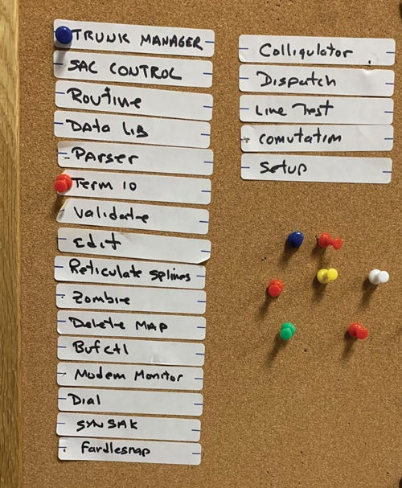
A need for version control systems
Drawer for your punch cards
Bulletin board
Source Code Control System (1972)
CVS (1985)
Subversion (SVN)
…
BitKeeper
GNU Bazaar
Mercurial (2005)
Git (2005)

Slide 10

Use Git!
an unpleasant or contemptible person.
"that mean old git"
Global information tracker (or goddamn idiotic truckload of ****)
Developed to support Linux core development by Linus Torvalds in 2005
Most popular Version control system with collaboration
Don’t get lost in your versions, name them and store them!
Backup and recovery
Sharing and dissemination
It’s easy, it’s open-source, it’s free
It is a necessity!

Slide 11
2005 was not the end of the story
Git won — it is the lingua franca
  GitHub, GitLab, VS Code, MATLAB, every CI system speaks Git
  Learning Git is not a bet on a fashion
But development did not stop: Jujutsu (jj) is the current serious contender
  Simpler model — no staging area, every change is already a commit, undo anything
  Uses a Git repository as its backend: same .git, same remotes, same GitHub
  Your collaborators cannot tell which one you used
Takeaway: learn the data model — commits, branches, remotes
  It outlives the tool. Not today, though — learn Git first.
Notes:
One minute. Point: the field is alive, but Git is the interchange format. jj is Git-compatible, so nothing you learn today is wasted.

Slide 12
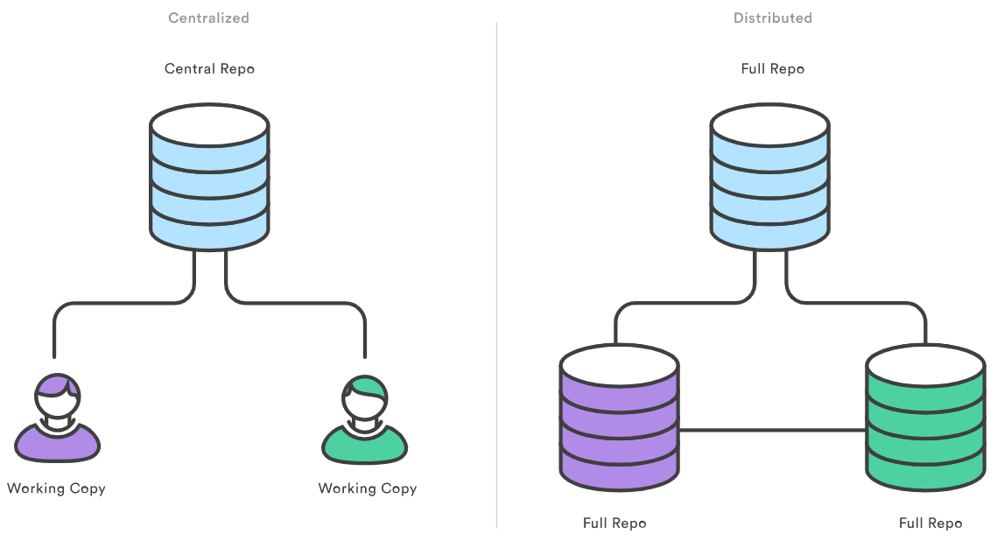



What is a Git Repository?
Repository: history and branches
Working copy: files on the drive
(usually in hidden subfolder, e.g. .git)
Just a folder with some extras..

Slide 13
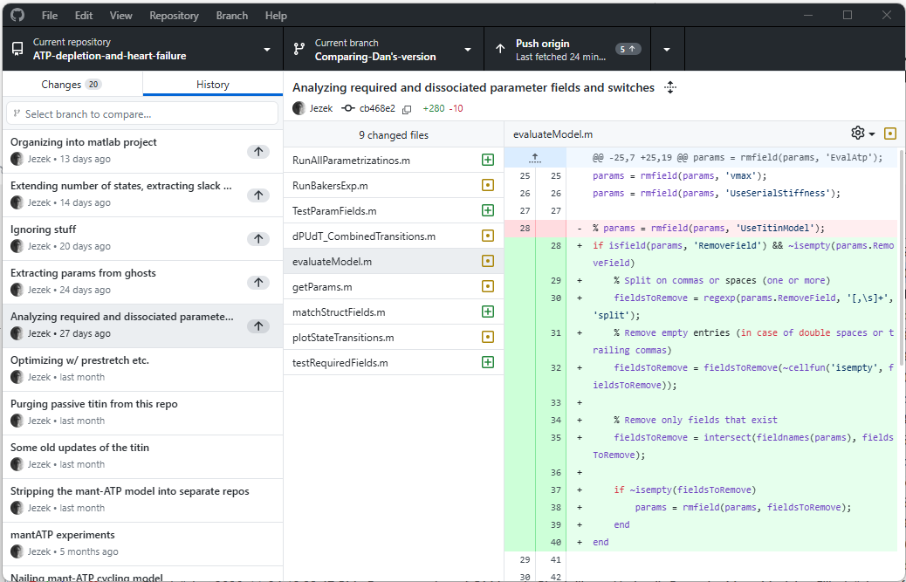
Repository log – take me to the past and back

Slide 14
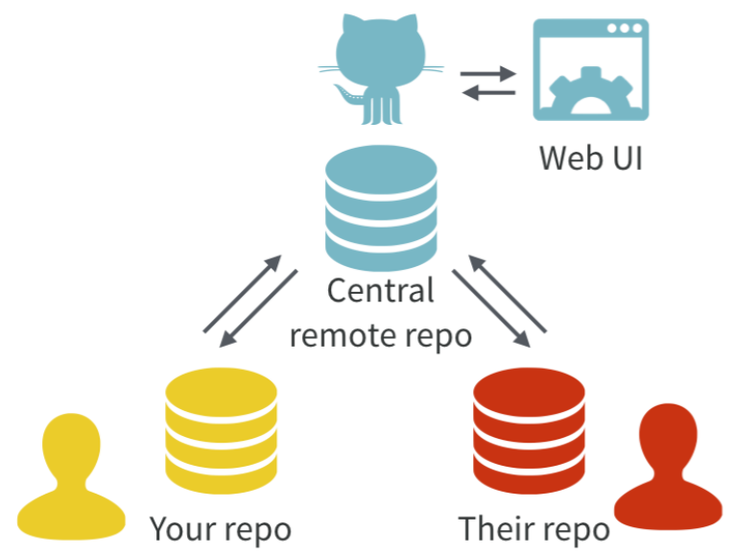
Centralized and distributed repositories and GitHub (1 of 2)
Centralized repositories:
All history on ONE place
(CVS, SVN…)
Users pull working copies
Distributed repositories: Full history locally
(local repositories)
Users synchronize their versions using pull / push
        (Git, Mercurial…)
GitHub (GitLab) adds WebUI to the server
https://www.atlassian.com/git/tutorials/why-git
https://doi.org/10.7287/peerj.preprints.3159v2

Slide 15

Centralized and distributed repositories and GitHub (2 of 2)
Centralized repositories:
All history on ONE place
(CVS, SVN…)
Users pull working copies
Distributed repositories: Full history locally
(local repositories)
Users synchronize their versions using pull / push
        (Git, Mercurial…)
GitHub (GitLab) adds WebUI to the server
https://www.atlassian.com/git/tutorials/why-git
https://doi.org/10.7287/peerj.preprints.3159v2

Slide 16
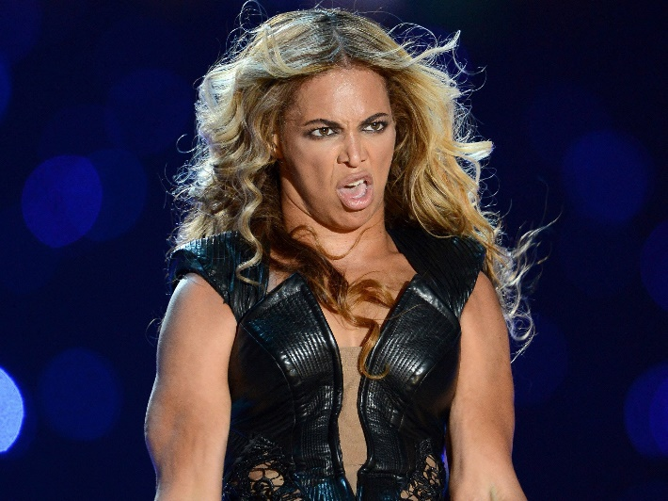
Distributed repositories
Everyone retains a copy of ALL history
  What has been done, can’t be undone*
  Careful with passwords etc. – Internet never forgets!
Synchronization
  1) Pull – update local repo
  2) Merge local – sort out the conflicts
  3) Push – update server, conflict-free
Pic of Beyonce, legally removed from the internet
* Terms and conditions apply – e.g. force push etc

Slide 17

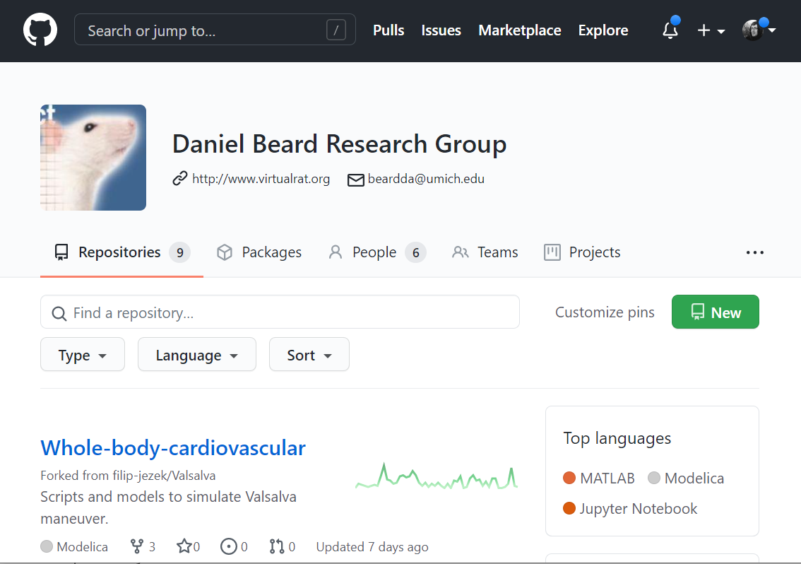
GitHub
A public, free git repository hosting (one of many)
Reliable, trusted, owned by Microsoft
Public repositories with unlimited collaborators
Unlimited private repositories, free, with unlimited collaborators (since 2020)
We already have the Beard lab on GitHub
UMICH has enterprise license U-M ITS GitHub service page

Slide 18

GitLab
Open source repository hosting, Hosted by many free and paid services
Unlimited private repositories, collaborators, etc..
UMICH ran a GitLab pilot — retired July 2023, everything moved to GitHub

Slide 19

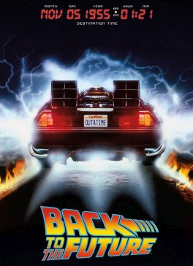

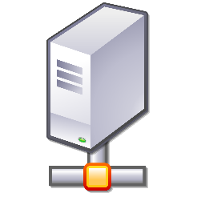

Process
DO THIS AS OFTEN AS POSSIBLE
File system
Local
Repository
Remote
Repository
Stage
Commit
Pull
Push
Do this for collaboration and backup

Slide 20
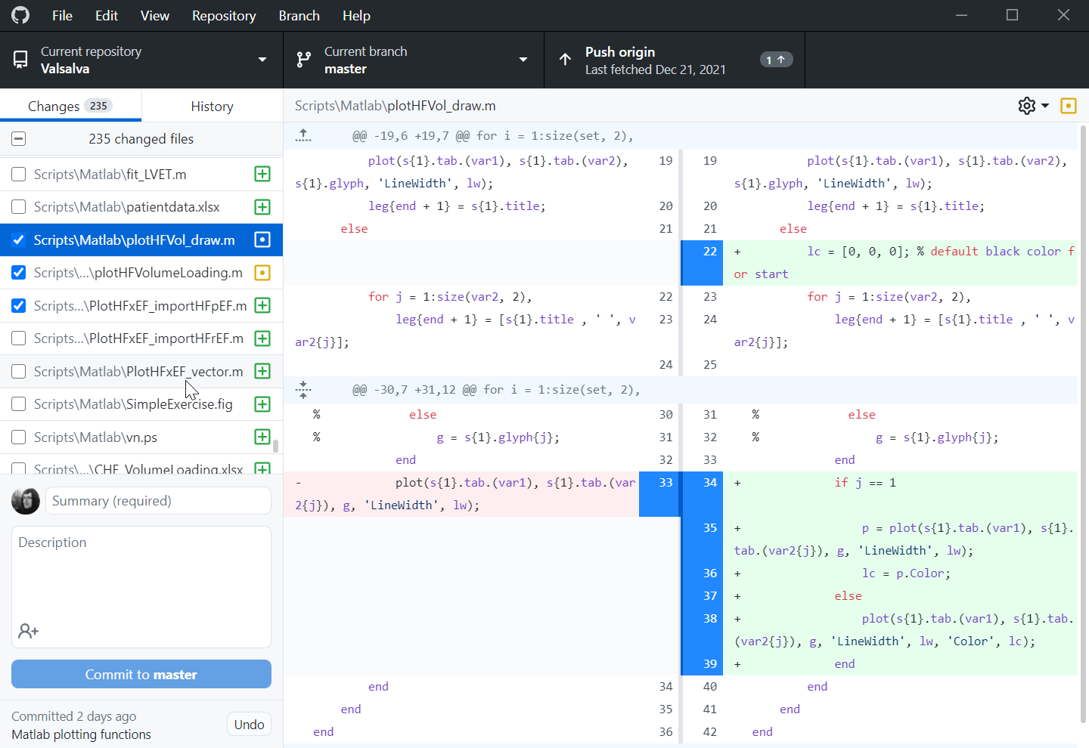
Process - stage
Selecting changes
  Adding new files
  Selecting changed files (or parts)

Slide 21
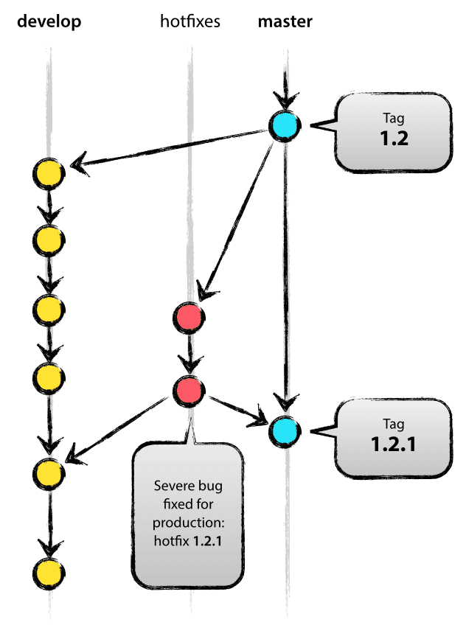
Process – COMMIT
Add a commit summary*
Commiting the changes into LOCAL repository
  Safe checkpoint
  On top of current BRANCH
  Or to a NEW branch
Roll back to any previous commit
Compare with any previous commit

Slide 22
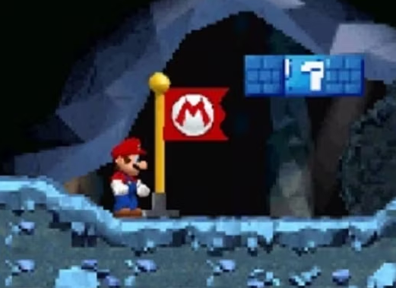
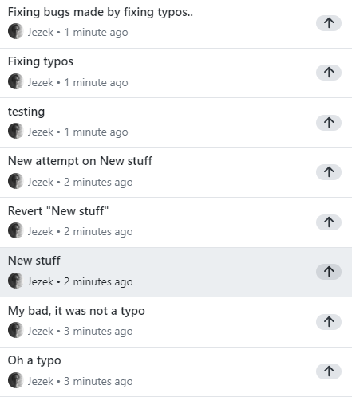
Process – COMMIT = safe checkpoint
DO NOT be afraid of dumb commits
All of them might be useful checkpoints
All opensource projects do that – it is no shame
You can use squash before pushing

Slide 23
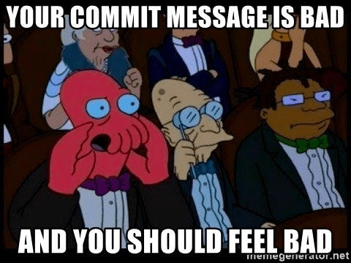
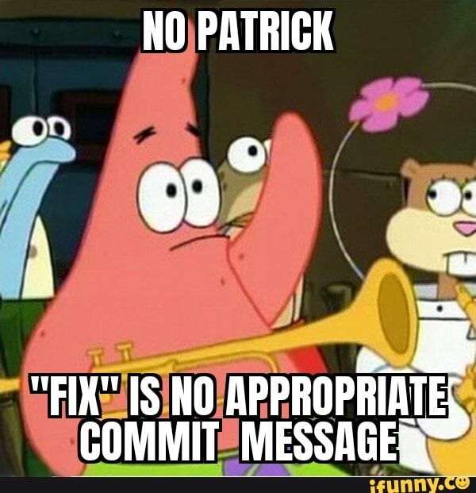
Process – COMMIT: Summary
Commit message (Summary) required
Try to be specific and concise,
your future self will thank you
E.g.
Fix typo in ReadMe
Adding project1 data files
Fix crashing during simulation
Use Description to provide further context, e.g.
Setting step size > 0.2 results in a crash

Slide 24
Process - PUSH
Pushing our LOCAL repository to the REMOTE repository
  Could have more remotes
  What if the REMOTE version is newer?
    Need to pull (aka fetch) first
    Merge and sort the conflicts on OUR side
Local
Repository
Remote
Repository
Pull
Push

Slide 25
Process - PULL
Pulling from the REMOTE server into LOCAL repository, updating the files
  Can have more remotes
  What if we made some changes?
Resolve conflicts, if present
(Fetch - just sync’s the repo, no merge)
Local
Repository
Remote
Repository
Pull
Push

Slide 26
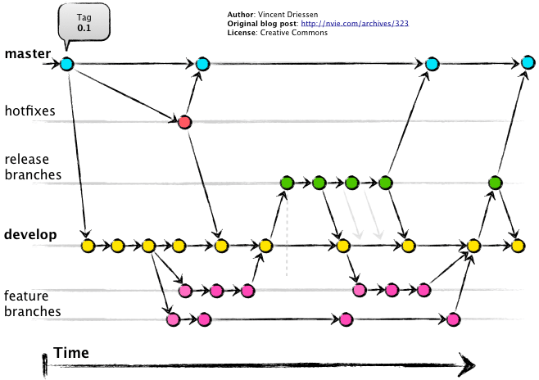
Branching
Each commit is a snapshot in time
  Everything is checksummed with a SHA hash, with a custom label
  (commit name)
  Has one or two parents
Branch is a pointer to a commit
  Most recent commit in a branch
  Default name:
  “master”, “main” or
  “CommitMcCommitFace”
Branches are meant to merge
Do not have to overuse with
GitHub

Slide 27
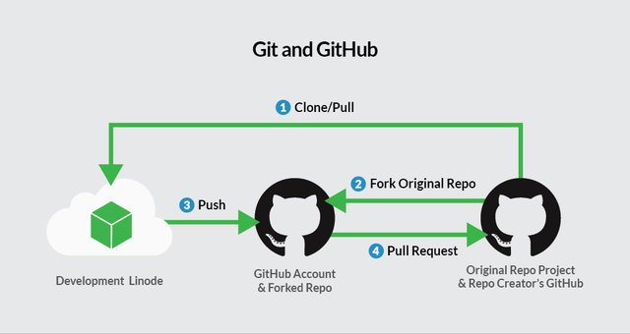
Collaboration
Collaborators in your group share the same remote
  Write access?
Outside collaborators for open-source project
  Use GitHub’s pull request features:
  Collaborator:
    Makes a copy (Fork) of the repo
    Commits his changes
    Issues pull request
  Maintainer:
    Reviews and merges the changes

Slide 28
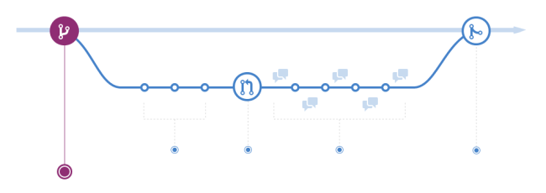
Pull requests
Open the code to wide public, incl. non-collaborators
  Still prevent them from messing your code
“Hey, I fixed your code, wanna merge?”
You are sharing your code, Bob checks it out (forks).
Fork is Bobs version (= Bob’s branch)
Bob makes some changes and commits to his repository (which is a branch of your repository).
Bob finalizes his codes.
Bob can’t rewrite your code,
issues a pull request
You check his changes and merge

Slide 29
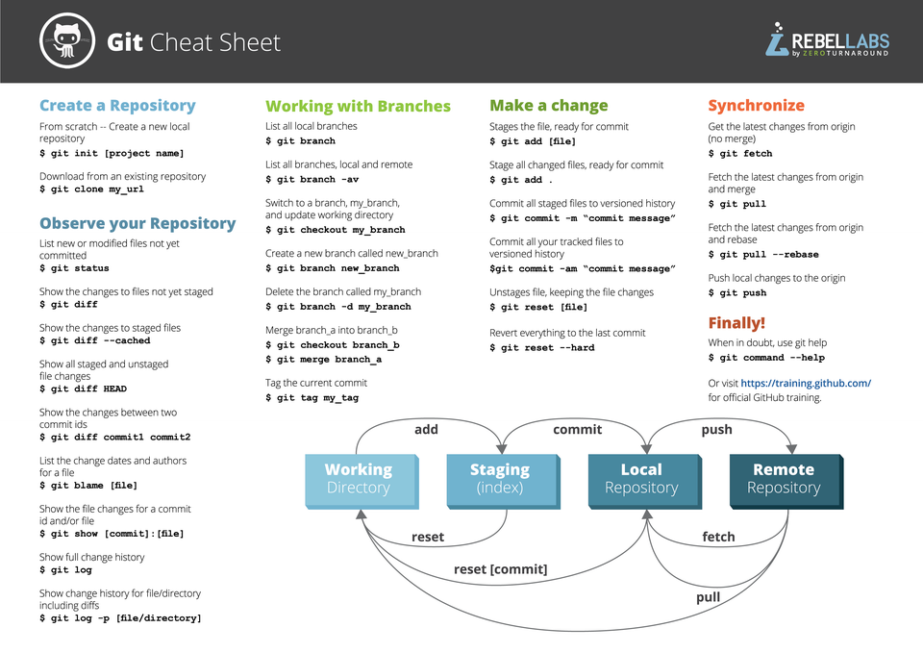
Client tools
Git GUI clients (git-scm.com)
Command line?
  git-scm.com
Windows
  TortoiseGit + Git for Windows
  GitHub Desktop
MacOs
  GitHub Desktop
  …
Integrated into Matlab, VS Code…

Slide 30
GUI or command line? It is the same Git
Git is one program. Every GUI is a layer on top of it — it types the commands for you
  GitHub Desktop ships its own copy of Git inside
  Install Git for Windows and VS Code, MATLAB, RStudio, TortoiseGit all share that one
  So it is never GUI versus CLI — you always have both installed
The GUI wins at: staging individual lines, reading a diff, browsing history, resolving conflicts
The command line wins at: the cluster (Great Lakes has no GUI), scripting, AI,
  and every answer you will ever find online
Recommendation: click in the GUI — but know which command each button is running.
  That is what lets you ask a useful question when it breaks.
Notes:
Honest framing: I use GitHub Desktop for nearly everything. But the day you SSH into Great Lakes, or paste an error into a search box, the GUI cannot help you.

Slide 31
The command card
Command | What it does | In GitHub Desktop
git clone <url> | Copy a remote repo to your machine (once) | File ▸ Clone repository
git status | What changed, what is staged, what to do next | …is the whole left panel
git add <file> / -p | Stage a file / selected lines | Tick the checkbox / select lines
git commit -m "…" | Checkpoint — local only | Commit to main
git log --oneline --graph --all | See the history as a graph | History tab
git diff / --staged | What exactly changed | The diff pane
git pull | Fetch the remote and merge it into your branch | Pull origin
git push | Publish your commits | Push origin
git switch <br> / -c <new> | Change branch / create one | Current branch menu
git restore <file> | Throw away your changes to a file | Discard changes
git reflog | Everywhere HEAD has been — your safety net | (no equivalent)
If you remember one line: git status. It tells you where you are and usually prints the next command for you.
Notes:
If they remember one line: git status. It tells you the state and usually prints the exact command you need next.

Slide 32
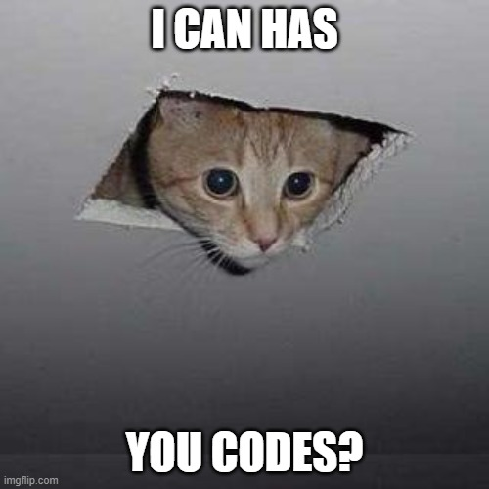
What to version control?
Anything plaintext, that you develop in time
  Track your progress, tag a release
Required data and supporting files (<100 MB !)
  Skip intermediate, generated files
Public stuff and Private stuff (GitHub)
  Top secret stuff? (own Git server?)
Have codes? Make a repository!
Working on code? Commit and push!
“Publish only finished” ?
  A project is never final

Slide 33
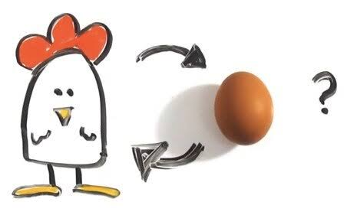
Source or product?
One question decides
Ask of every file: if I delete it, can the repo regenerate it? Is there a path to run WITHOUT it?
  Yes → it is a product. Do not commit.
  No → it is a source. Commit it.
Why products stay out
  They change on every run → diff noise, and Git keeps every version forever
  They invite the worst bug in science: the code and the result quietly disagree
A third category: local settings — true for you, wrong for everybody else
  .vscode/, .idea/, machine-specific paths, .env, MATLAB startup.m paths
So: commit the recipe, not the cake.
Notes:
The single rule of the lecture on this topic. Regenerable = out. Ask the room for examples from their own projects.

Slide 34
Your files, specifically
File | Commit? | Why
.m .py .mo .jl | Yes | Plaintext source — diffs line by line, merges cleanly
.ipynb | Yes, stripped | It is JSON — but stored outputs make diffs unreadable. Use nbstripout or Jupytext
.mlx .slx | Yes, if it IS the model | Binary: no line diff, no merge. MATLAB has its own Compare tool
.mat | It depends | Small fixed input data: yes. Simulation output: no — it is a product
Figures .png .pdf | No, if generated | Commit the script that draws them. Hand-drawn schematics: yes
.DS_Store Thumbs.db | Never | OS junk. The classic impostor — it is already in our course repo
.vscode/ .idea/ .env | No | Local settings and secrets
data/ (large) | No | See “Where does the data go?”
Notes:
Live moment: show them the .DS_Store sitting in beards-lab/Phys520. It got there because someone on a Mac committed everything blindly.

Slide 35

Where does the data go?
Git was built for source code: many small text files, changed line by line
  A 2 GB .mat changed twice = 4 GB of history, in every clone, forever
  GitHub:
  File 50 MB (warning), 100 MB (hard limit),
  Repository: warning past 1 GB, keep a repo under ~5 GB
Options, in the order you should consider them
  Small and stable (< ~10 MB) → just commit it. Best case: data lives with the code
  Zenodo / Figshare / Dryad / PhysioNet → a data deposit with its own DOI. Citable, archival, what a reviewer expects
  Git LFS → pointer in Git, file on a server. Works; quota-limited; adds friction
  DVC → data version control layered on Git, backed by S3 / Drive / campus storage
For this course: keep data out of the repo, script the download, and record the DOI and a checksum in the README.
Ignore the large files from Git stage
Notes:
The point is not that one tool wins — it is that 'just commit everything' has a size at which it stops working, and they will hit it.

Slide 36
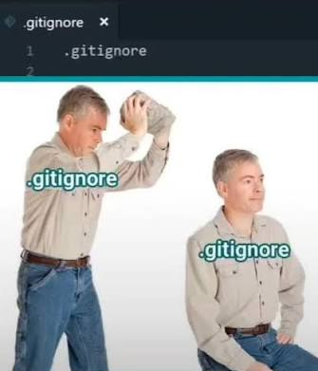
.gitignore: how to actually write one
A plaintext file in the repo root — and it is versioned too, so everyone gets it
One pattern per line:
# comment
* wildcard
trailing / = folder
leading / = root only
! un-ignores
Two traps
  .gitignore does not untrack what is already committed → git rm --cached bigfile.mat
  Ignored files are invisible to Git: no backup, no revert, gone on a fresh clone
A starter for this course:
  Matlab:
  *.mat
  results/
  figures/
  *.asv
  slprj/
  *.mexw64
  Python:
  __pycache__/
  .ipynb_checkpoints/
  *.egg-info/
  .venv/
  General:
  .DS_Store
  Thumbs.db
  desktop.ini
  .vscode/
  .idea/
  .env
  data/
  !data/reference_values.mat # keep this one anyway
Notes:
github.com/github/gitignore has ready-made templates for Python, MATLAB, macOS and Windows — tell them to start there and add to it.

Slide 37
Secrets: the one thing you cannot take back
Passwords, API tokens, licence keys, patient data, unpublished data
Once pushed, it is on GitHub's servers, in every clone and every fork
  Deleting the file does not help — the old version is still in the history
  Rewriting history does not reach forks, caches, or anyone who already pulled
GitHub now scans pushes to public repos and blocks known secret formats
  Helpful, but it only knows the patterns it knows. It will not catch your data.
If it happens: rotate the credential first. Rewriting history is the second step, not the first.
Prevention: keep secrets in a config file or environment variable, and ignore that file
Notes:
Tie back to the Beyoncé slide. Emphasise: the fix is revoking the key, not cleaning the repo — by the time you notice, assume it is compromised.

Slide 38
Worktrees: several working copies at once
The situation: you are mid-experiment, the code half works — and you need the working version to compare against, or to review a colleague's pull request
  So far your options were: commit garbage, stash, or clone the whole repo again
A worktree is a second folder on disk, on a different branch, sharing one repository and one history
  No second clone, no duplicated history, nothing re-downloaded
  Commit in either folder — it is the same repository
Why this matters for modelling
  Run the old and the new model side by side, two MATLAB/Python sessions, and diff the outputs
  Let a long simulation keep running on main while you edit a branch
  Review a PR without destroying your working state
Limit: the same branch cannot be checked out in two worktrees at once
Notes:
This is the slide that sells worktrees to a modelling audience: comparing two model versions numerically is a daily task, and it normally means two clones.

Slide 39
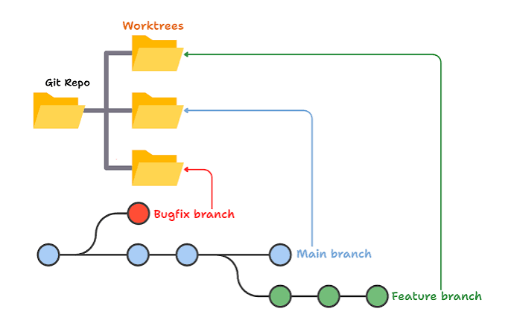
Worktrees: how
GitHub Desktop 3.6 (June 2026) added them — it is no longer CLI-only
  Repository ▸ New Worktree… → give it a name; leave the branch blank to make a new one
  A Current Worktree menu appears next to Current Repository and Current Branch
  Switching worktree switches the folder and the branch together — that is the whole idea
  Right-click a linked worktree ▸ Delete… (it refuses if you have uncommitted changes)
  You cannot rename or delete the main worktree
Command line
  git worktree add ../proj-main main
  git worktree list
  git worktree remove ../proj-main
Rule of thumb: put them next to the repo, never inside it, and delete them when done.
Notes:
Inside the repo they would show up as untracked files. Next to it, e.g. Phys520/ and Phys520-main/.

Slide 40

A repo somebody can actually reuse
README.md — what it is, how to run it, what to cite. The only file everyone reads
LICENSE — without one, nobody may legally reuse your code, public or not
  Research code: MIT or BSD-3-Clause. GitHub adds one for you in two clicks
CITATION.cff — GitHub turns it into a “Cite this repository” button
The environment — requirements.txt / environment.yml, or MATLAB version + toolbox list
One script that reproduces the main figure, end to end, from a fresh clone
A tag on the version that matches the paper: git tag -a v1.0-paper -m "MSB submission"
Test: hand the URL to a labmate and say nothing. If they get your figure, you are done.
Notes:
Connect to the Tiwari 2021 number from the motivation slide: about half of published ODE models were not directly reproducible. This checklist is the difference.

Slide 41
From repo to citable DOI (Zenodo)
A GitHub link is not archival — repos get renamed, made private, rewritten, deleted
Journals and reviewers increasingly ask for a persistent identifier
Once: log in to zenodo.org with your GitHub account, flip the switch for the repository
Then: publish a Release on GitHub → Zenodo archives that snapshot and mints a DOI
  A concept DOI that always points at the latest version
  A version DOI for this exact snapshot — that is the one you cite in the methods
Put the DOI badge at the top of the README
Zenodo is run by CERN and keeps the archive even if the GitHub repo disappears
Notes:
Two minutes, live if the wifi holds. This is the concrete answer to the 'make your research public' slide they just saw.

Slide 42

Git in the age of AI assistants
Assistants now edit many files at once, and you typed none of it
That makes version control more important, not less:
  Commit before you let an agent loose. That commit is your undo button
  git diff is how you actually review what it wrote — never accept what you have not read
  Small commits → small diffs → reviewable. Large diffs get rubber-stamped
The tooling has followed: GitHub Desktop 3.6 drafts commit messages and helps explain merge conflicts; pull-request review has AI assistance built in
Two cautions
  A generated commit message says what changed. Only you can say why
  Licences, secrets, and correctness are still yours — it is your name on the commit
And the instruction files (AGENTS.md, .github/copilot-instructions.md) are source too — commit them.
Notes:
Land the motivation: the reason to use Git in 2026 is stronger than in 2015, because you are now reviewing changes you did not write.

Slide 43
I messed up. What now?
Situation | Fix | Notes
Wrong commit message (not pushed) | git commit --amend | GUI: right-click the last commit ▸ Amend
Staged the wrong file | git restore --staged <file> | GUI: untick it
Throw away edits to a file | git restore <file> | GUI: Discard changes. Not recoverable
Undo last commit, keep the edits | git reset --soft HEAD~1 | GUI: Undo commit
Undo last commit and the edits | git reset --hard HEAD~1 | Only if it was never pushed
Already pushed — undo it | git revert <commit> | Makes a new, opposite commit. Safe for others
Just look at an old version | git switch --detach <commit> | Look, do not edit
Continue from an old commit | git switch -c fix <commit> | Full working state, new branch
“I destroyed everything” | git reflog | Every HEAD you have had, ~90 days. Find the hash, branch to it
Committed a huge or secret file | git rm --cached <file> | Rotate the secret first, then rewrite history
The rule: anything committed can be recovered. Anything never committed cannot. That is the whole argument for committing often.
Notes:
The one rule: anything COMMITTED can be recovered. Anything never committed cannot. That is the argument for committing often.

Slide 44
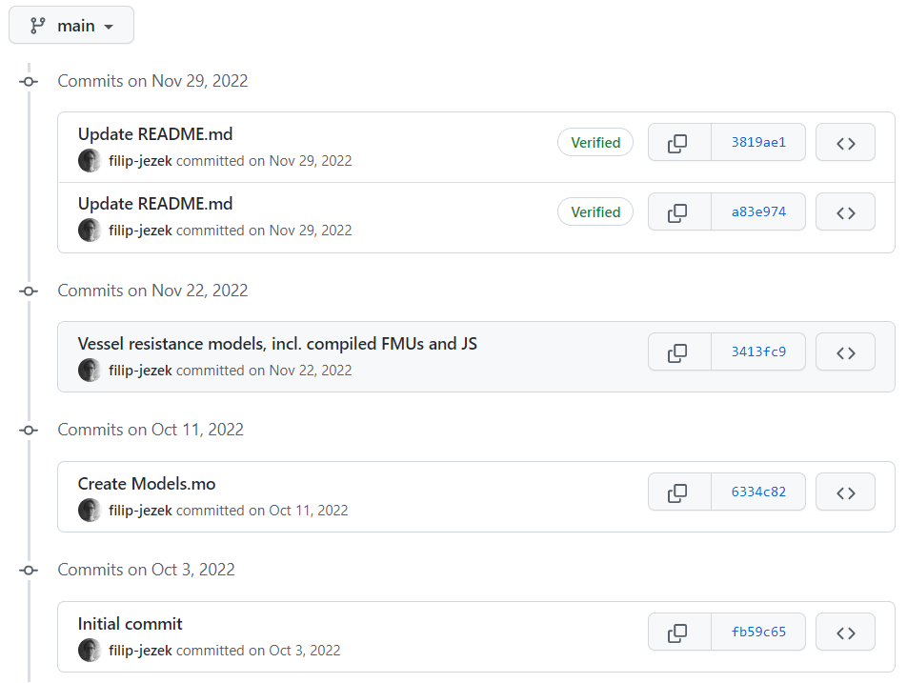
GIT: Get organized!

Slide 45
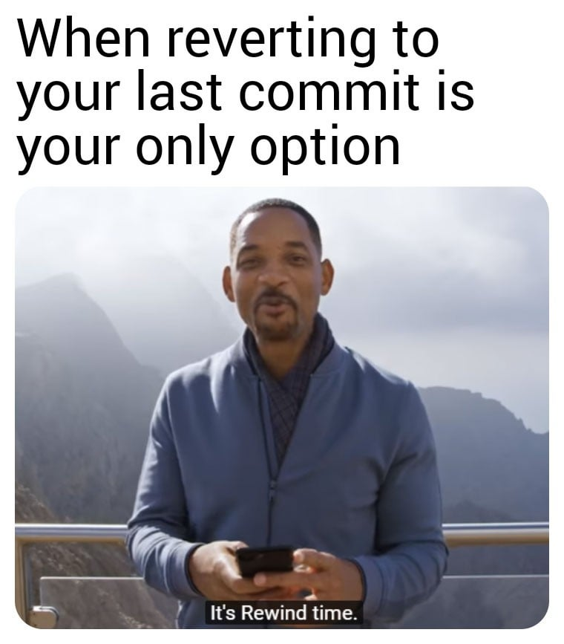
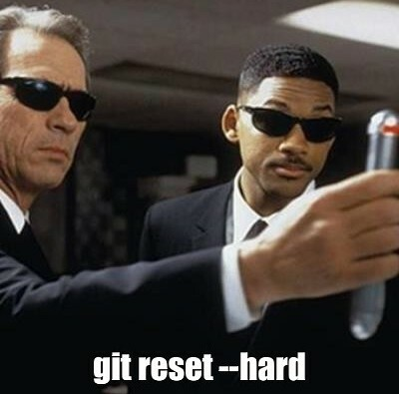
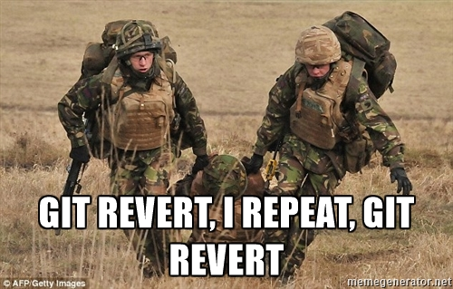
Git: Prepare for a mistake!
Made a big oops?
Overwrote an important file?
The project JUST does not run?

Slide 46
GIT: More versions of the same project
Hell to maintain?
Branches might merge back when successful, or die out

Slide 47


GIT: Get backed up!
GitHub:
Do not forget about the data!

Slide 48
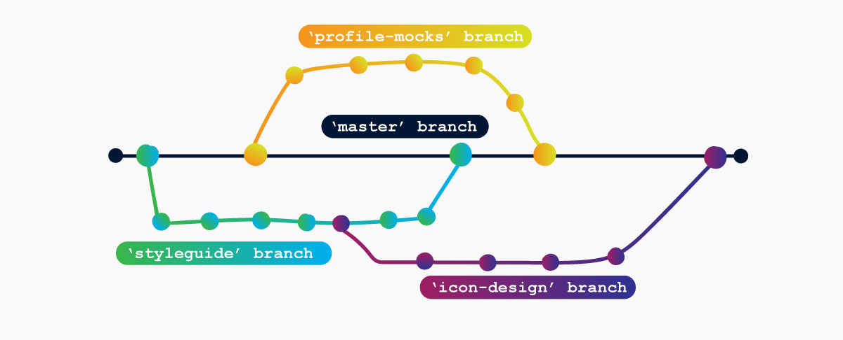
Git: Collaborate!
Invited collaborators
Pull requests from wide public

Slide 49
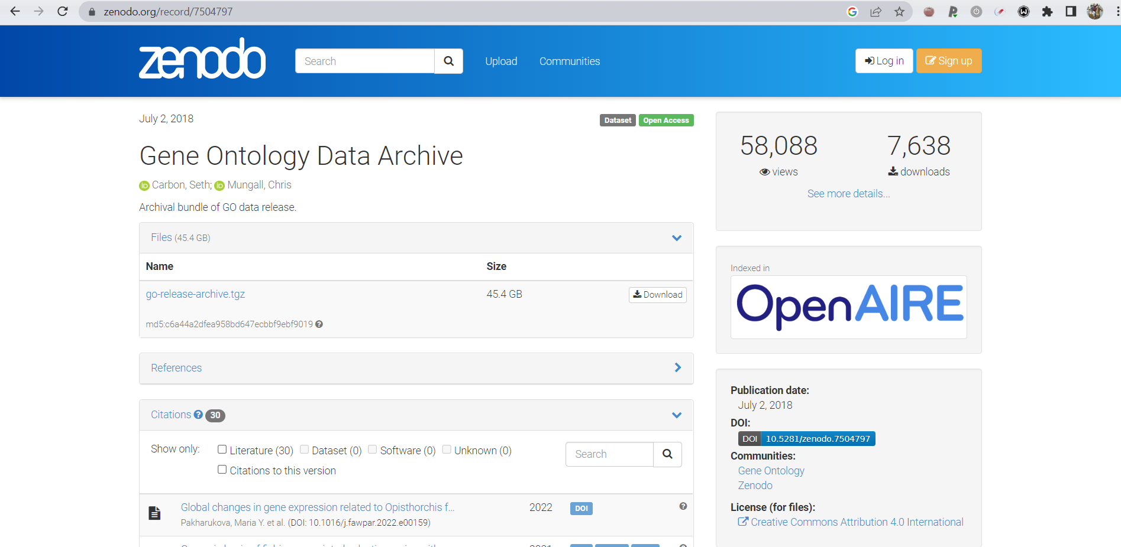
Git: Make your research public
A link to GitHub would do too
Dedicated storage repository - Zenodo - pin a release

Slide 50
Hands on

Slide 51
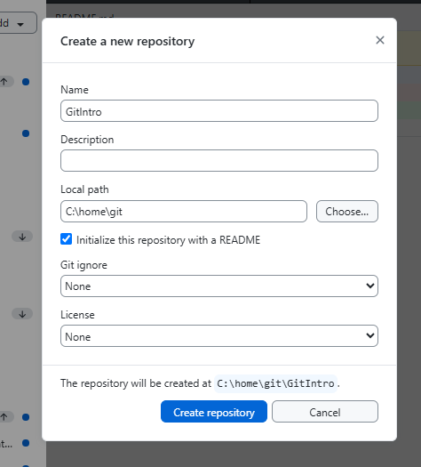
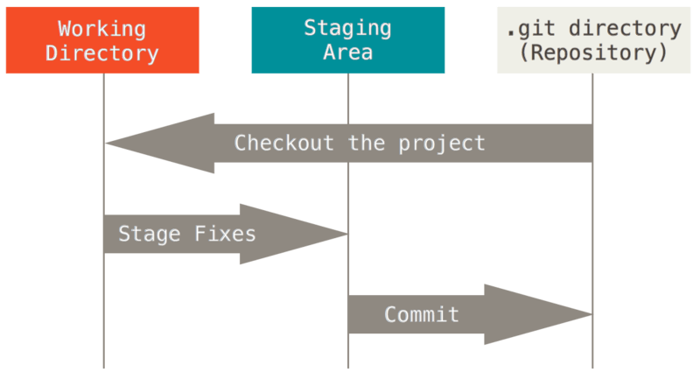
First commit, where we initialize
Initialize a new repository
Add a readme.md file, write down the “Hello world” line
Git commit
  Staging level
  Commit message
Pro Git book (free online)

Slide 52
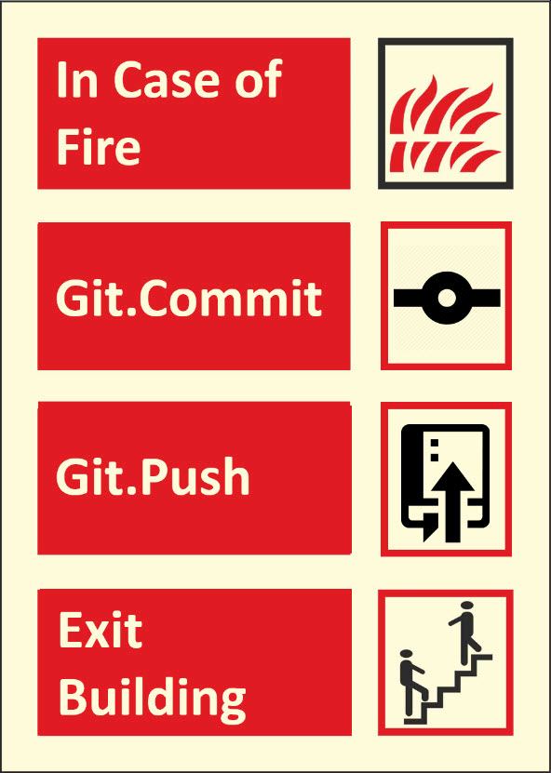
Second commit, where we extend and ignore
Add a line to the readme.md below the hello world:
“This is our testing repository”
Add data/topsecretfile.md
Add generatedfile.mat
Add .gitignore file
  Data/
  *.mat
Commit
Push (publish)

Slide 53


.gitignore
Commit only the sources,
not the products
  Ignore output and intermediate files
  NO secret data not to be shared
=> Ignore staging
.gitignore
  A specialized file stores what should be ignored at staging
  also versioned, can be ignored :)
  In any folder
  Names: topsecretfile.txt
  Wildcards: /*.mat
IGNORED FILES LIVE ONLY IN YOUR FOLDER
NO DISCARD
NO REVERT
NO CONTROL ON BRANCH SWITCH

Slide 54
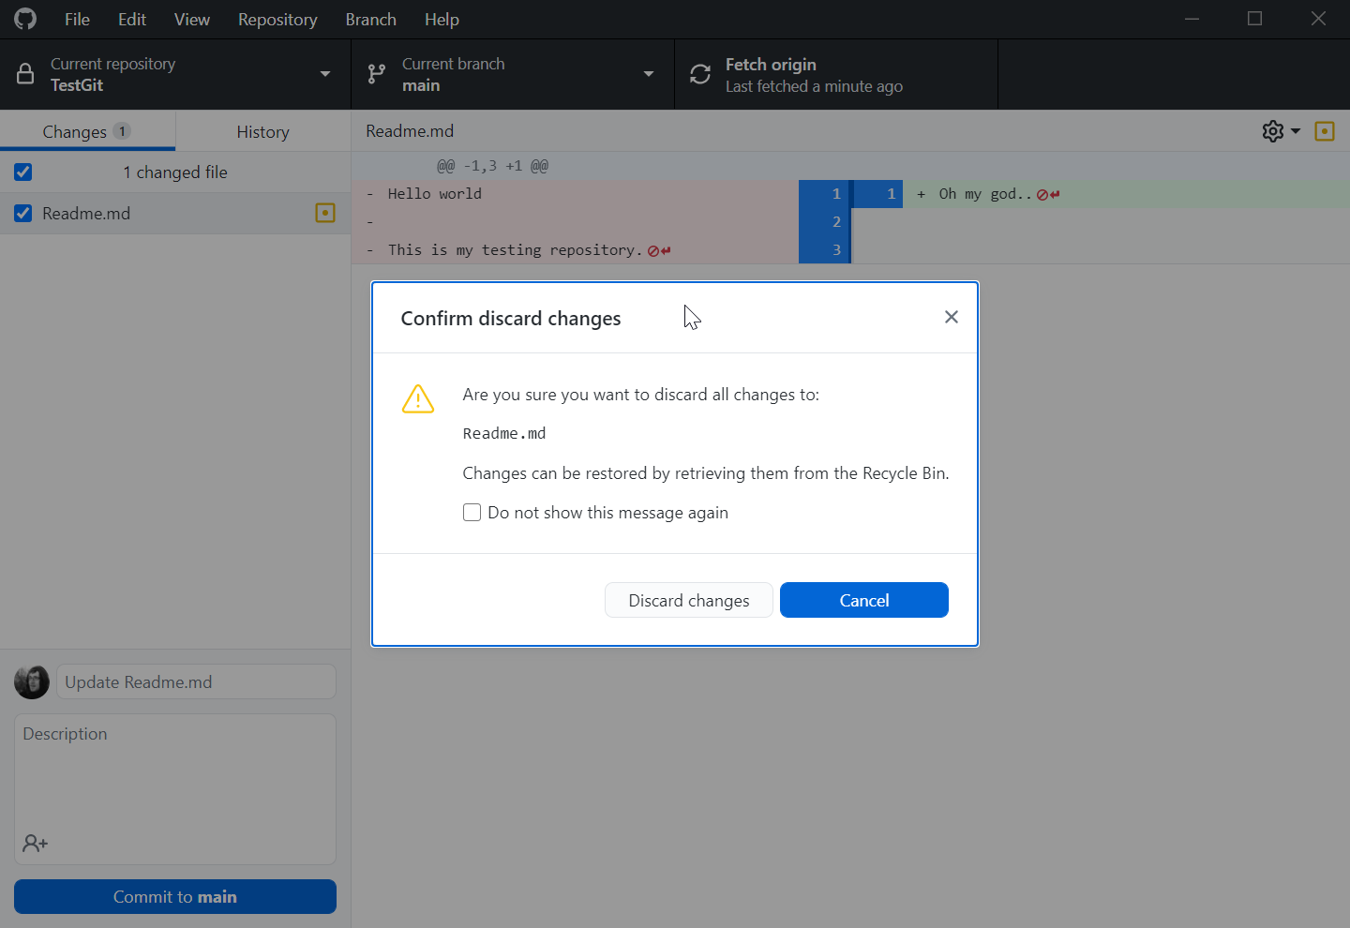
Third commit, where we mess up
Delete the content of the readme.md
  Discard changes
Mess up again and commit (locally)
  Undo commit (if it was not pushed)
    The files stay modified
  Reset to… (if it was not pushed)
    The files get reset too
After Push
  Revert the changes (not always convenient)
  Check out (always there)
  Make a branch on previous commit
  (Full working state)

Slide 55
How GitHub knows it is you
Your GitHub password has not worked for git since 2021. Pick one of these:
Browser sign-in via GitHub Desktop or VS Code — easiest, do this first
Personal Access Token (PAT) — a long password with a scope and an expiry, used over HTTPS
  Git Credential Manager stores it so you type it once
SSH key — a key pair; the right choice on Great Lakes and for long-term use
  ssh-keygen -t ed25519 → paste the .pub file into GitHub ▸ Settings ▸ SSH keys
GitHub CLI — gh auth login sets all of the above up for you
2FA is mandatory on GitHub. Set up the authenticator app now and save the recovery codes.
Not the same thing: user.name / user.email only label your commits.
  Use your @umich.edu address so your commits are attributed to you.
Notes:
This is where hands-on sessions die. That is why it is homework: account + 2FA + signed-in GitHub Desktop before the next session.

Slide 56
Homework before the hands-on
1. Create a GitHub account — use your @umich.edu address
  It unlocks the Student Developer Pack; pick a username you would show an employer
2. Turn on two-factor authentication and save the recovery codes
3. Install GitHub Desktop (desktop.github.com) and sign in
  Check it works: File ▸ Clone repository — you should see repositories listed
4. Recommended: install Git for Windows / check git --version on macOS or Linux
5. Send me your GitHub username so you get access to beards-lab/Phys520
Bring a laptop you are allowed to install software on.
Do not leave this to the morning of the session — account setup is where these sessions die.
Notes:
Read this one out loud and put it in the course announcement too.

Slide 57

Get GitHub Desktop
Get GitHub Desktop
(or any other git client)

Slide 58

That’s it!
… let’s see some advanced stuff with branching next time!

