Slide 1

SMART FIRE ALARM
BY: CLELAND AYENSU PHILEMON FRED KLENAM

Slide 2
A fire alarm system is designed to alert us to an emergency so that we can take action to protect ourselves when smoke, fire or carbon dioxide is detected.

Slide 3
Aim of the project
The aim of this project is to detect smoke and alert people to an emergency
Signal will be sent to a pump through a relay to move water from its original source to quench any existing fire
A message will be sent to the victim/owner of property when the smoke is detected.

Slide 4
COMPONENTS
HARDWARE
ESP32
MQ2 sensor
RGB LED
Relay
Pump
Buzzer
SOFTWARE
IFTTT

Slide 5
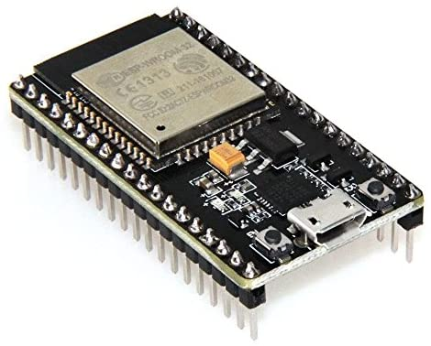


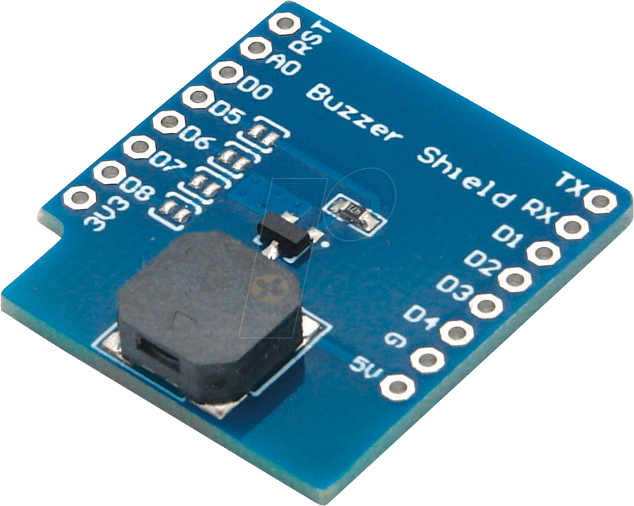




Slide 6


Slide 7


Slide 8
BLOCK DIAGRAM
START
IF SMOKE IS DETECTED
LED turns Red
Buzzer beeps
Signal is sent to the pump
Send message

Slide 9
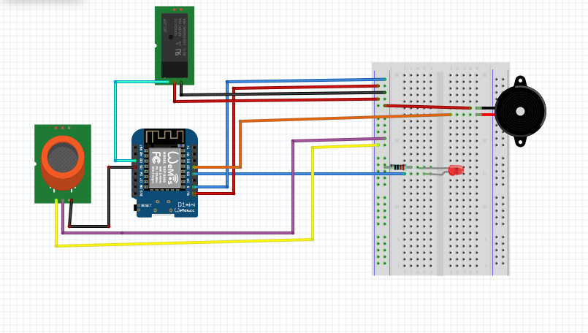
SCHEMATIC DIAGRAM

