Slide 1







Target Layer
Protection Method
Criteria Layer
Landmark Age
Landmark Size
Number of Visitors
Protection Costs
Solution Layer
On-Site Protection
Relocation Protection

Slide 2
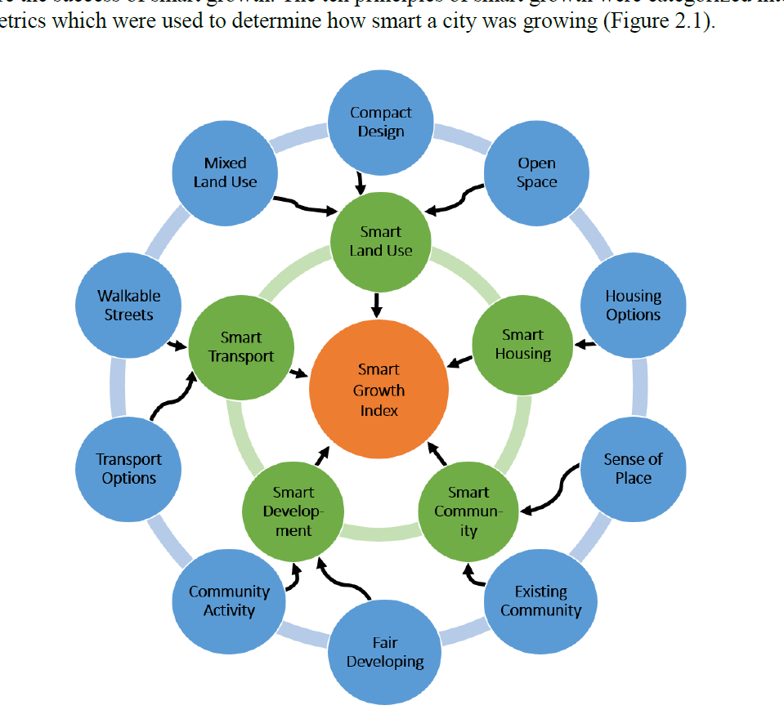
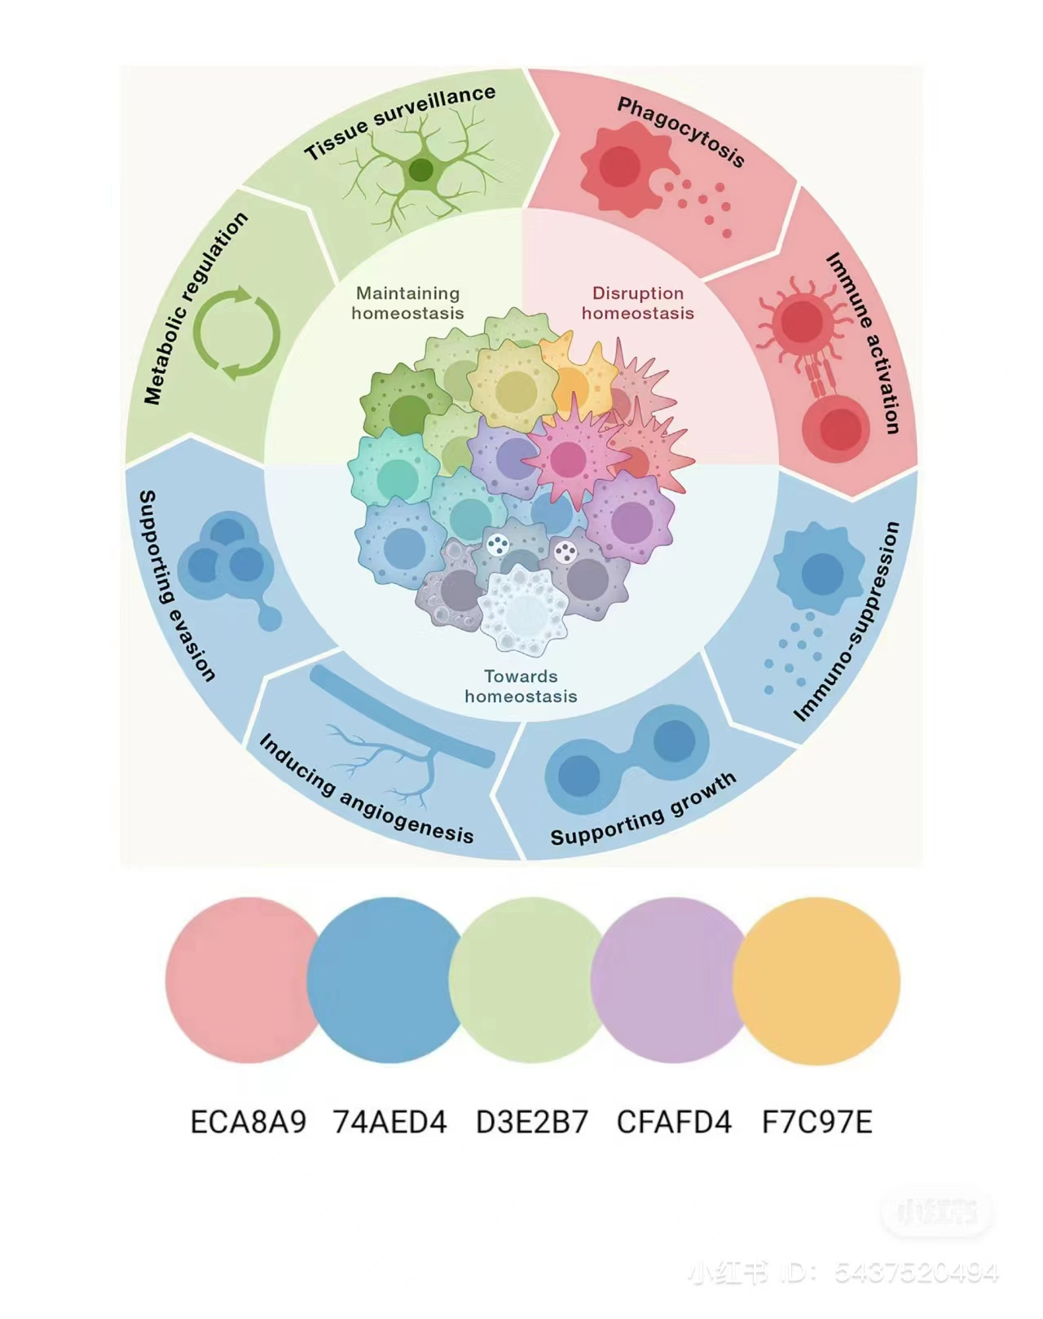
V
分权
意义构建
关心与同理
Thought
Group
统一标准
Leadership
Assessment
外部环境
Environment
Action
创造紧迫
内部环境
要事第一

Slide 3
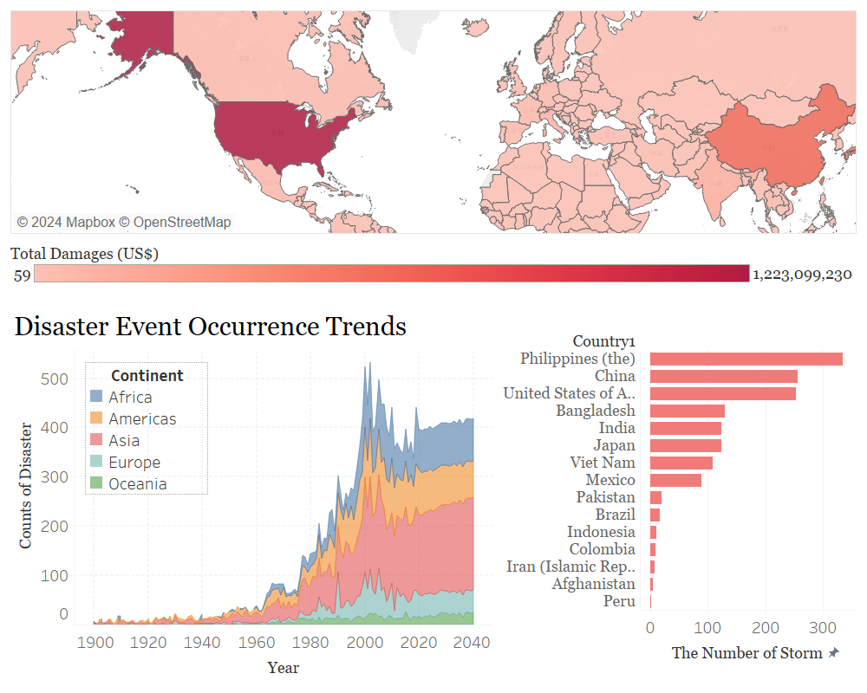

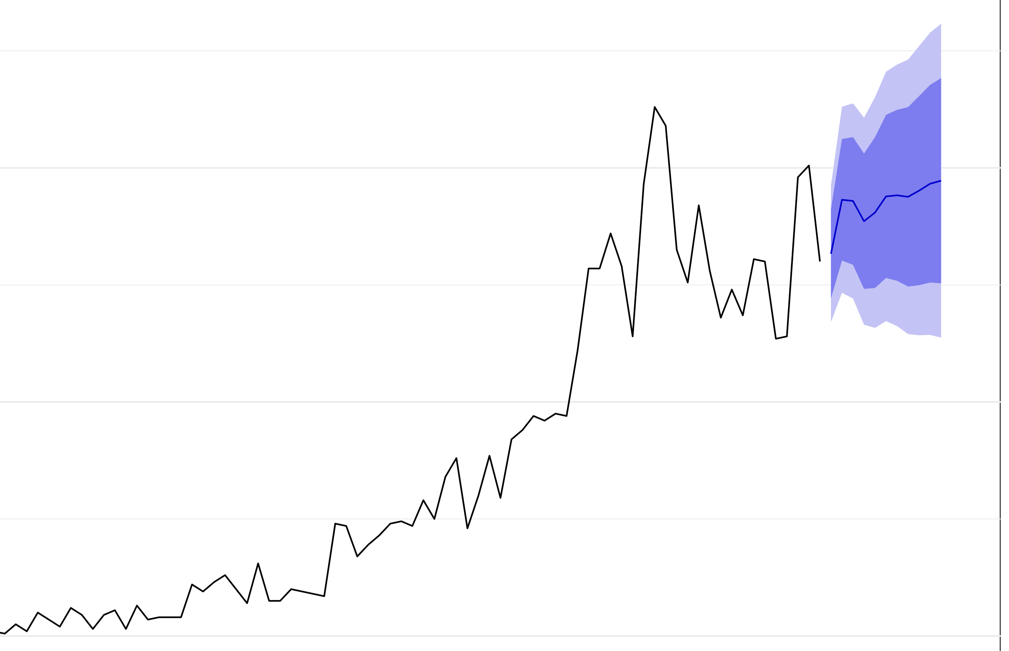



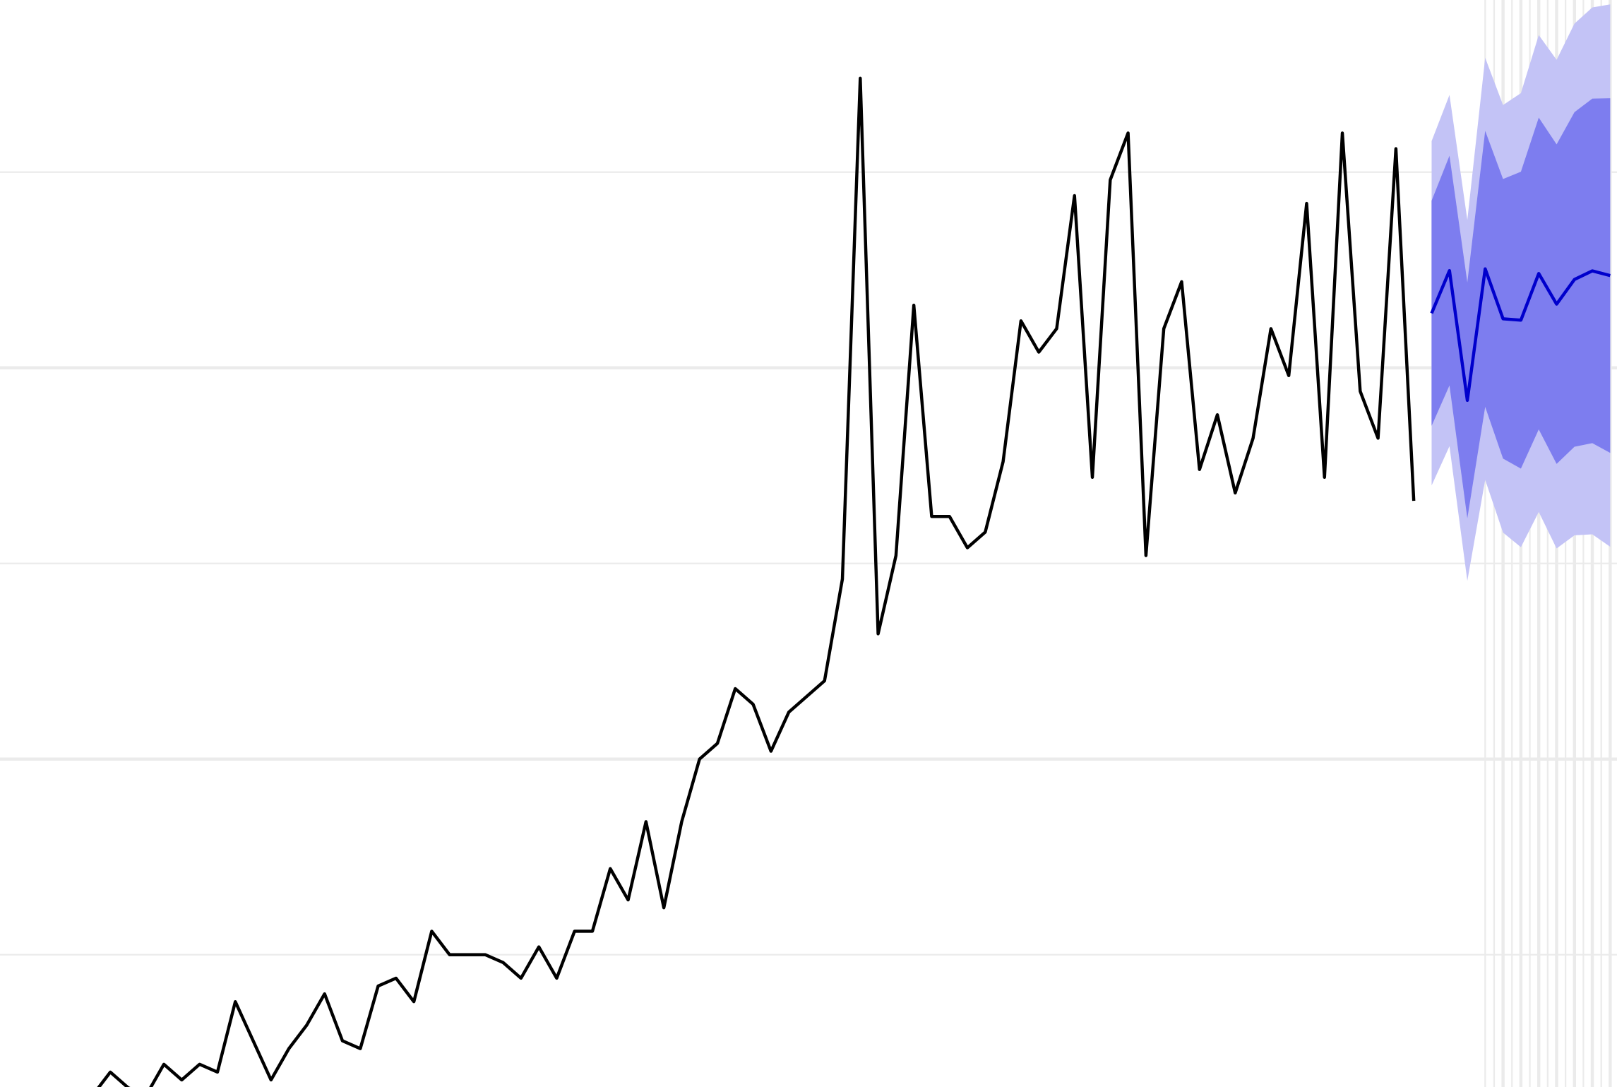
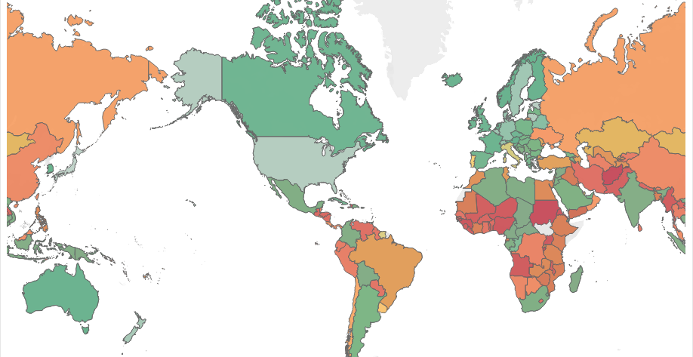
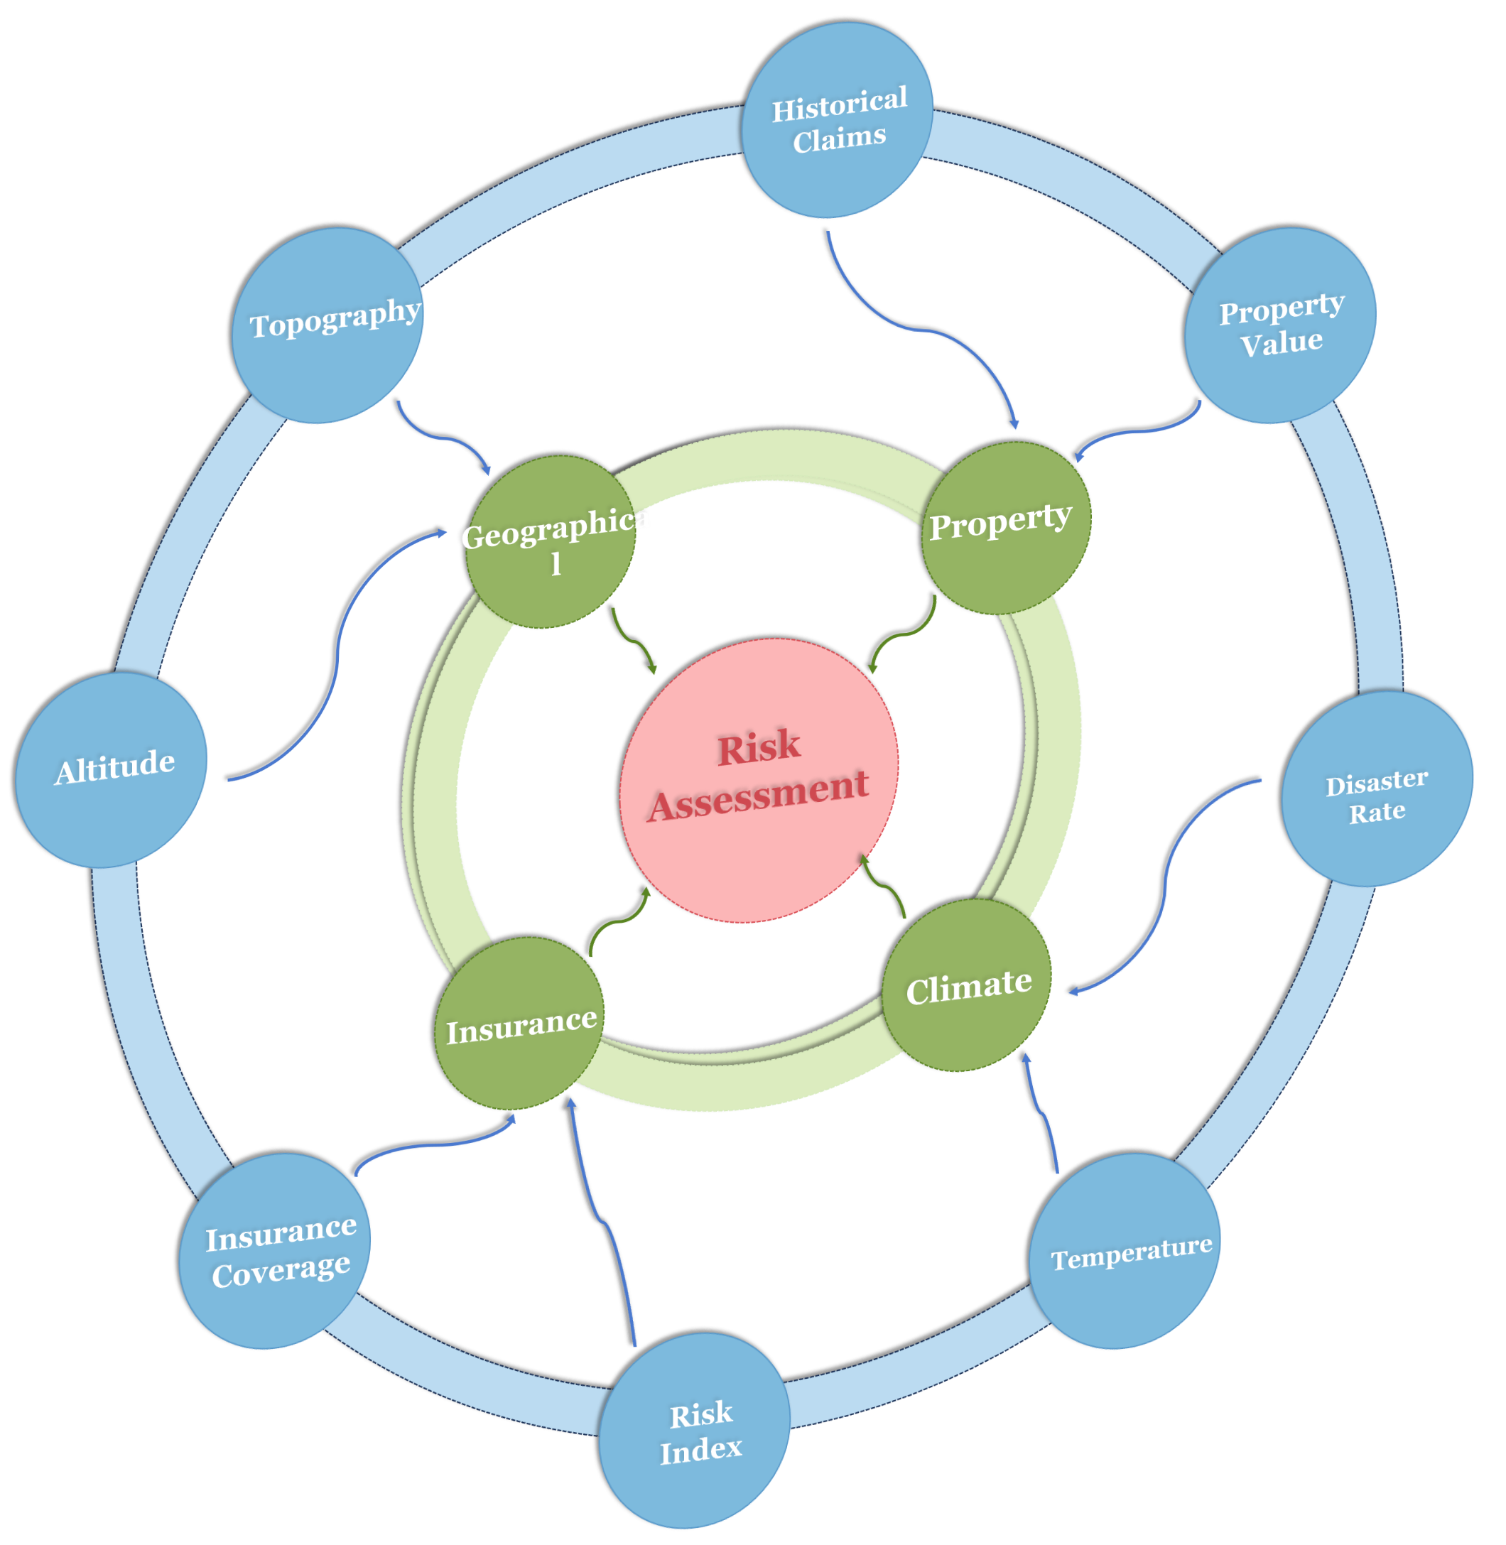




1
2
3
Insurance Company
4
Extreme Weather
Weather
Insurance
Data Collection And Analysis
ARIMA
Evaluation
Real-estate Company
Risk Index Analysis
Risk Assessment
GLM Model
Target Layer
Criteria Layer
Solution Layer
On-Site
Protection
Protection Costs
Landmark Size
Protection Method
Relocation
Protection
Community
Number of Visitors
Landmark Age
AHP MODEL
Linear Programming Model

