Slide 1
DEMO PAYROLL SYSTEM
Payroll, Workforce & Accounting
Built for Namibia's Security Industry
One platform for compliant payroll, site scheduling, client invoicing and live financials.
Live demo tenant: Apex Shield Security

Slide 2
THE PROBLEM
Security companies run payroll on spreadsheets—and it's costing them.
■ Compliance risk. Minimum wage, SSC contributions, PAYE thresholds and the 70hr/week overtime cap (s.17(3)) are easy to get wrong manually.
■ No site-level visibility. Guards rotate across dozens of client sites; spreadsheets can't track schedules, attendance and disciplinary history together.
■ Disconnected finances. Payroll, client invoicing and the general ledger live in separate tools — nobody has a real-time view of cash, AR or margins.
■ Slow, error-prone payslips. Manual tax and deduction calculations mean payday delays and disputes.
2

Slide 3
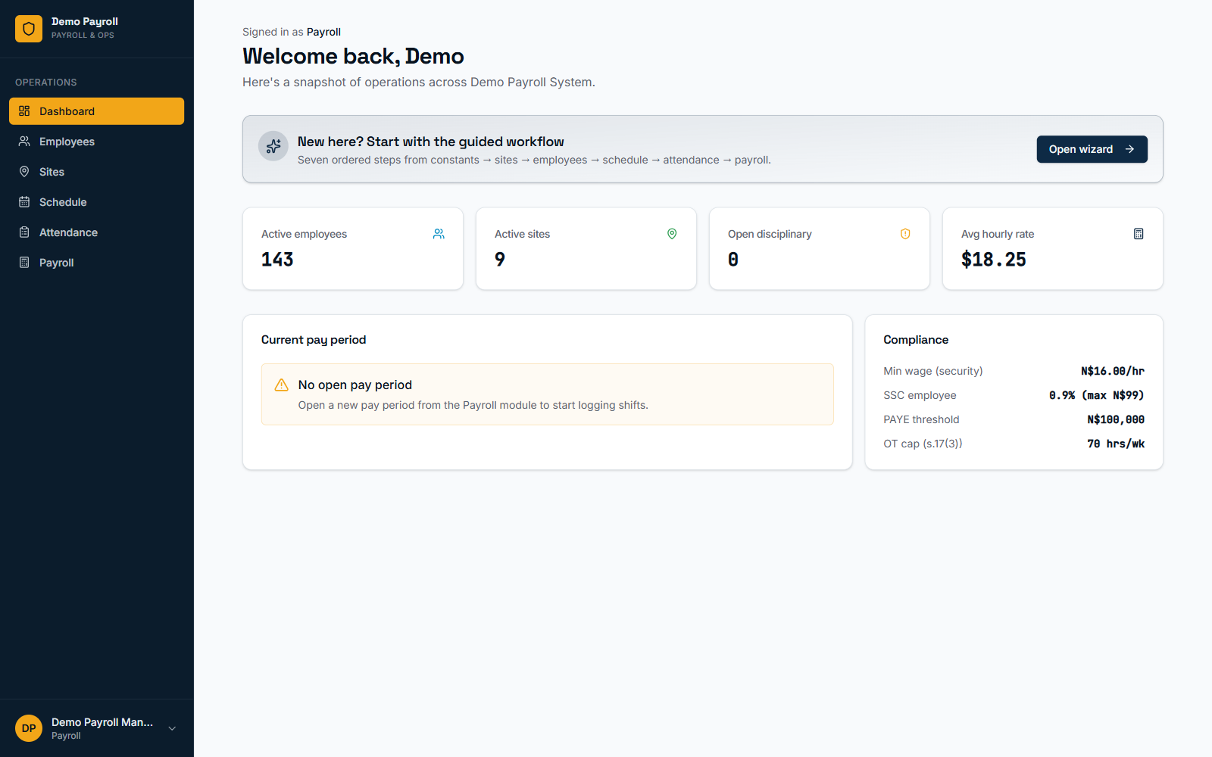
THE SOLUTION
One system: payroll, operations and accounting — fully connected.
■ Live operational dashboard across employees, sites and pay periods
■ Guided 7-step wizard: constants → sites → employees → schedule → attendance → payroll
■ Real-time compliance reference built into every screen
■ Role-based access for payroll, accounting and executive users
3

Slide 4
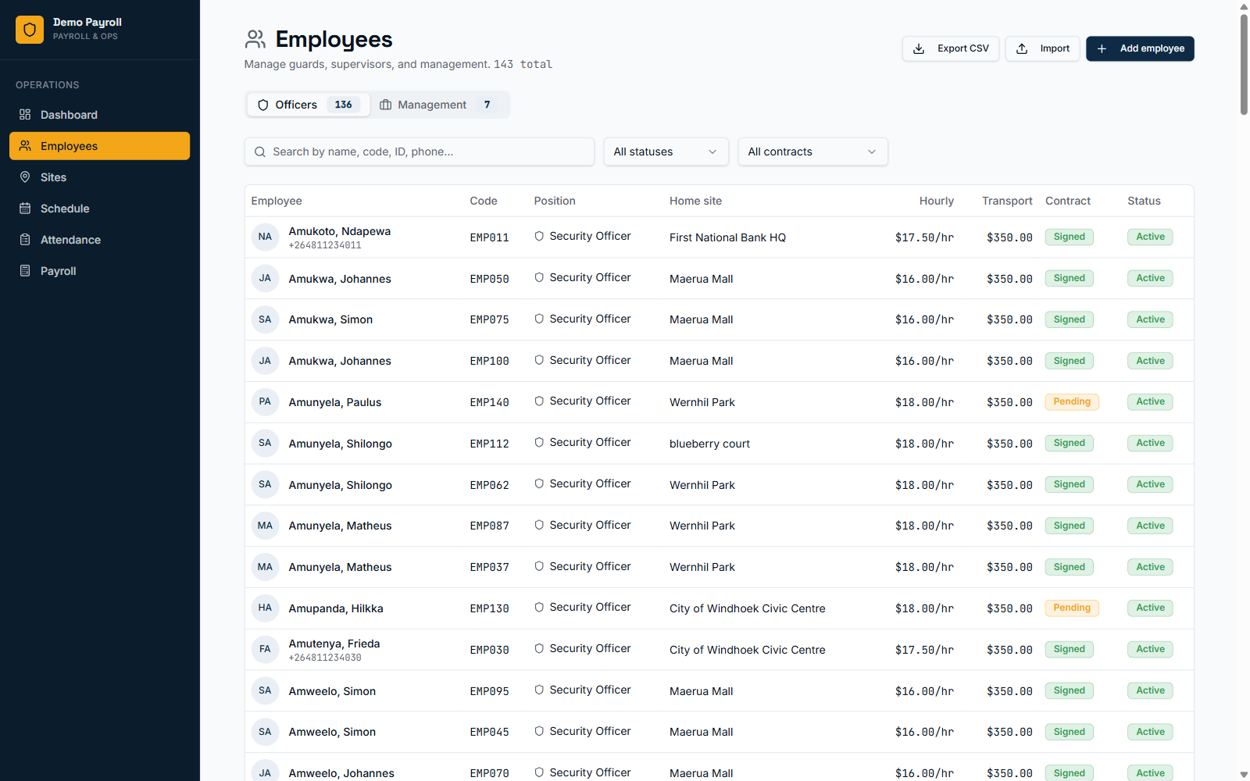
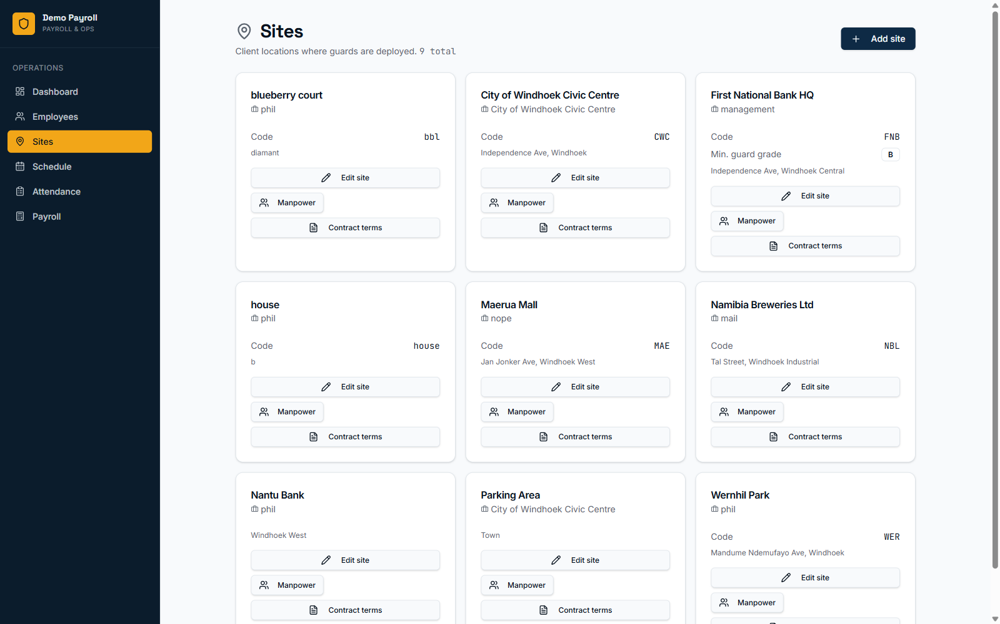
WORKFORCE OPERATIONS
Employees and client sites, organized from day one.
4

Slide 5
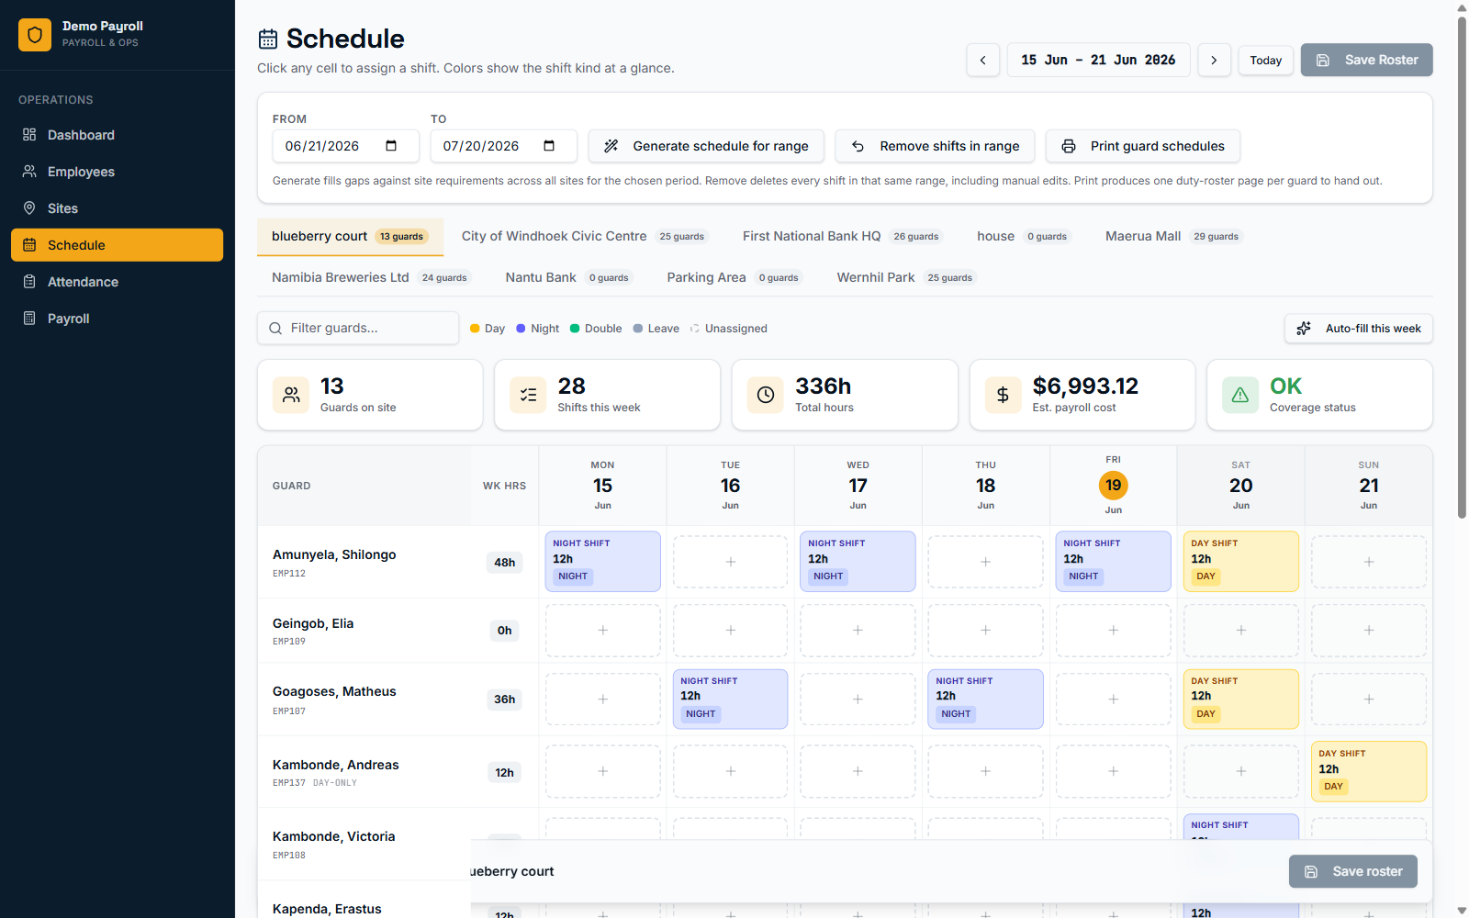
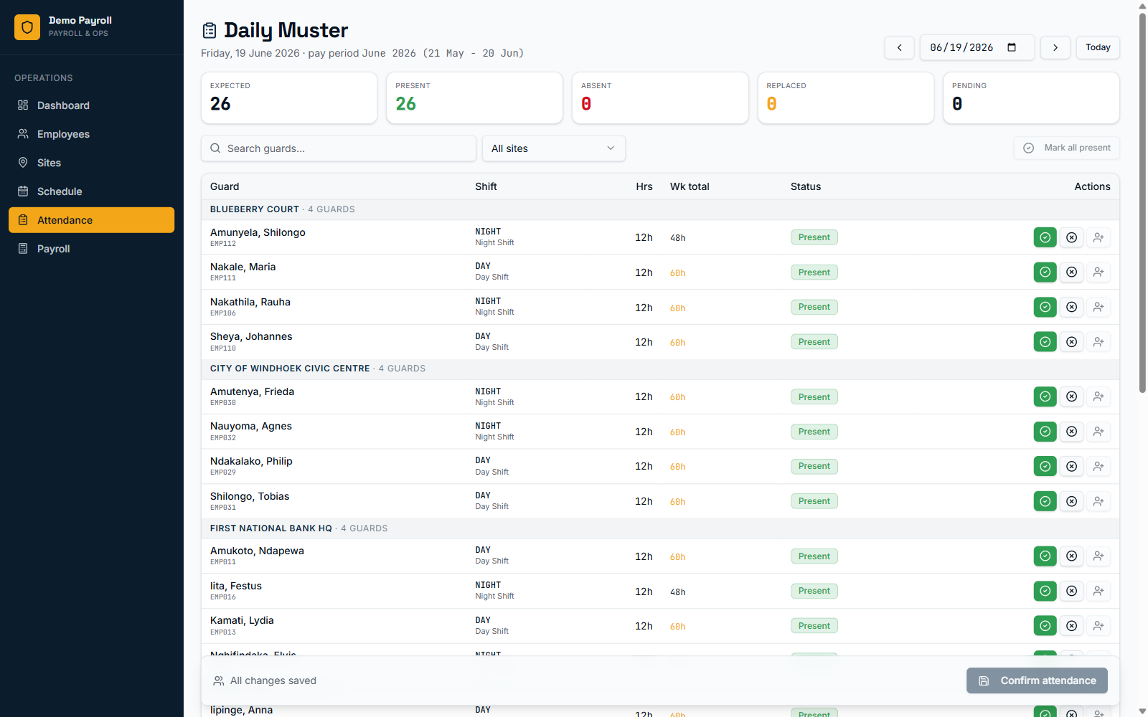
WORKFORCE OPERATIONS
Shift scheduling and attendance, feeding straight into payroll.
5

Slide 6
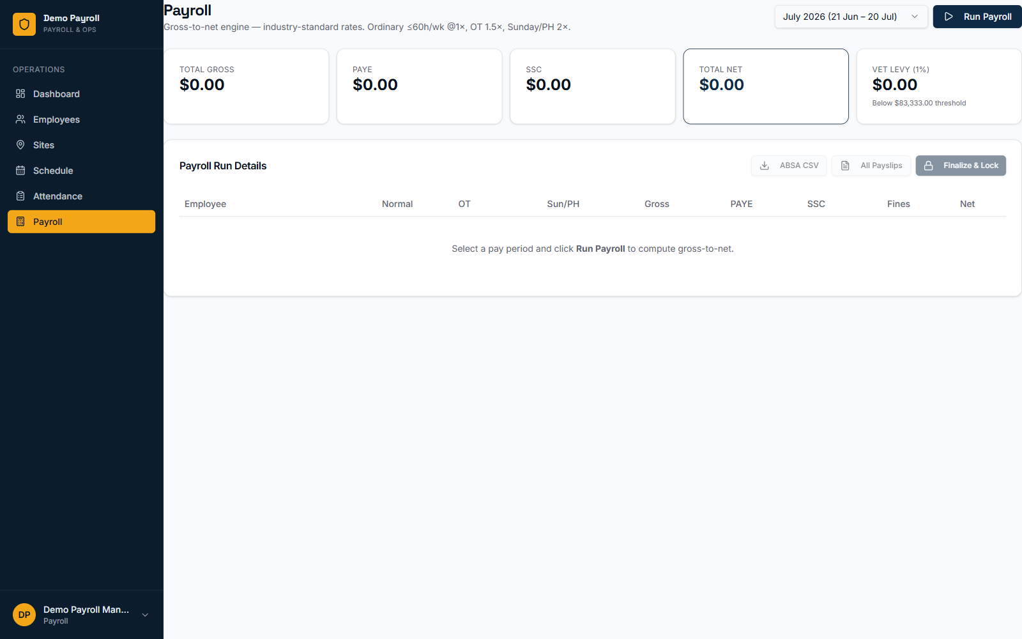
PAYROLL ENGINE
Compliant payroll runs, calculated automatically.
■ PAYE & SSC handled. Tax thresholds and social security contributions calculated per employee, every pay period.
■ Overtime cap enforced. 70hr/week cap (s.17(3)) tracked automatically against logged attendance.
■ One-click payslips. Finalizing a pay period generates payslips and posts straight to the ledger.
■ Full audit trail. Every pay run, adjustment and approval is logged for compliance review.
6

Slide 7
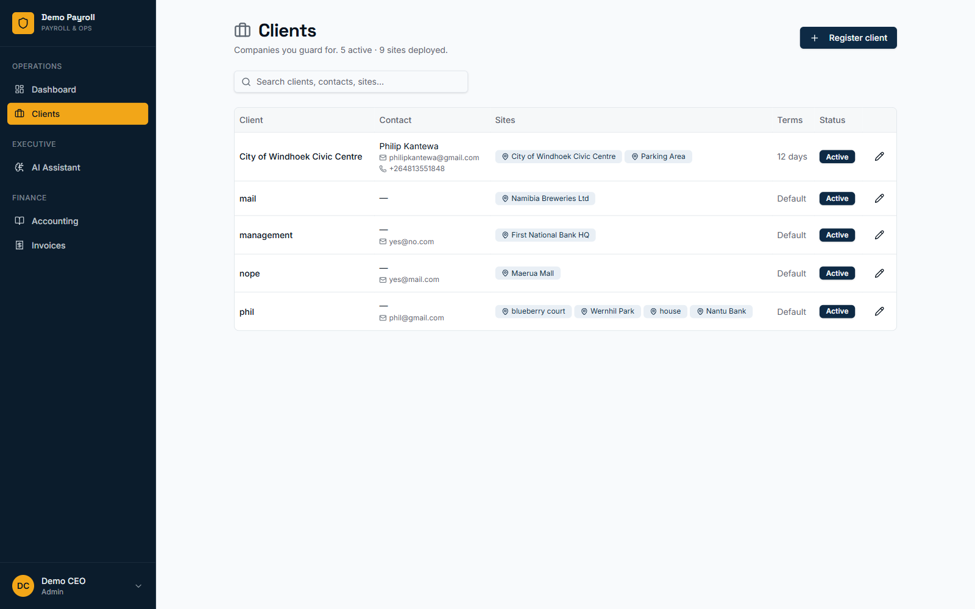
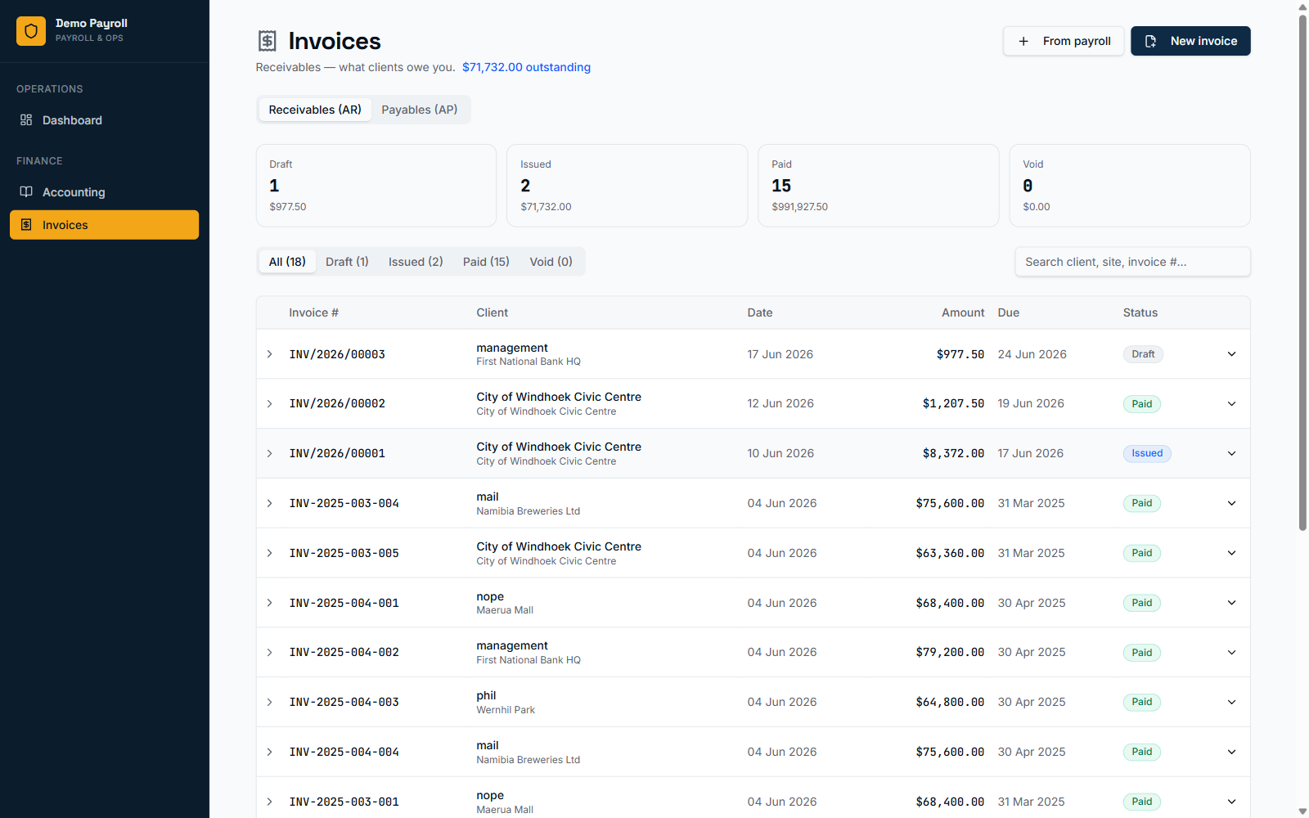
CLIENT BILLING
Clients, sites and invoices — connected end to end.
7

Slide 8
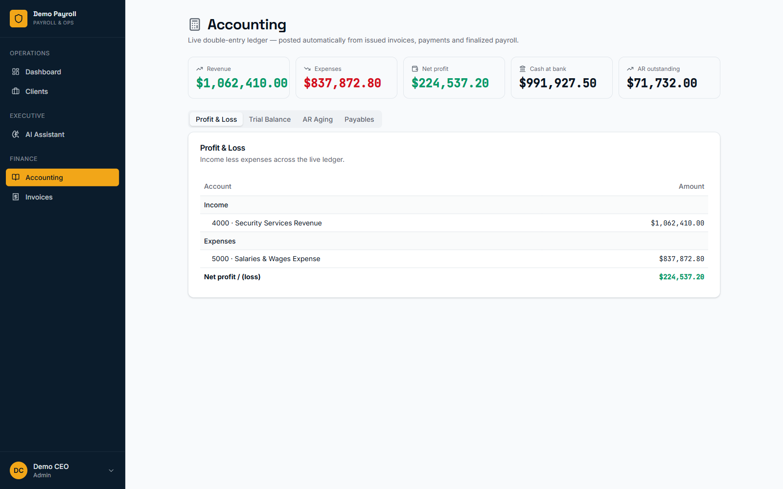
ACCOUNTING
A live double-entry ledger — not a spreadsheet.
■ Auto-posted. Invoices, payments and finalized payroll post to the ledger automatically — AR, AP, wages payable, tax control accounts.
■ Real-time P&L. Revenue, expenses and net profit visible at a glance, always current.
■ Trial balance & AR aging. Built-in reports for month-end close and collections follow-up.
■ AP & vendor bills. Track payables alongside receivables in the same ledger.
8

Slide 9
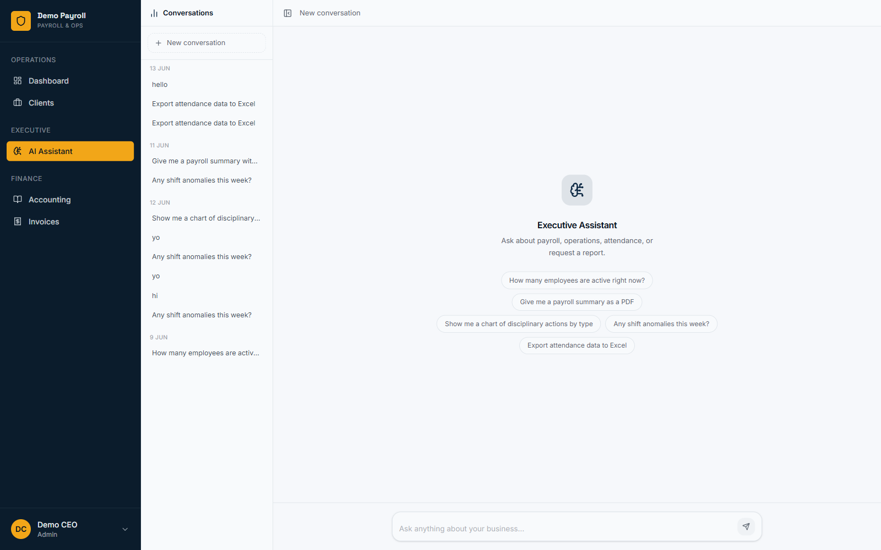
AI EXECUTIVE ASSISTANT
Ask your business a question — get a straight answer.
■ Plain-language queries. “What's our margin on Apex contracts this month?” — answered from live financial and operational data.
■ Tenant-aware. Every answer is scoped to your company's real numbers, not generic advice.
■ Executive-only. Reserved for CEO/admin roles, alongside full clients and P&L visibility.
9

Slide 10
WHY IT MATTERS
Less risk, less admin, more visibility.
Compliance built in
Hours saved monthly
Real-time financial view
Statutory rates and caps are encoded once, applied every pay run.
No more manual payslip math or reconciling three separate tools.
Revenue, AR and margins visible the moment work is invoiced.
10

Slide 11
Let's set up your security company on this platform.
Payroll, scheduling, client invoicing and live financials — in one place, from day one.
Demo Payroll System · Apex Shield Security demo tenant

