Slide 1
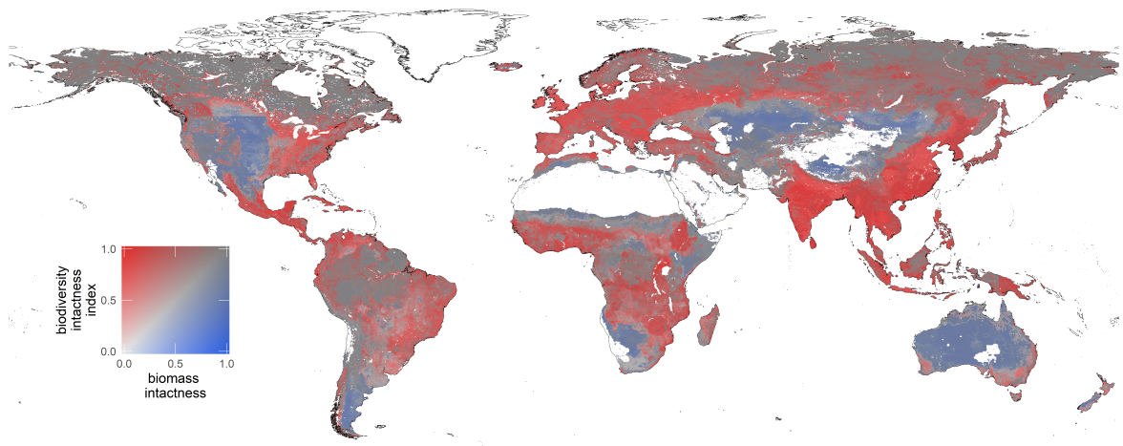
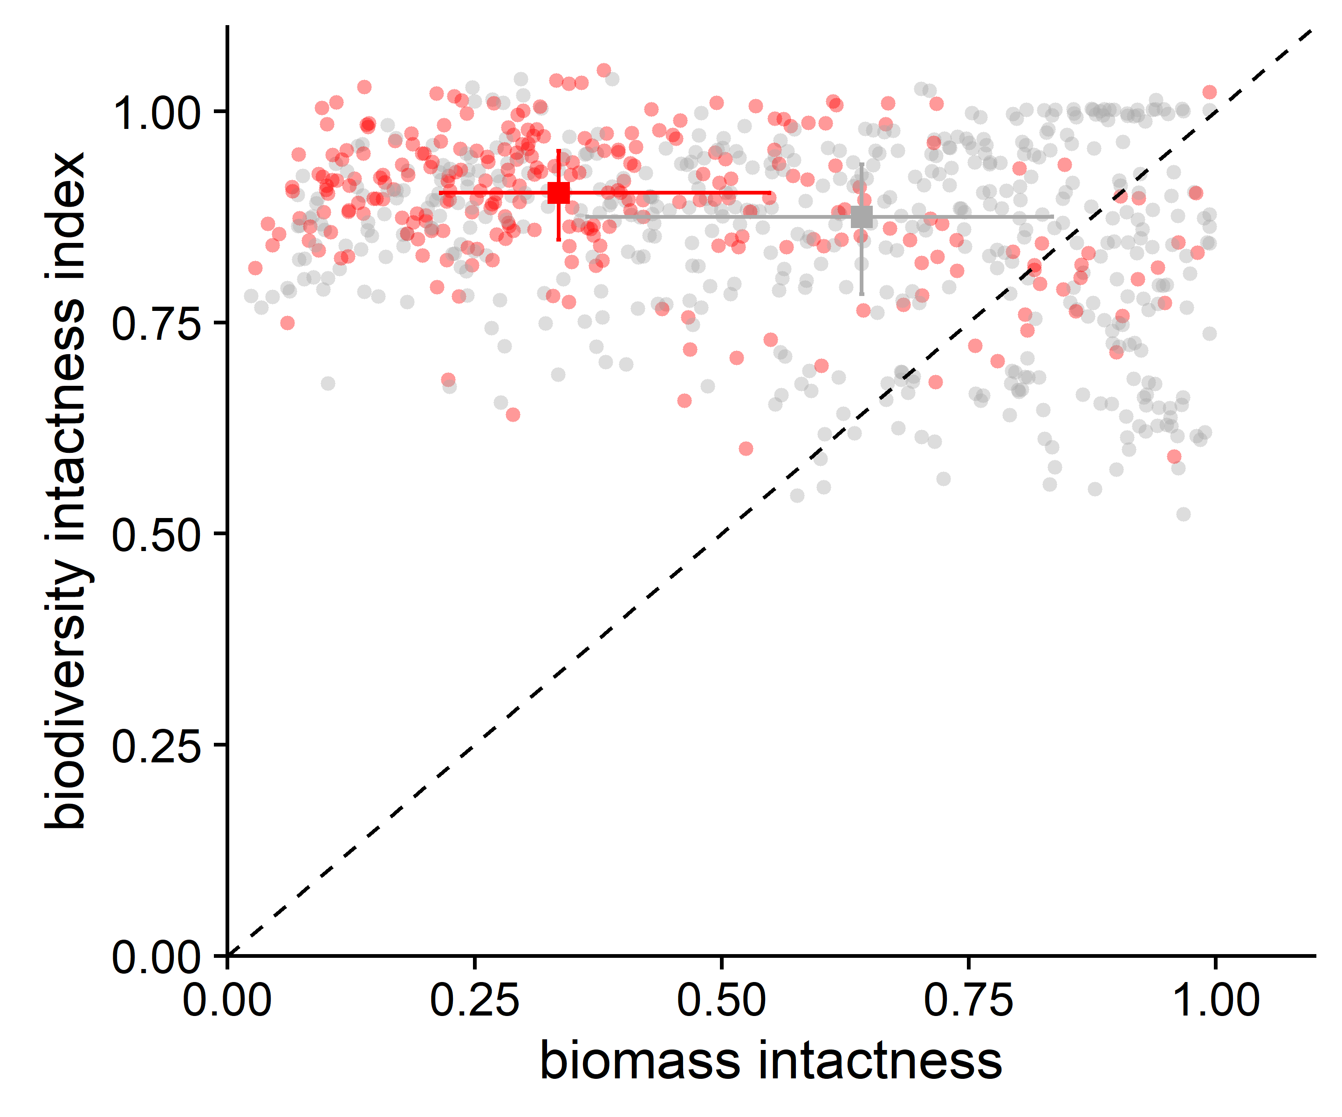
A
B
Figure 1. Global comparison of the Biodiversity Intactness Index with the ratio of actual to potential biomass stock.
(A) Bivariate map of BII and biomass intactness (BMI) . Areas of land shown in white had no data available for one or both of the two indices. (B) Plot of BII against BMI. Each point represents the mean of the two indices for a terrestrial ecoregion [6]. Red circles represent ecoregions with more than half of their area inside a biodiversity hotspot and grey circles represent other ecoregions . The squares and associated lines show medians and interquartile ranges. The dashed diagonal line indicates equality of the two indices.

Slide 2
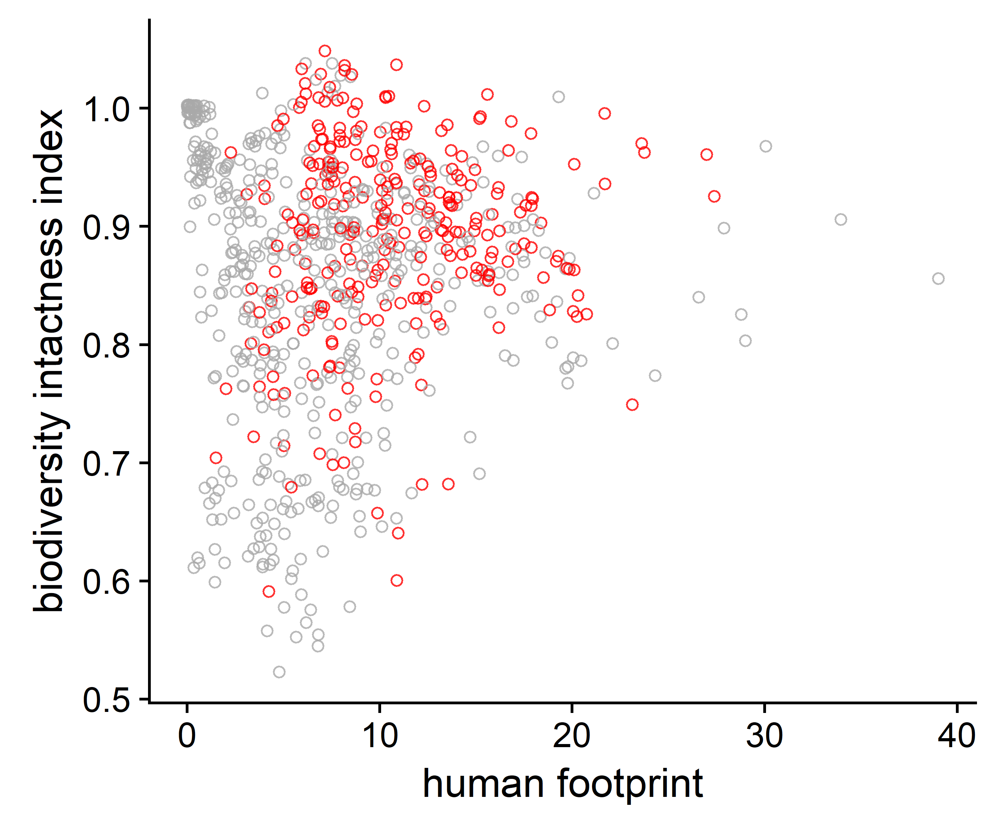
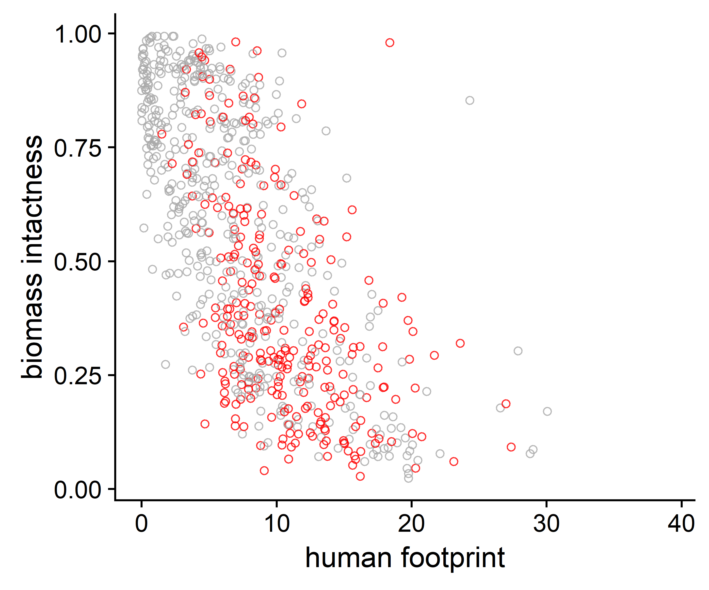
A
B
Figure S1. Comparison of the Biodiversity Intactness Index (BII) and Biomass Intactness Index (BMI) with the Human Footprint measure of human pressure on ecosystems.
(A) Plot of BII against Human Footprint index (from ref. 7 of the main text). Each point represents the mean of the two indices for a terrestrial ecoregion (from ref. 6 of the main text). Red circles represent ecoregions with more than half of their area inside a biodiversity hotspot and grey circles represent other ecoregions . (B) Plot of BMI against Human Footprint index. We expected that both BII and BMI would be negatively correlated with the Human Footprint measure of human pressure, but it is apparent that BII is not negatively correlated with Human Footprint , whereas BMI is negatively correlated with Human Footprint. We did not perform a statistical test of these correlations to avoid problems of spatial autocorrelation, which arise because many of the ecoregions are close to one another.

Slide 3
A
B

Slide 4
A
B

